Slide 1


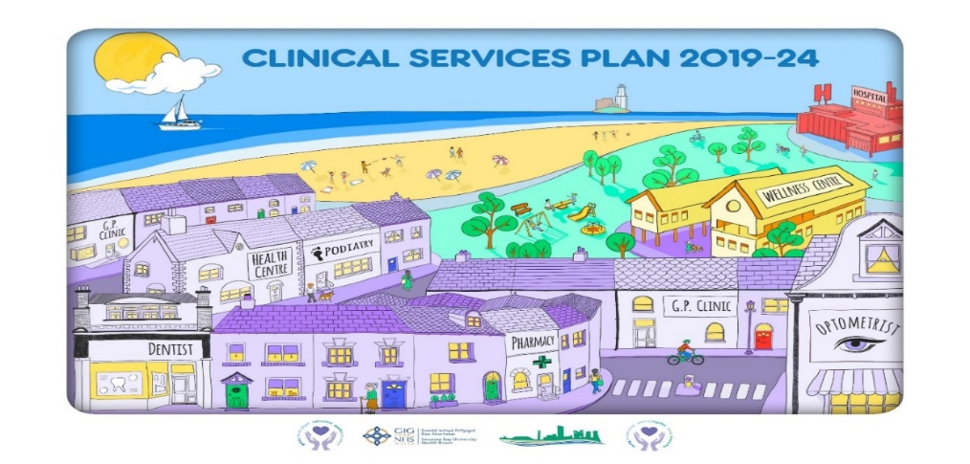

“Changing for the Future”
Estates Strategy
Sustainable Estates Infrastructure
to deliver our
Clinical Services Plan

Slide 2
Estates Strategy – Page of Contents
Strategic Context
2. Where are we now - Condition Surveys
3. Where do we want to be - Clinical Services Plan
4. How do we get there - Site Development Control Plans
5. How do we get there - Finance, Commercials and Disposals
6. How do we get there - Decarbonisation.
7. Summary - Case for Change

Slide 3
1. Estates Strategy – Strategic Context

Slide 4
Introduction
In response to the Clinical Services Plan, Swansea Bay University Health Board (SBUHB) is developing new clinical service models, which, in turn is enabling the identification and mapping of the estate changes required to facilitate them.
This Estate Strategy will continue to be flexible and open to regular updates to respond to the changing service needs as they are articulated.
The Estates Strategy will support the Health Board ambition to enable care to be delivered in communities in the most appropriate locations, at a scale which supports a future sustainable model of secondary care, and foster a community centric quality of care, appropriate for where it is needed, supporting sustainability of future service provision. Work has been ongoing throughout the clusters to analyse demographic data, patient activity trends and transport / accessibility links, per geographical area.
In collaboration with primary care clusters and with partner organisations, the current service need has been aligned to service delivery and ambition for the future. Emerging from this process is the identification of the optimum locations for, and scale of, the physical building spaces required to meet the delivery need and, alongside partners, to best serve the communities.
This Estate Strategy 2022-2032 presentation (supported by an enabling reference document) articulates the required reconfiguration and transformation of the estate to facilitate delivery of the required new models of care for the Swansea Bay UHB population, working alongside the infrastructure to support the developments (See Supporting Pack)
Clinical Services Plan
6 Facet Property Survey
Development Control Plans
10 Year Capital Investment Programme
Commercial & Disposal Strategy
Estates Strategy
Decarbonisation
An estate strategy provides the following benefits:
• premises developments that support service/capacity requirements;
• the provision of safe, secure and appropriate buildings;
• the provision of high-quality healthcare environments, which may aid staff retention/morale and patient outcomes/satisfaction levels;
• a plan for change that enables progress towards goals to be measured;
• a clear commitment to complying with sustainable development and environmental requirements/initiatives;
• a means of targeting investments to minimise the risks associated with the built environment;
• an opportunity to dispose of surplus and/or poorly-used assets and reinvest released resources;
• an opportunity to optimise occupancy costs. Who is responsible for the estate strategy?

Slide 5
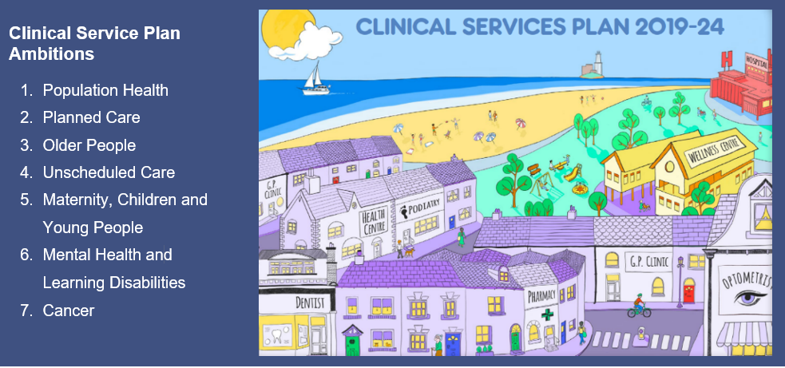
Where are we now?
Clinical Services Plan 2019 - 2024
set in the context of the Welsh Government vision for the NHS in Wales, ‘Together for Health’,
Foundations
Create services that are safe and sustainable - the Health Boards first 5-year clinical plan - over 300 stakeholders worked within seven priorities for clinical workstreams:
A clinical services plan that addresses the 7 clinical workstreams current and projected service challenges and opportunities for unscheduled care, surgical and regional services in areas where not changing current pathways and ways of working will continue to cause delivery issues and unsustainability over the longer period.

Slide 6
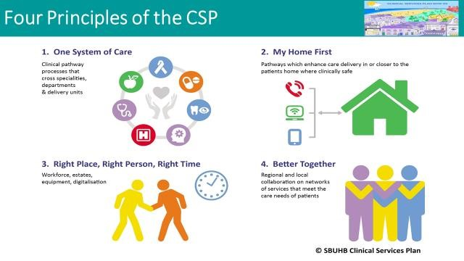
Where are we now – Centres of Excellence
A clear ambition was created to develop Centres of Excellence built upon a bedrock of wellbeing, community, mental health and primary care services focussed on improving wellbeing, prevention, early intervention and rapid access.
Maximise regional opportunities with dedicated specialist expertise
Central to new pathways is the ambition to improve population health and take care closer to home; giving people timely access to community based care.
Networked Hospitals and a Systems approach;
One system of care with Cefn Coed a centre of excellence for adult mental health Neath Port Talbot as the centre of excellence for orthopaedics, spinal care, diagnostics, rehabilitation and rheumatology and Morriston and Singleton as Health Campuses
Focused population health - health and wellbeing focus ‘system shift left’. Build resilience and embed health and wellbeing centres and their approaches linked also to giving every child the best start in life and advancing socio-economic approach to population health
Transforming Primary, Community, Mental Health and Learning Disabilities Care - resources flow from secondary care into primary and community provision enhanced by the Accelerated Cluster Development Programme for 2022

Slide 7
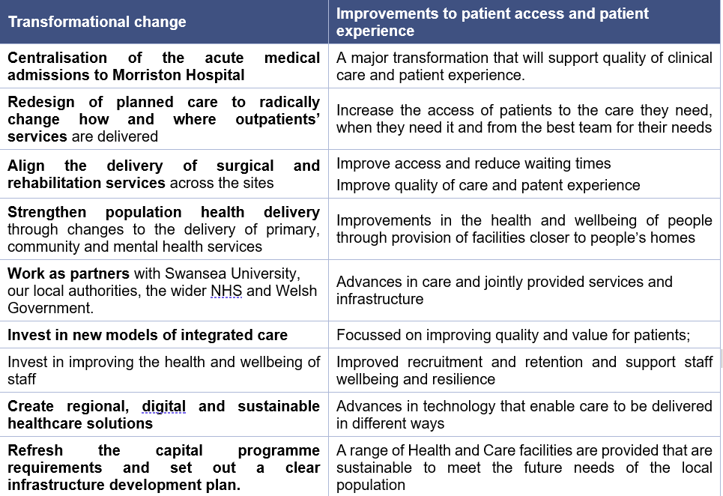
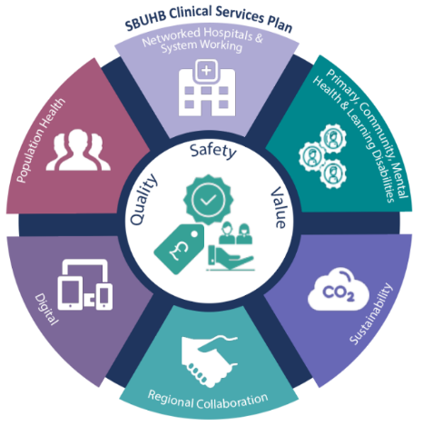
Clinical Services Plan 2021-2027
The Clinical Services plan (2021-2027) incorporates the Recovery and Sustainability Plan (2022 – 2025) and provides the vehicle for delivery of critical path changes for the next 5 years, with clinically led improvements and realisation of benefits alongside operational effectiveness and efficiency.
A new focus to scale up regional partnering, optimise digital solutions and innovation and adopt more sustainable approaches to healthcare and the estate

Slide 8
Clinical Services Plan – Case for Change
The solid Case for Change for the Estate demonstrates that the Health Board’s plans are based on agreed clinical improvement plans, robust recovery and sustainability plans and endorsed through public and staff engagement and assessments of best practice from world class healthcare systems. The Health Board is fully committed to make the changes, find the solutions and to actively continue to collaborate with the public and partners from across the region.
The Case for Change shows how the CSP will demonstrably improve the health and wellbeing of the communities served and the health and care system that it is operated in. The critical path for delivery is clearly aligned to the Health Board’s Recovery and Sustainability Plan (R&S Plan) and marks the pace of the major service change the Health Board is going to make in the next five years to 2027. There is clear demonstration of the scale of improvement required to both meet and realise the benefits, to:
Improving the population wellbeing;
Support the complex healthcare needs of the people served;
Improve operational effectiveness and efficiency;
Implement clinically led service change;
Scale up the regional partnering for new pathways of care;
Optimise digital solutions and innovation;
Adopt more sustainable approaches to healthcare.

Slide 9
2. Where are we now? Condition Surveys

Slide 10
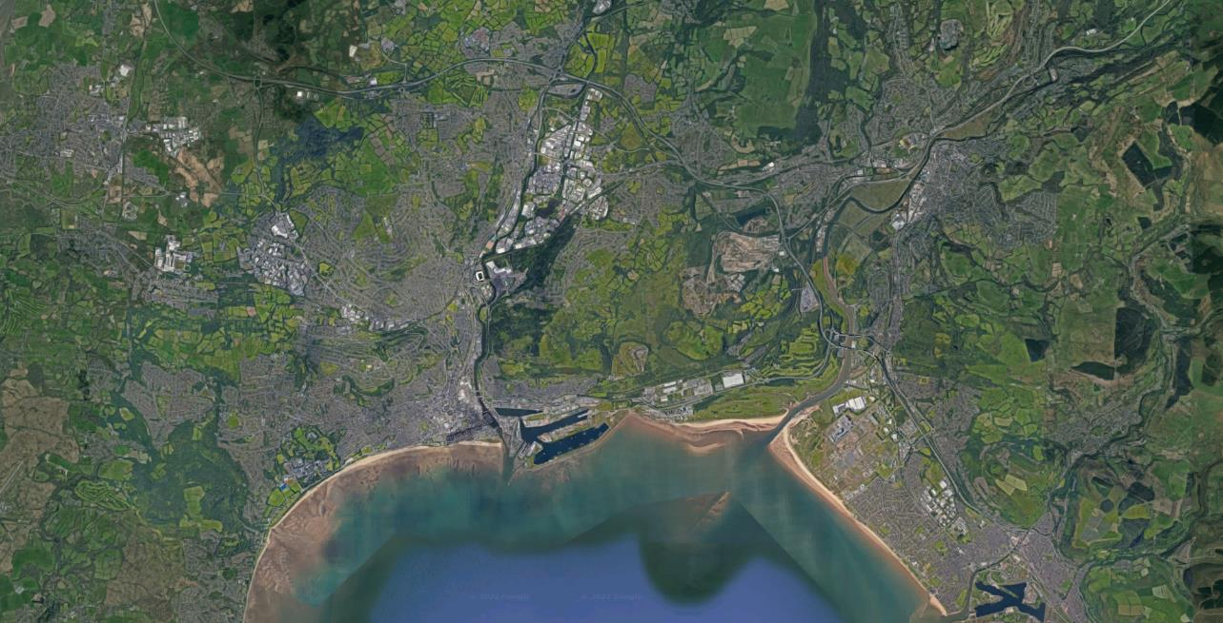
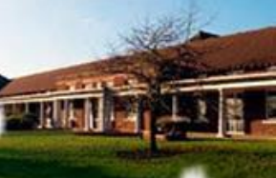
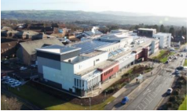
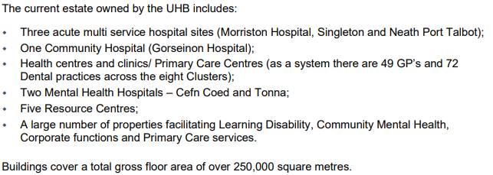
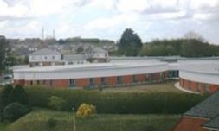
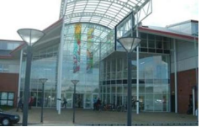
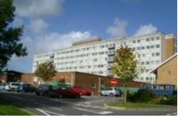
Swansea Bay UHB – Main Hospital Sites
Morriston
Tonna
Gorseinon
Cefn Coed
Singleton
Neath Port Talbot

Slide 11
Current Estates Challenges
The Estate Strategy is a long-term plan for managing the estate in the most advantageous way in relation to our service and business needs and the local health economy. It needs to be able to deliver resilient, sustainable and fit-for-future accommodation, with buildings and equipment in the right place, in the right condition, of the right type and able to adapt and respond to future service needs, which includes:
analysis of the current estate and how it performs;
proposed changes to the estate over the next decade;
proposed performance improvements;
estate optimisation plans;
site master plans;
a comprehensive estate investment programme.
The Estate has a critical influence on the key quality issues of:
Environmental conditions (energy/emissions/sustainability);
Physical environment (internal and external);
Access;
Safety;
Infection control;
Fire precautions;
Suitability for function;
Transportation / car parking;
Aid to healing;
Recruitment and retention of staff

Slide 12
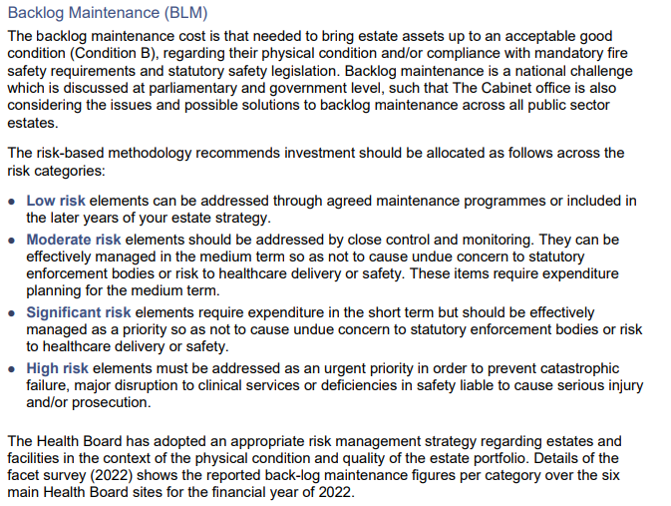
6 facet Survey – Backlog Maintenance
Estates Infrastructure Review
A full 6 facet survey of the Health Board owned estate was carried out in 2022.
The 6 facets review were;
Condition (Backlog Maintenance)
Functional Suitability
Space Utilisation
Quality Audit
Statutory Compliance
Environmental

Slide 13
6 Facet Survey – Key risks & Business Continuity Impacts
Current condition and configuration
of our estate presents the following risks:
Business Continuity Impacts:
Estates failure increase.
Impact on operational service delivery on a regular basis (theatre downtime, un-planned ward moves, temporary closure of areas, impact on access to services – such as lift failures). Health Board is at risk of prosecution if anyone comes to harm as a result of health and safety risks associated with the condition and management of the estate.
Patient outcomes adversely impacted.
In the majority of infection out-breaks, there is a potential environmental risk associated. The majority of our ward configuration does not provide adequate single room accommodation to support optimal IPC management.
Issues often highlighted in HIW inspections and patient safety walk arounds.
Patient experience adversely impacted.
Whilst patient feedback remains overwhelmingly positive, we know that patient dignity and privacy is sometimes compromised because of the care environment, with staff having to put in place work arounds where possible.
Issues often highlighted in CHC visits.
Estates maintenance is disproportionately focused on reacting to failures.
More costly and is associated with greater impact on operational service delivery than a proactive maintenance programme.
Backlog rises.
Estates, reflecting the age of the real-estates. Backlog continues to rise.
Health and Safety Compliance
Water safety - legionella risk
Fire safety - non-compliance with latest standards
Asbestos pervasive across our estate and deteriorating at increasing rate
Disability access - environments not appropriately accessible for disable people and people with sensory or cognitive impairment
Functional suitability for current operational delivery
Due to the age of much of our estate, many of our clinical environments were not designed for the service function they are now providing.
As services have grown and developed, they have expanded on an ad-hoc basis into environments that are less than optimal for modern patient care in many instances
The strategic objectives cannot be achieved with the existing infrastructure (estates and IT) due to restricted envelope footprint

Slide 14
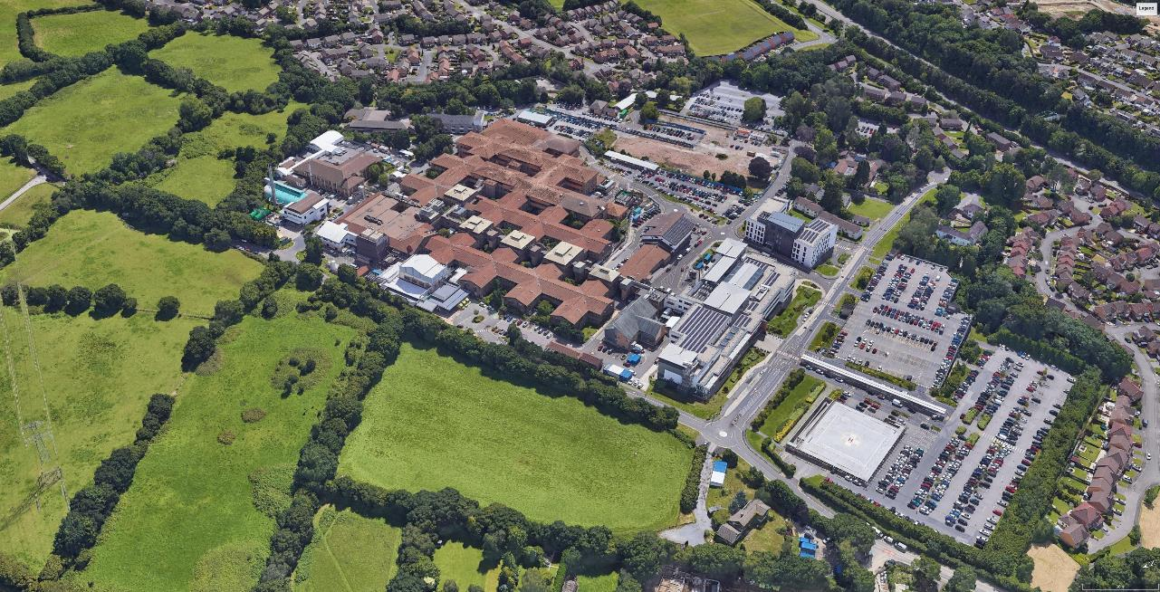
Estates Critical Path – Morriston Hospital
Morriston Hospital Centre of Excellence
for urgent & emergency care, specialist care & regional surgical services, including complex medical interventions

Slide 15
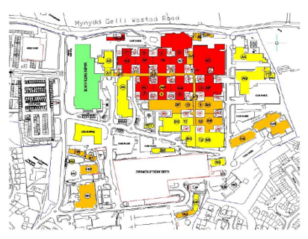
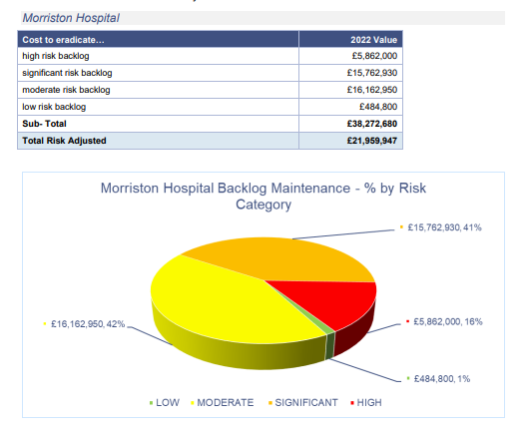
6 Facet Survey & Estates Backlog Maintenance – Morriston Hospital
Morriston Hospital
High & significant Risk Categories | High and Significant Risk Costs | Comments | Enablers
Roof covering replacement | £3.9m | All pitched roofing 1st floor / Flat roof areas. | Appropriate access to all areas 1st floor Template. Decant ward required to undertake the works.
AHU,s / Ventilation | £7.0m | site wide – EFAB funding/Discretionary Capital. | Appropriate access to all areas. Decant ward required.
Electrical Switch gear / distribution boards, wiring / sockets. | £2.1 | Site wide | Decant facilities required to undertake the works
Pipework - Med Gas | £1.4m | Wards and clinical areas. | Appropriate access to all areas. Decant ward required.
Building Internal Fabrics | £3.2m | Site wide | Appropriate access to all areas. Decant ward required.
Heating/Boilers | £2.3m | Site wide | Back up boilers to mitigate loss of services to switch over boilers when undertaking the works.
Nurse Call | £1.5m | Ward areas - | Appropriate access to all ward areas. Decant ward required or phased vacated areas to undertake the works.
Cooling Plant | £3.7m | Site wide | Appropriate access to all areas. Decant ward required to undertake these works.
Fire Panels / Alarm and detection. | £1.3m | site wide - EFAB Funding | Decant facilities required to undertake the works
Fire compartmentation. | £3.6m | Site wide | Decant facilities required to undertake the works within the wards and theatres. Office accommodation and corridors could be programmed out of hours.
Domestic Hot / Cold water | £3.0m | Site wide EFAB funding / Discretionary Capital. | Appropriate access to all areas. Decant ward required to undertake the works.
Internal Doors | £1.3m | Site wide | Decant facilities required to undertake the works
Total | £31.1m including on costs (estimated)

Slide 16
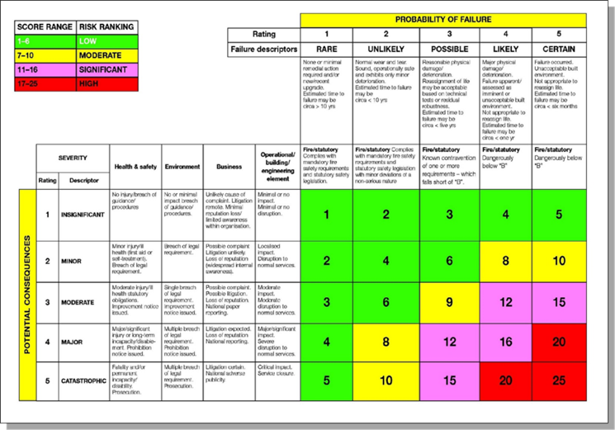
Condition Survey – High and Significant Backlog Costs

Slide 17
Survey Key Findings Morriston Hospital
Roof Coverings - require replacement, impacting on future business continuity of wards and theatres
Wards - the majority of our ward configuration does not provide adequate single room accommodation or bed spacing to support optimal Infection Prevention Control. Ward environments are challenging to maintain due to lack of suitable decant space and limited funding for a refresh programme.
Air handling is based on natural ventilation in many ward areas with electrical and medical gas infrastructure out of date.
Theatres - the fabric is typically worn and deteriorated. Mechanical and electrical infrastructure is dated and beyond design life in nearly all aspects, including ventilation, medical systems, fire safety and nurse call.

Slide 18
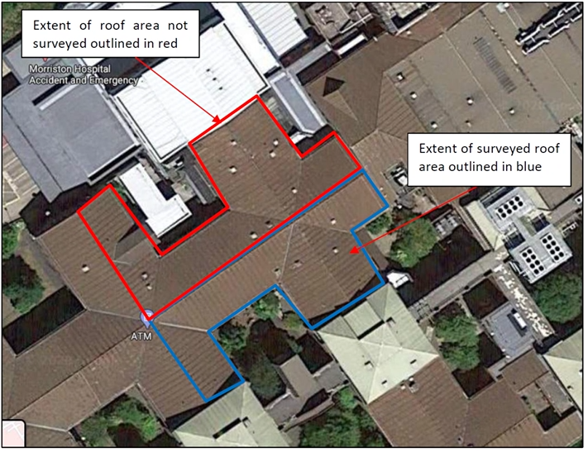
Issues with Existing Nucleus Templates – Morriston Hospital
Issues with Existing Nucleus Template
Roof across 1st floor wards and theatres needs to be replaced with decant facilities provided.
Wards are not compliant with WHBN/WHTM for space standards, single rooms and allowances for support accommodation.
If Model Wards to be implemented, permanent additional space will be required (existing theatre template and modular wards)
Theatres are not compliant with WHBN and WHTN for space standards and AHU ventilation standards.

Slide 19
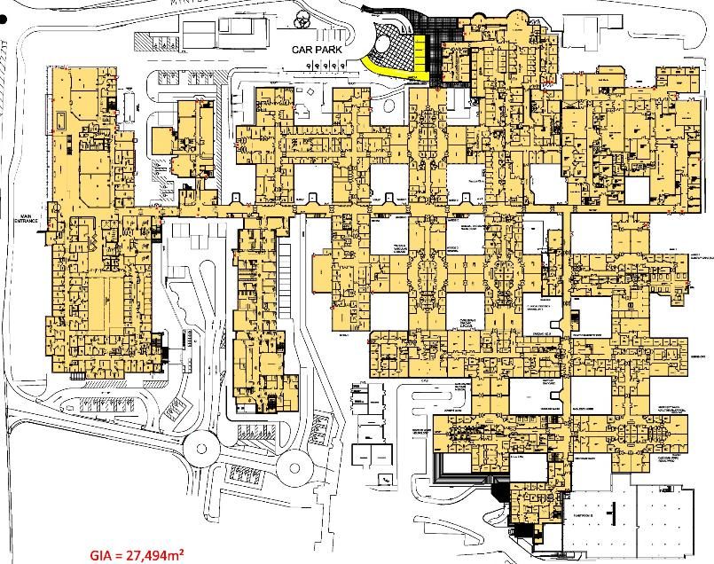
Re-Purposing the Existing Nucleus Templates - MORRISTON HOSPITAL
RE-PURPOSING THE NUCLEUS TEMPLATES
Suggested ward refurbishment. Ground floor
Wards A & B (47 beds)
Wards C & D (47 beds)
Clinical Decisions Unit (44 beds)
Elderly Care Ward (32 beds)
Anglesey and Cardigan Wards (44 beds)

Slide 20
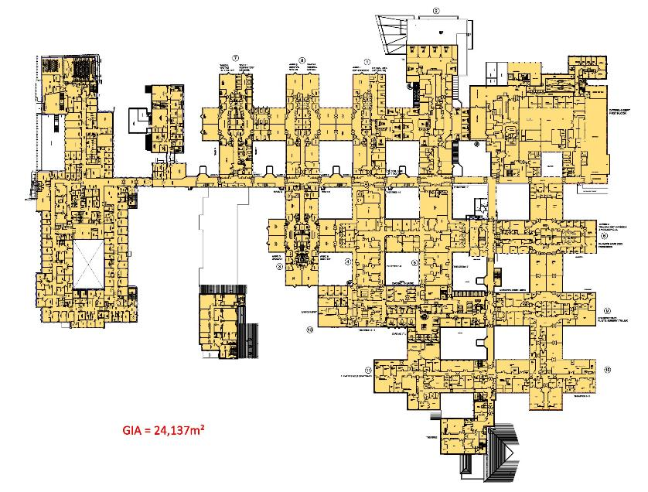
Re-Purposing the Existing Nucleus Templates - MORRISTON HOSPITAL
RE-PURPOSING THE NUCLEUS TEMPLATES
Suggested ward refurbishment. First floor
Wards T & V (59 beds)
Wards R & S (54 beds)
Wards G & H (51 beds)
Ward M & Oakwood (44 beds)
Pembroke Ward (39 beds)
Theatres / ICU decant allowing further ward refurbishment tbc

Slide 21
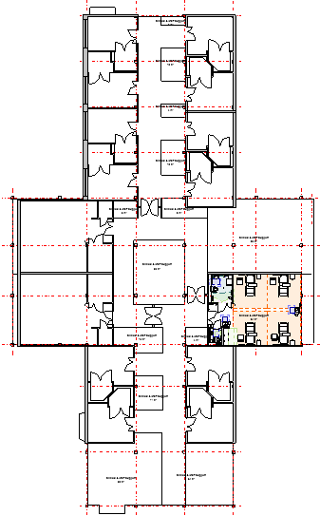
Health Board Endorsed – Model Ward
RE-PURPOSING THE NUCLEUS TEMPLATES
Suggested ward refurbishment solution. 50% single bedrooms
Solution based on Welsh Health Building Notes (with derogations)
Nested en-suite arrangement
24 beds per ward (3 x 4 bed bays and 12 x single bedrooms)
50% single rooms
3 nursing units – 8 beds per unit
Additional clinical support services
Fire escape strategy requires further consideration
Additional ventilation requirements WHTM 03-01
Natural light to four-bed bays
Existing - circa 10 nucleus templates (based on layout plans)
Existing nucleus template = 2 x 28 bed wards
Retention of existing 560 inpatient beds (excluding burns & CCU)
Proposed reduction of 32 beds per template (total reduction of 320)
New decant facility – Six x 32 bed wards =192 beds
Further work required to consider impact of phased refurbishment on roof replacement and services infrastructure upgrade works – see following slides
Final bed number requirements will be modelled as part of detailed business case preparation.

Slide 22


Summary Repurposing the Existing Nucleus Templates – Morriston Hospital
RE-PURPOSING THE NUCLEUS TEMPLATES
Potential refurbishment & roof replacement timeline
Existing bed numbers – circa 560 beds needs to be maintained as part of the CSP (non-compliant spaces)
Phase 1: Build 6 x 32 bed decant wards. Open 4 wards (avoid significant increase in bed numbers)
Decant four wards into new build and refurbish. Work done in pairs due to roof configuration
Phase 2: Decant two wards into refurbished area and two wards into new build.
Phase 3: Decant two wards into refurbished area and close two wards to allow roof replacement
Phase 4: Decant two wards into refurbished area and close two wards to allow roof replacement
Phase 5: Decant two wards into refurbished area and close two wards to allow roof replacement
Phase 6: Complete and open remaining wards. Circa 432 beds (compliant spaces)
Solution to maintain permanent bed base at 560.
Stage 1 Phases 1-2 once 6 decant wards in place.
Stage 2 Phases 3-6 reuse existing theatre template once new ED, Critical Care & Theatre Unit opens. Requires new access road.

Slide 23
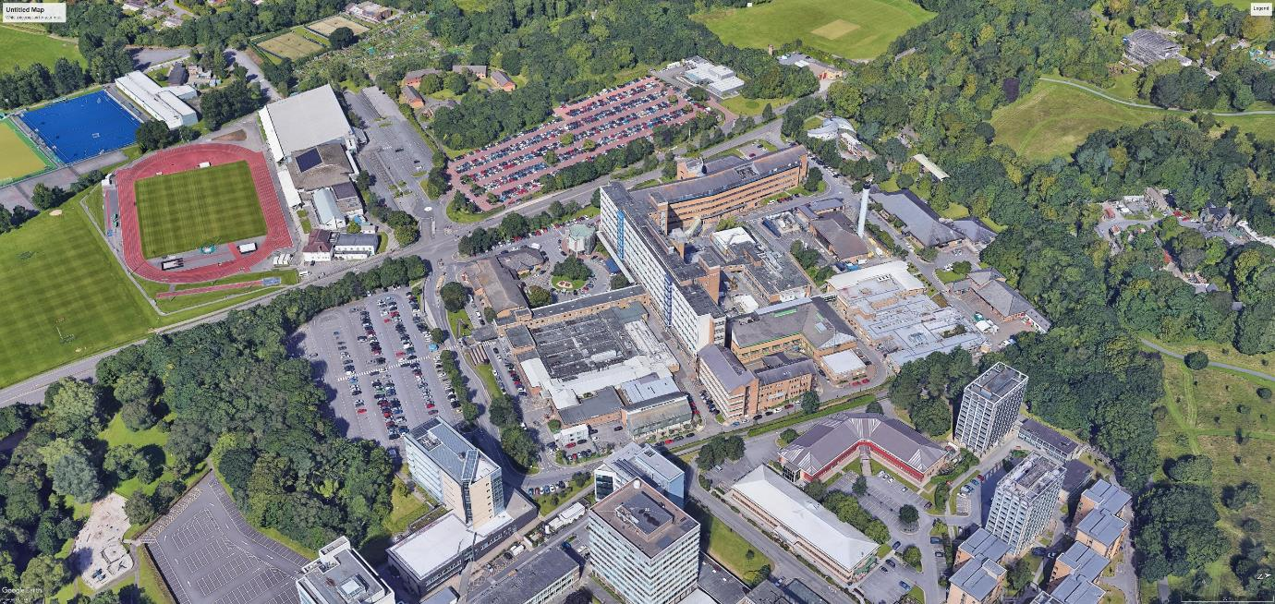
Estates Critical Path - Singleton Hospital
Singleton Hospital Centre of Excellence for planned care, cancer, maternity and diagnostics.

Slide 24
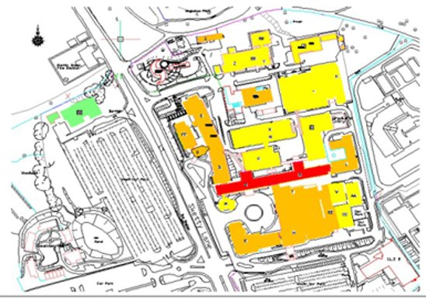
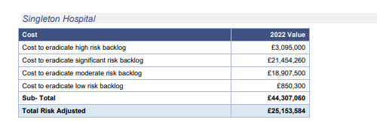
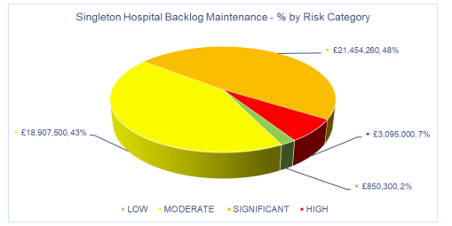
6 Facet Survey & Estates Backlog Maintenance – Singleton Hospital
Singleton Hospital
High & significant Risk Categories | High and Significant Risk Costs | Comments | Enablers
Domestic Hot / Cold water and drainage. | £2.7m | Mainly Centre ward block | Removal of asbestos in voids and duct risers to obtain access to all areas - Required decant facilities (cost of £1.5m per ward asbestos removal).
Main switch gear / wiring / sockets. | £5.8m | Site wide ward areas. | Appropriate access to all areas - Potential for decant facilities to be available.
Heating/Boilers | £1.4m | Site wide / plant rooms | Decant facilities required to undertake the works
Heat Emitters | £1.6m | Site wide / plant rooms | Potential loss of services to switch overheat emitters.
Pipework / Medical gases and Manifolds. | £3.0m | Site wide / EFAB Funding / Discretionary funding. | Appropriate access to all areas - Potential for decant facilities to be available
Building Internal Fabrics | £2.4m | Site wide | Appropriate access to all areas. Decant ward required.
AHU's | £5.0m | site wide | Decant facilities required to undertake the works
Fire compartmentation | £2.7m | Site wide | Decant facilities required to undertake the works
Internal Doors | £1.0m | Site wide | Appropriate access to all areas - Potential for decant facilities to be available
Roof Covering | £1.2m | Main ward blocks only | Decant facilities required to undertake the works
Nurse call | £2.2m | Site wide | Appropriate access to all areas - Potential for decant facilities to be available
Lifts | £3.9m | Site wide | Lifts to be phased to ensure lift access to each area
Total | £32.9m including on – costs.

Slide 25
6 Facet Survey & Estates Backlog Maintenance – Other Hospital Sites
Tonna Hospital
High & significant Risk Categories | High and Significant Risk Costs | Comments | Enablers
Windows | £392k | Whole block | Appropriate access to all areas - Potential for decant facilities to be available
Pipework - Med Gas | £832k | Whole block | Appropriate access to all areas - Potential for decant facilities to be available
Wiring/Sockets/Switches | £785k | Whole block | Decant facilities required to undertake the works
Asbestos | £1.4m | Whole block | Appropriate access to all areas - Potential for decant facilities to be available
Fire compartmentation | £162k | Whole block | Appropriate access to all areas - Potential for decant facilities to be available
Asbestos | £2.1m | Whole block | Substantial refurbishment and modernising work is required and identified within Facet 1. To enable this work complete clearance of asbestos will likely be required.
Generators | £314k | Generator room | Potential impact on services, possible decant facility required
Roof | £147k |  | Decant facilities required to undertake the works
External works/fabric | £688k |  | Various external works including windows
Flooring | £230k |  | Requires replacement
Ceiling | £251k |  | Requires replacement
Decoration | £204k |  | Redecoration required
Fixed units | £112k |  | Requires replacement
Sanitary fittings | £248k |  | Replacement/repairs required
Internal doors | £259k |  | Requires replacement
Total | £8.1m
Gorseinon Hospital
High & significant Risk Categories | High and Significant Risk Costs | Comments | Enablers
Building - Internal Fabric | £570k | Whole block | Appropriate access to all areas - Potential for decant facilities to be available
Engineering - Electrical | £180k | Whole block | Appropriate access to all areas - Potential for decant facilities to be available
Statutory Compliance | £1.3m | Whole block | Appropriate access to all areas - Potential for decant facilities to be available
Total | £2.050m
Cefn Coed Hospital
High & significant Risk Categories | High and Significant Risk Costs | Comments | Enablers
Fire compartmentation | £404k | Whole block | Appropriate access to all areas - Potential for decant facilities to be available
External Fabric | £460k | Whole block | Appropriate access to all areas - Potential for decant facilities to be available
Internal Fabric | £3.1m | Ground Floor | Appropriate access to all areas - Potential for decant facilities to be available
Statutory Compliance | £2.7m | Whole block | Appropriate access to all areas - Potential for decant facilities to be available
Total | £6.6m

Slide 26
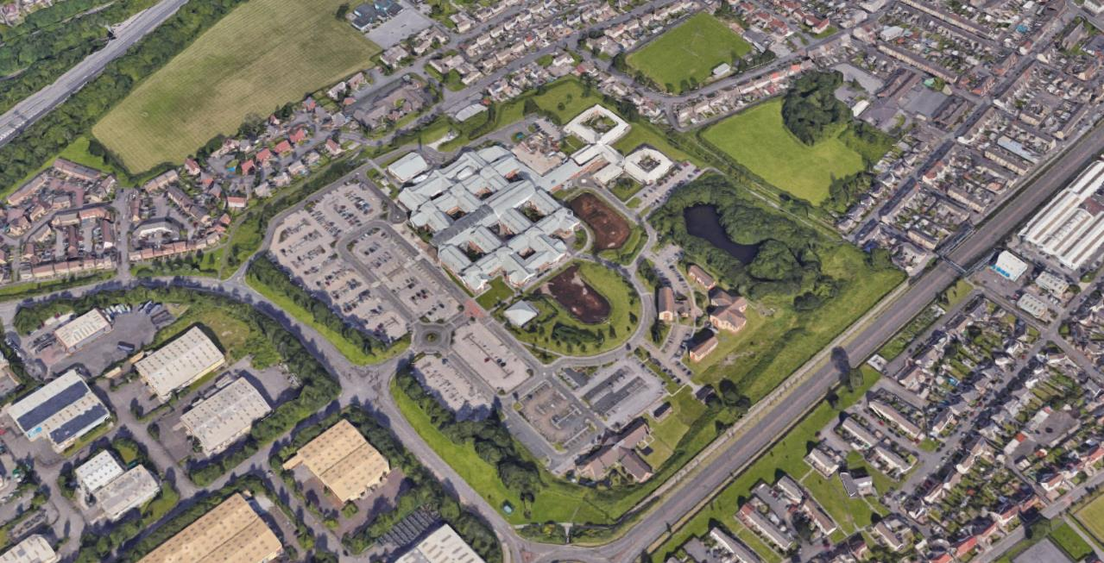
Estates Critical Path – Neath Port Talbot Hospital
Neath Port Talbot Hospital Centre of Excellence for orthopaedic and spinal care, diagnostics, rehabilitation and rheumatology.

Slide 27
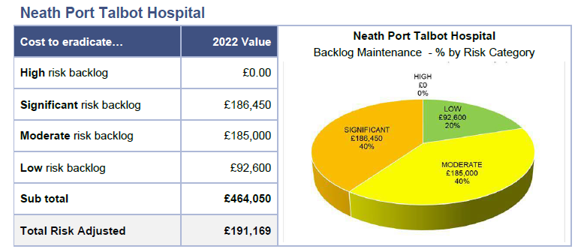
Estates Critical Path – Neath Port Talbot Hospital

Slide 28
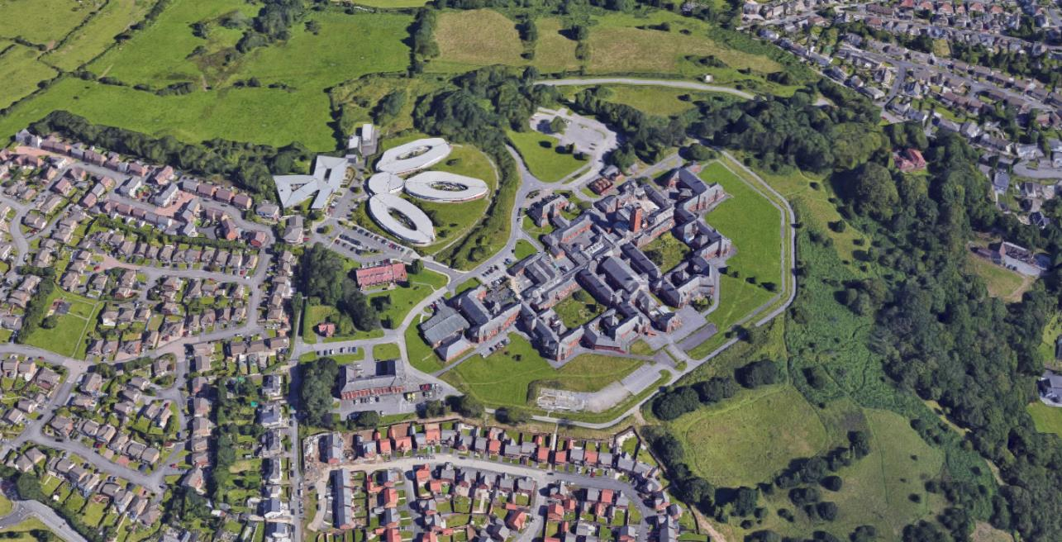
Estates Critical Path – Cefn Coed Hospital

Slide 29
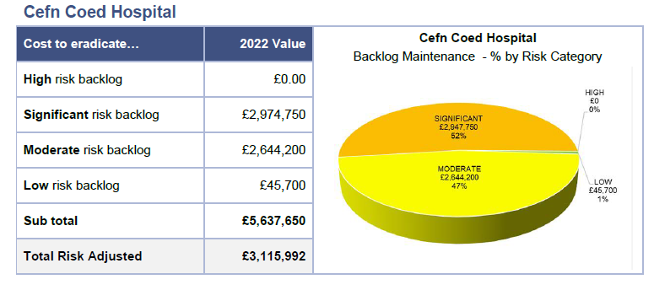
Estates Critical Path – Cefn Coed Hospital

Slide 30
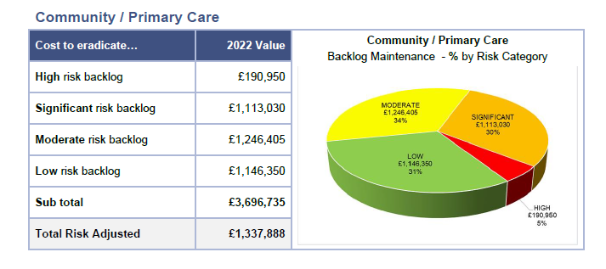
Backlog Maintenance - Summary
In 2023/24 we will work with colleagues in the primary, community and therapy services group along with strategy colleagues to agree the overarching service model for the wide variety of non-hospital services that the Health Board provides and then develop a specific set of plans to consider the estates strategy and the service strategy in detail.

Slide 31
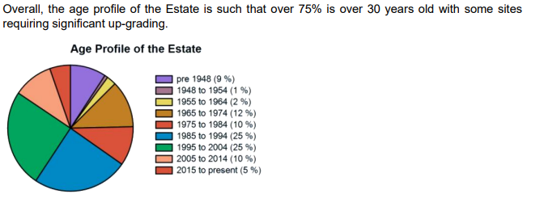
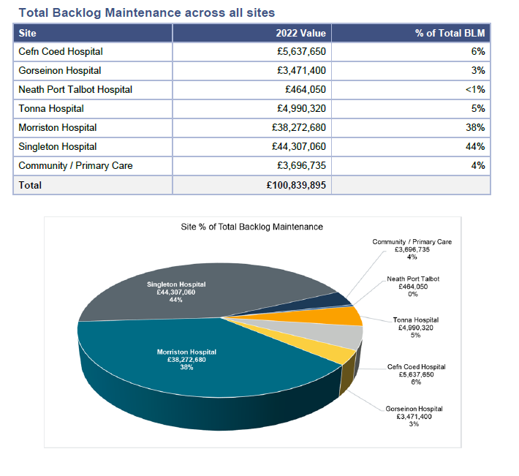
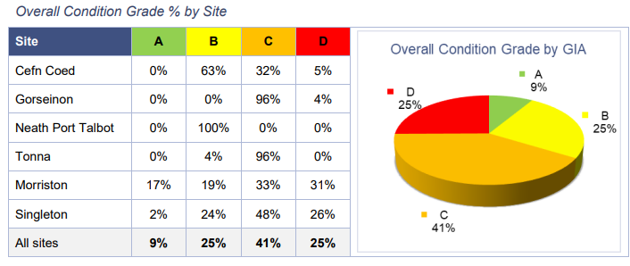
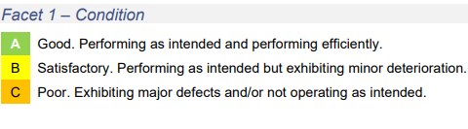

Backlog Maintenance - Summary
Pie chart shows that Morriston and Singleton Hospitals account for over 82% of backlog maintenance
Primary and Community Care facilities owned by the Health Board have also been assessed along with Mental Health Facilities

Slide 32
3. Where do we want to be - Clinical Services Plan

Slide 33
Objectives
As part of the Strategic Estates Plan the following estate objectives were identified:
To support the delivery of the Health Boards clinical strategy by developing a property portfolio, that meets the needs of the Health Boards service development plans and represents efficient use of resources. This means that the estate will be continually reviewed to ensure it meets the needs of the service Swansea Bay University Health Board.
Play a strong supporting role in development of Tertiary, Acute and Primary Care facilities to deliver healthcare with healthier outcomes
Maintain or improve compliance levels to ensure the Health Boards physical environment is delivered to the highest affordable standards
Supports operational services and business development to capitalise on the Health Boards estate to bring a greater range of healthcare services, working with commissioners and stakeholders in the development of regional services.
Support the development of agile working initiatives, through intelligent use of properties and technology.
Deliver a low carbon, sustainable estate that minimises its carbon footprint

Slide 34
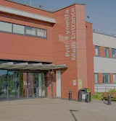
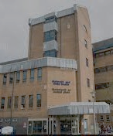
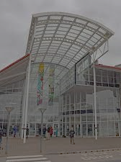
Strategic Direction – Delivering our Clinical Services Plan, Centres of Excellence
Morriston Hospital will be the centre of excellence for urgent and emergency care, specialist care and regional surgical services, including complex medical interventions.
Singleton hospital will be the centre of excellence for planned care, cancer, maternity and diagnostics.
Neath Port Talbot Hospital will be a centre of excellence for orthopaedic and spinal care, diagnostics, urology, rehabilitation and rheumatology.
Focus on Population Health, delivering more effective action aimed at preventing ill-health and supporting good health and well-being and addressing inequalities.
Improve Mental Health and Learning Disability Care so that people have easy access to tools and support to maintain and improve their mental wellbeing and improve the quality of life for people who have been diagnosed with and treated for mental illness moving from a predominantly inpatient model to a more community focused service
Transform Primary and Community Care to strengthen integration between primary and secondary care, to ensure whole system approaches and to support sustainability of services. Focussed around the communities and Clusters within Swansea Bay we will ensure care is better coordinated to promote the wellbeing of individuals and communities
Improving Quality & Safety with a relentless effort to build a culture of improvement with a focus on patient safety, experience, outcomes, clinical effectiveness and reducing harm.
Improving Children’s Services to deliver services that meet the health needs of children, young people, parents and carers in order to provide effective and safe care, through appropriately trained and skilled staff, working in a suitable child friendly and safe environment,
Our Plan will keep people healthy, support them to avoid ill health and be there with excellent healthcare when people need it.

Slide 35
Capacity Requirements
Secondary care - Swansea has the third highest projected growth rate (%) of the 22 Welsh local authorities, behind only Cardiff and Wrexham. An overall growth rate of 9% (around 21,600 people) in the next 15 years, is 3.6% higher than the projected population increase of 5.4% expected across Wales.
The developing infrastructure requirements for community and primary care delivery demonstrate the model of care delivery expected for where the Health Board want to be. It is important to note however, that Primary and Community developments should not be in isolation of secondary care as further pressures on service change alongside the increasing use of technology for access to and within treatment of health, which is, at the same time, increasing the number of patients managed in different ways e.g., via telephone advice, e-advice, other alternatives, and supported self-care routes.
The pressure to maintain operational functionality in a predominantly aging built environment, a significant proportion of which is intensively utilised 24/7, with increasing volume demands, is a constant challenge. In addition, technological, clinical and medical advances require estate reconfiguration / extension / new developments which need to be accommodated whilst maintaining operational functionality. A clear process and proactive approach to maintaining our infrastructure is therefore critical. Alongside efficiency measures and cost reduction, to secure sustainability, we will be accelerating the reshaping of services to ensure they are integrated, innovative, and agile reflecting the design principles set out in the Clinical Services Plan.
Investment required to address our backlog requirement is critical. Investment in our community cluster network will enable us to replace some of our poorer estate. However, the infrastructure which supports secondary care delivery presents much more of a challenge due to its scale and criticality of resilience to maintain our specialist and emergency services.
During the next ten years and running alongside the community developments, the acute services accommodation will continue to be transformed to facilitate the new service delivery models, create the clinical and specialist additional capacity where needed and incrementally implement schemes which enable the shift of more elective work to the Singleton and Neath Port Talbot sites, creating more capacity at Morriston for more complex activity.

Slide 36
4. How do we get there - Site Development Control Plans

Slide 37
Development Control Plans (DCPs)
The Health Board will align to the national, regional and local drivers which impact how services are delivered and how the estate is development.
There will also be other localised service developments as a result of national drivers such as system working alongside all health, social care and third sector organisations to tackle social detriments to health and continue to find innovative way to provide safe, high-quality care that is sustainable for future generations to come.
The Clinical Services Plan (CSP) priorities have been set to advise and support the changes as we drive forwards our joined-up approaches to service delivery and a focus on out of hospital care. By Integrating primary and community-based services, physical and mental health services, with our partners, and transitioning new pathways of care out of hospital into the community where possible will strengthen the ‘system’ as a whole and improve the health of the population.
Development Control Plans (DCPs) have been compiled for each of the main hospital sites (Morriston, Singleton, Neath Port Talbot and Cefn Coed)
These are high-level site plans for future development/management of our estate and wider healthcare community flowing from the Clinical Services Plan(CSP) and 6 facet survey results. The plans have taken into account the current and future healthcare needs of our local population and current condition of our healthcare estate.
These service led changes to the estate will take place over the next 10 years and be subject to detailed design, planning and business cases. The DCPs are flexible and provide a vision to ensure the optimal use of the estate.

Slide 38
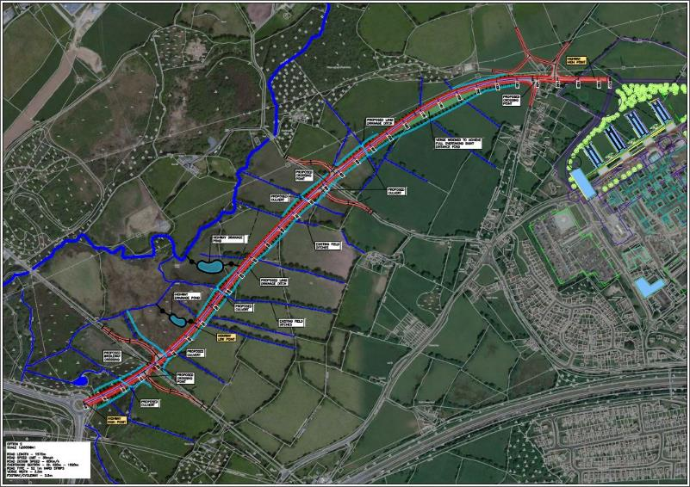
ENABLERS – Access Road Moriston Hospital
Proposed expansion of Morriston Hospital driven by the Swansea Bay University Health Board’s clinical strategy
Local Development Plan considered traffic generation and concluded that a new access road was required for any new major new build on the existing Morriston site and for any development on the new land to the north of the site.

Slide 39
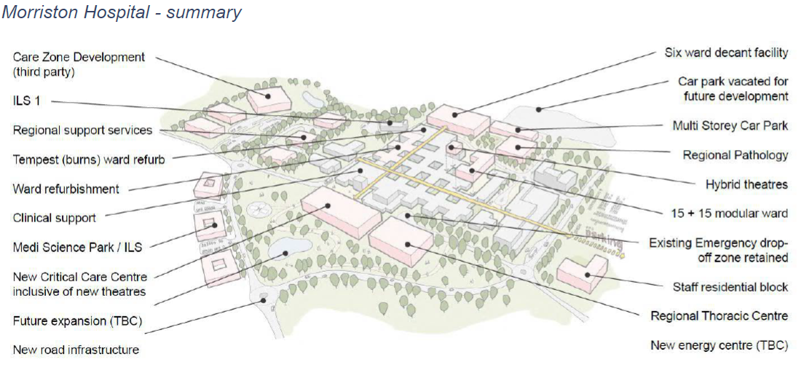
Development Control Plan - Morriston Hospital

Slide 40
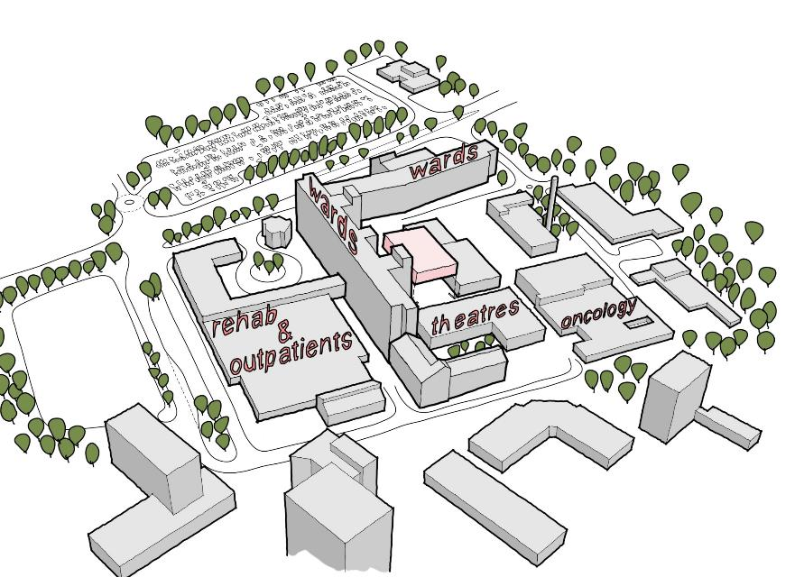
Development Control Plan – Singleton Hospital
SINGLETON HOSPITAL SUMMARY (short to medium term)
Ward block cladding replacement (ongoing)
Modular theatre block
Existing offices / physio relocated into pathology. New Ambulatory Care unit.
Existing pathology building re-purposed for non-clinical use
Potential new MSCP (patient/visitor)
Potential new MSCP (staff) relocation of estates areas

Slide 41
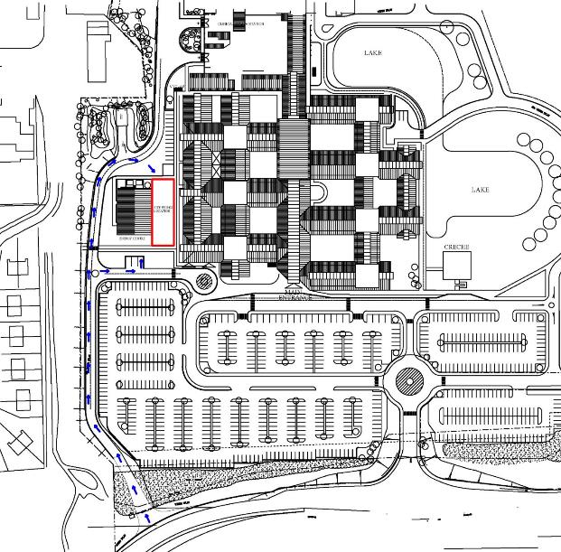
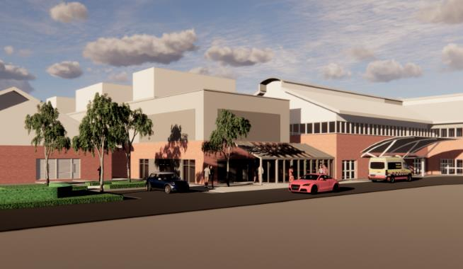
Development Control Plan – Neath Port Talbot Hospital
New Modular Orthopaedic Theatres (3 as below)
Centralise WFI (NPT and Cardiff)
Additional 2 Regional Orthopaedic Theatres

Slide 42
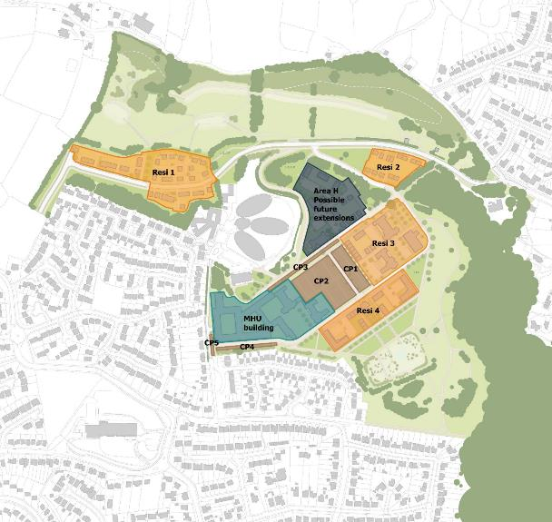
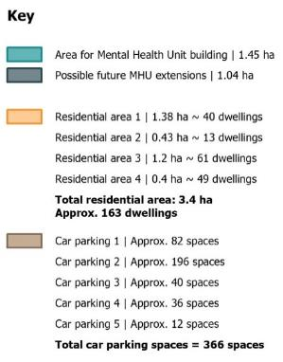
Development Control Plan – Cefn Coed Hospital
New Adult Acute Mental Health Unit

Slide 43
5. How do we get there – Finance, Commercials and Disposals

Slide 44
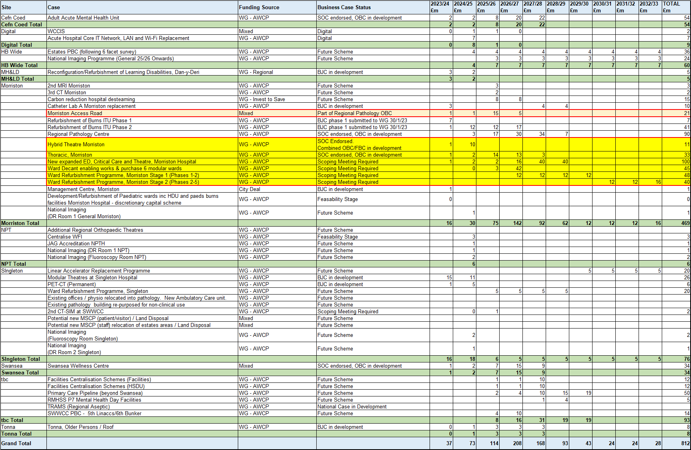
High Level 10 Year Capital Investment Programme
High level indicative capital investment costs £812m over the next 10 years updated for the Recovery & Sustainability Plan 2023/24 – 2025/26
Highlights the enabling projects required for the critical backlog maintenance estates issues identified from the Morriston Hospital 6-facet survey on wards and theatres.

Slide 45
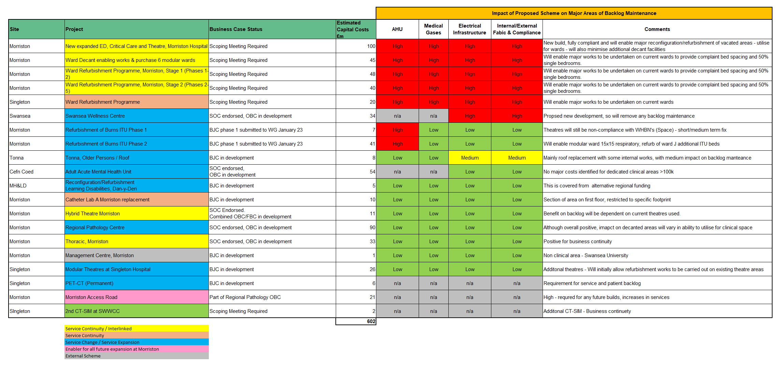
Impact of 10 Year Capital Investment Programme on Estates Backlog Maintenance
Highlights the impact of key schemes from the proposed 10 year capital investment programme on the major areas of backlog maintenance identified in the 6 facet surveys

Slide 46

Funding Models
Funding Source | Access Funding to Support Capital Programme and Backlog Estates Maintenance | Ability to Access
Discretionary Capital | Significant backlog replacement programme for medical equipment and digital (devices and infrastructure) | Low
EFAB (Estates Funding Advisory Board) | Bids approved 2023-24 and 2024-25 priorities £7.9m (of which 30%/£2.4m HB discretionary funding) | High
City Deal | £1m Morriston Access Route design fees included in approved Campuses Business Case. Awaiting sign-off of funding agreements. | High (note: required to balance approved 2023-24 discretionary capital programme)
AWCP (All Wales Capital Programme) | AWCP already over-committed for 2023-24. Impact of reduced central funding and increased local requirements (est All Wales c£10bn over 10 years v £3bn to £4bn funding). Paper to NHS Wales IIB (Investment Infrastructure Board) April/May 23 to establish prioritisation criteria. | Low Potential that WG will start to advise organisations to reprioritise their capital programmes, with some schemes being put on hold.
Mutual Investment Model (MIM) | The WG Treasury team have developed the Mutual Investment Model (MIM) to finance major capital projects. MIM is currently being used to finance the 21st Century Schools programme, A465 Dualling and the Velindre Cancer Centre. | Unclear. We have asked WG to advise us on the criteria for the MIM model.
Regional Housing with Care Fund IRCF (Integration & Rebalancing Capital Fund). | Established HB projects within the draft West Glamorgan RPB 10 year capital programme. Potential for hub funding to support Primary Care and Mental Health. | High
Disposals | See previous slides on disposal opportunities. WG limit on HBs retaining the first £0.5m from disposal proceeds. - Should be able to mitigate Cefn Coed as part of future site investments. - Ability to retain beyond £0.5m with other investment proposals and where HB invested discretionary capital in original purchase | Medium
Revenue Leases | Already commenced with NPT Orthopaedic Theatres. Likely to be the preferred funding route for Singleton Theatres. | High Will require revenue funding
3rd Party Funding | Will need to ensure fits with revenue lease accounting treatment and also WG/Treasury funding rules. | Low/Medium
PFI Exit 2030 | Exit from the NPT PFI contract in 2030, will free up the mortgage payment. Potential to invest revenue into capital investment programme / revenue leases. | Medium

Slide 47
Disposals and Commercials – Project Brief
Our approach for the commercial review revolves around six key sites.
Neath Port Talbot
Morriston hospital
Singleton Hospital
Cimla Health & Social Care
Ty Garngoch
Cefn Coed Hospital
Gorseinon Hospital
Our approach for the commercial review involved.
Commercial considerations
Disposal feasibility
Non-clinical admin strategy
Hybrid working
Partnership opportunities
Retail
Car parking
Residential development and alternatives

Slide 48
Morriston Hospital
Our approach for the commercial review for Morriston includes:
DCP update - 55 acres
ILS 3 and University facility
Surplus land north & east of the DCP
Car park south development
Car park west
Retail - main entrance
Renewable energy infrastructure
DCP - pathology, decant and energy centre
Surplus land uses
UHB accommodation south - disposal and re provide accommodation to east

Slide 49

Singleton Hospital
Commercial approach:
• DCP update - MSCP locations
• Car park west
• Car park south - student and ILS
• Solar infrastructure
• Retail provision
• Residence blocks

Slide 50
Neath Port Talbot Hospital
Opportunities:
Car park infrastructure
• There is 2.35 Ha of single level car parking that could be fitted with frame mounted solar with electricity
offsetting for the hospital
• Potential to provide electric vehicle charging, with potential monetisation.

Slide 51
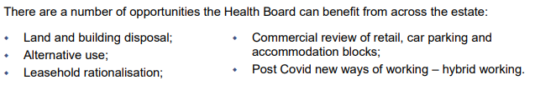
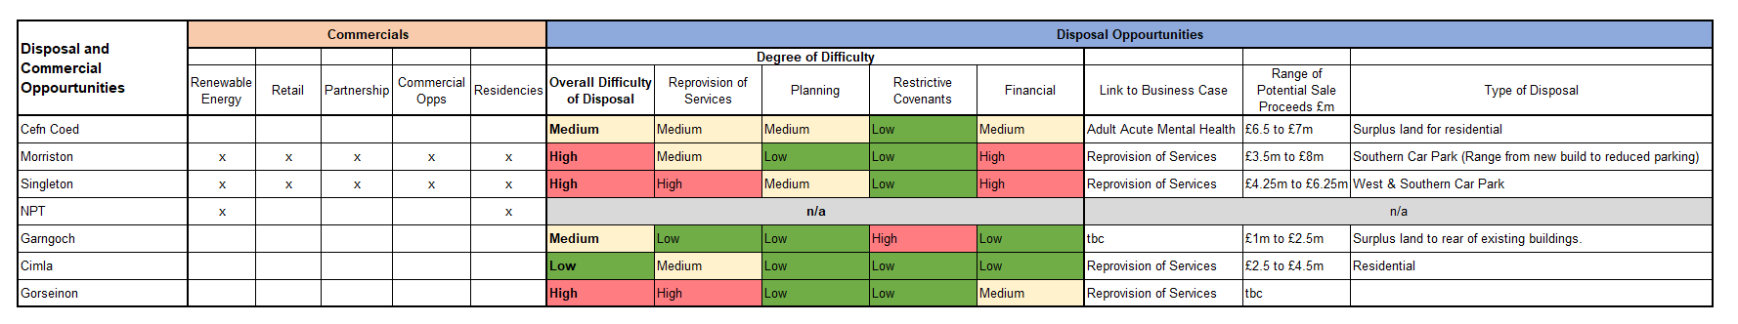
High Level Commercial and Disposal Opportunities
Renewable Energy Infrastructure
Frame mounted solar panels built above
existing car parks to provide opportunity to
provide energy to existing hospital estate, plus
the potential to store energy in batteries for EV
car charging.
Income generation opportunity for EV car
charging ports

Slide 52
6. How do we get there – Decarbonisation.

Slide 53
Decarbonisation
The Health Board have recently produced the Swansea Bay UHB Recovery and Sustainability Plan that aligns with the Swansea Bay UHB Annual Plan.
The Health Board is engaged in delivering exciting, innovative and transformational carbon reduction projects that currently lead the way in the UK and Europe. Visible change includes how the estate is powered, the greening of spaces, digitising of the services and reductions in staff commuting. However, total the Health Board emissions are still estimated at 81,467.99 CO2 e (2020-21) the equivalent of the carbon held by over 99,000 acres of forest. Over 70% of this is from how the HB purchase services and goods, staff travel to and from work, and how it manages water and waste services.
The Health Board is committed to delivering the Well Being of Future Generations Act 2015 and to reaching the NHS Wales target of net zero by 2030. To achieve this, HB have committed to delivering a SBUHB Decarbonisation Plan (Appendix D) and our staff have formed their own green group to support this.
The Health Board’s Decarbonisation Action Plan (DAP) for 2022 - 24, outlines how the Health Board will support the Welsh Public Sector in becoming net zero by 2030, through:
Culture and ways of working;
Buildings, Estates Planning and Land Use;
Transport and Travel;
Procurement;
Approach to Healthcare.

Slide 54
Decarbonisation
Current Developments
The Health Board has completed energy audits across its community premises highlighting decarbonising opportunities
•The Health Board is just starting a £3.6 million project to extend the solar farm and a 2 MW battery installed .
• Proposals have been completed for decarbonising of both Morriston and Singleton Hospital Estimated at £26 million and £24.6 million respectively
•Work is commencing on a High Level assessment of the viability of a solar array on the NPT site
Next Steps
• The Health Board is making a bid for central funding for the Decarbonisation project for Morriston and Singleton Hospital sites.
The Health Board is making a bid for central funding for the Decarbonisation project within a number of the community premises.
•The Board is investigating alternative funding opportunities to support these initiatives.

Slide 55
7 Summary – Case for Change.

Slide 56
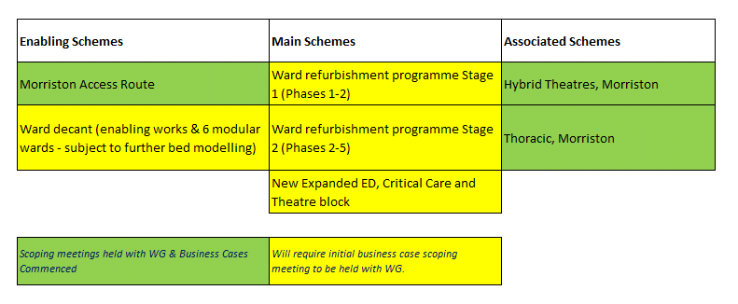
Summary - Case for Change
This Estates Strategy reflects the Clinical Services Plan and 6 Facet Survey undertaken in 2022.
Very high level capital investment estimates in advance of any detailed designs suggest a significant investment of £812m over a 10 year period. This will be subject to project business cases and discussions with Welsh Government on affordability.
To ensure business continuity for key clinical services on the Morriston site, a number of schemes below have been identified as key priorities taking a risk bases assessment alongside our clinical service development ambition.
6 Facet Survey – Estate Backlog Maintenance
CSP – Design Control Plans
Risk Assessed Business Continuity
Service Change
Prioritised plans to mitigate the main risks to continued operation of Morriston wards and theatres.
Failure to commence planning now, could result in the loss of ward and theatre operating capacity over the next few years.

