Slide 1
Principles 3 Year Sustainable Financial Plan
FY 2025/26 – 2027/28
27th August 2024
Notes:
This slide can be used for presentations which are from a health board-wide perspective or for a whole HB audience as the graphic device to the right of the slide includes all four service group colours and red for the corporate team.

Slide 2
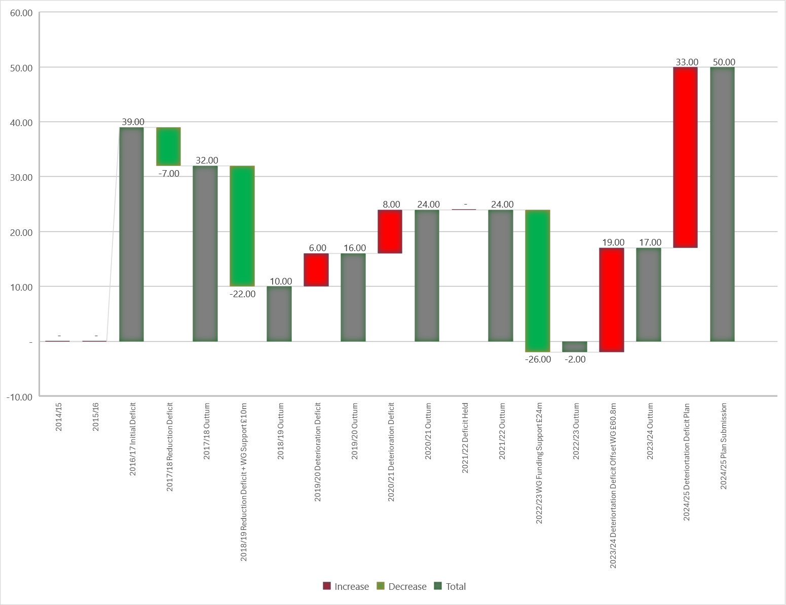

History of Deficit 2014/15 Onwards
From the trend over the last 10 years when the organisation has been in a balanced position as 2015/16 and again in 2022/23 it can be seen from the waterfall diagram opposite that it is unable to sustain this financial position in the following year(s).
Therefore, in setting out the approach , over 3 Financial Years, to aspire to remove the Underlying Financial Deficit (ULD) any plan needs to focus on year 4year + to ensure the achievement is sustained.
Critical to this will be:
Programme 3 of the Recovery & Sustainability Portfolio
Financially modelled plan alongside Programme 3 building in Financial Years 4 – 10.
Linked to the comments above this paper will be split into two parts:
PART A – 3-Year Planning principles 2025/26-2027/28
PART B – 10 Year Live Financial Model
Notes:
This is a generic copy slide.

Slide 3
PART A – PRINCIPLES 3 YR PLAN (2025/26-2027/28)
Notes:
This slide can be used for presentations which are from a health board-wide perspective or for a whole HB audience as the graphic device to the right of the slide includes all four service group colours and red for the corporate team.

Slide 4
Assumptions Underpinning the Principles of 3 Year Plan 2025/26-2027/28
Underlying deficit remains @ £50.1m.
Service Groups and Corporate Directorates to remain within the funding envelope provided
Savings Target is set at maximum of 2.5% of core funding. This based on historic level of savings achieved by the Health Board over the last 3-4 yeas against a minimum expectation from WG of 2% (24/25 target). This is further explored in SLIDE 6.
Principles of the approach for 2025/26-2027/28, as outlined in the first slide of this document, is it must sit alongside Programme 3 of the Recovery & Sustainability agenda, to ensure we have a sustainable plan past Year 3.
Notes:
This is a generic copy slide.

Slide 5
Plan of Two Halves
PART 1: Underlying Deficit | PART 2: Growth
Generally, the setting of SAVINGS TARGET is to support the gap between the income received and the level of expenditure within the plan. For 2025/26-2027/28 the SAVINGS TARGET will be applied directly to the £50.1m underlying deficit held in Central Cost Centre to reduce the value over the period of the plan to zero and achieve a balanced underlying position. | All agreed growth in expenditure linked to demand, inflation, national business cases and local decisions MUST be contained within the Annual Uplift set through the WG Annual Budget setting process. The type or level of investment will be prioritised by the Executive Team and approved by the Board as part of the Financial Planning process.
Underpinned by the Recovery & Sustainability Programme
Notes:
This is a generic copy slide.

Slide 6
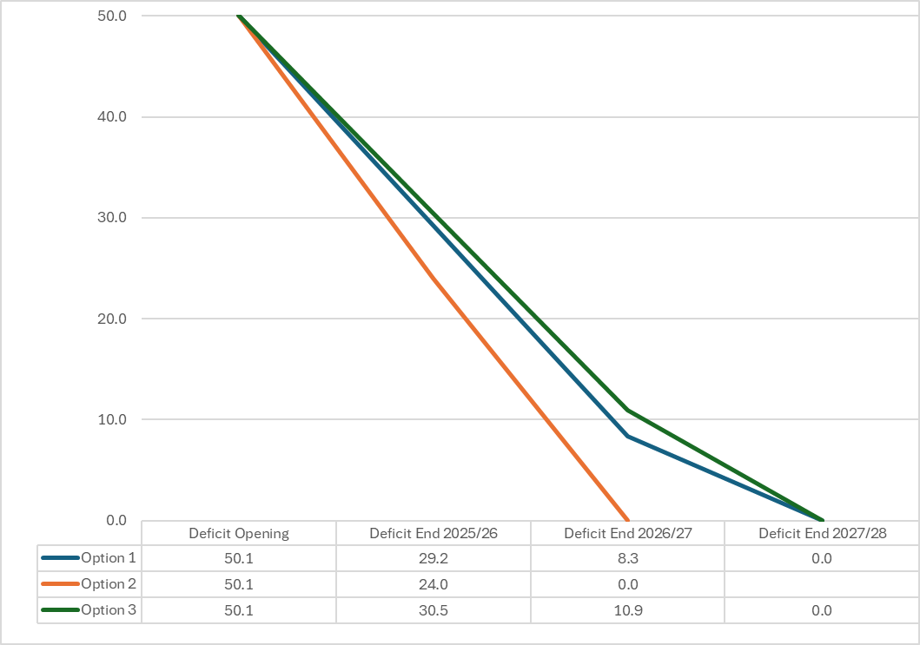
Part 1 Savings & Options for Consideration
Key difference between the 3 options is the speed at which the underlying deficit is removed. However, consideration also needs to be given to the ability of areas to deliver savings, at a time when areas will have less investment for Growth compared to previous financial years.
This is illustrated in the graph below.
Note #1 – in FY 2027/28 on basis that all saving achieved excess used to support Growth in Year 3
Notes:
This is a generic copy slide.

Slide 7
Part 2 Growth Process
Areas of Growth by:
NHS Wales | SB Strategic Options
General Non Pay Inflation @ CPI Drugs (Primary, Secondary, NICE) CHC (Growth & Investment) Joint Commissioning Committee National Digital Projects (e.g. LINC/RISP) Uplifts LTA/SLA NWSSP National Support Welsh Risk Pool Changes | Digital Strategy Clinical Service Plan Changes OR1 Theatre Investment Contractual Obligations (e.g. PFI) Energy
Annual Value WG Uplift (Exc. Pay Award)
2023/4 | 2024/25
1.5% Uplift = £12.9m | 3.67% Uplift = £34.6m
Therefore, the health board will need a clear prioritisation process to review the level and areas growth funding will be deployed, which will then be presented to the Board for approval
October/November 2024 assess data to provide indicative value for each item detailed in the table above
Early December request Executive Team prioritise order, noting some may not be a choice but national decision.
24th December HB receive 2025/26 Allocation Letter confirming the % awarded and expectations regarding savings target
Early January dependent on the % and expectations of WG, finalise option applied in Part 1
Mid-January - first full presentation of the assessed 2025/26 Financial Plan
Updates from each step in the process will be reported to Executive Team / Management Board / Performance & Finance Committee and Board at various points from October through to final approval in January 2025
Notes:
This is a generic copy slide.

Slide 8
Submission IMTP Timeline January – March 2025
End January ’25 - PFC/Board approve 2025/26 Accountability Letter and Annual Budget Management document
Early February ’25 - Accountability Letters are issued to Service Group Directors and Corporate Directors
End Jan ’25 - Translate the Financial Plan into the 2025/26 Budgetary Allocations and Savings Target for each Service Area
Mid-March - all areas to produce robust plans for 2025/26 Savings and address requirements of accountability letter
End March ’25- the opening 2025/26 budgets are uploaded into the financial ledger
Notes:
This is a generic copy slide.

Slide 9
PART B – MODELLING & PRINCIPLES 10 YEAR FINANCIAL PLAN (2025/26 - 2034/35)
Notes:
This slide can be used for presentations which are from a health board-wide perspective or for a whole HB audience as the graphic device to the right of the slide includes all four service group colours and red for the corporate team.

Slide 10
Overview
OBJECTIVE | Develop a rolling 10 year Financial Plan Year 1 comprehensive and detailed with Year 2-10 based on information avaible from trends and horizon scanning Agile and updated to reflect known changes to circumstances Once Year 1 goes live, this is removed and replaced by a new Year 10
HOW | Look at best practice Seek information from NHS England, where Foundation Trusts have previously done 10-year modelling Learn from errors in early years to build a robust model for future planning purpose
WHAT INCLUDED | Prediction on growth based on averages and trends Data on Macro-Economic climate Planned Services changes as part of HB Clinical Services Plan Changes to Population Demographics/ Health recognising issues raised in the NHS in 10+ years An examination of the projected impact of Long-Term Conditions and Risk Factors in Wales (Science Evidence Advice (SEA) (gov.wales)) Horizon Scanning NICE or changes in Clinical Practice Medium / Longer Term Outputs from Recovery & Sustainability Programme Review all Business Cases and ‘Choices’
WHO OWNS IT | Live document held by the Finance Team but shared periodically across the year with Performance & Finance Committee (times to be determined)
WHAT IS NEEDED | Change in structure of the Finance Team to bring together the various elements of the current Team into one Strategic Planning, Commissioning and Intelligence arm, for which a consultation document is being drafted.
Notes:
This is a generic copy slide.

