Slide 1


Performance & Finance Committee
Primary Care, Communities and Therapies Service Group
27th August 2024

Slide 2

High Level Summary
Top 3 Actions to address position:
Action savings following Star Chamber 19.8.24
Continue to engage in Swansea Bay and National Continuing Health Care Value and Sustainability Program
Continue to identify revenue reduction options and associated impacts for assessment including Swansea Bay Recovery & Sustainability controls.

Slide 3
Agenda Detail
Health Board & Service Group Financial Summary
In-Month Revenue Position
Savings Performance
Key Drivers
Risks, Next Steps & Mitigating Actions
Appendices

Slide 4

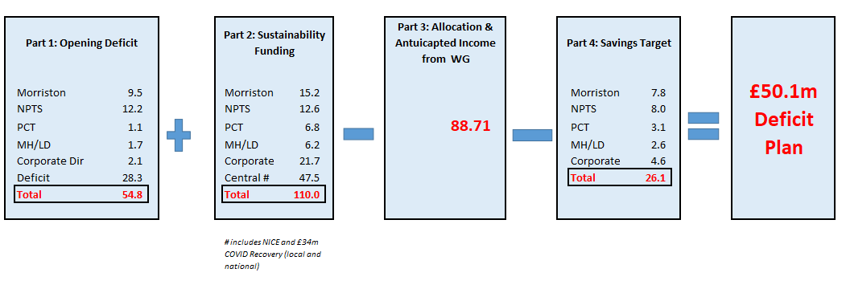
Health Board Summary Elements of Financial Plan
Note: Specific elements from Part 1, 2 and 4 of the plan that relate to this service area are summarised on the next slide.

Slide 5

Service Group Element of Financial Plan

Slide 6

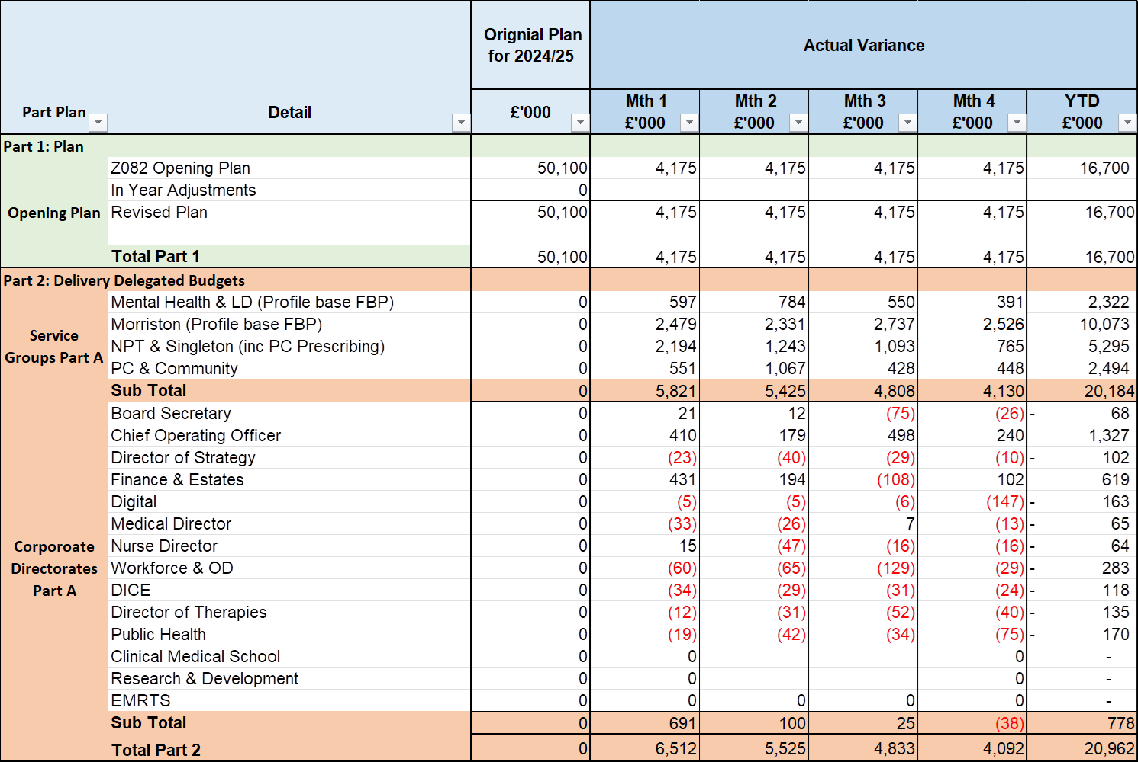
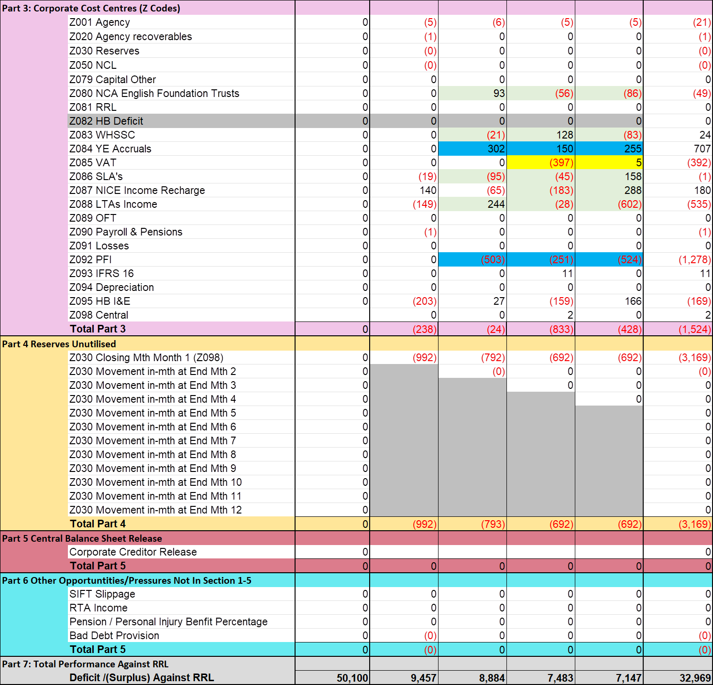
2024/25 In Year Health Board Position

Slide 7
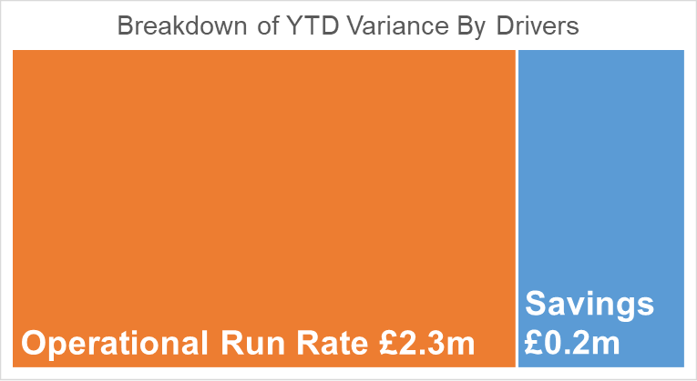
Service Group Position By Month & Divisions
Month 4 included the release of balance sheet benefits to the value of £250k in line with the financial plan. This offset an increase in Continuing Healthcare costs therefore the position increased overall by £19k versus month 3.
Main variances:
Therapies & Health Sciences
  Underspends are largely pay related
Nurse Director:
  Continuing Healthcare overspend £653k
  District Nursing £77k (incl variable pay of £86k)
  Looked After Children £87k – additional packages recharged by Local Authorities
  Gorseinon – £62k additional 15 surge beds staffed using variable pay (£68k in month)
Service Group Management:
The Service Group has an historic underspend target from 2019-20 relating to Primary Care Contracts (£1.7m) and non recurrent savings (£1.5m) which equates to a monthly cost pressure of £263k. This has been offset in month 4 by the release of £250k of balance sheet benefits and other one off savings of £44k. .

Slide 8
In month Service Group Position By Division & Type Expenditure/Income
Key Drivers:
Income
Main pressure relates to Dental Patient Charge Revenue which is £112k lower than Welsh Government target due to Contract Reform
Non Pay
Pressures in Nurse Director mainly relate to
  £653k Continuing Health Care
  £87k Looked After Children Packages
  £42k 23/24 unmet savings target
  £44k District Nursing
  £32k Prison & Sexual Health drugs spend
Pay
Underspends in pay partially offset the non pay pressure.

Slide 9

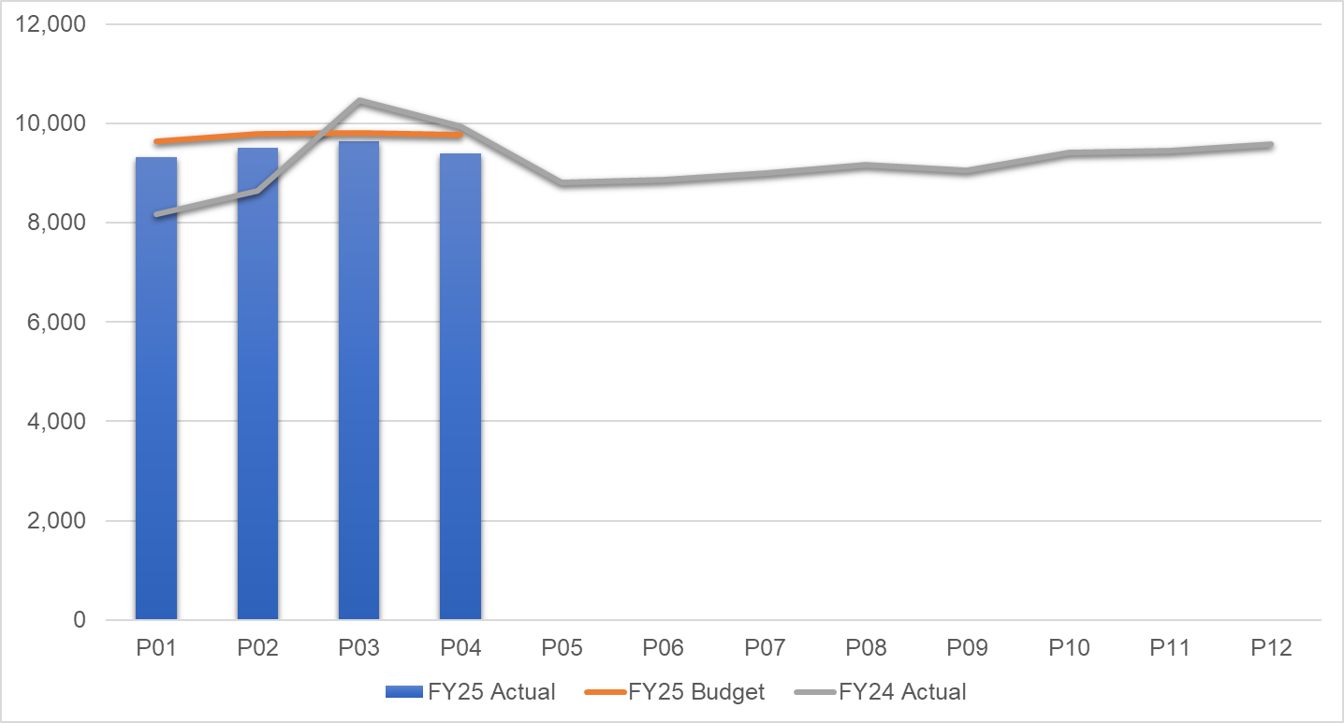
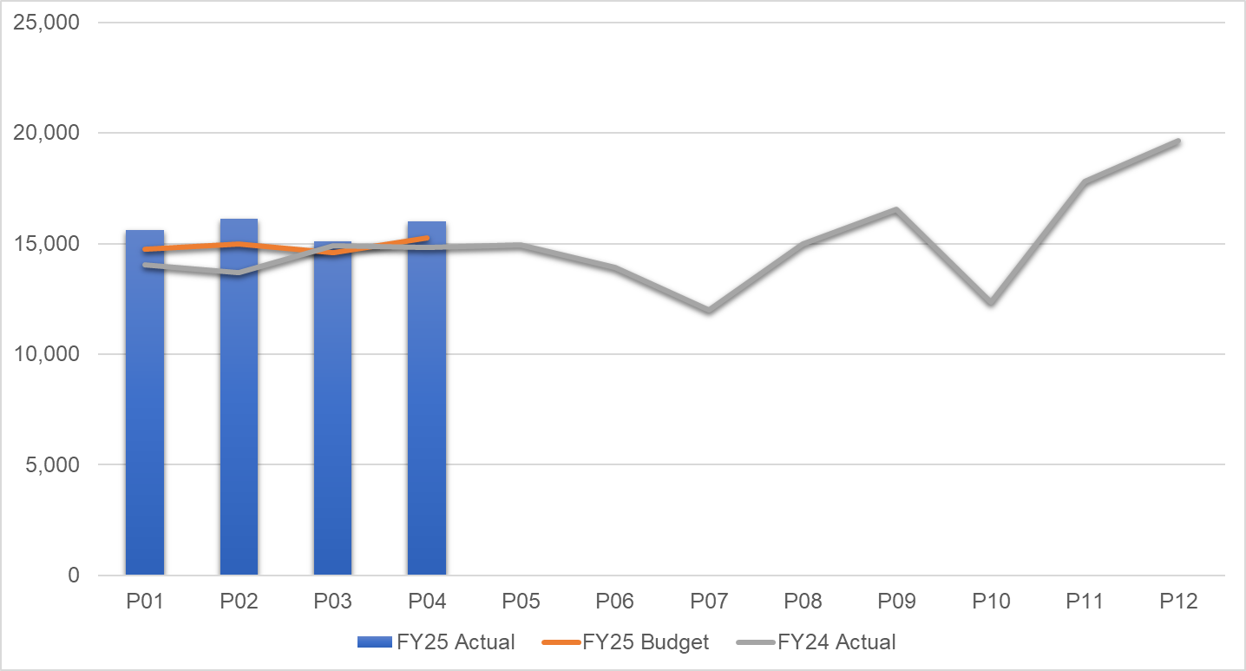
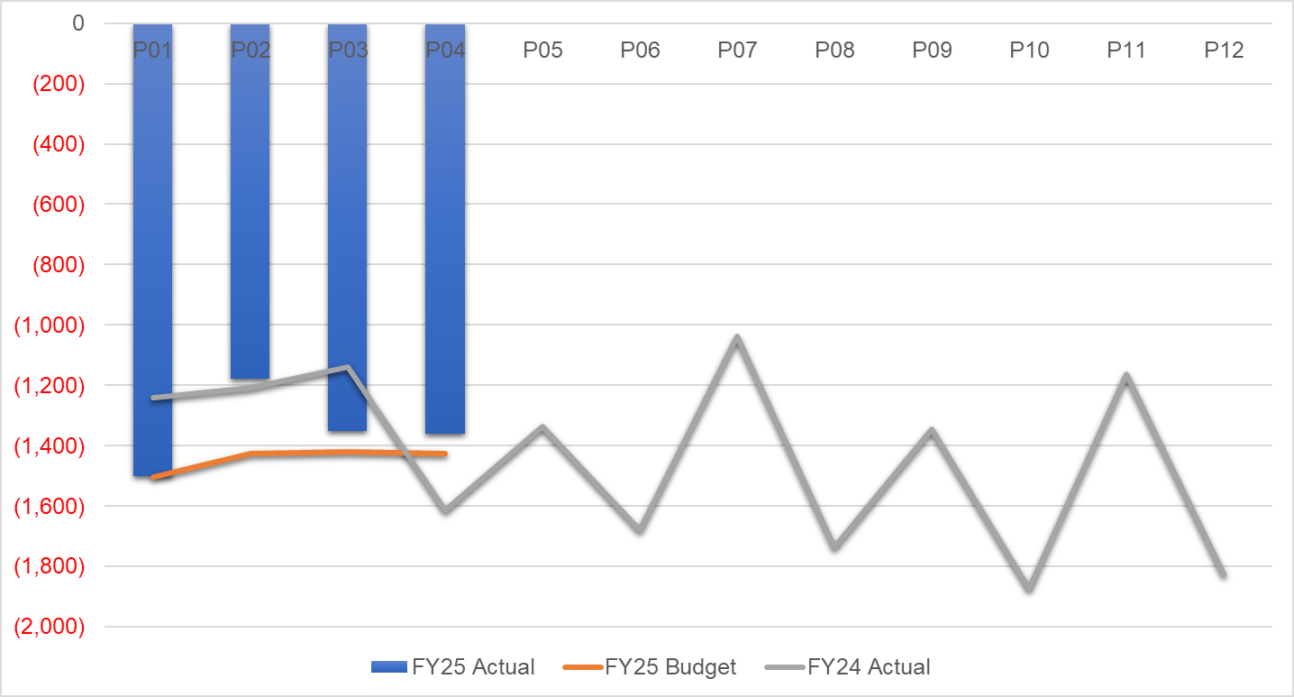
financial performance: Overall trends
Pay by Month £000s
Non Pay by Month £000s
Income by Month £000s
Key Messages:
PAY: M3 increase relates to virtual ward investment / recruitment. Pay is consistently below budget.
NON PAY:
  Continuing Health Care (Care Homes and Looked After Children packages costs) account for 25% of non pay spend. The spike in month 4 is due to some 24/25 inflationary uplifts being applied and some catch-up in packages started in previous months. CHC spend is running 23% up on last year’s average and 14% in excess of budget.
  Primary Care contracts account for 65% of non pay spend and are on trend.
INCOME: Dental Contract Patient Charge Revenue is 27% less than budgeted levels as a result of contract reform and accounts for the Income shortfall vs budget.
Notes:
PAY M3 23-24 spike relates to 23-24 Recovery Pay award payment. Last year’s increasing trend is investment related (Virtual Wards, Therapies, Smoking Cessation etc).

Slide 10
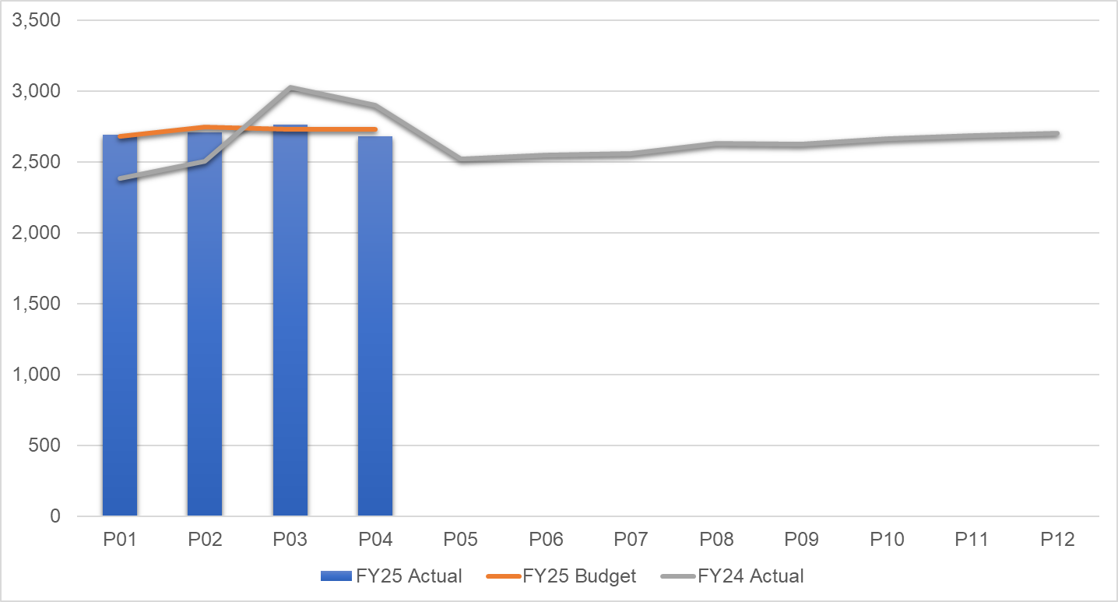
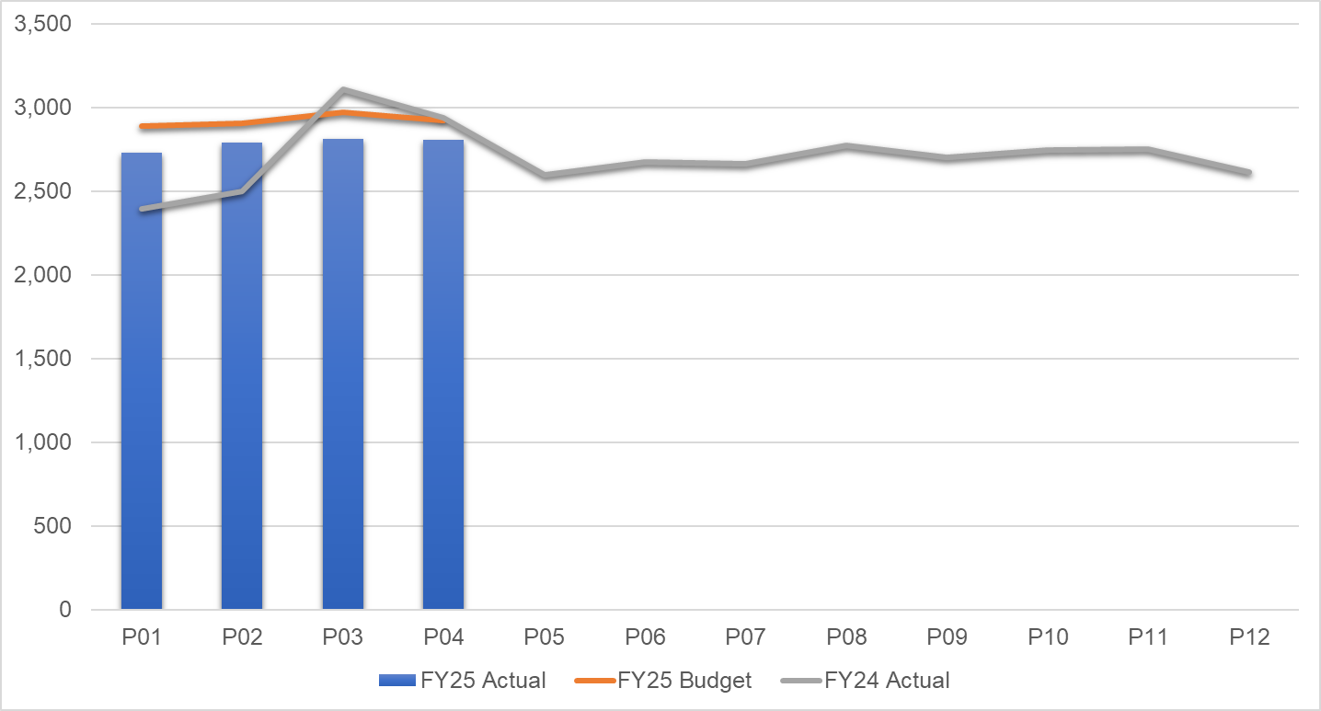
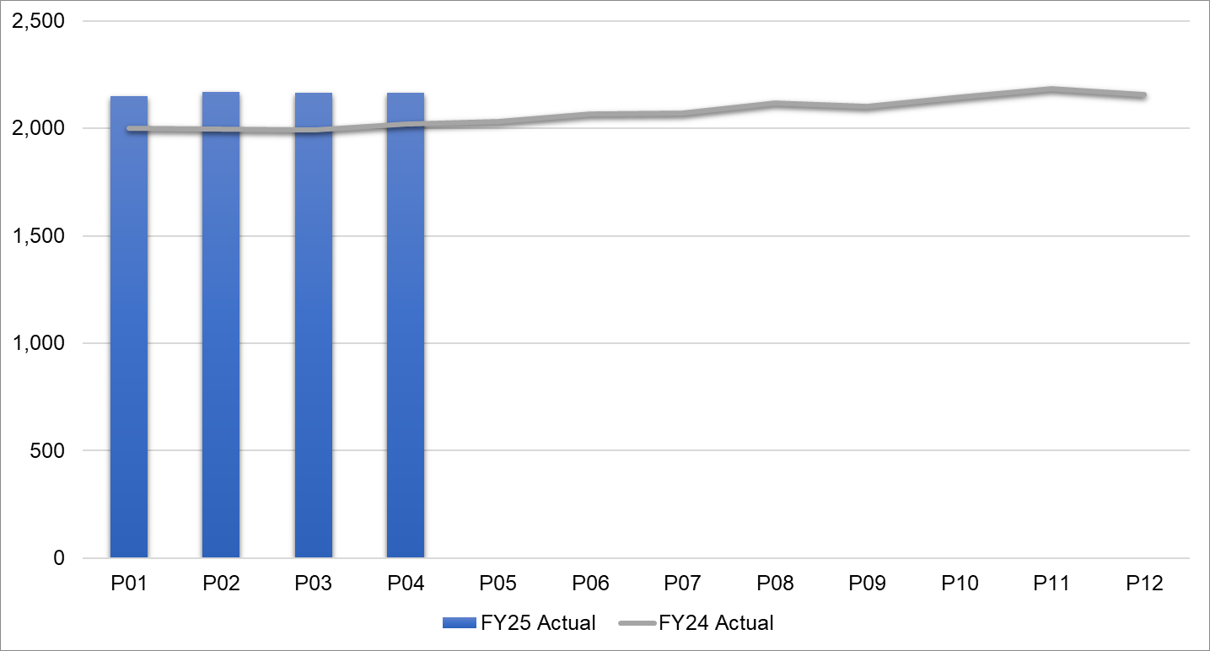
Pay Summary
Registered Nursing by Month
Allied Health Professionals by Month
WTEs by Month
Key Messages:
Nursing pay spend is in line with budget and last year’s spend.
Allied Health Professionals’ pay spend consistently below budgeted levels
WTEs are showing an increase on last year in line with investments and recruitment to vacancies.

Slide 11
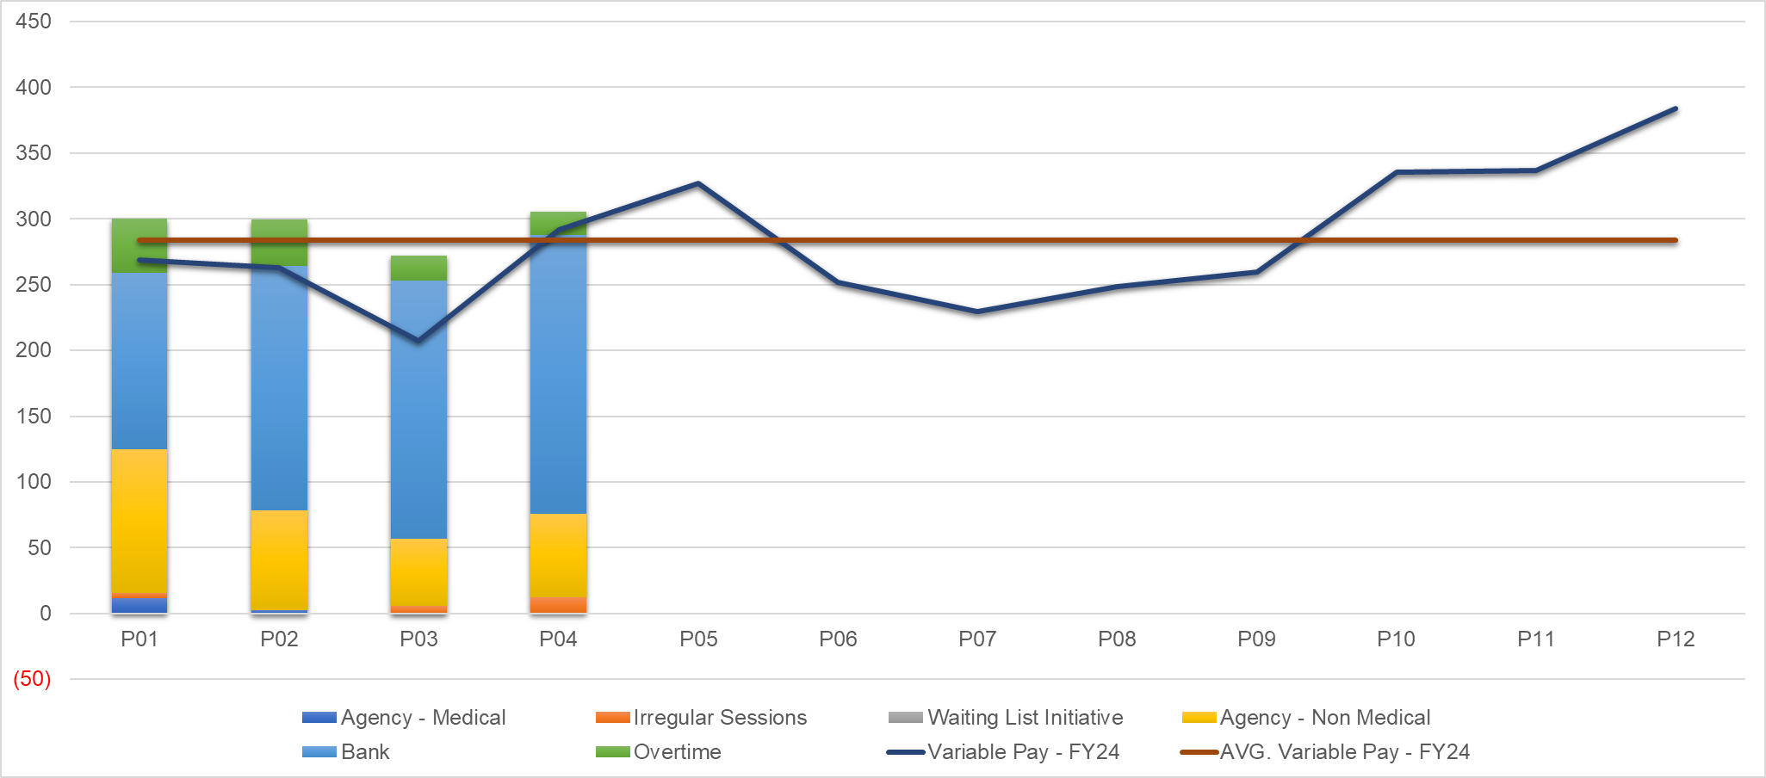
Pay : Variable pay
Variable Pay Trends £000s
Key messages:
Variable pay is largely linked to surge beds in Gorseinon, higher activity in District Nursing and high sickness / vacancies in Ty Olwen plus the opening of 4 additional beds in Q4 23-24. These three areas account for almost two thirds of the July variable pay. This also explains the increase versus 23-24.

Slide 12
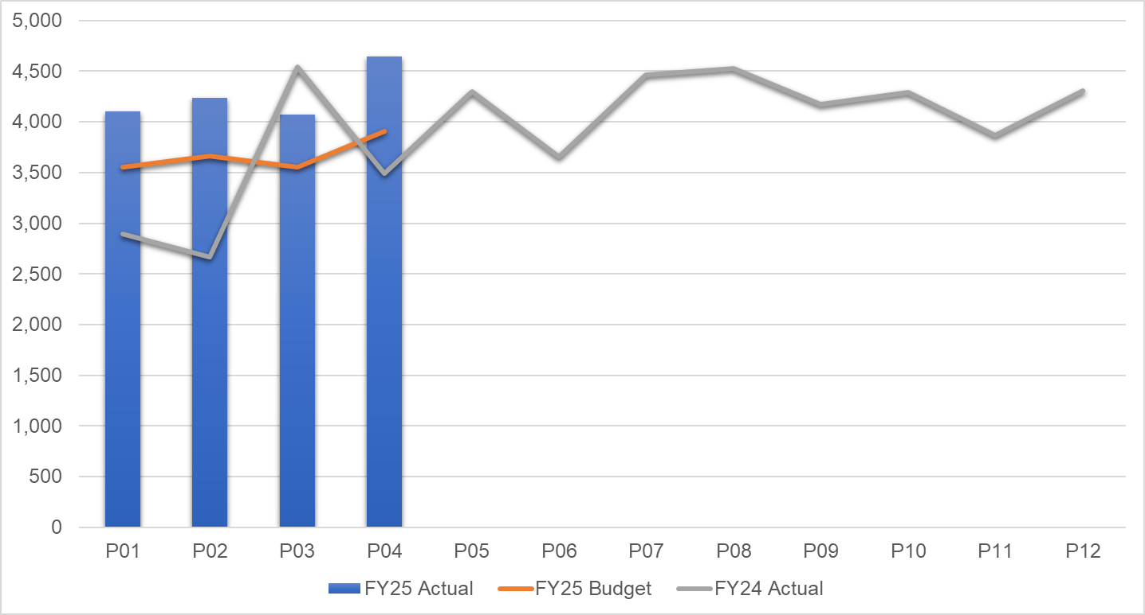
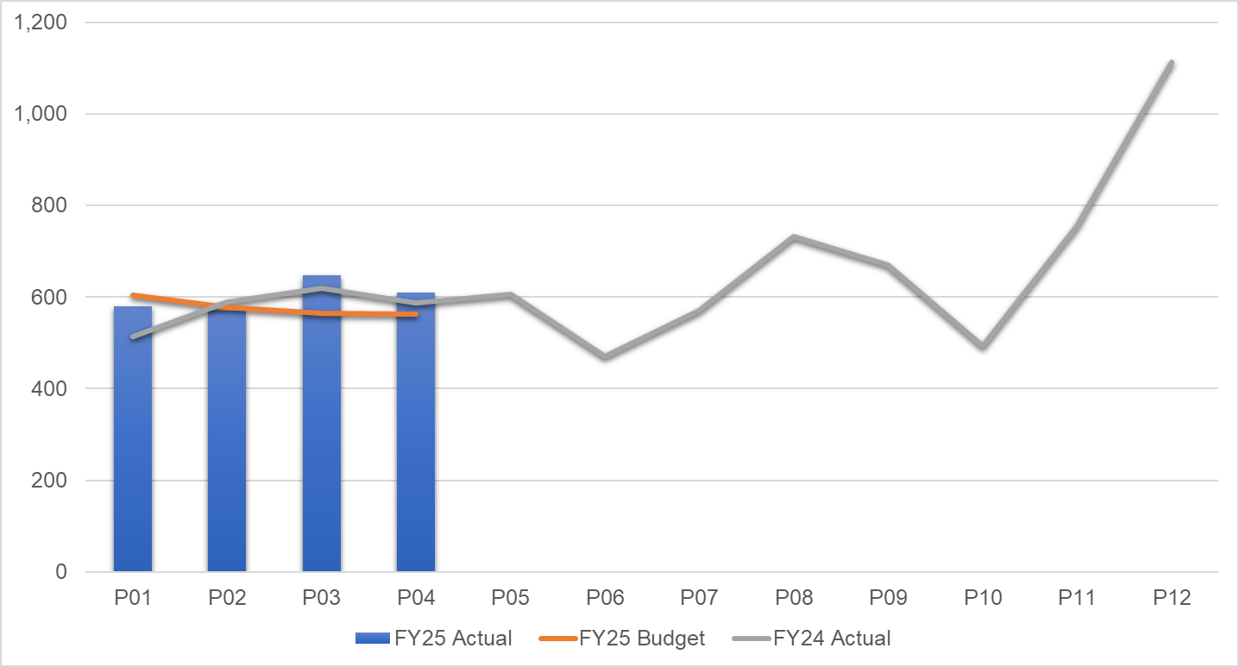
Non Pay: key drivers
Continuing Health Care / Funded Nursing Care by Month
Clinical Supplies incl. Drugs by Month
Key Messages:
Continuing Health Care and Funded Nursing Care continue to be the largest cost pressure due to a growth in volumes of patients and higher acuity, resulting in an increased average weekly cost per package.
Clinical Supplies spend is tracking 4% above budget caused by Sexual Health and Prison Drugs spend, District Nursing Clinical Supplies in line with increased activity and Continence price inflation.

Slide 13

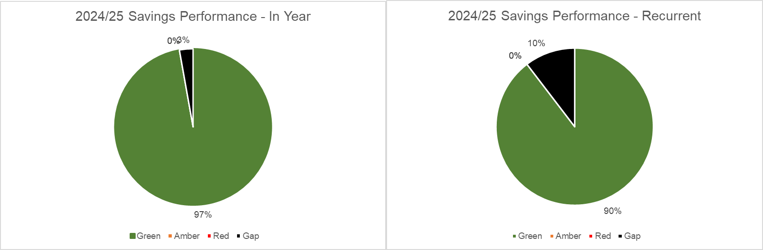
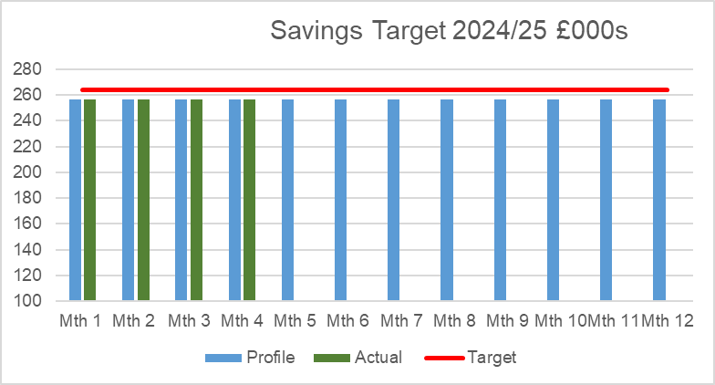
Savings Summary (Proportion HB Target £26.1m)
Identification of Opportunities & Profile
The Service Group have a target of £3.171m and have achieved 97% in year and 90% recurrently. Service Group actively reviewing opportunities to close gap in conjunction with the run rate reduction actions.

Slide 14
Savings Detail

Slide 15

Identification Opportunities & Risk (Including Hot Spots)
Further Opportunities:
Balance sheet benefits from 23-24, currently being assessed, to offset shortfall in run rate savings and cost pressures.
Further opportunities submitted to the CEO on 14th August 2024 as part of the Options Assessment and Star Chamber process.
Further Risks:
Community Equipment Store Cost Pressures (Management Meeting outlining options 29th August 2024)
Looked After Children Contributions to Local Authorities
Continuing Health Care increase in acuity resulting in more expensive packages and requests for inflationary increases above rate agreed by Board.
Impact of Welsh Government changes to the rates paid to Community Pharmacy

Slide 16
Action & Next Steps To Be Taken By Service Group
Actions and Next Steps:
Service Group to action decisions made at 19th August Star Chamber and outcome for further discussions with Board on 5th September.
Service Group to action cost control measures as per Health Board’s Recovery & Sustainability programme.
Continue to identify revenue reduction options and associated impacts for assessment

