Slide 1


Performance & Finance Committee
Primary Care, Communities and Therapies Service Group
29th April 2025

Slide 2

High Level Summary
Top 3 Actions to address position:
PCT Service Group achieved a £0.2m under spend at 24/25 year end. This was £2m better than the control target.
Additional funding received from Welsh Government for Optometry and CHC Retrospectives accounted for £0.7m.
The Continuing Healthcare pressure improved in Q4 as well as further non recurrent benefits, partially offset by higher Looked After Children costs.

Slide 3
Agenda Detail
Health Board & Service Group Financial Summary
In-Month Revenue Position
Savings Performance
Key Drivers
Risks, Next Steps & Mitigating Actions
Appendices

Slide 4

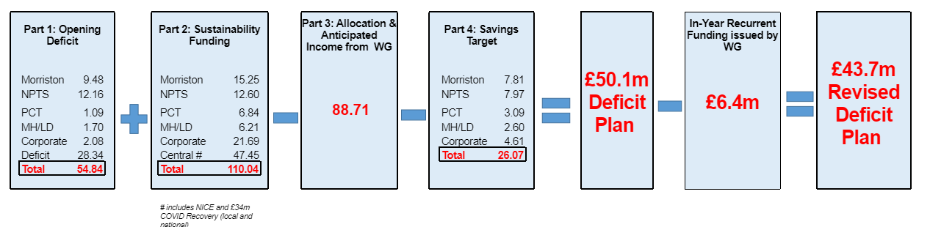
Health Board Summary Elements of Financial Plan
Note: Specific elements from Part 1, 2 and 4 of the plan that relate to this service area are summarised on the next slide.

Slide 5

Service Group Element of Financial Plan

Slide 6

2024/25 In Year Health Board Position

Slide 7
Service Group Position By Month & Divisions
Key messages:
There have been improvements month on month largely through non recurrent benefits.
The majority of the cost pressures relate to:
  continuing care home spend (£5m)
  higher Looked After Children contributions to the local authorities (£1.3m)
  additional beds in Gorseinon above funding (£0.9m)
  District Nursing £0.7m .
Offset by vacancies and non recurrent benefits.

Slide 8
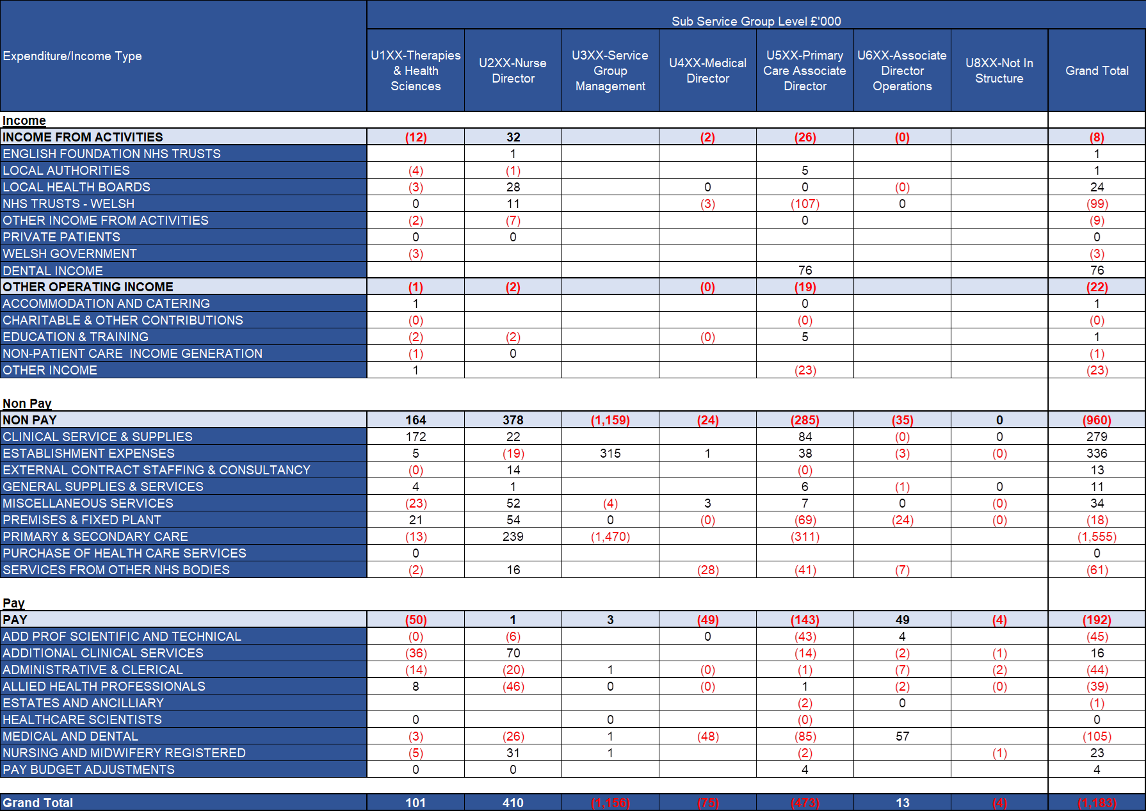
In Month Service Group Position By Division & Type Expenditure/Income
Key Drivers:
Income
Main pressure is dental income. There is a benefit from addition income for dental trainees but this would be offset by pay costs.
Non Pay
The impact of the non recurrent benefit release and non investment of 23/24 dental under-achievement is creating the underspend, offset by a provision for GP Out of Hours legal cases, additional audiology costs and Cluster / Dental Clinical Supplies.
Pay
Underspends in pay are the result of vacancies partially offset by pressures in Registered and Unregistered Nursing due to variable pay for Gorseinon surge beds, District Nursing high demand and Ty Olwen

Slide 9
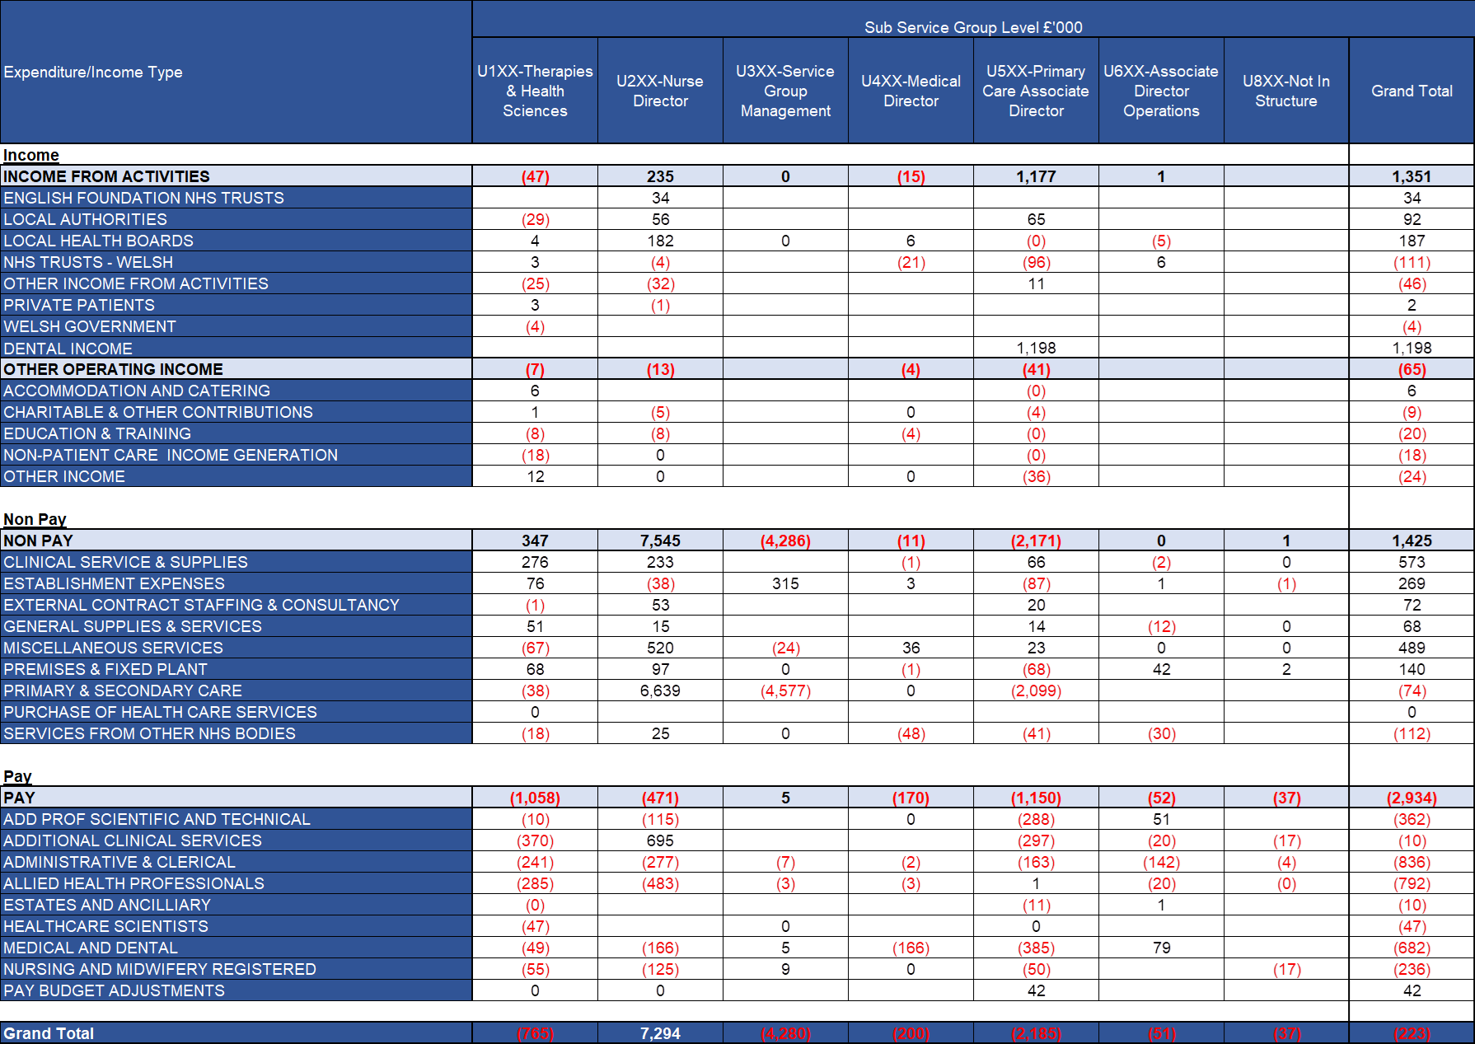
Year To Date Service Group Position By Division & Type Expenditure/Income
Key Drivers:
Income
Main pressure is dental income. The other significant pressure is the result of the loss of CTM Lymphoedema SLA income.
Non Pay
CHC and LAC cost pressures are partially offset by the impact of the non recurrent benefit release and non investment of 23/24 dental under-achievement. The large Miscellaneous over spend is the unmet 23-24 CIP within Nurse Director.
Pay
Underspends in pay are the result of vacancies across all staff groups, offsetting areas of pressure within Nursing such as District Nursing, Gorseinon, Ty Olwen.

Slide 10

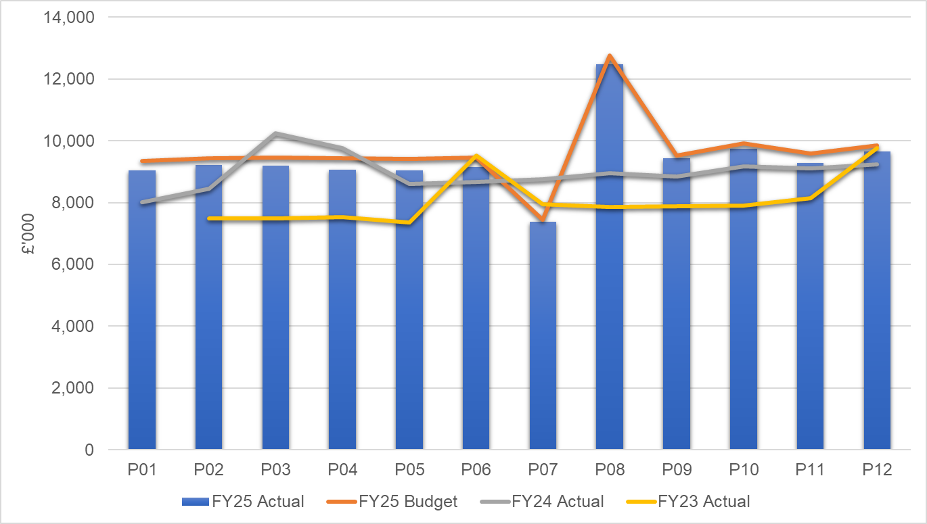
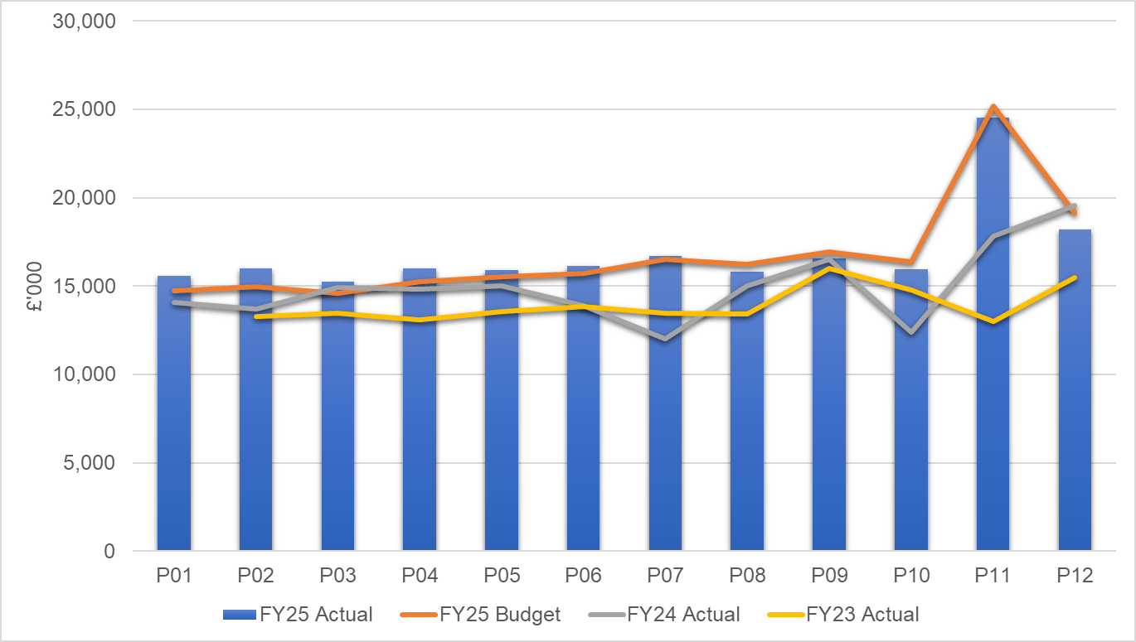
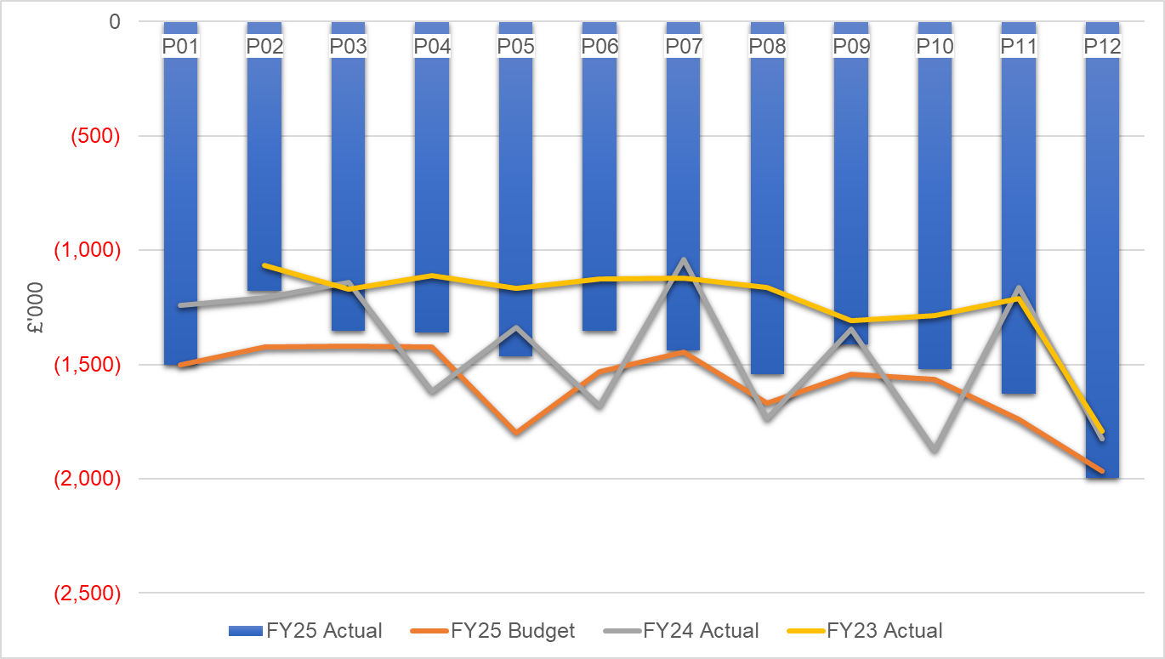
financial performance: Overall trends
Pay by Month £000s
Non Pay by Month £000s
Income by Month £000s
Key Messages:
PAY:
Trends were affected by the transfer of Acute Clinical Team in month 7 and the pay award in month 8.
NON PAY:
Primary Care contracts account for 67% of non pay spend. The spike in month 11 is due to the contract uplifts backdated to 1st April 2024.
INCOME: Dental Contract Patient Charge Revenue as a result of contract reform accounts for the Income shortfall vs budget, though it has increased vs. 23/24 due to the national fee increases. The M12 increase in income is in relation to 111 recharges.
Notes:
PAY M3 23-24 spike relates to 23-24 Recovery Pay award payment. Last year’s increasing trend is investment related (Virtual Wards, Therapies, Smoking Cessation etc).

Slide 11
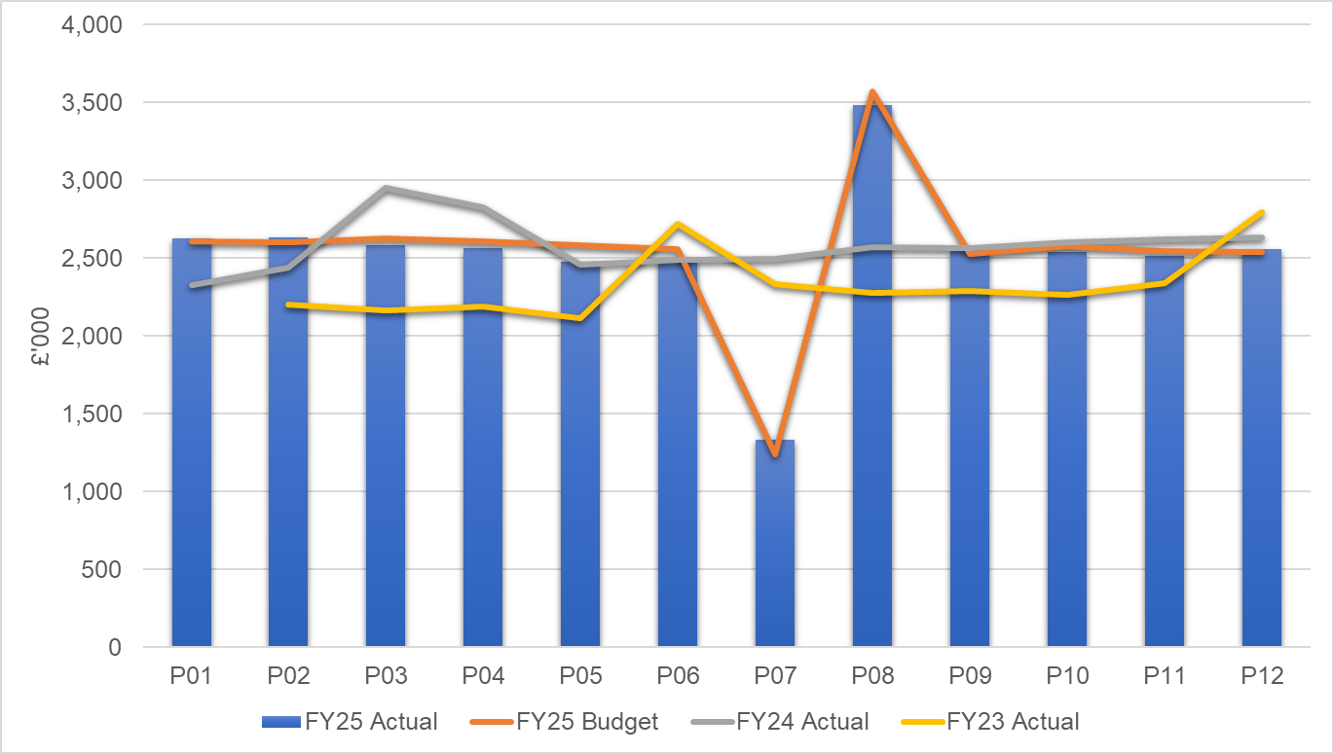
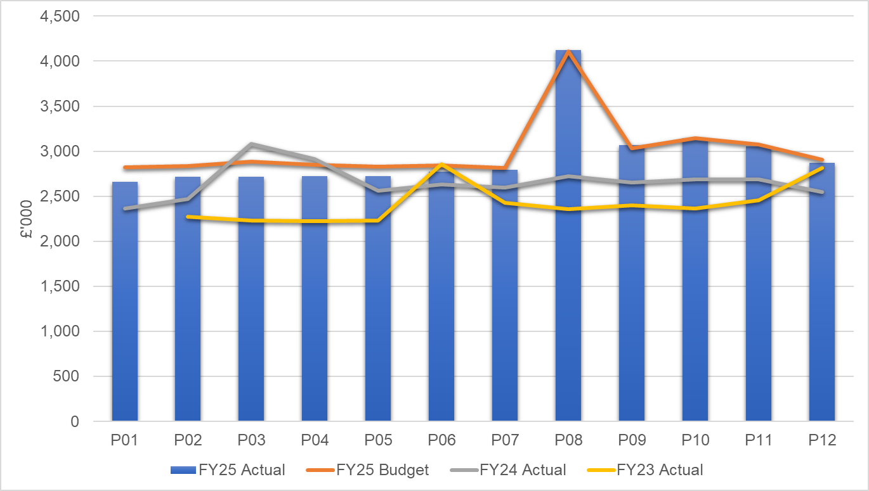
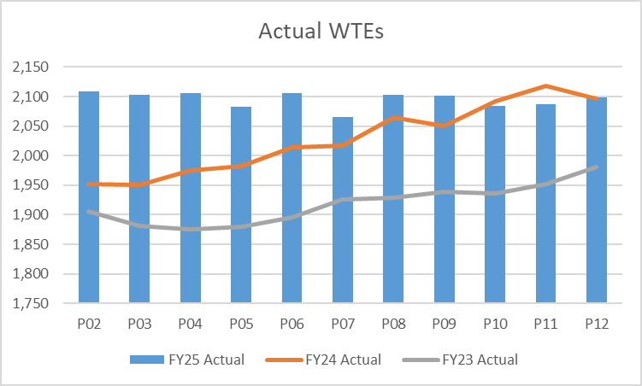
Pay Summary
Registered Nursing by Month
Allied Health Professionals by Month
WTEs by Month
Key Messages:
Month 8 includes the year to date pay award.
Registered Nursing in month 7 was impacted by the transfer of the Acute Clinical Teams to Morriston Service Group
Allied Health Professionals’ pay spend have been consistently below budgeted levels but are now in line with budget with the recruitment of Band 5 student streamliners.
WTEs are showing an increase on last year in line with investments, transfers into the service group from NPTS and recruitment to vacancies.

Slide 12
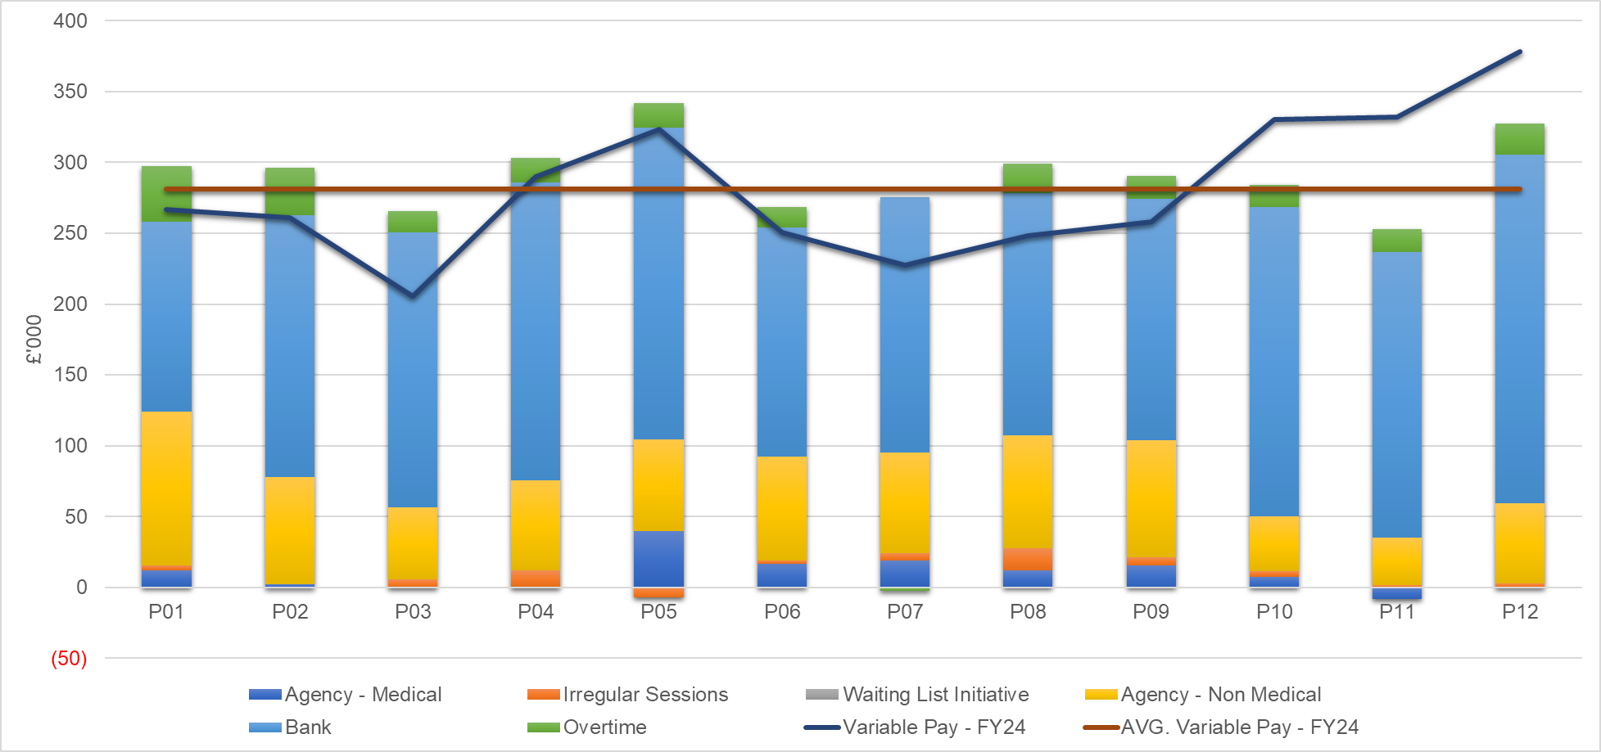
Pay : Variable pay
Variable Pay Trends £000s
Key messages:
Variable pay is largely linked to surge beds in Gorseinon, higher activity in District Nursing and high sickness / vacancies in Ty Olwen. These three areas account for two thirds of the in month and year to date variable pay. This also explains the increase versus 23-24.
The variable pay controls have had an impact on agency usage, though bank has offset.
M12 included an increase in agency linked to short-term WG funding as well as District Nursing, Gorseinon and Ty Olwen.

Slide 13
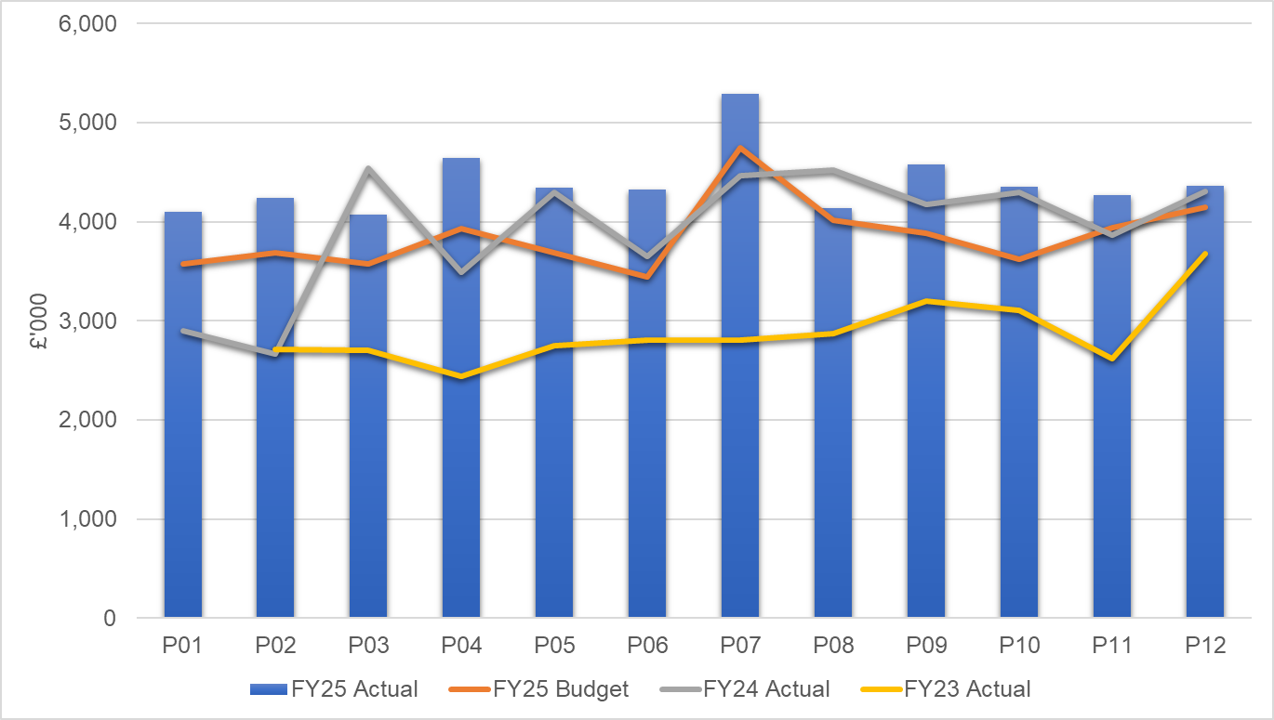
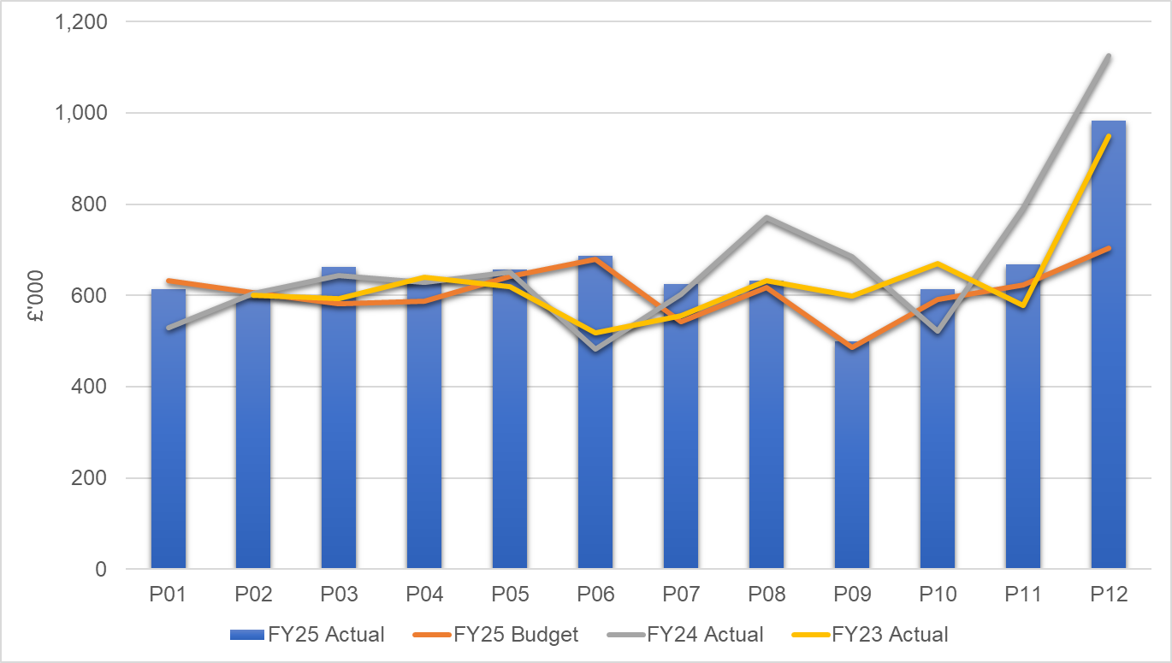
Non Pay: key drivers
Continuing Health Care / Funded Nursing Care by Month
Clinical Supplies incl. Drugs by Month
Key Messages:
Continuing Health Care and Funded Nursing Care continue to be the largest cost pressure due to a growth in volumes of patients and higher acuity, resulting in an increased average weekly cost per package.
Clinical Supplies spend is tracking above budget due to higher audiology hearing aid costs, orthotics pressures, sexual health costs linked to higher external tests linked to HIV care and Gender service. District Nursing costs have also significantly increased year on year due to the higher number of end of life patients being looked after by the team. Community Continence’s cost pressure is caused by contract increases including a delivery charge per patient. The month M12 increase is in relation to stock and year end adjustments.

Slide 14

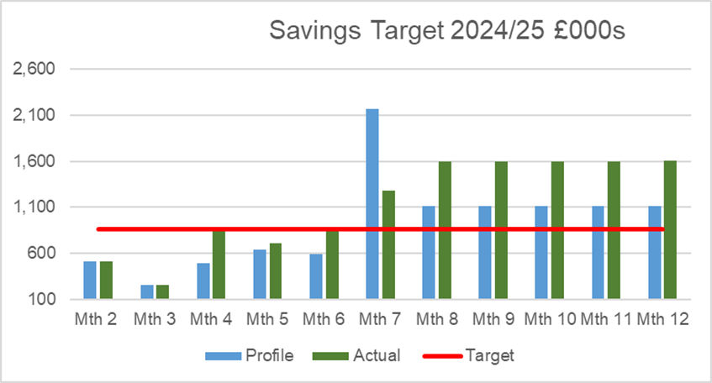
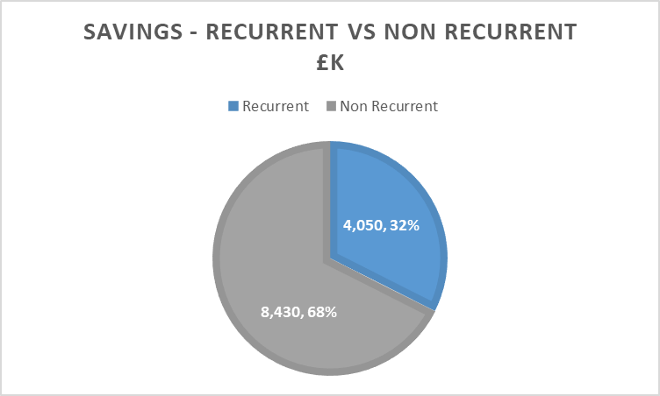
Savings Summary (Proportion HB Target £26.1m)
Identification of Opportunities & Profile
The Service Group had a target of £3.171m, £9.5m including run rate reduction requirements. PCT Group has identified £12.5m of savings and run rate reductions, though this is largely non recurrent, resulting in a forecast underlying deficit of £9.8m going into 2025-26.

Slide 15

Identification Opportunities & Risk (Including Hot Spots)
Going into 2025-26 the service group are managing a number of risks with some offsetting opportunities.
RISKS
Conflicting priorities re: releasing 24/25 underspends, investing in areas of high demand re: ULD and achieving CIPs eg District Nursing / Dental
Gorseinon surge beds – unfunded above 30
GMS – new Directed Supplemented Services and practice premises risk
GMS –Implications of D2RA to 25/26 cost profile e.g. Community Equipment Store, resourcing Integrated Discharge Hub
Growth in CHC (only inflation funded in the annual plan)
Prison staffing
Financial implications of achieving Ministerial Delivery Expectations eg vaccination rates, community pharmacy, weekend community nursing
Implications of Section 33 / RIF Review – WGRPB Community Services Review
Trem y Glyn added demand on overstretched services DN/AHPs possibly GP – possible Regional Partnership Board funding for 2025-26 only
Additional support to maintain therapies at 14 weeks
OPPORTUNITIES
Balance Sheet / Non Recurrent opportunities
Looked After Children
GP OOH IR35 national agreement

Slide 16
Action & Next Steps To Be Taken By Service Group
Actions and Next Steps:
Service Group to resolve number of Gorseinon beds with Executive colleagues.
Pursue CIP opportunities
Review 2024/25 areas of cost pressure and make funding / staffing decisions vs releasing budget from services with 2024-25 underspends.
Resolve Looked After Children disputes with local authorities
Assess implications of Community Services Review / D2RA
Review dental plan re: need to increase capacity vs achieve savings

