Slide 1


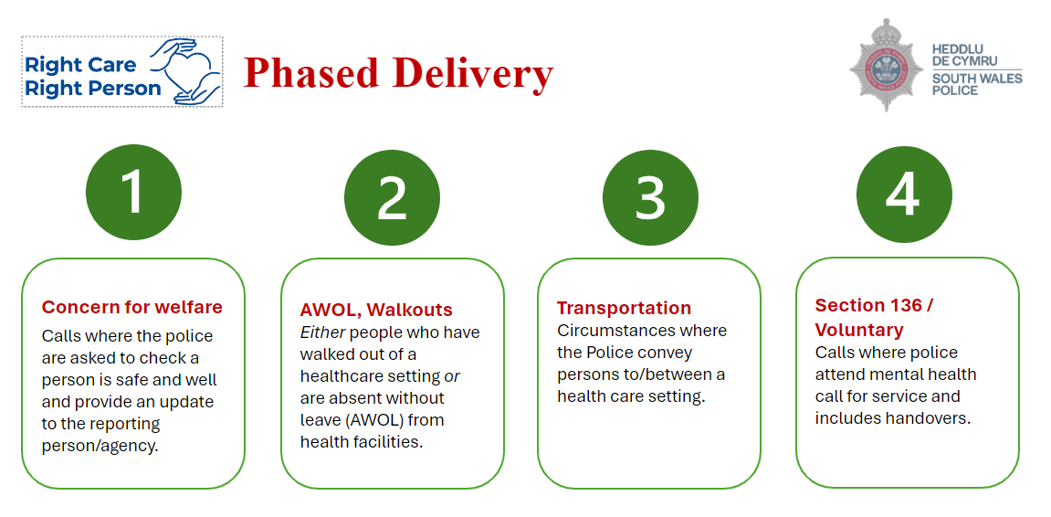
August 2024
When RCRP is implemented Police will still attend calls where:
  There is a threat to life
  There is a threat of serious harm
  Police powers are required
  A crime has occurred / suspected
  The person is a missing person (responding to a missing person report is excluded from RCRP)
Swansea Bay UHB Position
The Health Board have set-up a task & finish group to assess the impact of this new Policy, to identify the most vulnerable groups and take action on the implications for our services, staff training, polices and procedures. It is important to recognise that this is an updated position by the Police and not a complete withdrawal, and staff should still call the Police when they assess that they are needed.
Some additional considerations will be made when dealing with children and young people​. The Children Act 1989 introduced Significant Harm as the threshold that justifies compulsory intervention in family life in the best interests of children. Physical Abuse, Sexual Abuse, Emotional Abuse and Neglect are all categories of Significant Harm.​ The role of police in safeguarding is not affected.
What do I need to do now?
There is no need to change your current response to incidents. Continue to call the police when indicated as per your service area’s usual practice
Await further updates and guidance. These will be will be provided before implementation of Phase 2, 3 and 4
There will be further communication about this over the coming weeks, but if you have any concerns please contact your line manager. Management can contact SBU.Partnerships@wales.nhs.uk for further information.
What is the Right Care Right Person?
The Right Care Right Person (RCRP) is a Police policy that will be making changes to the response to calls relating to the health, wellbeing and mental health of service users. Some of the key drivers for this policy are as follows:
  Police forces frequently deal with a wide variety of incidents and calls for assistance. Some of these are policing matters, others are in relation to mental health, concern for welfare and social care issues.
  The police are not always the most appropriate service to respond in these situations
  The police role often overlaps various parts of the NHS and other agencies. The police are often seen by the public as a ‘do all’ service.
  Consequently, substantial demand is placed on police resources to deal with calls for service that may be better suited to other agencies, and diverting officers away from core policing functions
The implementation of the RCRP will be phased as outlined below:
Phase 1 – implemented in February 2024
Implementation dates for the remaining phases to be confirmed

Slide 2
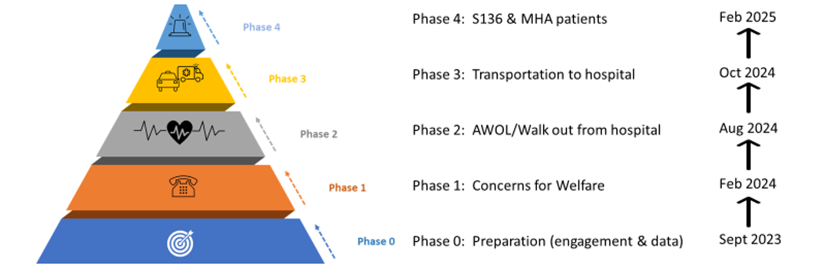
Implementation Phases

