Slide 1
Summary Financial Position
Month 5 FY 2024/25
6th September 2024
Notes:
This slide can be used for presentations which are from a health board-wide perspective or for a whole HB audience as the graphic device to the right of the slide includes all four service group colours and red for the corporate team.

Slide 2

Financial Performance Month 5
 | In Mth |  | YTD
 | £'m | RAG | £'m | RAG
Performance Against RRL | 6.9 |  | 39.8
Performance Against £50.1m Plan | 2.7 |  | 18.9
Health Board Plan submitted at end March 2024 reported a £50.1m planned deficit but control total set by Welsh Government is £17.1m
In Month 5 there is an in-month overspend of £6.9m.
YTD at Month 5 is an overspend of £39.8m
Overall, the Health Board YTD position is £18.9m off the delivery of the £50.1m deficit plan
In the graph above the orange bars illustrate the potential financial change required to be able to deliver the £50.1m
The yellow line depicted the level required if the HB were to achieve the £17.1m control total.
Notes:
This is a generic copy slide.

Slide 3
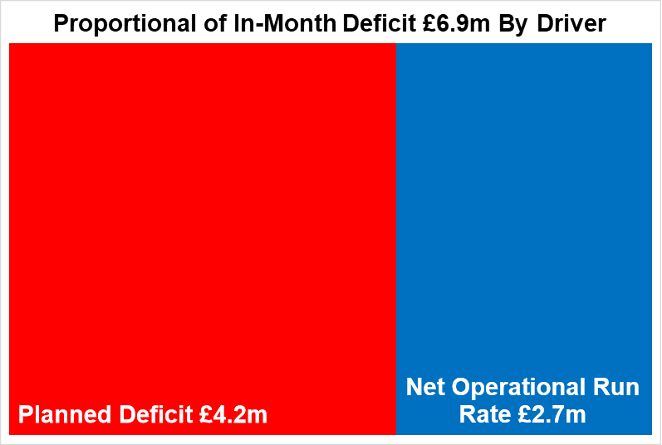

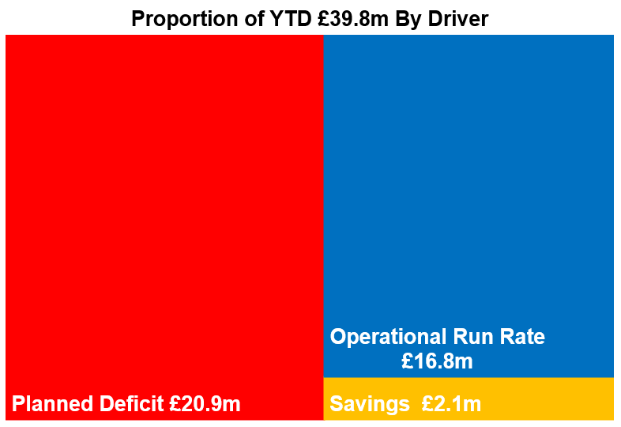
Key Elements of the Mth 5 & YTD Position
Key Message:
Planned Deficit remains at £4.2m or 1/12th of £50.1m deficit plan in month and £20.9m YTD.
Savings were overachieved in month by £1.5m and so reduced the operational run rate value. But overall there remains a shortfall in delivery of the £26.1m targets YTD of £2.1m.
Net Operational Run Rate after over achievement of savings: in month Mth 5 the main drives for the £2.7m were variable pay, deterioration in JCC performance and increase in secondary care drugs expenditure and other areas of clinical consumables. Overall, the YTD is £16.8m over.
Notes:
This is a generic copy slide.

Slide 4
Summary Month 5 & Movement In Month
Notes:
This is a generic copy slide.

Slide 5
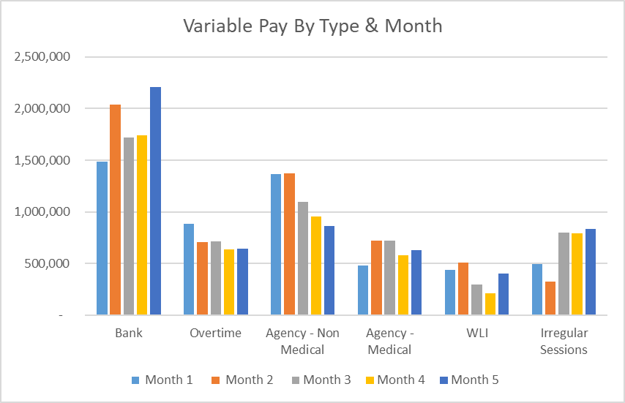
Summary Variable Pay
Notes:
This is a generic copy slide.

