Slide 1
Financial Position Month 07 2025/26
Audit Committee
20th November 2025
Notes:
This slide can be used for presentations which are from a health board-wide perspective or for a whole HB audience as the graphic device to the right of the slide includes all four service group colours and red for the corporate team.

Slide 2
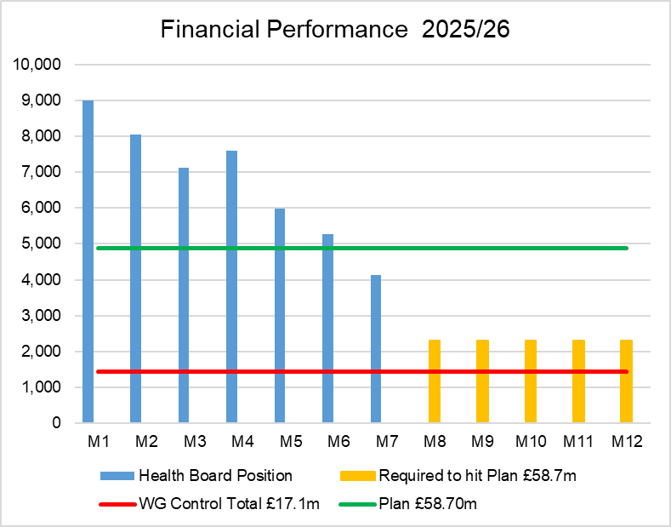
Financial Performance Month 07
The Plan submitted at the end of March, which has not been approved reported a £58.7m deficit with a requirement to deliver £55.4m of savings. The Control Total for the Health Board set by Welsh Government remains £17.1m.
The table below provides the Variance and the Performance against the £58.7m Deficit Plan for 2025/26:
In Month 07 there is an in-month overspend of £4.1m. This is £0.8m below the planned deficit of £4.9m (1/12th of the £58.7m).
At Month 07 the YTD overspend is £47.1m. This is £12.9m above the planned deficit of £34.2m (6/12th of the £58.7m).
 | In Mth |  | YTD
 | £'m | RAG | £'m | RAG
Variance Overspend / (Underspend) | 4.1 |  | 47.2
Variance Against £58.7m Plan Overspend / (Underspend) | -0.8 |  | 12.9
Notes:
This is a generic copy slide.

Slide 3
In Month Reconciliation of Variance by Area & Expenditure Type
Notes:
This is a generic copy slide.

Slide 4
Month 07 Variance by Area
Notes:
This is a generic copy slide.

Slide 5
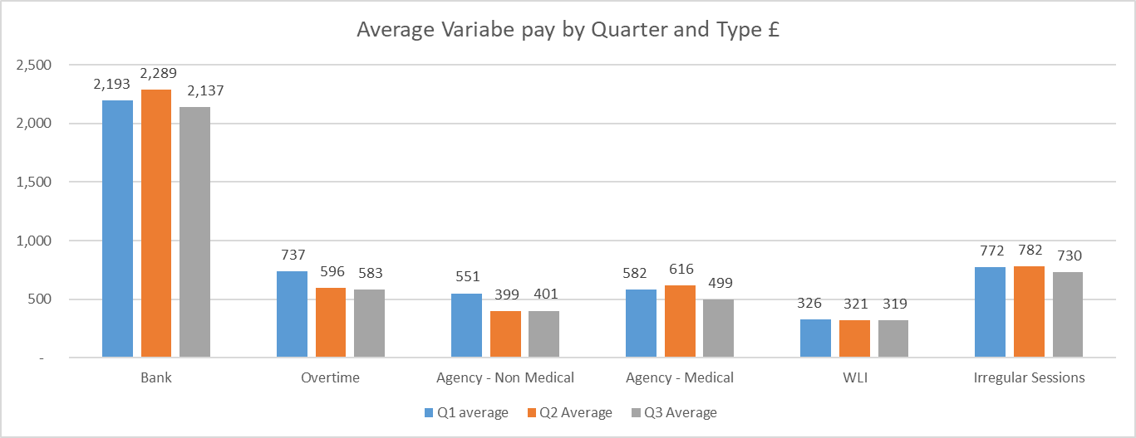
Summary Variable Pay
Period | Type | FY2526 Total £m | FY2425 Total £m
Mth 1 | Actual Variable Pay | 5.1 | 5.1
 | Actual Total Pay | 70.4 | 64.0
 | Variable Pay % Total Pay | 7.2% | 8.0%
Mth 2 | Actual Variable Pay | 5.3 | 5.7
 | Actual Total Pay | 71.3 | 64.8
 | Variable Pay % Total Pay | 7.4% | 8.8%
Mth 3 | Actual Variable Pay | 5.1 | 5.3
 | Actual Total Pay | 70.7 | 65.0
 | Variable Pay % Total Pay | 7.2% | 8.2%
Mth 4 | Actual Variable Pay | 5.4 | 4.9
 | Actual Total Pay | 70.3 | 63.8
 | Variable Pay % Total Pay | 7.7% | 7.7%
Mth 5 | Actual Variable Pay | 4.9 | 5.6
 | Actual Total Pay | 81.7 | 63.9
 | Variable Pay % Total Pay | 6.0% | 8.7%
Mth 6 | Actual Variable Pay | 4.7 | 4.9
 | Actual Total Pay | 73.0 | 72.1
 | Variable Pay % Total Pay | 6.4% | 6.8%
Mth 7 | Actual Variable Pay | 4.7 | 5.8
 | Actual Total Pay | 72.6 | 63.4
 | Variable Pay % Total Pay | 6.5% | 9.1%
Mth 8 | Actual Variable Pay |  | 5.9
 | Actual Total Pay |  | 90.5
 | Variable Pay % Total Pay |  | 6.5%
Mth 9 | Actual Variable Pay |  | 5.1
 | Actual Total Pay |  | 68.7
 | Variable Pay % Total Pay |  | 7.4%
Mth 10 | Actual Variable Pay |  | 5.3
 | Actual Total Pay |  | 72.1
 | Variable Pay % Total Pay |  | 7.4%
Mth 11 | Actual Variable Pay |  | 5.3
 | Actual Total Pay |  | 69.1
 | Variable Pay % Total Pay |  | 7.7%
Mth 12 | Actual Variable Pay |  | 6.5
 | Actual Total Pay |  | 72.5
 | Variable Pay % Total Pay |  | 9.0%
The actual variable pay spend at Month 7 was £4.7m. A detailed breakdown of variable pay by month, type and job family can be found in Appendix 1.
Notes:
This is a generic copy slide.

Slide 6
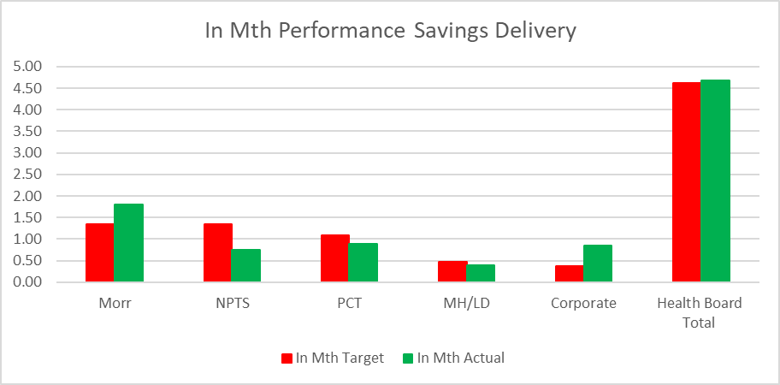
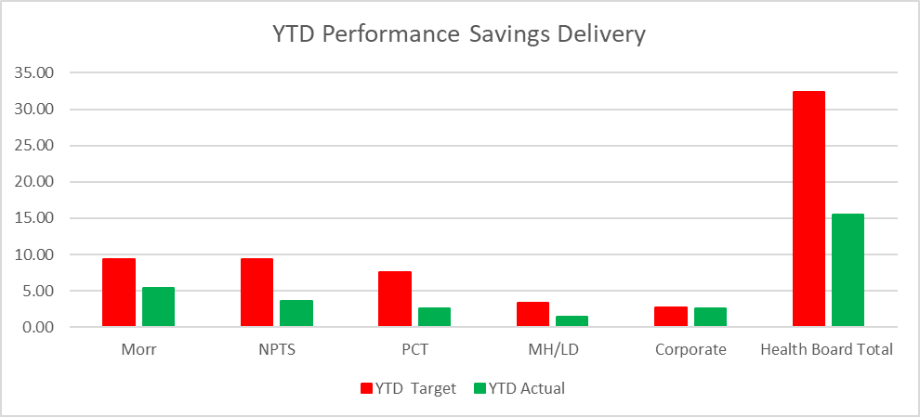
Summary of Savings £55.4m Savings Delivery @ Month 07
To two graphs above demonstrate the performance by Service Group, Corporate Directorates and the combined overall Health Board Total for the Savings Position for Month 7 and the Year-To Date, with red bars reflecting the target required and the green bars the actual delivery.
In summary the £58.7m plan required the Health Board to deliver £55.4m of savings. In month 7 there was an overachievement of savings totalling £0.07m. YTD there remains a shortfall of £16.78m. This is the key issue in the delivery of the 2025/26 financial position.
Notes:
This is a generic copy slide.

Slide 7
Performance Against 11th September £55.4m Savings Plan @ Mth 7
Notes:
This is a generic copy slide.

Slide 8
Forward Look
Notes:
This slide can be used for presentations which are from a health board-wide perspective or for a whole HB audience as the graphic device to the right of the slide includes all four service group colours and red for the corporate team.

Slide 9

Financial Plan 2026/27 (10:15-10:40)
Illustration 2025-28 Plan Assuming Nil Allocation Growth
Comments:
Appendix 1 – provides the breakdown of Section B1-B3
The table on the left excludes pressures arising in year, which have a recurrent impact into 2026/27.
It also assumes that the HB has delivered the £55.4m recurrently.
If the national pressures were to be reflected the Deficit would increase further as per the table below:
Notes:
This is a generic copy slide.

Slide 10
Executive Summary: Key findings – Deficit Drivers
Deficit drivers have been quantified based on a combination of Health Board provided information and independent analysis where appropriate. The values have been identified across a range of KLOEs and subsequently included as deficit drivers where relevant.
This has identified deficit drivers in the region of £94m - £108m as set out in the table below. 78-80% of the deficit drivers have been categorised as either operational or strategic and therefore within the Health Board’s to control to lead opportunities to address.
Table 1: Quantification of Deficit Drivers
Theme | Key Line of Enquiry | Value Identified | Deficit Driver Value Included | Driver Segmentation
 |  |  |  | Operational | Strategic | Structural
Expenditure Growth | Review of expenditure growth 19/20 to 25/26 (FOT) | Not quantified | N/A | N/A | N/A | N/A
Workforce Growth | Total HB workforce growth 19/20 to 25/26 | £104.0m | - | Excluded to mitigate overlaps with other themes
UEC | UEC Workforce growth UEC Investments & Choices | £21.8m | £21.8m | £15.7m | £6.1m | -
CHC | CHC expenditure growth compared to Wales Health Boards average | £20m - £34m | £20m - £34m | £20m | £14m | -
Acute Income & Cost | Long Term Agreements and JCC cost of activity vs income received. | £17.6m | £17.6m | £5.9m | £5.9m | £5.9m
 | SBUHB Income & Cost | £20.4m | - | Excluded to mitigate overlaps with other themes
Planned Care Productivity | Planned Care Productivity | £16.0m | £16.0m | £16.0m | - | -
Sites, Beds and Rurality | Number of sites compared to England average | Not quantified | N/A | N/A | N/A | N/A
 | Number of beds per 1,000 population | £15.6m | £15.6m | - | - | £15.6m
Medicines Management | Comparison of NICE costs and corresponding Welsh Government funding | £3.2m | £3.2m | - | £3.2m | -
Total |  | £218.6m – £232.6m | £94.2m - £108.2m | £57.6m | £29.2m | £21.5m

Slide 11
2026/27 & 2027/28 Pipeline Development
The Phase One programme of work has identified, some of the key components which should form part of the savings plan for future years. In areas prioritised for identification support (CHC, UEC, Planned Care and Mental Health. A 2026/27 Planning workshop on 12th November will further inform priority opportunities
Theme | Q3&4 2025/26 | Q1&2 2026/27 | Q3&4 2026/27 | Q1&2 2027/28 | Q3&4 2027/28
Workforce (overarching)
Workforce – Nursing
Workforce – Medical
Planned Care
CHC & MH
UEC
Procurement & Corporate Services
Sickness / Absence Improvement Programme
Embed Variable Pay Controls
Spans of Control / Organising for successes restructuring of workforce design and delivery
Nursing Workforce Optimisation Programme – rightsized, redesign, and process optimisation
HCSW Sustainability Model development and implementation
Job Planning Optimisation Programme
Likely priority Services for redesign as part of a multi-year efficiency programme:
Pathology
Anaesthetics
Radiology
Cardiothoracic
DCC Delivery Tracking Implementation
Service Redesign Programme
Elective Care Productivity Programme
Mental Health Model of Care redesign
CHC Package Rightsizing and reviews
CHC Operating Model, Market Management, and Joint Funding Arrangements
UEC Flow Improvement Programme
UEC Out of Hospital provision / Virtual Wards optimisation
Clinical consumables efficiencies
Strategic Procurement Programme & contract consolidation and efficiencies
Rationalise, prioritise and optimise digital tools (enabler to spans of control)
Corporate Services Rationalisation
Further detail /analysis included in Phase One Deliverables

Slide 12
Appendices
Notes:
This slide can be used for presentations which are from a health board-wide perspective or for a whole HB audience as the graphic device to the right of the slide includes all four service group colours and red for the corporate team.

Slide 13
Appendix 1 - Variable Pay Breakdown
Notes:
This is a generic copy slide.

