Slide 1
Summary Financial Position – month 7 2024/25
Audit Committee - 21st November 2024
Notes:
This slide can be used for presentations which are from a health board-wide perspective or for a whole HB audience as the graphic device to the right of the slide includes all four service group colours and red for the corporate team.

Slide 2
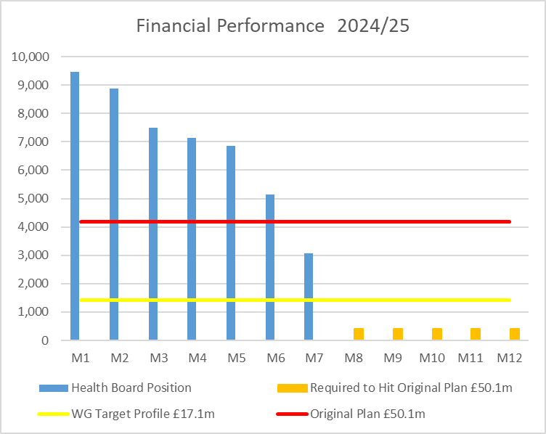

Financial Performance Month 7
 | In Mth |  | YTD
 | £'m | RAG | £'m | RAG
Performance Against RRL | 3.1 |  | 48.0
Performance Against £50.1m Plan | -1.1 |  | 18.8
During September, the Health Board submitted a revised Recovery & Sustainability Assessment for 2024/25. Formal feedback has been received and the Health Board is required to deliver as a minimum a £50.1m deficit in 2024/25, noting that the control total set by Welsh Government remains £17.1m.
In Month 7 there is an in-month overspend of £3.1m.
YTD at Month 7 is an overspend of £48.0m
Overall, the Health Board YTD position is £18.8m off the delivery of the original March submitted £50.1m deficit plan.
In the graph above the orange bars illustrate the potential financial change required to be able to deliver the original £50.1m deficit.
The yellow line depicts the level required if the HB were to achieve the £17.1m control total.
Notes:
This is a generic copy slide.

Slide 3

Summary Month 7 & Movement In Month
Notes:
This is a generic copy slide.

Slide 4
Summary of the Mth 7 & YTD Position
Notes:
This is a generic copy slide.

Slide 5
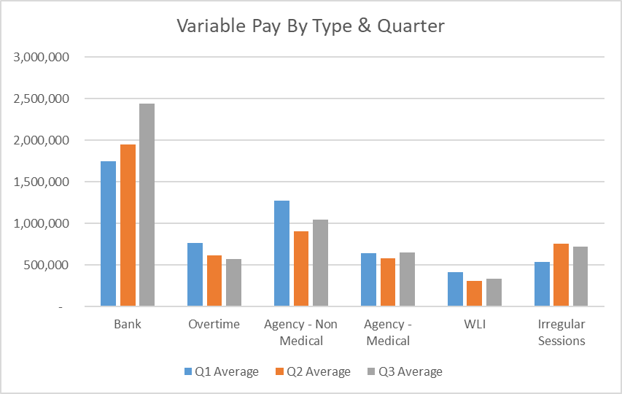
Summary Variable Pay
Variable Pay Target - the HB set a target for variable pay to be reduced by 25% versus the average spend in Q1 by the end of Q2, with a further 25% reduction at the end of Q3. The reduction at the end of Q2 would require variable pay spend to reduce to £4.0m a month from Month 6. The actual variable pay spend at Month 7 was £5.8m, £1.8m short of the target set.
Notes:
This is a generic copy slide.

Slide 6
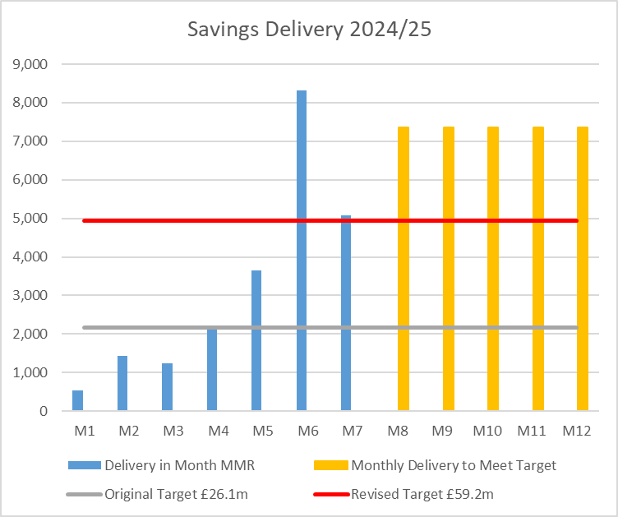
Summary of Savings Position @ Mth 7
Notes:
This is a generic copy slide.

Slide 7
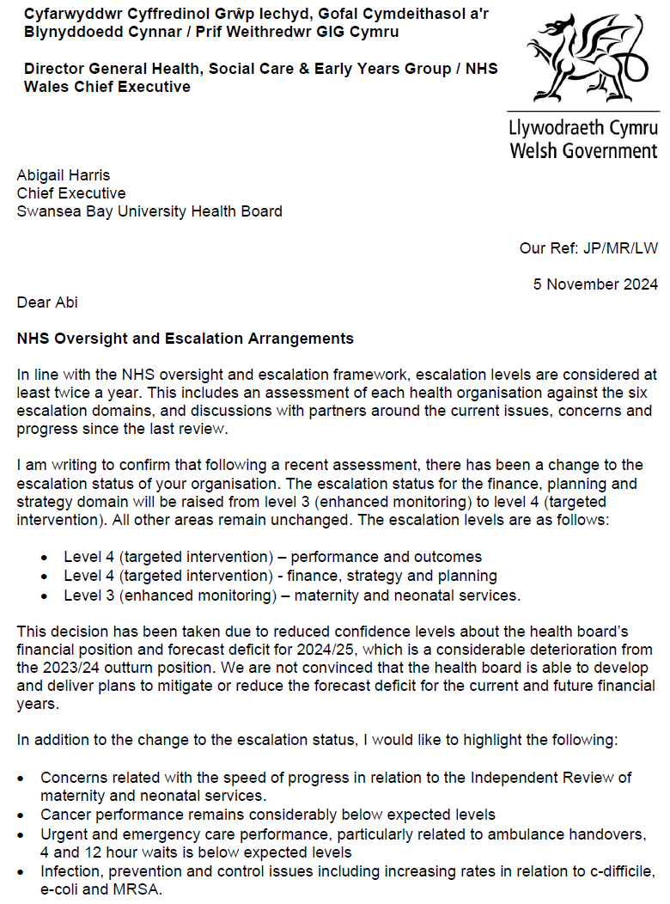
Targeted Intervention
Health Board escalated to Targeted Intervention for Finance, Planning and Strategy
Not clear what this means in detail but likely more monitoring and expectations of increased scale and pace
Comes with a suggestion of support which we need to consider
Links to the confidence in delivery of the £64.1m point and even more so the actions to move to £50.1m
Notes:
This is a generic copy slide.

