Slide 1


Swansea Bay University Health Board
Audit Committee - 9th November 2023
Month 6 financial position and year end forecast - 2023/24

Slide 2
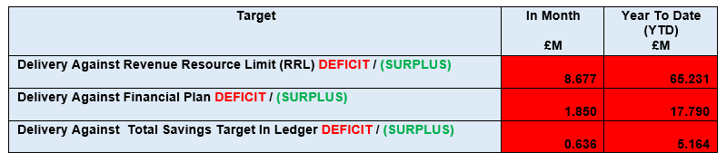
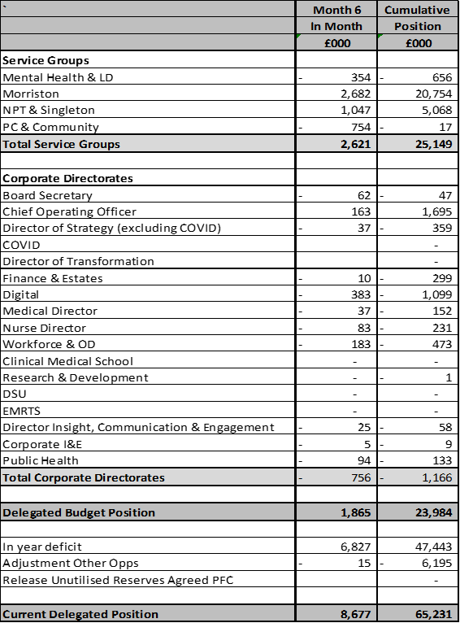
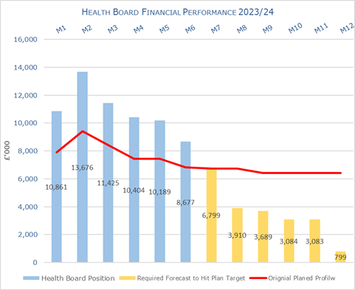
Health Board Reported Position @ Mth 6 2023/24 Against £86.8m Plan

Slide 3
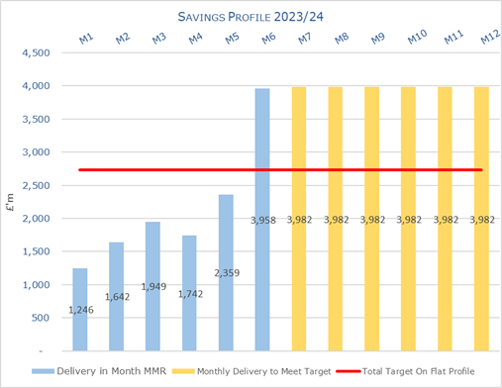
Health Board Savings @ Mth 6 2023/24

Slide 4
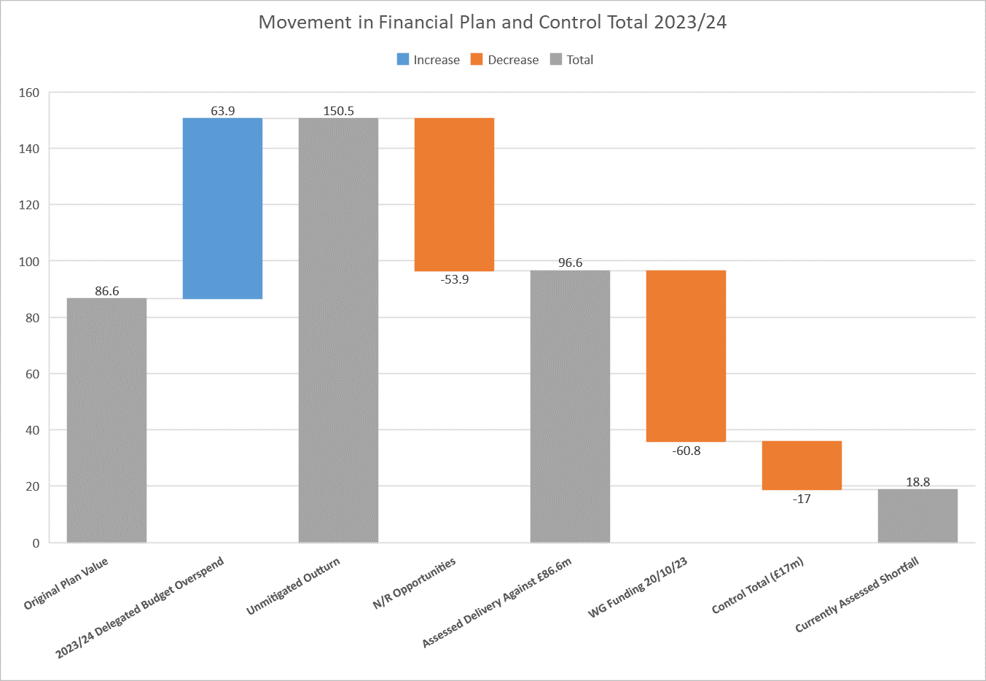
Update Post Mth 6 & WG Announcement on £425m NHS Wales
HB original plan had a deficit of £86.6m (column 1)
The assessment undertaken post Mth 6 shows a £63.9m overspent against all delegated budgets to 31st March 2024 (column 2)
If no action taken to mitigate the positon then the year end deficit = £150.5m (Column 3)
For 2023/24 ONLY £53.9m of mitigations have been identified (column 4)
After mitigating actions this takes the plan to £96.6m or £10.0m above original deficit (column 5)
As part of the £425m investment from WG announced on 17th October and shared HB on 20th October, SB will receive £60.8m to support the plan (column 6)
In addition WG have agreed for SB to overspend by £17m (column 7)
£18.8m (column 8) is the assessed shortfall in hitting the £17.0m control total. This is made up of 2 elements:
  £10.0m = £63.9m (column 2) less £53.9m (column 4)
  £8.8m = £86.6m (column 1) less £60.8m (column 6) less £17m (column 7). The £8.8m reflects the requirement from WG for all HBs to deliver a 10% reduction on their opening plan.
?

