Slide 1


Audit Committee
16th May 2024
Draft Financial Performance 2023/24

Slide 2

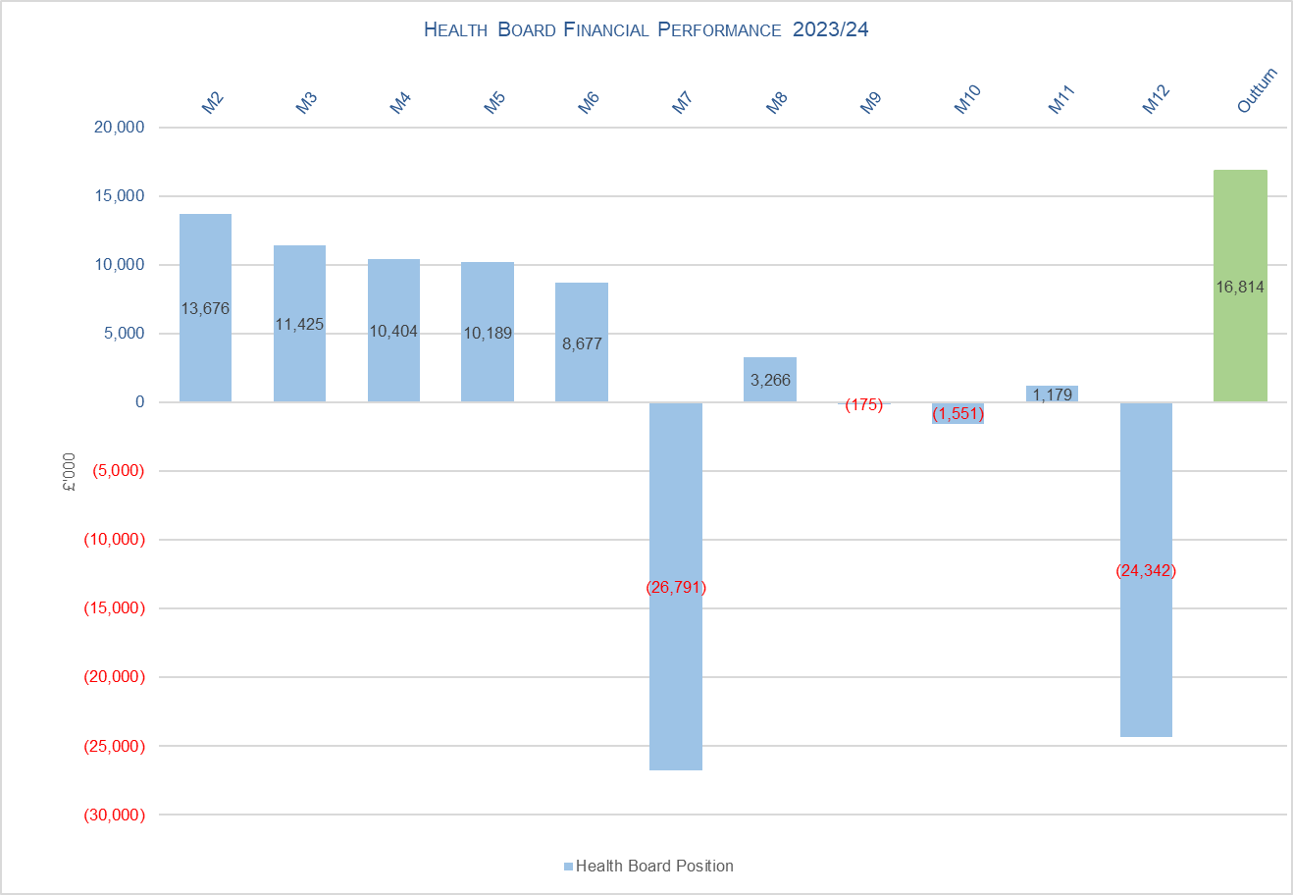

Summary Draft Overview 2023/ 2024
Target | Delivery
Public Sector Payment Policy (PSPP) – Target 95% | Achieved = 96.1%
Capital Resource Limit (CRL) Performance | Achieved = £0.06m under CRL
Revenue Resource Limit (RRL) Performance | Achieved Control Total of £17.1m Deficit = £16.8m Deficit

Slide 3
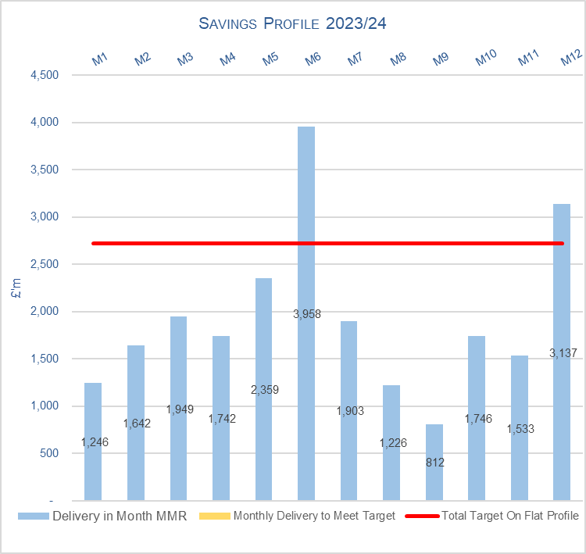
Savings Position 2023/ 2024
Note: MMR regulations requires the HB to include Medical Study Leave and Annual Leave Release as savings in the submission but for purposes of tables/graphs here both these items have been excluded as they are not a savings scheme but a release from balance sheet to support the 2023/24 landing plan

Slide 4
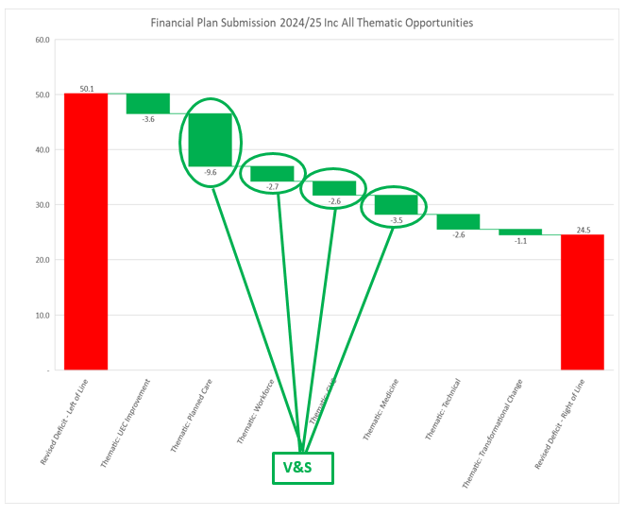

2024/2025 Thematic Programmes: Phase 1
Thematic work was already underway when March 2024 submission was made
Themes have been extended to include a critical review of all variable pay; this will be allocated largely to the UEC and workforce themes
Once assessed and delivery confidence assured, the deficit will be formally reduced as part of the internal governance process
Ambition is to significantly reduce forecast deficit and reduce risk within the plan
Governance process: -
  Management Board 15th May
  Special extended Performance and fincne committee – 21st May
  Board 23rd May
  Formal submission 31st May

