Slide 1
Audit Committee Briefing
Summary Financial Position
Month 11 FY 2024/25
20th March 2025
Notes:
This slide can be used for presentations which are from a health board-wide perspective or for a whole HB audience as the graphic device to the right of the slide includes all four service group colours and red for the corporate team.

Slide 2
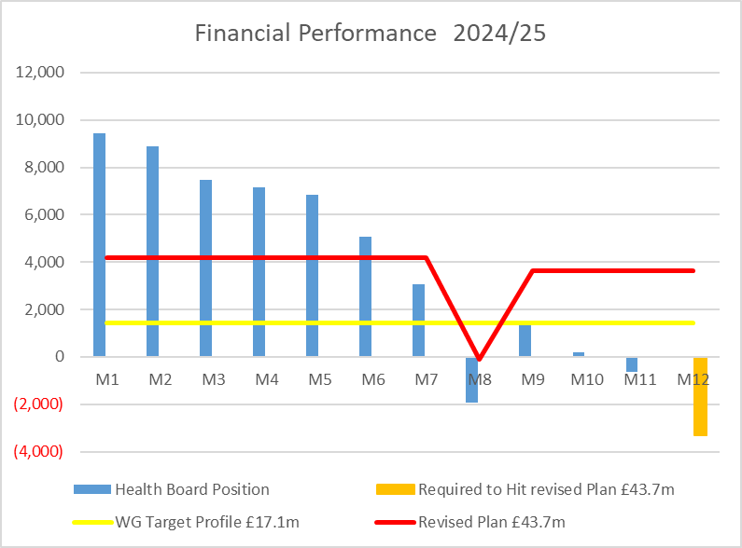

Financial Performance Month 11
On the 2nd December the Health Board were notified that WG will issue £6.4m of funding to reduce our planned deficit to £43.7m, noting that the control total for 2025/26 set by Welsh Government remains £17.1m.
In Month 11 there is an in-month underspend of £0.7m.
YTD at Month 11 is an overspend of £47.0m. This is in excess of the £43.7m 2024/25 revised plan.
To hit the £43.7m revised Plan the HB needs to underspend in March by a total of £3.3m
The yellow line depicts the level required if the HB were to achieve the £17.1m 2025/26 control total.
Notes:
This is a generic copy slide.

Slide 3

Summary Month 11 & Movement In Month
Notes:
This is a generic copy slide.

Slide 4
Summary of the Mth 11 & YTD Position
Notes:
This is a generic copy slide.

Slide 5
Summary Variable Pay
Variable Pay Target - the HB set a target for variable pay to be reduced by 25% versus the average spend in Q1 by the end of Q2, with a further 25% reduction at the end of Q3. To meet this target would require variable pay spend to reduce to £4.0m at Q2 and to be down to £3m by month 9. The actual variable pay spend at Month 11 was £5.3m, £2.3m short of the target set. A detailed breakdown of variable pay by month, type and job family can be found in Appendix 1.
To note; the position does not include the WLI arrears originally planned to be paid in M10. The indicative total is £0.27m.
Notes:
This is a generic copy slide.

Slide 6
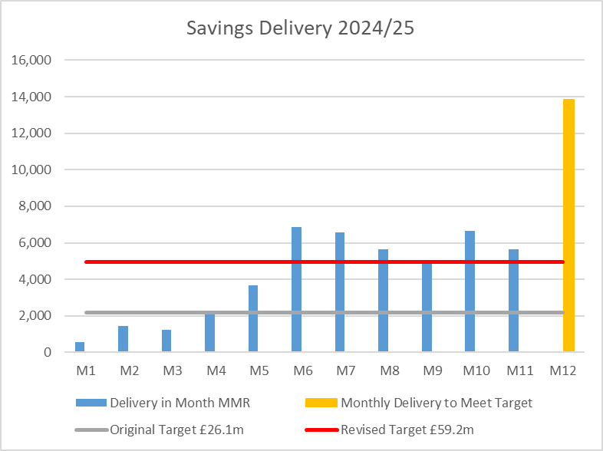
Summary of Savings Position @ Mth 11
Notes:
This is a generic copy slide.

Slide 7
Indicative Assessment to Month 12 & £43.7m Target
Part 1: Service Group Forecast | Part 2: N/R Opportunities
Part 1 and Part 2 = £43.6m
Notes:
This is a generic copy slide.

Slide 8
Risks 2024/25
2024/25 Pay Award settlement – whilst majority has been received there remains £1.371m of funding for Medical & Dental Pay Award made in January which WG has not confirmed funding for. Details have been submitted to the NHS Executive and will be reported in the Month 11 MMR. The £1.371m is assumed within the position reported on slide 7.
Service Group Positions – the tables in Part 1 of the previous slide assumes a level of spend that presents a risk, and below ae some examples:
    MH/LD = expectation that this area underspends in Mth 12 to achieve the £2.4m target
    NPTS = with the original £25m there was £1.4m of opportunities against PC Prescribing. Based on the December PAR, this has been transferred to the £8.9m forecast for NPTS. However further assessment will align to the January PAR data published later in March.
    Corporate Directorate = COO/Estates to remain at current level of spend and remaining areas continue with underspend.
N/R opportunities – the table in Part 2 provides an assessment following Working Day 5 Month 11 closedown process. However, none of the £3.2m in Month 12 are currently 100% confirmed and these are the numbers that will flex as we close the financial position.
Summary – whilst slide 7 shows a route to achieve the Deficit Target there are numerous Risks that need to be noted that could adversely impact the position. A summary of some of the key issues are summarised in the table below (left). Equally there may be further opportunities that could improve the delivery of the £43.7m and some examples are included in table below (right).
Notes:
This is a generic copy slide.

Slide 9
Risk If No Change – Impact on 2025/26
1.Current Actual Spend:
In spite of the focus of the R&S Board the level of spend across the HB key drives, on an Actuals basis, remains unchanged. Changes in expenditure will be needed if the HB is to deliver the levels of savings / run rate reductions aligned to the plan.
2. 2025/26 Planning Targets:
As a minimum the HB will need to reflect a 12th of the finalised 2025/26 Deficit Plan and a 12th of the finalised Savings from Month 1, which could result in a significant deficit at the end of Q1 if savings are not identified and delivered.
3. Underlying Deficit (ULD):
As set out in the PFC In Committee Presentation from 25th February 2025 the ULD is the assessed run rate at December 2024 (using Mth 8 data). The ULD will include services with cost pressures which were overspending and services which were underspending. If those services currently underspending increase spend in 2025/26 this will impact on the delivery of the plan.
4. Example Issues:
If current level of actual spend growths 1% higher than plan, the savings delivering is not met and those areas underspending do not remain within current level of spend the Health Board could be facing significant variation from the plan. An illustrative example in provided below and at end Q1 could be £32.9m in deficit:
Notes:
This is a generic copy slide.

