Slide 1


Swansea Bay University Health Board
Audit Committee
Financial Performance Overview - Month 11 2023/24
21st March 2024

Slide 2
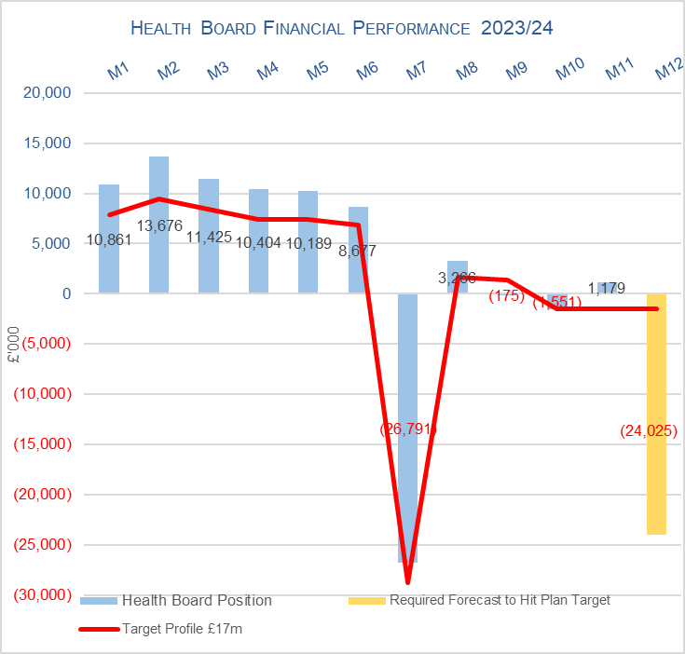
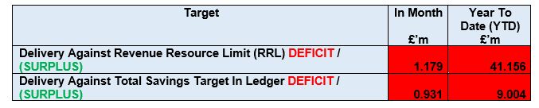
Health Board Reported Position @ Mth 11 2023/24

Slide 3
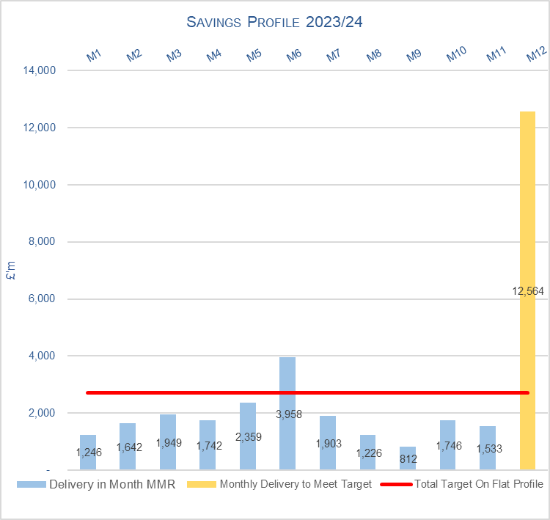
Health Board Savings @ Mth 11 2023/24

Slide 4
2023/24 Landing Plan

