Slide 1
Summary Financial Position
Month 03 FY 2025/26
Audit Committee
17 July 2025
Notes:
This slide can be used for presentations which are from a health board-wide perspective or for a whole HB audience as the graphic device to the right of the slide includes all four service group colours and red for the corporate team.

Slide 2
Financial Performance Month 03
The Plan submitted at the end of March, which has not been approved reported a £58.7m deficit with a requirement to deliver £55.4m of savings.
The Control Total for the Health Board set by Welsh Government remains £17.1m, however on 6th June 2025 Welsh Government wrote to confirm the expectation for 2025/26 only, which as a minimum must equal the outturn from 2024/25 (£42.5m deficit). This requires an additional £16.2m of savings to be delivered, taking the total savings requirement for 2025/26 to £71.6m.
In Month 03 there is an in-month overspend of £7.1m. This is £2.2m above the planned deficit of £4.9m (1/12th of the £58.7m).
At Month 03 the YTD overspend is £24.2m. This is £9.5m above the planned deficit of £14.7m (3/12th of the £58.7m).
In order to deliver the £58.7m planned deficit, the Health Board needs to recover the year to date overspend of £9.5m in future months.
Notes:
This is a generic copy slide.

Slide 3
In Month reconciliation of variance by Area & Expenditure type
Notes:
This is a generic copy slide.

Slide 4
Month 03 Variance by Area
Notes:
This is a generic copy slide.

Slide 5
Summary Variable Pay
The actual variable pay spend at Month 3 was £5.1m. A detailed breakdown of variable pay by month, type and job family can be found in Appendix 1.
To note, Month 2 pay included 1 month of arrears for the Real Living Wage increase. The arrears payments totalled circa £200k.
Notes:
This is a generic copy slide.

Slide 6
Summary of Savings Position @ Month 03
Savings delivery in month was £1.14m. This is £3.48m lower than the planned saving of £4.62m (1/12th of the £55.440m target for 2025/26).
Note that the above Table reports delivery against the original deficit plan target of £55.44m; to deliver the Welsh Government expectation of a £42.5m deficit would require an additional £16.2m of savings to be delivered, taking the total savings requirement for 2025/26 to £71.6m.
Notes:
This is a generic copy slide.

Slide 7

Next Steps
Nursing
Workshop – nursing variable pay Friday this week
Review next 6 week booking and unbook
Approval for bank, agency and overtime now taken off matrons and sisters and elevated to heads of nursing
Twice daily meetings for approvals
Moving staff across wards but meeting with resistance
Medical staff
Review of possible system workarounds being undertaken
Job plan baseline now needs redesign to maximise productivity and value for money
Need to get all medics on E-Rostering
Approvals outside of process – Deloitte to review as well
New rate card needed and will be developed
Other
All exec leads to blanket ban overtime in their areas
Workforce redesign and workforce planning needed in pathology
Variable Pay Steering Group
First meeting 2 July 2025
Next meeting 15 July 2025
10 workstreams
10 plans on a page next Tuesday
External Support
Preliminary data this week
1.5 hour detailed briefing Thursday this week
Deloitte on the ground next Monday
Focus on pay controls and run rate reduction
Notes:
This is a generic copy slide.

Slide 8
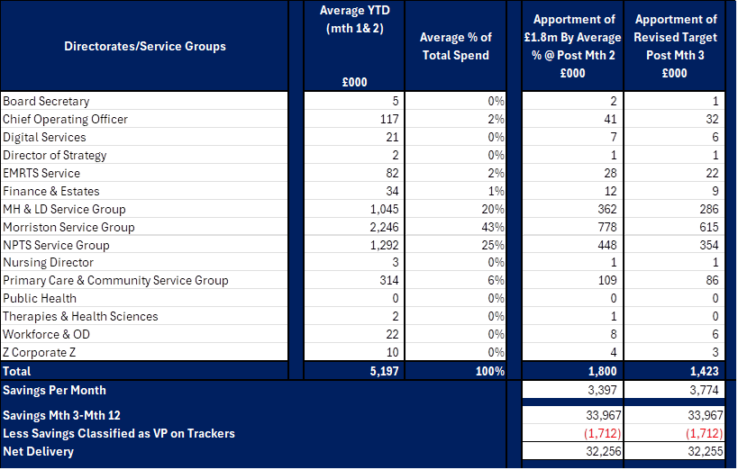
New Caps
Notes:
This is a generic copy slide.

Slide 9
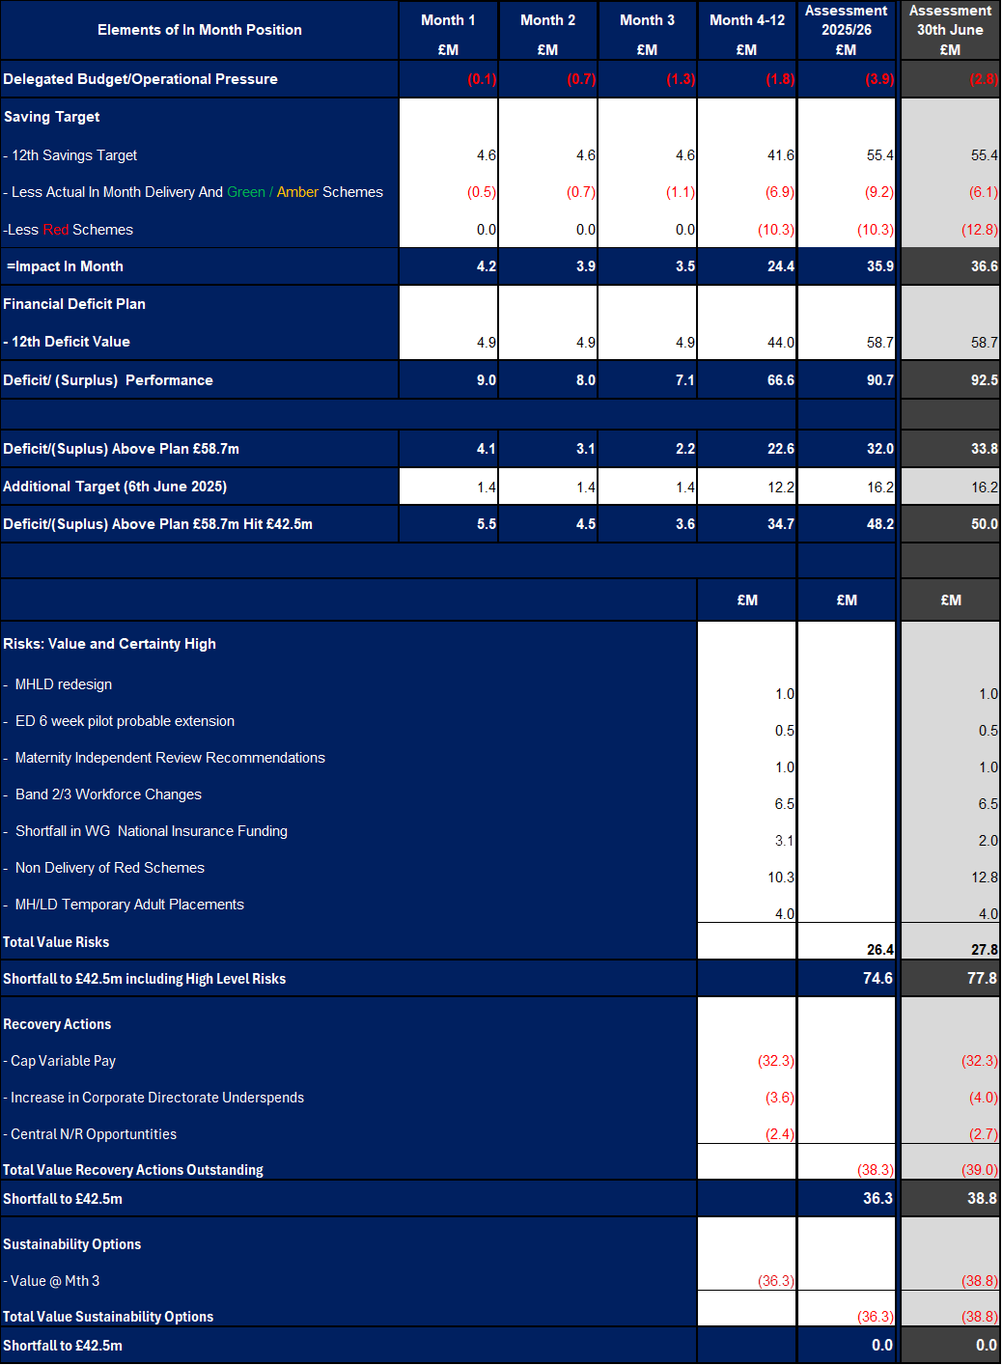
M3 v 30/06/25
Notes:
This is a generic copy slide.

Slide 10
Appendices
Notes:
This slide can be used for presentations which are from a health board-wide perspective or for a whole HB audience as the graphic device to the right of the slide includes all four service group colours and red for the corporate team.

Slide 11

Appendix 1 - Variable Pay Breakdown
Notes:
This is a generic copy slide.

