Slide 1
Summary Financial Position
Month 3 FY 2024/25
Audit Committee – 11th July 2024
Notes:
This slide can be used for presentations which are from a health board-wide perspective or for a whole HB audience as the graphic device to the right of the slide includes all four service group colours and red for the corporate team.

Slide 2
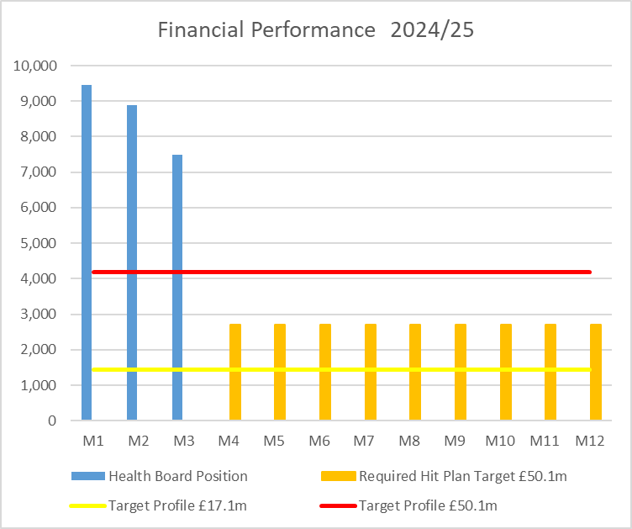

Financial Performance Month 3
Health Board Plan submitted at end March 2024 reported a £50.1m planned deficit but control total set by Welsh Government is £17.1m
In Month 3 there is an in-month overspend of £7.5m.
YTD at Month 3 is an overspend of £25.8m
Overall the Health Board YTD position is £13.3m off the delivery of the £50.1m deficit plan
In the graph above the orange bars illustrates the potential financial change required to be able to deliver the £50.1m
The yellow line depicted the level required if the HB were to achieve the £17.1m control total.
Notes:
This is a generic copy slide.

Slide 3
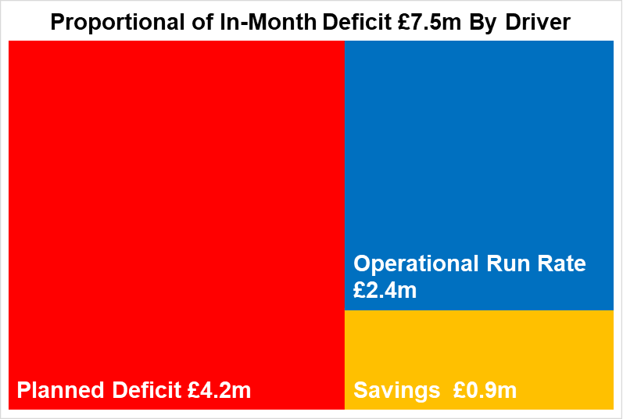
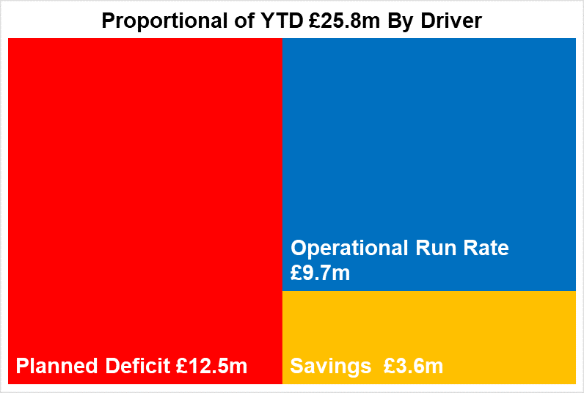

Key Elements of the Mth 3 & YTD Position
Key Message:
Planned Deficit: remains at £4.2m or 1/12th of £50.1m deficit plan in month and £12.5m YTD.
Savings: deterioration in month of £0.2m in delivery and overall there remains a shortfall in delivery of the £26.1m targets YTD of £3.6m.
Operational Run Rate: overall improvement of £1.6m in month as a result of two Non Recurrent benefits in Mth 3 linked to rebate on energy and VAT recovery, however operational run YTD is £9.7m over.
Notes:
This is a generic copy slide.

Slide 4
Summary Month 3 & Movement In Month
Notes:
This is a generic copy slide.

Slide 5
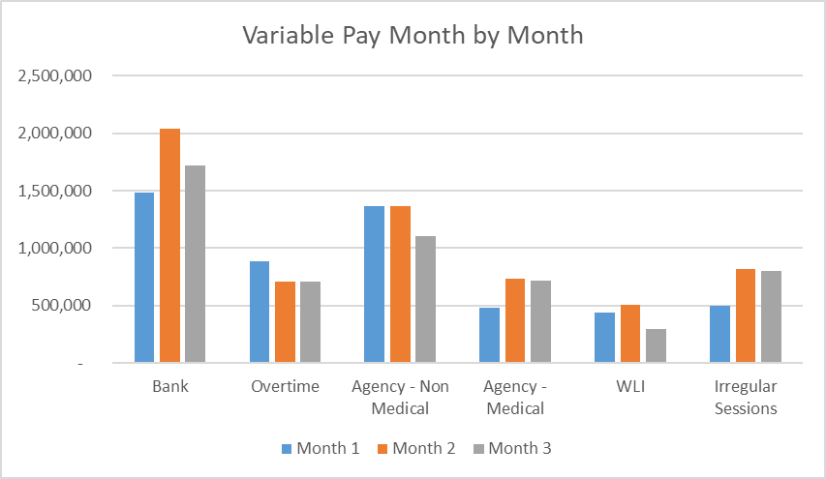
Summary Variable Pay
Notes:
This is a generic copy slide.

Slide 6

Fin4: Recovery & Sustainability Programme Areas Focus
Programme 1 Expenditure Control
Programme 2
Short Term Service Change
Programme 3
Medium Term Financial Recovery
Areas of Focus (including Thematic Programmes)
Variable pay grip and control
CHC case review
Prescribing and medicines management changes
Non pay spend
Vacancy control
Surge beds/beds above surge capacity
Medical staffing models
Acceleration of pipeline of savings to implementation
Value and Sustainability Board
Vault and benchmarking opportunities – hand in to item 2
Identification of “just do it” standards
Funded cost pressure review and the choices made via the planning process
Theatre efficiency and productivity
Urgent and Emergency care redesign – whole system, primary, community, clusters, acute, partnership
Headcount review
Acceleration of digital benefits realisation
Medical staffing models
Delivery and closure of thematic review work
Clinical Services Plan
Estate review
Regional service opportunities – via Regional JC?
Clinical pathway redesign – One Bay Way
Services to decommission
Operating model review (corporate model)
CHC repatriation and streamlining
Long Term Agreement rebasing and strategy
Wider partnership opportunities
Health protection opportunities
Value Based Healthcare
Supported by Cross System Change
Workforce &OD
Digital & Commutations
Q&S/EQIA/QIA
Governance
National Value & Sustainability Programme
Health Board Repository
The Vault
Local schemes and savings identified

