Slide 1
Integrated Discharge Hub
Strategic Overview
Notes:
This slide can be used for presentations which are from a health board-wide perspective or for a whole HB audience as the graphic device to the right of the slide includes all four service group colours and red for the corporate team.

Slide 2
Phase 1
Launch on July 8th Phase 1 Morriston site
Improve pace of referrals/decision making and flow out
Improve accuracy, clarity and deliver efficiencies through streamlining
Outcomes
1. Single system
2. Integrated discharge workforce
3. Improved flow
4. Improved efficiency
5. Better understanding of community capacity required to support flow/AA
Notes:
This is a generic copy slide.

Slide 3
Phase 2
Initial scoping underway via T & F
Scale up to NPTH/Singelton
Increase capacity to support discharge planning
3.

Slide 4
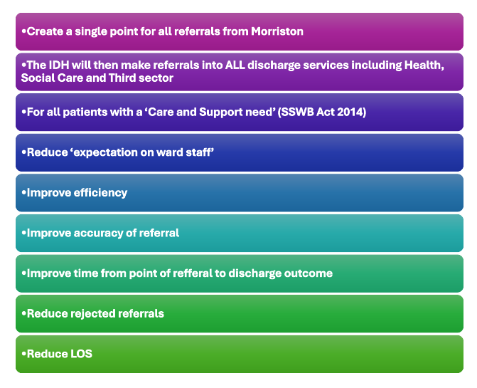
Goal
Notes:
This is a generic copy slide.

Slide 5
Agreed Outputs
1. MULTI AGENGY SCOPING WORKSHOP
2. DEFINED OPERATING MODEL
3. AGREED WORKFORCE MODEL
4. PERFORMANCE & OUTCOMES FRAMEWORK

Slide 6
Deliverables
Multi Agency Collaborative scoping Workshop W/C 3rd June 2024
Outline draft operating model 14th June 2024
Confirm digital solutions/requirement for implementation i.e. referral mechanism, data reporting by 14th June 2024
Agree workforce model by 17th June 2024
Engagement & Communication with relevant stakeholders 17th-24th June 2024
IDH open July 1st 2024
W/c 3rd June
Scoping workshop
3rd-14th June
5th-14th June
Draft Operating Model & SOP
Scope and agree digital solutions/requirements
17th-24th June
1st July
IDH go live date
Staff Engagement & Comms
17th June
Agree Operating Model

Slide 7
Governance
UEC Programme Board
Morriston UEC Programme Board
PCT Part 1 Operational Business Meeting
IDH Implementation Group

Slide 8
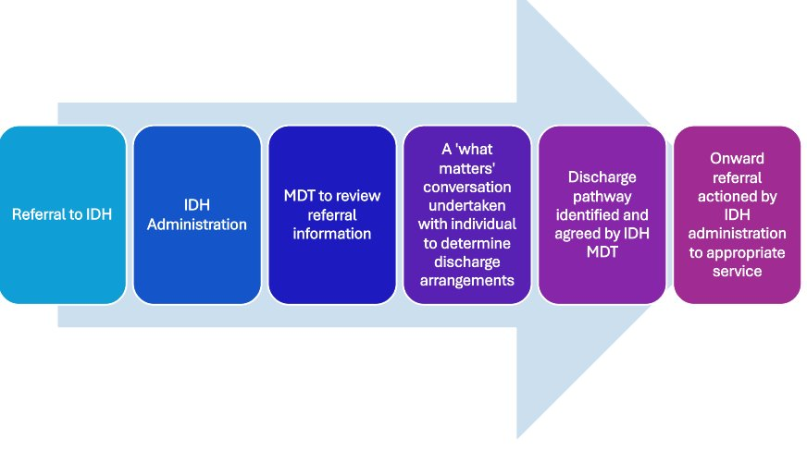
IDH Strategic Model

Slide 9
Evaluating Performance/ Impact (Example)
How much did we do? | How well did we do it? | Is anyone satisfied?
Number of referrals received Number of referrals directed to appropriate service Number of referrals directed to appropriate D2RA pathway Number of referrals to: - ACT - Virtual ward? - Home First - District Nursing - Third Sector -Other | Response times % contact response time achieved within 2 working days % individuals referred onwards to appropriate service within 24 hours of receiving referral to IDH % improvement in appropriate referrals to community services Shorter time between referral to acceptance of referrals to community services Complaints/compliments | Ward staff satisfaction Community team satisfaction Patient experience

Slide 10
Thank you

