Slide 1



SBUHB - 27 March 2025
Annual Health Board Engagement with the NHS Wales Joint Commissioning Committee (JCC)
Ian Green
Chair
Stacey Taylor
Interim Chief Commissioner
George Galletly
Director of Transition & Transformation
‘The Centre of Excellence for Collaborative Commissioning’

Slide 2

Aim of session
About the Joint Commissioning Committee;
  Who we are
  What we do
Focus to date;
  Establishment – Governance & Recruitment
  Transition
  Organisational Change
  Business Continuity - Development of IMTP & Assurance
Focus for the Future;
  Implementation of new structure
  Commissioning Strategy
  Commissioning Framework – Value & Transformation
  Deliver the Foundational Annual Plan 2025/2026
  Continue to strengthen collaboration with HBs through the CCLG

Slide 3

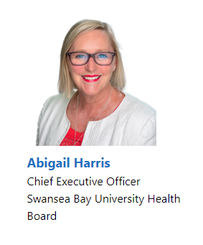
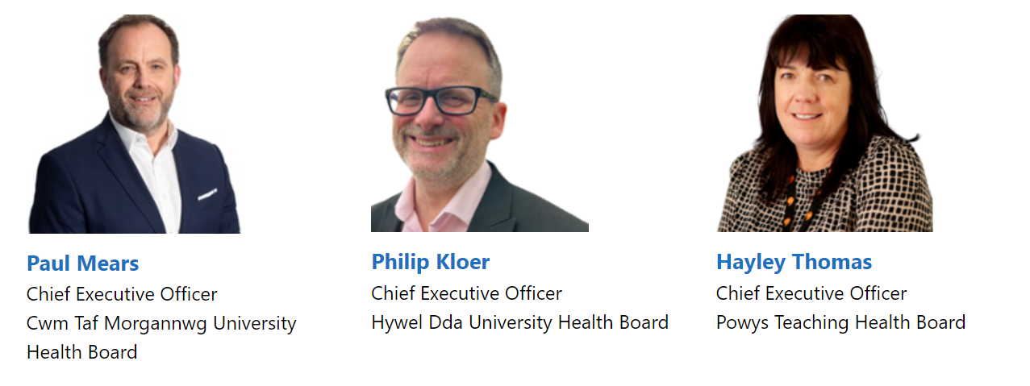
About the Joint Commissioning Committee
Who we are

Slide 4


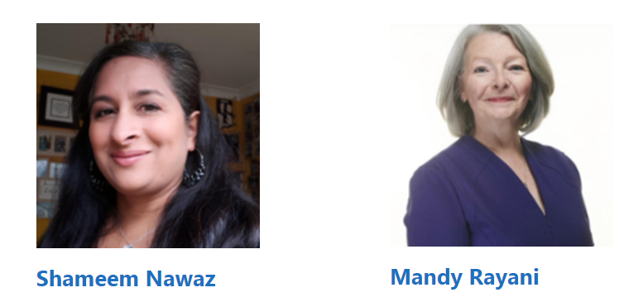
About the Joint Commissioning Committee
Who we are
JCC Chair
  Accountable directly to the Cabinet Secretary for Health & Social Care in respect of their performance as Chair of the JCC
  Has a bi-lateral relationship with each of the Chairs of the 7 HBs
Lay Members
  Responsible to the Committee Chair for discharging their roles as Lay Members of the JCC
  Appointed by the Cabinet Secretary for Health & Social Care

Slide 5


About the Joint Commissioning Committee
Who we are
JCC Senior Leadership Team
Chief Commissioner
Director of Finance, and Value/ Dep Chief Commissioner
Director of Commissioning - Ambulance Services and 111 (B9)
Director of Commissioning - Specialised Services
(B9)
Director of Commissioning - Mental Health, Learning Disabilities and Vulnerable Groups (B9)
Medical Director
Director of Nursing and Quality (B9)
Deputy Director of Commissioning (8d)
Deputy Director of Commissioning (8d)
Deputy Director of Commissioning (8d)
Deputy Medical Director (0.5WTE)
Deputy Director of Finance & Value
(Bd)
Director of Corporate Planning & Strategy
(B9)
Deputy Director of Corporate Planning & PMO
(8d)
Committee Secretary
(8d)
Deputy Director of Communication and Engagement
(8d)
Assistant Director of Nursing and Quality (8c)

Slide 6
About the Joint Commissioning Committee
What we do
  Specialised Services for:
  Cancer and blood disorders
  Cardiac conditions
  Renal
  Neurosciences
  Women and children
  Ambulance/111 Services;
  Emergency medical services
  Non-emergency patient transport services
  Emergency medical retrieval and transfer services
  NHS 111 services
  Mental Health & Vulnerable Groups Services;
  Secure Mental Health
  Child & adolescent mental health services
  Welsh Gender Service
  Sexual assault referral centres
  And
  Services where there is agreement between the Local Health Boards that they should be arranged on a regional and national basis,
  Other services as directed by the Welsh Ministers.

Slide 7
About the Joint Commissioning Committee
What we do
  In 2023/2024, the predecessor organisation/s enabled access for 3461 patients from SBUHB to the most appropriate care and treatment from across the Uk including;
    313 patients for specialised cardiac surgery
    211 patients for neurosurgery
    200 children for specialised services (surgery, neurology, gastroenterology etc)
    2687 patients for plastic surgery (inc. burns)
    9 patients for treatment for spinal injuries and further <5 for spinal surgery
    147 patients for specialist thoracic surgery
    9 patient for transplant surgery

Slide 8
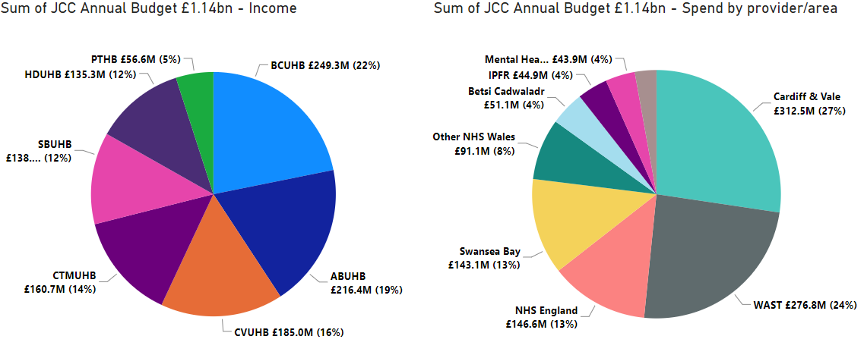
About the Joint Commissioning Committee
What we do
Source of Funds & Spend by Area/Provider

Slide 9
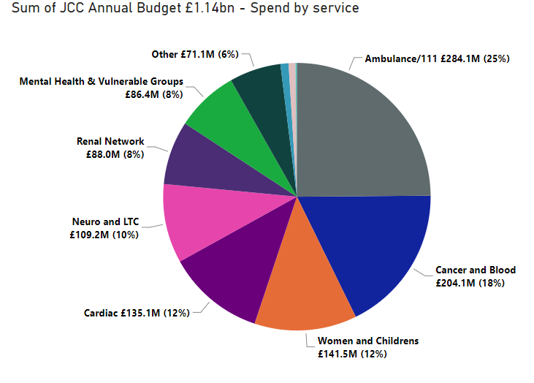
About the Joint Commissioning Committee
What we do

Slide 10

Focus to date
Establishment
Governance
Regulations, Directions, Standing Orders, Standing Financial Instructions, Hosting Agreement, Memorandum of Agreement
Recruitment
Chair & Lay Member, Chief Commissioner & Senior Leadership Team Recruitment
Strategic Direction
Vision, Mission, Strategic Objectives & Values and Behaviours
Transition to Routine Business

Slide 11
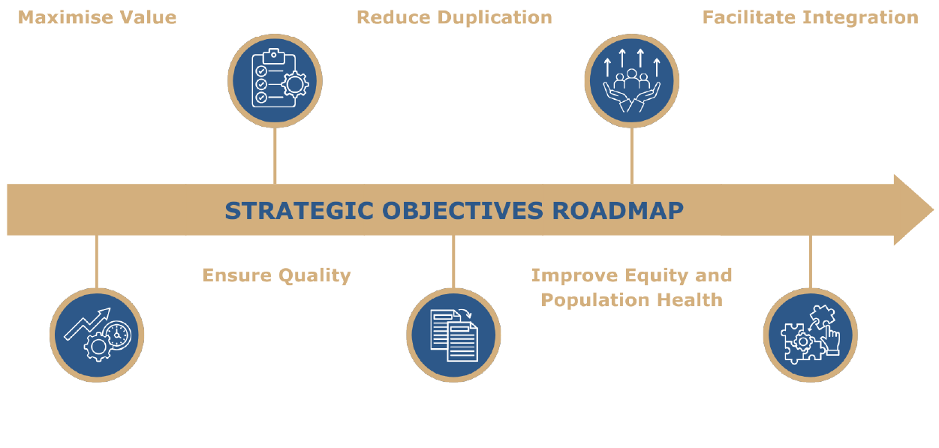
Focus to date
Establishment

Slide 12

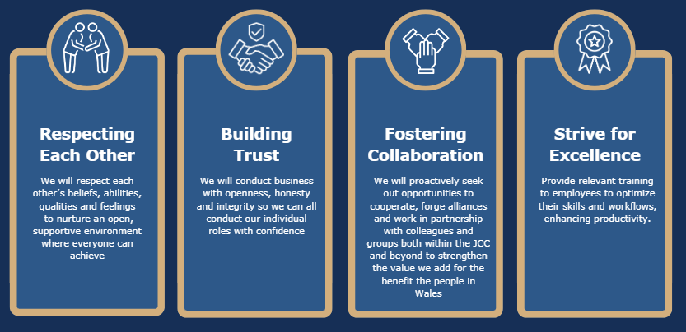
Focus to date
Establishment
JCC Values & Behaviours

Slide 13

Focus to date;
Establishment
Vision, Mission & Strategic Objectives
Commissioning Approach; IMTP & Strategy
Operating Model
Routine Business
Stakeholder Engagement
Transition to Routine Business
Sept 2025
Business processes
April 2025
Effectiveness self- assessment
Organisational Change Policy
November 2024
Advisory Review
Working Group with HBs
September 2024
Culture and Organisational Development
Collaborative Commissioning Leadership Group
SLT Management Meetings
Sub Committee Structure & SoD
2024/2025 Transition
December 2024

Slide 14

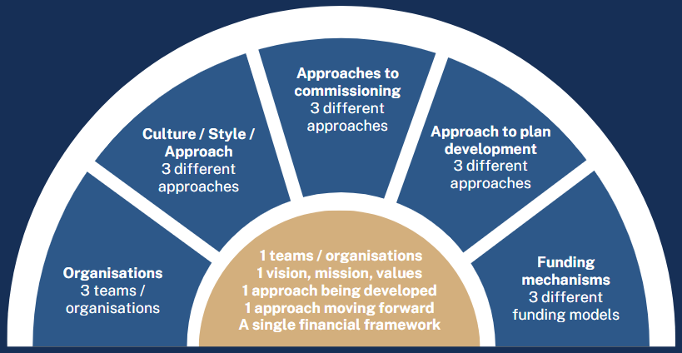
Focus to date
Business Continuity - IMTP
Current Position – Developing the NWJCC Approach
Before April 2024
April 2024 Onwards

Slide 15
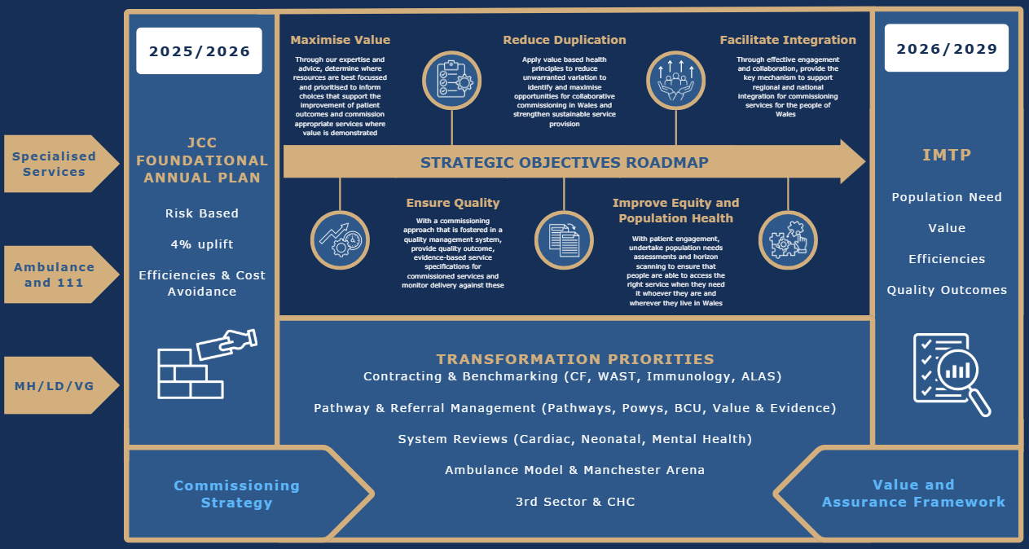
2025/2026 FOUNDATIONAL PLAN ON A PAGE

Slide 16
Focus to date
Business Continuity - Assurance
Joint Committee
  Formal Public meetings - bi-monthly, assurance report to HBs via Board secretary for inclusion on Board agendas
  Private Development sessions – bi-monthly
Sub-Committees
  Quality Safety & Outcomes Sub- Committee - assurance report will be via the JCC and DONs for inclusion on HB QPS sub-committee agendas
  Planning , Performance and Finance committee – assurance report will be via the JCC
  CTM UHB Audit and Risk Committee – assurance report via the JCC
CTMUHB Safeguarding Committee - DON attends
Chief Commissioner
  Director General NHS Wales
  NHS Wales CEO meeting
Chair
  NHS Wales Chairs Meeting
Annual HB Board meetings – the JCC Provide a strategic presentation to HB Board meetings/Development sessions annually
Professional peer group meetings
WG policy leads/NWJCC Officer meetings
Notes:
George

Slide 17
Focus for the Future
  Implementation of new structure
  Development of Commissioning Strategy
  Commissioning Framework – Value & Transformation
  Deliver the Foundational Plan 2025/2026
  Engagement & collaboration with Health Boards - Collaborative Commissioning Leadership Group

Slide 18
DIOLCH / THANK YOU
AM WRANDO /FOR
LISTENING
Home - NHS Wales Joint Commissioning Committee

