Slide 1


Supporting Staff Resilience & Wellbeing
Swansea Bay UHB Board Meeting 28th March 2024
Paul Dunning – Professional Head of Staff Health & Wellbeing

Slide 2
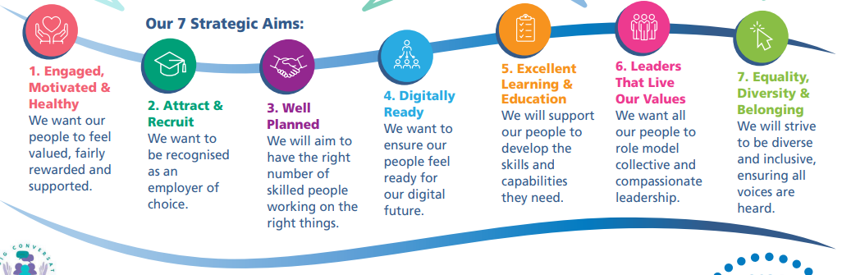
People Strategy 2024-2029;
supporting the 10 year vision of a high quality organisation
The content:
is aligned to national workforce strategies, our Health Board vision and responds to Our Big Conversation feedback
includes 7 strategic people aims/ goals, each outlining methods of delivery and success measures

Slide 3
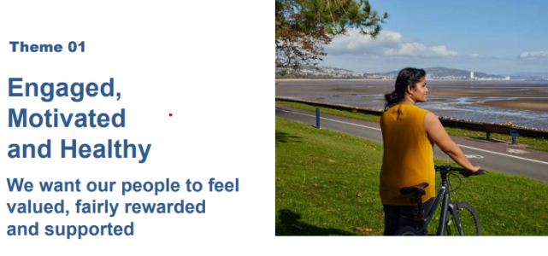
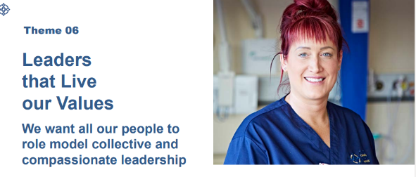
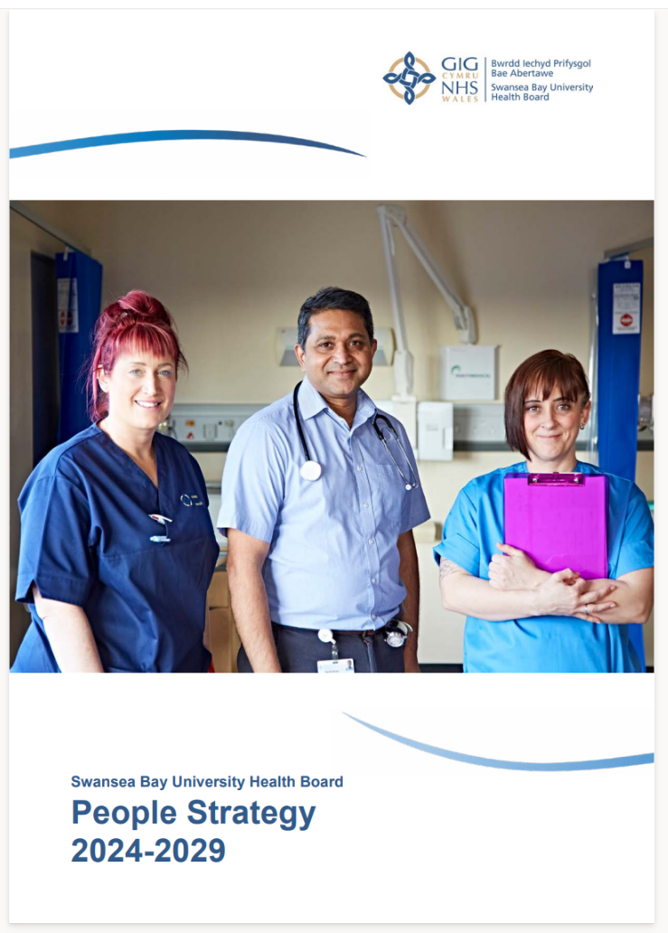
People Strategy 2024-2029; supporting the 10 year vision of a high quality organisation
‘Focus on the wellbeing of our people with timely access to Occupational Health and Wellbeing support, providing relevant training and information and extending our wellbeing champions network’
‘Continue to listen to our people and take action when they speak up.’
Supports staff retention – empowered staff with the right skills and resources in supportive teams contributes to high quality patient outcomes
‘Review and refresh our existing Leadership Development Programmes to include collective and compassionate leadership principles’
‘Design a suite of new leadership development initiatives for all levels of clinical and non-clinical leaders that support us to embed our values, behaviours and deliver our ‘One Bay Way’ 10-year vision’

Slide 4
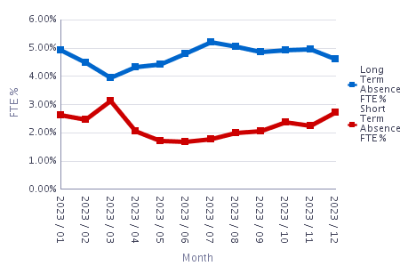
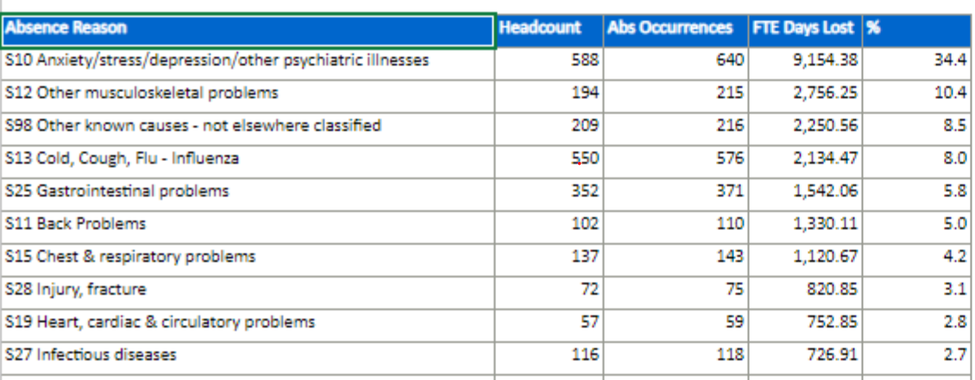
Workforce sickness absence data
Recent review of the Data suggests the need for targeted interventions as highest % mental health in 51-55 age group (17%) and highest back problems and ‘other MSk’ in 56-60 age group (43%)

Slide 5

Current pressures undermining staff wellbeing/ resilience
Sustained industrial action – impact on planned care & staff morale
Current escalation status, service pressures and external reviews
Significant service change
Workforce shortages/staff sickness absence
‘Our Big Conversation’ demonstrated 20% staff disagree or strongly disagree that, ‘Managers and Leaders are responsive towards staff when they face problems in my area of work’. Therefore, team culture in some areas may lack dynamic & compassionate leadership that supports staff wellbeing

Slide 6
Social Partnership Duty
The Social Partnership and Public Procurement (Wales) Act 2023 (‘the Act’) provides a framework to promote the well-being of the people of Wales by enhancing sustainable development (including by improving public services) through social partnership working, promoting fair work and socially responsible procurement
A collaborative social partnership approach allows us to draw on the combined knowledge, experience and ideas of employers, workers and trade unions in developing solutions to common challenges
In alignment with the Social Partnership Duty, the SBUHB People Strategy 2024-2029, developed in partnership with our key stakeholders, looks to ensure our people feel valued, fairly rewarded and supported and to ensure our people (HR) processes align with best practice and a learning culture
From 1st April 2024 an amendment to the Act outlines how our wellbeing initiatives must align to creating a ‘A Prosperous Wales’ as a well-being goal. We will review how our well-being objectives are designed to contribute to fair work in the context of the amended well-being goal and in alignment with SBUHB People Strategy
SB UHB Best Practice Review allows us to work collaboratively, in partnership, to ensure our HR processes are person centric, fair and prevent employee harm
SB UHB’s Professional Head of Staff Health & Wellbeing sits on Welsh Government's Occupational Health Tripartite Group, working with WG and Unions to enhance NHS Wales OH Services

Slide 7
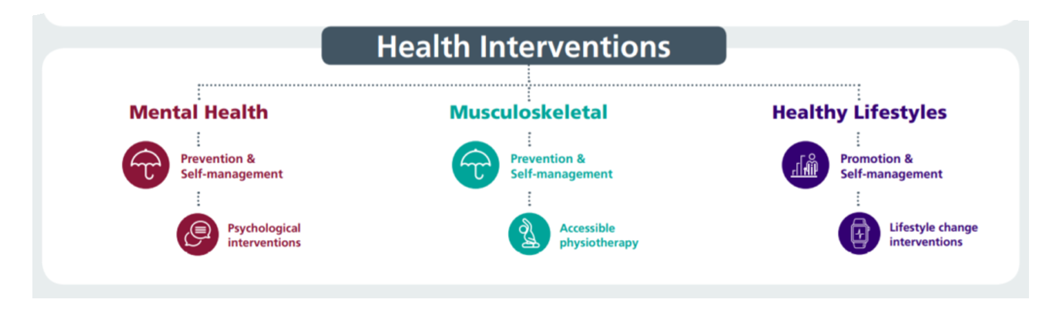
Our Staff Wellbeing Services supporting physical and mental health
1313 referrals to staff wellbeing service (March 23- Feb 24) –12.5% increase on previous 12 months
53% referrals to the service are staff in work (presentees) supporting early intervention
47% of referrals are sickness absentees
Specialist Psychological interventions for trauma, PTSD, bereavement. Increased capacity in self-management for anxiety, depression, self-harm and suicide
Suicide Prevention – 50 disclosures of related thoughts in 12 month period with significant reductions post intervention.
TRiM team rolling out preventative and post-incident support - 76 staff TRiM trained to deliver and support, 3483 staff REACT trained, 33 bespoke interventions for teams/services after adverse incidents
634 Wellbeing Champions (+9% from 22/23) supporting teams with wellbeing info/signposting and health promotion activities– regular update workshops facilitated
Manager training - use of work-related stress assessment and managing mental health at Work
Staff Wellbeing Forum – HB wide representation to share best practice/disseminate info across the HB with related presentations
Time2Change Wales – regular presentations to reduce stigma & discrimination of mental health in work with other 1000 staff having attended. Shortlisted for a CIPD Award 2024 Awards 2024 Shortlist - CIPD Awards Wales 2024 (cipdwalesawards.co.uk)

Slide 8
Our Occupational Health Service supporting physical and mental health
OH waits (based on most available data) – Doctor: 15 days, Nurse: 11 days, Physiotherapist: 15 days, Occupational Therapist: 14 days. Reports with consent sent to manager on same day in most cases.
2687 OH management referrals (March 23-Feb 24) compared to 2497 (-7%), 4995 staff cleared for pre-employment. OPAS G2 operating system = reduced waits for health clearance, more robust health surveillance programme & reduced waits for reports to managers. Progressing application for industry standard SEQOHS accreditation
Work-based Physiotherapy support - ergonomic assessments, early interventions and MSk advice. Leading on promoting health campaigns via Team Brief and other Comms
SBU has the only Occupational Health Service in Wales with full complement of Nursing Team using ‘grow our own’ model. 3 Nurses have completed the OH Diploma course and are awaiting exams - 1 Nurse has completed the Diploma. Leading HB menopause support and working towards Menopause Friendly Employer accreditation and only service with OT support for staff with Long Covid and other LTC’s
Staff Wellbeing Forum – HB wide representation to share best practice/disseminate info across the HB with related presentations
Time2Change Wales – regular presentations to reduce stigma & discrimination of mental health in work with other 1000 staff having attended. Shortlisted for a CIPD Award 2024 Awards 2024 Shortlist - CIPD Awards Wales 2024 (cipdwalesawards.co.uk)

Slide 9


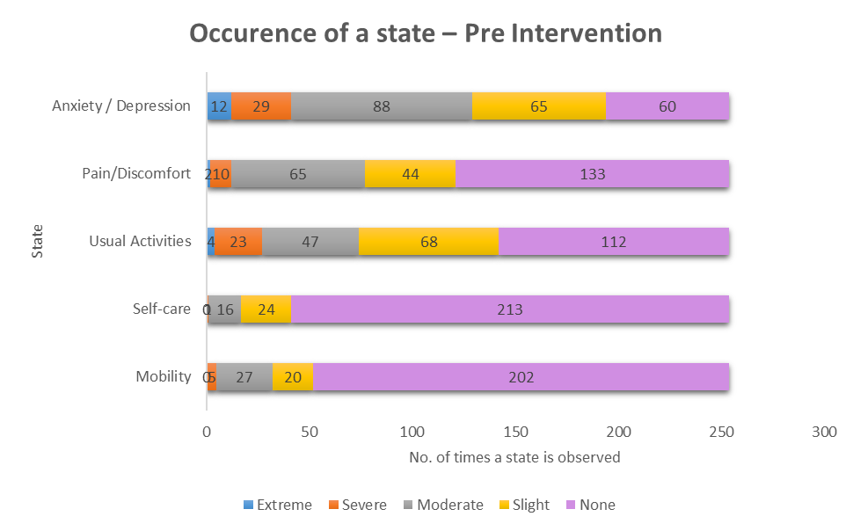
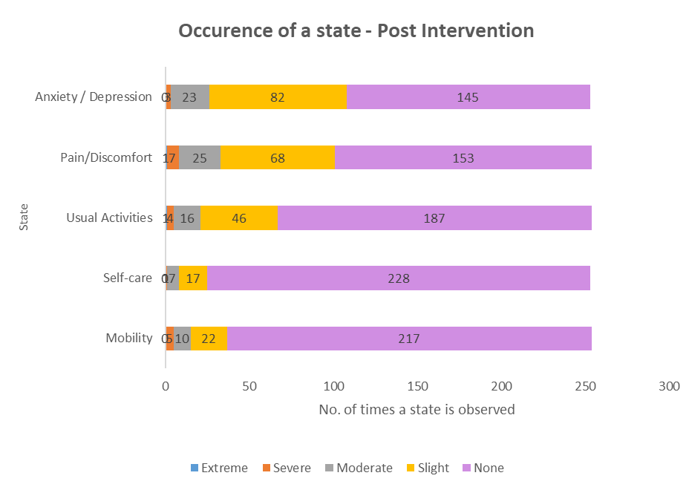
EQ5DL Pre and Post Outcome Scores

Slide 10
GTEP sessions (accumulative stress)
Wellbeing Champion Network
Compassion Rounds
React & Suicide Prevention
Staff Health Checks
Menopause Workshops
My Health Passport
Preventative Interventions
Mindful & Meaningful Living course
Steps to Wellbeing webinars
TRiM
Men’s Health Forum
Mental Health Awareness training
Work-related Stress Risk Assessment Training
Managing your Wellbeing course

Slide 11

Current focus on areas of high absence - examples of current initiatives to support the wellbeing of our staff
MH&LD Service Group
- Bespoke support for acute incidents
- Staff Wellbeing survey undertaken
- Guardian visits across all sites
- Service Group Staff Counsellor
- Review of TRIM support to the Group
Support Services
Hotel Services – piloting Tailored Adjustments training for managers to increase experience of using these to flexibly support staff to remain in work/return to work
Estates – delivering men's health sessions to male staff to increase awareness of support available related to mental and physical health. Includes REACT/TRiM awareness
Morriston Service Group (including Theatres)
- Monthly Health & Wellbeing Newsletter – monthly topics/information and links to support
- Wellbeing resource pack – physical and electronic copies available – includes new starter feedback questionnaires.
- Pulse surveys conducted in areas that are identified from the data as requiring additional HR/OD support – for example,
number of ER cases, high absence - this work include implementing an overseas champion network from April 2023

Slide 12
Outcomes from Wellbeing Service to demonstrate effectiveness
Evidence suggests that sickness absence may be higher without the support of the wellbeing service. Evidence also suggests improved productivity at work
Improved health outcomes on EQ5D-L outcome measure (improvements in depression/anxiety, participation in valued activities and reduced pain)
25% of staff who have attended Suicide Prevention Level 1 training have used this to support a colleague
Significant reduction in thoughts and plans related to suicide disclosures
Initial staff feedback data suggests:
47% absentees still off sick at discharge stated the service helped move closer to work
82% absentees stated the service helped them RTW sooner
70% staff in work stated the service helped remain in work
59% stated the service helped improve work performance
Increased confidence to manage mental health at work from related training
Competence and confidence to undertake work related stress assessment after related training

Slide 13
Conclusion
The Health Board’s OH and Staff Wellbeing Services provide a range of support for mental and physical health that support and enable managers and staff to manage health at work and improve wellbeing and resilience - outcome evidence indicates the effectiveness of these interventions.
Working in collaboration, we will continue to support staff wellbeing in a timely way and develop initiatives and interventions aimed at prevention and early intervention, with a focus on the sickness absence data related to an aging workforce
Reducing sickness absence and promoting staff resilience is a priority. The Occupational Health and Staff Wellbeing Services working in conjunction with leaders and the Workforce Operations team, will continue to take steps to support the organisation through both a cultural change and by providing the practical means in which managers are equipped, supported and given confidence to effectively manage absence, presenteeism and promote resilience. This has to be driven and owned by our managers.
We will continue to provide progress updates for assurance to the Workforce, OD & Digital Committee
,

Slide 14
Recommendations/Actions
The Board is asked to note and discuss the details of this presentation. The actions proposed are aimed to support staff wellbeing and avoid sickness absence
We will continue to maintain as well as modernise and develop a range of staff wellbeing interventions that support staff wellbeing and resilience, contributing to safe, high quality patient experience
Building on the People Strategy and 10 Year Vision, along with working with our Trade Union partners, we will continue to develop a culture where managers are empowered to respond in a flexible and timely manner to support staff to remain in work/return to work
We will continue to promote the evidence that ‘good work is good for health’ and influence the development of ‘good work’ across the organisation
Focus on collaborative working and building on WF&OD ‘best practice’ across Service Groups

