Slide 1


Appendix Three:
The Senedd post May 2026
Richard Thomas, 13 March 2026

Slide 2

Senedd – a quick overview
Covers a number of devolved areas, including health, education, local government, transport, planning, economic development, social services, culture, Welsh language, environment and agriculture and rural affairs
Has a budget of c£26bn with around 50% going to health and social care
Makes laws for Wales and agrees Welsh taxes and holds the WG to account in plenary and through Senedd Committees
Tuesdays focus on FMQs and Government business
Wednesdays focus on scrutinising the Welsh Government and opposition debates
Committees take place from Monday to Thursday – this is where WG policies and expenditure is scrutinised and Ministers are held to account plus proposed legislation is examined
Committees are made up of MSs from different political parties
Committees relevant to ourselves include Health and Social Care; Finance; Public Accounts, Petitions and the Covid-19 Inquiry Committee

Slide 3
Senedd – high level changes post May 2026
Number of MSs - moving from 60 MSs to 96 MSs
New constituencies – from 40 constituencies and 20 members elected via 5 separate regional lists to 16 new constituencies, each electing 6 MSs
New voting system – from seeing the candidates name on the ballot paper to a system where MSs are elected through a closed list (voters choose either a political party or independent candidate)
New voting system – from first past the post as well as the proportional regional lists to ‘each vote matters’
Frequency of election – from every 5 years to every 4 years
Whatever happens in the election, a large number of MSs are likely to be new MSs due to the number of sitting MSs standing down (so far 13 Labour MSs have announced they won’t be standing)

Slide 4
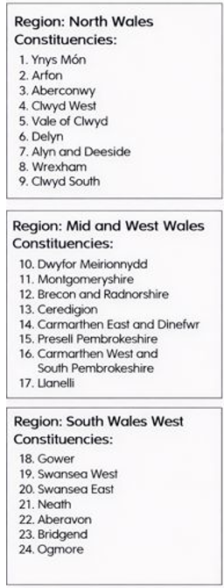
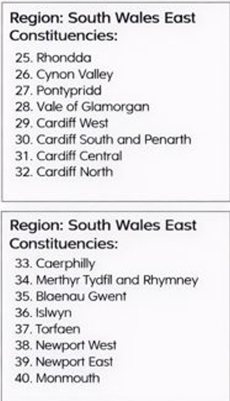
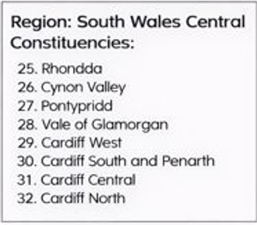
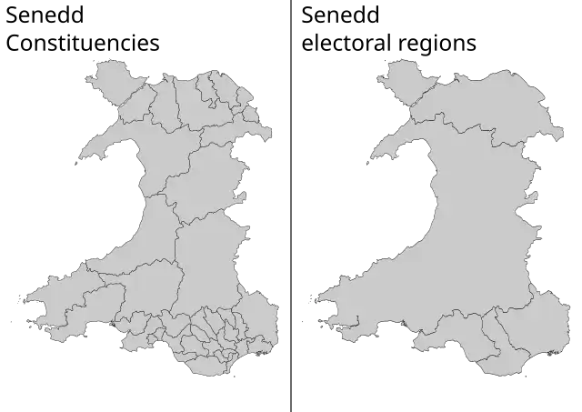
Senedd – current constituencies
The existing system is a mix of first past the post constituency seats such as Aberavon as well as regional list seats
This means that some MSs currently cover their own specific constituency whilst others cover a wider patch – there are currently 40 constituency MSs and 20 regional list MSs

Slide 5
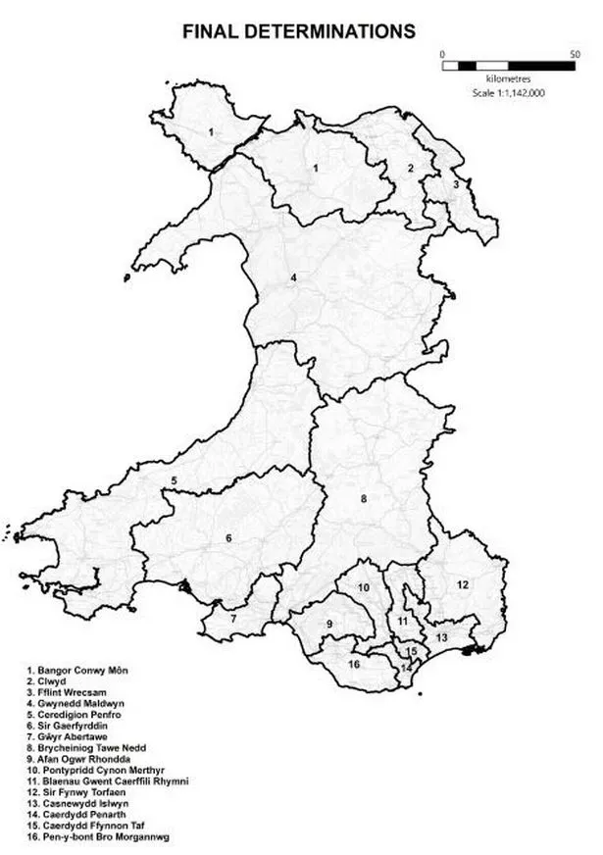
Senedd election 2026 – what’s changing?
The landscape will change dramatically in terms of the numbers of MSs and their constituencies as a result of the election. There is also a chance that the political make up of the Senedd will change considerably.
Post May, there will be 16 constituencies across Wales, each of which will have six MSs – that gives a total of 96 MSs in the post May Senedd.
Swansea Bay includes three constituencies (and therefore 18 MSs):
Gwyr Abertawe (number 7 on the map)
Brycheiniog Tawe Nedd (number 8 on the map)
Afan Ogwr Rhondda (number 9 on the map)
While Gwyr Abertawe is solely within the Swansea Bay area, both Brycheiniog Tawe Nedd and Afan Ogwr Rhondda are shared with other Health Boards – the former with Powys and the latter with CTM.
This means that 12 of our 18 MSs post election will also have relationships with another Health Board. As a result, we need to consider our plans in conjunction with Powys and CTM.
We also need to bear in mind that our 18 elected MSs will have varying degrees of familiarity and affinity with our patch – some will gravitate more towards us and others might take a greater interest in other geographic areas.

Slide 6
A snapshot of the new constituencies
Gwyr Abertawe (number 7 on the map)
Sits entirely within the Swansea Bay area
Combines the Westminster constituencies of Gower and Swansea West
Covers parts of Swansea, particularly the western and more rural areas stretching from suburban Swansea to the rural Gower and the Loughor estuary as well as areas to the north such as Llangyfelach and Pontarddulais
Brycheiniog Tawe Nedd (number 8 on the map)
Shared with Powys HB
Combines the Westminster constituencies of Brecon, Radnor and Cwmtawe with Neath and Swansea East
Covers settlements such as Brecon, Llandrindod Wells, Neath, Skewen, Ystradgynlais, Cwmtwrch and communities in the east of Swansea
Afan Ogwr Rhondda (number 9 on the map)
Shared with CTM
Combines the Westminster constituencies of Aberafan Maesteg and Rhondda and Ogmore
Includes three local authority areas – Bridgend, RCT and NPT
Covers communities such as Maesteg, Port Talbot, Treherbert, Treorchy, Tonypandy and Ogmore Valley communities

Slide 7
High level timetable
27 March - Senedd closes for Easter recess
8 April - dissolution of the Senedd and pre-election period starts
9 April – deadline for candidate nominations
7 May - election day
8 May - voting count
29 May - deadline for first meeting of the Seventh Senedd and election of the Presiding officer and Deputy.
4 June - deadline for nomination of a First Minister
16 June - Welsh NHS Confederation event in the Senedd. Drop in event between NHS leaders and MSs. Further information will be shared with members.

Slide 8
Existing approach
Monthly MS / MP briefing
Held to update politicians on the big issues our Health Board is dealing with and an opportunity for politicians to raise issues with us
The agenda is agreed in advance between HB and the attendees
The session is attended by the Chair, Deputy Chair, Chief Executive and other members of the executive
Usually around 4-5 MSs attend with occasional attendance by MPs – the invitation is strictly limited to the MSs and MPs themselves – attendance isn’t open to office managers or researchers and this approach has been strictly enforced and endorsed by the politicians themselves
Action log kept and sometimes additional briefings are provided on a one to one basis as a result of issues raised and requests made at the briefing
The meetings are held on a confidential basis to ensure the discussion isn’t inhibited in any way
Briefings on specific issues
On occasions, specific issues crop up that are of specific interest to a politician or affect their constituency – individual briefings are provided as and when necessary, sometimes face to face, on the phone / Teams or in written form
Visits
Visits are suggested by the HB or can be requested by the politicians – these are then organised in conjunction with the relevant service group
A policy is in place whereby any requests for visits need to be shared and approved by DICE before any firm commitment is made – this policy is in place to ensure a coordinated approach and appropriate representation
Correspondence
Politicians get in touch with the HB on a regular basis regarding case work or big issues affecting their constituency – the correspondence is channelled through the Chair and Chief Executive’s office with input as and when necessary from DICE

Slide 9
Diolch

