Slide 1
Swansea Bay University Health Board
Integrated Performance Report
March 2026

Slide 2
Report Overview
The Health Board Integrated Performance Report will provide updates against all areas under escalation with Welsh Government, all performance metrics outlined within the NHS Wales Performance Framework 202-26, along with updates against the Delivery Expectations and the Ministerial Enabling actions as outlined in the NHS Wales Planning Framework 2025-2028
Section 1: Updates against all Escalation areas with Welsh Government
Section 2: Performance against the Health Board’s Strategic Objectives
Section 3: Service Specific Updates

Slide 3
Section 1:
Updates against all Escalation areas
with Welsh Government

Slide 4

Delivery against Targeted Intervention and Enhanced Monitoring Criteria 2025/26
TI Area (Level 4) | Criteria to achieve | Performance (Feb -26)
Cancer | 60% performance maintained for 3 months against the SCP target. | 55% (Jan- 25)
UEC | Continuous reduction of ambulance handovers over an hour of at least 11% in three consecutive months and maintained for 3 months (Based on Q2/Q3 2023 baseline | 501 (11.2% increase)
 | Continuous improvement towards no more than 7% of patients waiting over 12 hours at each individual site and across HB | 11.86%
 | Median time from arrival at emergency department to assessment by a clinical decision maker should not exceed 60 minutes | 82.93%
 | Continuous reduction in delayed pathways of care of 5% for three consecutive months and then maintained for three months (based on Oct-Dec 23 baseline) | 200 (12.5% Increase)
HCAIs | A clear improvement plan based on a root cause analysis to address the issue of hospital onset HCAIs. | In place
 | C-Diff: reduce the number of hospital onset infections by 40% and maintain for 3 months (from a baseline of the average number of cases in quarter 3 of 10 cases to no more than 6 per month | 7 cases
 | Staph aureus: reduce the number of hospital onset infections by 25% and maintain for 3 months (from a baseline of the average number of cases in quarter 3 of 4 cases to no more than 3 per month | 0 cases
 | E-coli: reduce the number of hospital onset infections by 20% and maintain for 3 months (from a baseline of the average number of · cases in quarter 3 of 5 cases to no more than 4 per month) | 6 cases
 | Klebsiella: reduce the number of hospital onset infections by 10% and maintain for 3 months based on 2017/18 figures (baseline –54 cases in 2017/18, reduce to average of at most 4 per month) | 2 cases
Finance | Detailed Updates included within the report
Strategy & Planning | Detailed Updates included within the report
Maternity & Neonates | Detailed Updates included within the report
Dashboard

Slide 5
Delivery against Targeted Intervention and Enhanced Monitoring Criteria 2025/26
Escalation Area (Level 3) | Criteria to achieve | Performance (Feb-26)
CAMHS | 80% of LPMHSS mental health assessments undertaken within 28 days from the date of receipt of referral | 94%
 | 70% of therapeutic interventions started within 28 days following an assessment by LPMHS | 76%
 | 85% of HB residents in receipt of secondary mental health services who have a valid care and treatment plan | 95%
Planned Care | 100% of open outpatient pathways to be waiting less than 52 weeks and maintained for 3 month | 100%
 | Continuous improvement towards 75% of all open outpatient pathways waiting less than 26 weeks | 83.41%
 | 100% of open pathways to be waiting less than 104 weeks and maintained for 3 months | 99.99%
 | Continuous improvement towards 80% of all open pathways waiting less than 36 weeks | 76.24%
 | 12% reduction in the number of patients delayed by 100% for their follow up appointment in three consecutive months and maintained for 3 months (Based on the November 2024 baseline.) | 19.67%
 | 68% R1 ophthalmology patient pathways to be waiting within or no longer than 25% of their target date for an outpatient appointment and maintained for 3 months | 72.60%
 | 85% of patients waiting for a diagnostic test to be waiting less than 8 weeks and maintained for 3 months | 82.17%
 | 85% of patients waiting for a diagnostic endoscopy to be waiting less than 8 weeks and maintained for 3 month | 63.87%
 | 85% of patients waiting for a NOUS and non cardiac MRI to be waiting less than 8 weeks and maintained for 3 months. | 82.06%
 | 90% of patients waiting for therapies to be waiting less than 14 weeks and maintained for 3 months | 100%

Slide 6
Level 4 – Cancer
Criteria to Achieve | Current Performance
60% performance maintained for 3 months against the Single Cancer Pathway (SCP) target. | November – 52% December – 62% January – 55%
Actions being taken to improve include:
Continued focus on front end of pathway for all specialties
Commencing demand and capacity work in relation to the cancer pathway supported by Transformation Team
Outsourcing pathology backlog for Skin, Urology and LGI
Detailed Dermatology demand and capacity exercise, supported by Healthcare Systems Engineering team currently in progress.
Phase 2, business case development for the long-term provision of complex gynae-oncology surgery commences.
Mobilisation workshop for Board-owned Cancer Improvement Programme took place on Monday 9th March
*A Service Specific update around Cancer Care can be found at the end of this Integrated Performance Report*

Slide 7
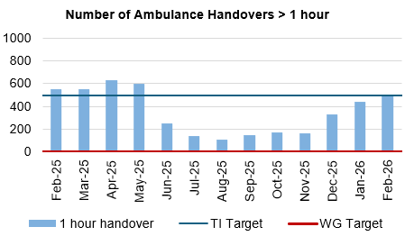
Level 4 – Unscheduled Care
Criteria to Achieve | Current Performance
A continuous reduction of ambulance handovers over an hour of at least 11% in three consecutive months and maintained for 3 months (Based on quarter 2 and 3 2023 baseline). | December – 329 (103% increase) January – 445 (35% increase) February – 501 (11.2% increase)
Continuous improvement towards no more than 7% of patients waiting over 12 hours at each individual site and across the health board. | December – 9.95% January – 11.66% February – 11.86%
Actions being taken to improve include:
Revised flow operating model: The revised operating models implemented as part of the test of change in Morriston remain in place. However, increase in demand for emergency care, high levels of patient occupancy driven by medical bed day utilisation has challenged the Health Board’s ability to maintain flow and thus the level of ambulance handover performance achieved following the tests of change. The emergency pressures have tipped the Health Board into two formal Business Continuity incidents, consistent with the pattern currently seen across NHS Wales. These system pressures continue, however there is evidence to demonstrate that the improvements implemented in June 2025 continue to have impact. This position is further complicated with an increase in the Clinically Optimised patient cohort, which significantly impacts patient flow.
UEC capital redesign – The Health Board ambition to co-locate assessment functions in Morriston into one facility adjacent to the Emergency Department features as part of the capital plan. This remains a priority in terms of UEC service delivery however is dependent on Capital funding to progress.

Slide 8
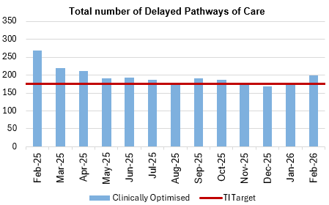
Level 4 – Unscheduled Care
Criteria to Achieve | Current Performance
Median time from arrival at an emergency department to assessment by a clinical decision maker should not exceed 60 minutes. | December – 84.87% January – 84.11% February – 82.93%
A continuous reduction in delayed pathways of care of 5% for three consecutive months and then maintained for three months (based on Oct-Dec 23 baseline). | December – 169 (In target) January – 175 (In target) February - 200
Actions being taken to improve include:
Full implementation of D2RA model – recent communications between the Health Board Chair and CEO and council leaders have enabled a reprioritisation of the work programme to deliver discharge pathways whereby more of the patient assessment occurs within the community. There is an ongoing review of the integrated discharge hub as it is recognised that the resourcing of the service needs to increase in order to deliver an enhanced function. This will be achieved through redirection of Health Board resources in partnership with Local Authorities.
Pathway of Care Delays (PoCD) – The PoCD position continues to challenge patient flow at a time where both ED and ambulance attendance has increased. Despite significant effort being invested in managing the Clinically Optimised patients, the outputs remain limited resulting in patients spending extended periods of time in hospital when they are deemed clinically optimised. There has been a recent increase in the number of patients delayed and the bed days utilised by this patient group.

Slide 9
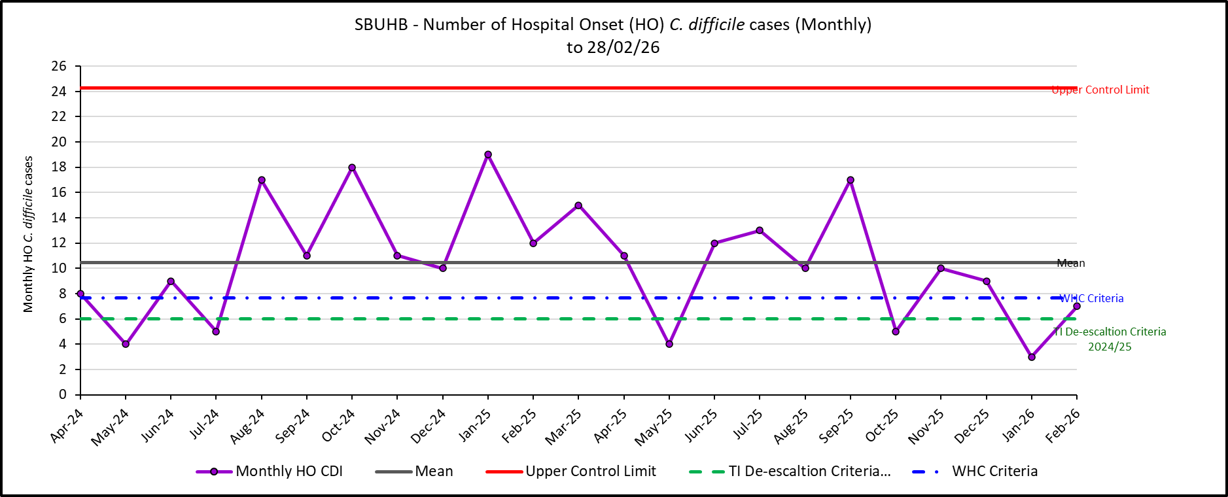
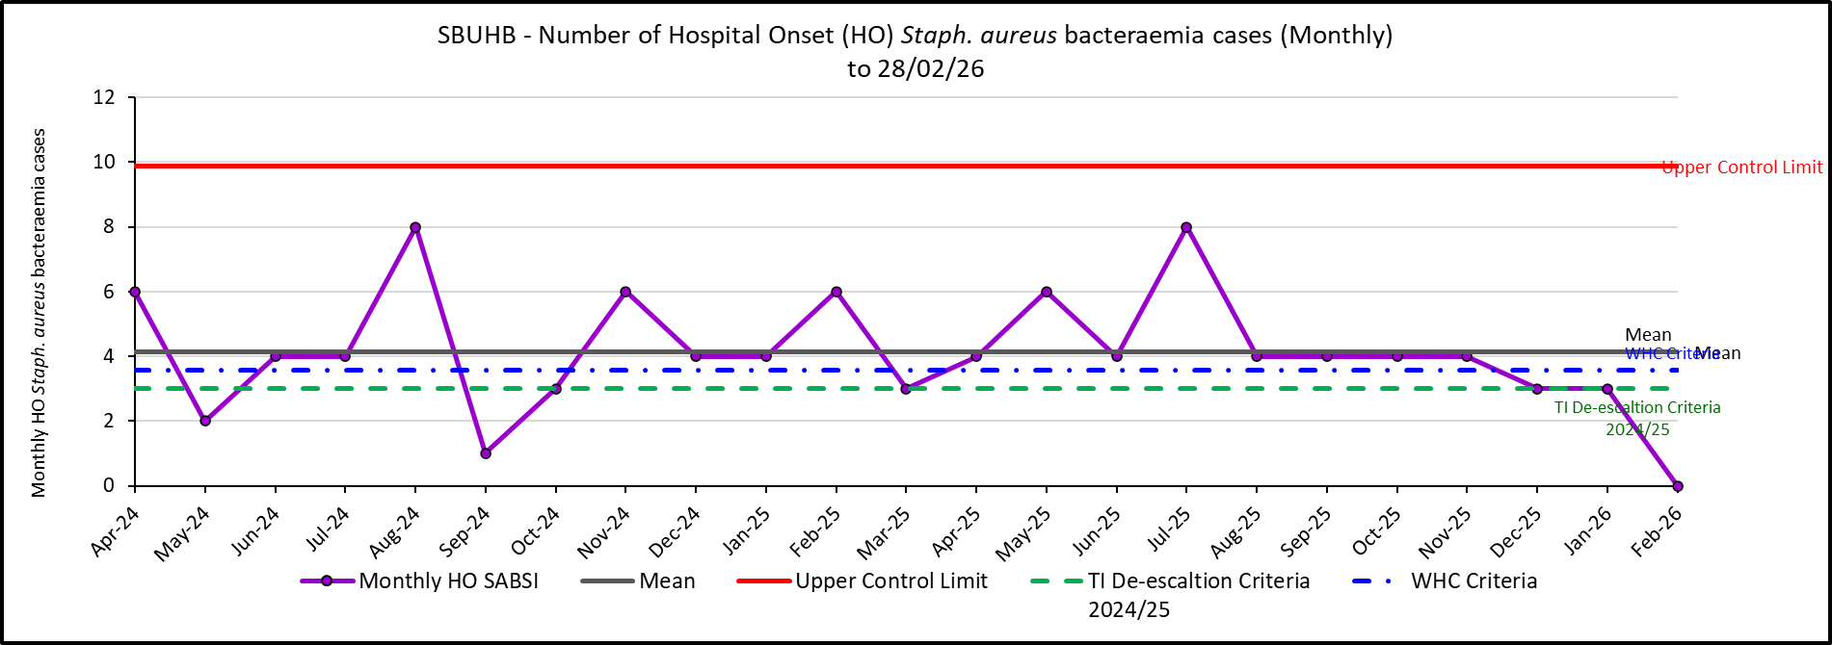
Level 4 – Healthcare Acquired Infections
Criteria to Achieve | Current Performance
A clear improvement plan based on a root cause analysis to address the issue of hospital onset HCAIs. | In Place
C-Diff: reduce the number of hospital onset infections by 40% and maintain for 3 months (from a baseline of the average number of cases in quarter 3 of 10 cases to no more than 6 per month | December – 9 January – 3 February – 7
Staph aureus: reduce the number of hospital onset infections by 25% and maintain for 3 months (from a baseline of the average number of cases in quarter 3 of 4 cases to no more than 3 per month | December – 3 January -3 February - 0

Slide 10
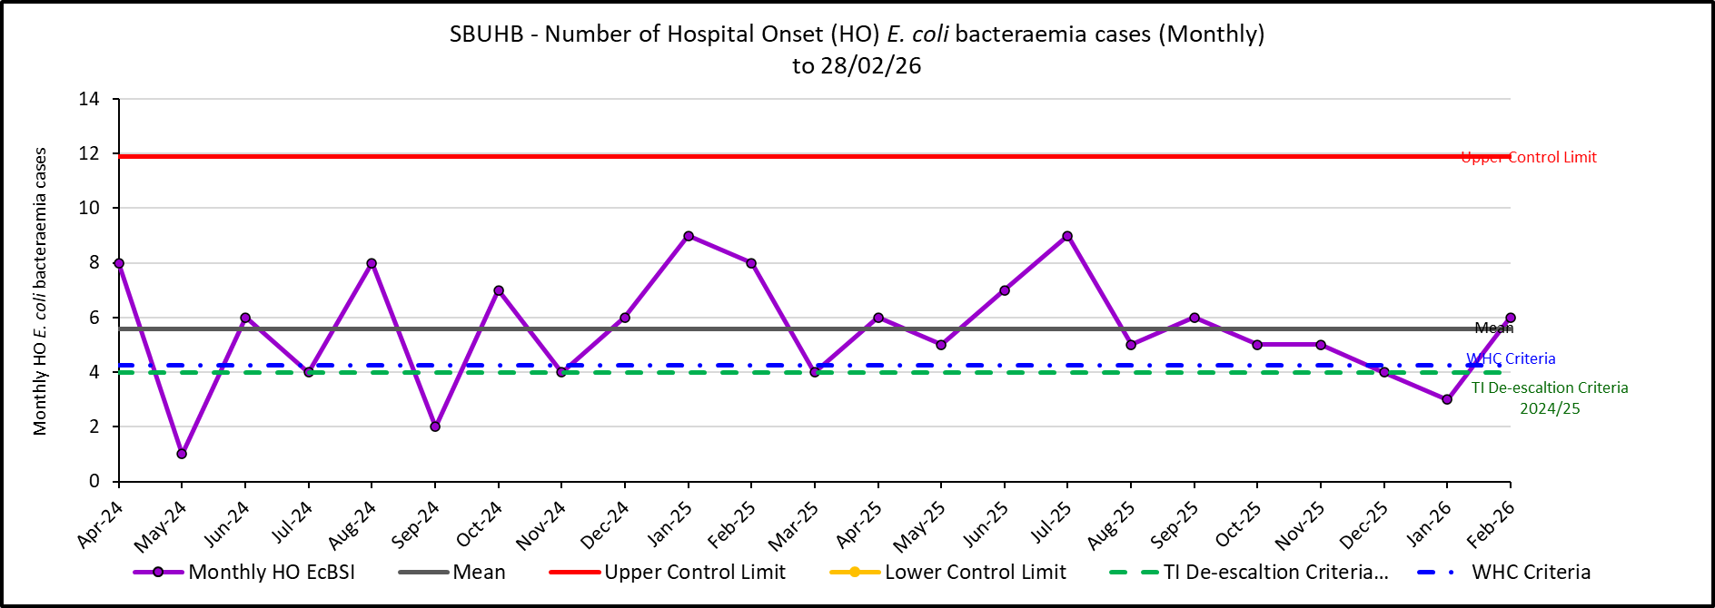
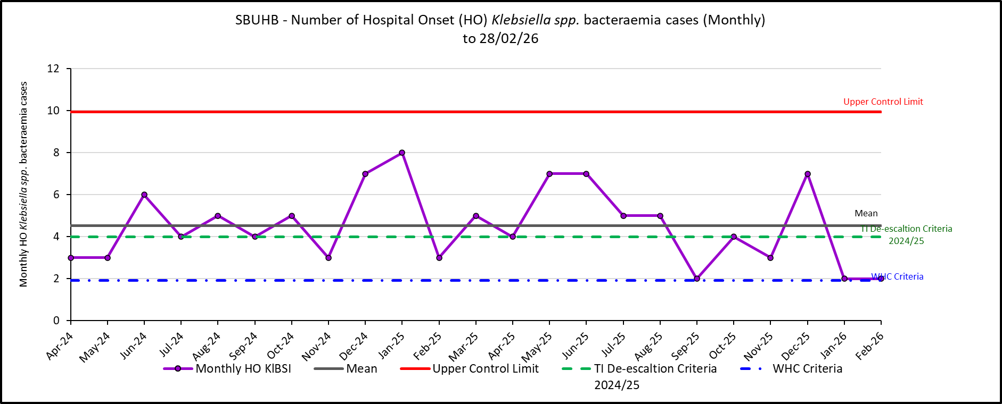
Level 4 – Healthcare Acquired Infections
Criteria to Achieve | Current Performance
E-coli: reduce the number of hospital onset infections by 20% and maintain for 3 months (from a baseline of the average number of · cases in quarter 3 of 5 cases to no more than 4 per month) | December – 4 January -3 February - 6
Klebsiella: reduce the number of hospital onset infections by 10% and maintain for 3 months based on 2017/18 figures (baseline –54 cases in 2017/18, reduce to average of at most 4 per month) | December – 7 January – 2 February – 2

Slide 11
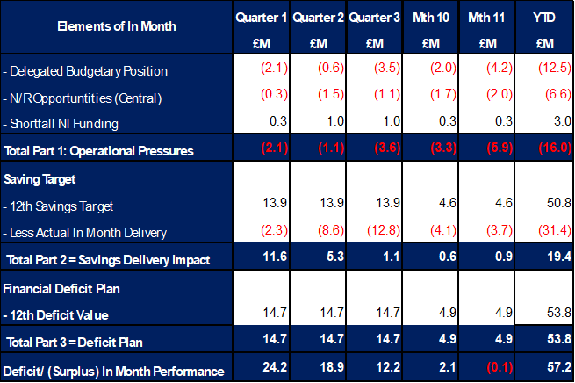
Level 4 – Finance
The Health Board’s assessment on performance against the £58.7m deficit has three components Operational Pressure, Savings Target, and Planned Deficit. Performance against these three elements at Month 9 is summarised in Table 1 below. At Month 11 there was an In-Month underspend of (£0.1m), which is £5.0m below the £58.7m planned deficit, with the YTD position reporting a £57.3m deficit, which is £3.5m above £58.7m plan.
Table 1: Delivery YTD
It has been clear all year and as detailed in Table 1 that the In-Year issue has remained the non-delivery of savings. This shortfall in delivery YTD is in part mitigated by ‘Delegated Budget’ position underspending and the central N/R opportunities as set out in the 11 September 2025 submission delivering. Whilst excluding the non-delivery of saving most areas are within the delegated operational budgets, the key exception remains Mental Health & LD Services. Throughout the year there have been pressures linked to pay and CHC but also Temporary Adult Placements. The latter issue has resulted in an in-month pressure of £0.7m, with YTD expenditure of £6.8m.

Slide 12
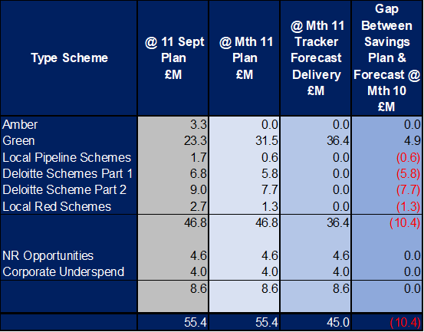
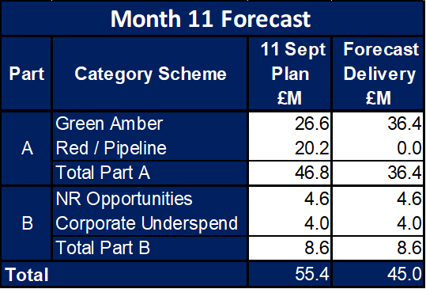
Level 4 – Finance
On savings performance the submission made on 11 September 2025 set out the Plan to deliver the £55.4m savings in 2025/26. This was a combination of (1) Part A - budgetary releasing savings delivery supported by our external strategic partner; alongside (2) Part B - delivery of underspends in the operational budgets specifically around the corporate directorates and N/R opportunities. The monitoring of the performance for Part A is undertaken through the existing governance arrangements, using the Health Board’s savings trackers. This data is then used to complete the WG Monthly Monitoring Return (MMR) Savings Tables. However, as Part B are improvements in run rate and not a formal budgetary savings this element of the plan is not reported in Savings Tables but is incorporated in the wider run rate position. A summary of the assessed performance is provided in Table 2a:
With regard to the delivery of the £46.8m the top section of Table 2b below demonstrates the original plan at 11 September 2025, the plans as per the trackers at Month 11 and the forecast delivery at Month 11. The scheme type is split based on the Amber and Green as per the MMR, Local Red schemes, Local Pipeline ideas and those schemes presented by Deloitte. From Month 10 to Month 11 there has been no movement in the overall delivery, simply a movement of all Ambers to Greens.
Table 2b: Summary of Savings
Table 2a: Summary Performance against £55.4m

Slide 13
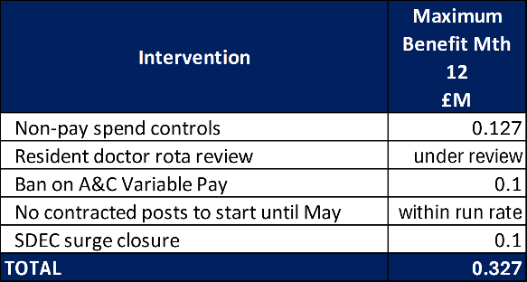
Level 4 – Finance
The pressures seen in operational areas such as Mental Health as detailed above as well as non-delivery of the £55.4m savings target, alongside the pressures linked to ENIC and Nurse Streamline numbers has culminated in the Health Board needing to identify further actions to address the £58.7m deficit plan. At the end of February further actions were agreed by the Executive Team and the Board, which will also support the opening Quarter of 2026/27, prior to a further review at the start of the next financial year. A summary of these additional actions and their assumed savings is summarised in the table below:
Whilst the Health Board has agreed a number of actions, the delivery of the £58.7m and mitigations of the in-years challenges has been driven by the identification of non-recurrent opportunities. Since Month 9 a summary of further opportunities has been shared both with the Board and Welsh Governance, with a number already accounted for and supporting the Month 11 in-month improvement. Work on these items will continue through March.

Slide 14
Level 4 – Strategy & Planning
Updates against the de-escalation criteria outlined by Welsh Government can be found below;
De-escalation Criteria | Actions – Updated March 2026
Submission of a balanced and credible three-year medium-term plan or acceptable annual plan in line with the current planning framework. | Accountable Officer letter submitted on 12th Feb to Welsh Government which confirms that the Health Board will not be able to submit the statutory balanced Integrated Medium-Term Plan for 26/29. Health Board remains focused on delivery of our 2025/26 plan (forecast £58.7m deficit position). This is in addition to urgent work working on reducing our run rate from 2025/2026 into 2026/2027 to improve the opening position. Work is ongoing with Deloitte to define the ‘flight path’ to a sustainable financial position and a sustainable model of service provision. The flight path will be completed for inclusion in our end of March 2026 submission and will set out the sequenced actions required over the planning period. Indications are that a multi-year financial recovery programme is required, underpinned by service reconfiguration, site rationalisation and organisational restructure.
Evidence of a clear roadmap and implementation of the health board’s Clinical Services Plan. | Second meeting of the Clinical Reference Groups for Integrated Community Care and Networked Hospitals held 25th February. Further plan for patient, public and clinical engagement being developed with support from Freshwater ltd. Executive agreed naming of Clinical Services Plan as ‘Transforming for the Future’ to go to Board in November 2026
Welsh Government’s confidence in delivery based on an assessment against an agreed planning maturity matrix | Positive formal feedback receive on our November Submission: “ It was pleasing to see such a comprehensive self-assessment return, giving confidence to the process undertaken and it is positive to see the improvement journey. In addition, it was encouraging to see the process used as an opportunity for objective reflection on planning capability and capacity, including the methodology used for scoring. While some of your own scoring may have been lower than you had hoped, this demonstrates a positive level of maturity - acknowledging areas for development is a critical step toward building a stronger, more resilient planning function.”
Progress made with regional planning | Previous Regional Joint Committee 18th August. Subgroup updates were received for: Regional Health Economy, Clinical Services Planning, Workforce and OD, Data and Digital, Finance and Commissioning, Research and Innovation. The Regional Drive and Delivery Group, Chaired jointly by Abi Harris and Phil Kloer, met on 16 October and provides oversight of subgroup work programmes. Full updates are scheduled to be reviewed at the next RJC meeting 22 January.

Slide 15

Level 4 – Maternity & Neonates
Criteria to Achieve | Current Performance
Ensure that the recommendations and actions in the Independent Review are progressed in line with agreed timescales and report progress to Welsh Government monthly, highlighting risks to delivery. | Perinatal improvement programme has been established Dec 2025 Exec led workstreams are underway Dec 2025 Quarterly Perinatal updates to Board ongoing Perinatal Improvement Programme agreed in principle by Health Board Jan 2026; with Independent Oversight Panel for scrutiny.
Ensure that the agreed actions in the family-led review into Swansea Bay maternity services are progressed in line with agreed timescales and report progress to Welsh Government monthly, highlighting risks to delivery. | The agreed actions of the family led review have been integrated to the Independent Review improvement plan – Jan 2026
Receive a positive assessment from the Welsh Government independent observer on progress against the agreed maternity and neonatal action plan. | We await the outcome of the assessment process – anticipated Feb 2026
Agree a set of sustainability conditions with Welsh Government that can be used to track improvements. | Have developed Perinatal reporting to Board through Quality & Safety committee Jul 2025 Routinely reviewing staff retention and well-being plan – revised plan signed off Jan 2026 Pulse surveys underway – quarterly Robust Governance processes in place – Dec 2025
Evidence effective Board scrutiny and oversight of maternity and neonatal services. | Complete Governance structure in place – July 2025; updated Dec 2025
Embed the maternity and neo-natal dashboard across the service to demonstrate that data is driving real decision making. | Complete
Regularly review the risk register, appropriate risk management, and mitigations. | Ongoing The risk register is reviewed at monthly Perinatal committee and flagged at Quality & Safety Committee and through to the Board
Regularly review against agreed outcomes to demonstrate that there is continued embedding of the LRI/NRIs, complaints and concerns process within quality governance, ensuring responses in a timely manner. | Ongoing Monthly reporting through Perinatal Committee and Board Ward to Board reporting
Evidence a joint and effective PMRT meetings across the service with engagement of affected families. | Ongoing Part of the improvement plan and reported through Perinatal committee

Slide 16
Level 4 – Maternity & Neonates
Criteria to Achieve | Current Performance
Maintain the required staffing establishment at appropriate numbers and grades. | Ongoing Reported monthly through Perinatal committee, into Quality & Safety committee and into Board. Key element of performance report
Achieve and maintain training compliance rates for all staff in maternity and neonatal services. | Complete Reviewed at monthly performance and perinatal committee – key element of the report
Demonstrate required corrective action against Patient Reported Outcome Measures and Patient Reported Experience Measures data for maternity and neonatal services. | Ongoing All reported monthly through Perinatal committee, into Quality & Safety committee and into Board. Additional requirements included in perinatal improvement plan
Evidence how women and family feedback shapes service design within the health board. | Ongoing – Perinatal Improvement Plan outlines engagement blueprint as follows: Service specific engagement undertaken by the service itself, mostly using its own contact with service users; ongoing rolling programme with reporting through Perinatal Committee. Service specific engagement undertaken by corporate teams, particularly DICE and the independent review’s engagement lead “Always on” engagement at a pan-Health Board level which sees generic engagement activity offering up insights and feedback relevant to the maternity and neonatal services. Ongoing Mapping of groups across the Swansea and Neath Port Talbot areas – to be completed April 2026 Develop a Network of Sounding Boards that builds on work being undertaken as part of the Women’s Health Plan – April 2026
Provide assurance that clinical leadership is consistent, visible, effective, and that leadership development support is in place. | Ongoing Senior clinical staff present as required by BAPM guidance; underpinned by audit cycle and key indicators which include care planning in decision making. Reported to Perinatal Committee on monthly basis. Multidisciplinary Team Development Programme rooted in compassionate leadership, culture and behaviours to be delivered between Feb and April 2026; first session held 6 Feb 2026.
Provide assurance and evidence of an improving culture through appropriate surveys, and/or qualitative assessment for maternity and neo-natal services. | Ongoing Reported through monthly Perinatal committee and includes: Workforce heat maps that cover staff feedback Patient feedback Guardian service Patient voices forum Pulse surveys Feedback from all visitors reporting positive change

Slide 17
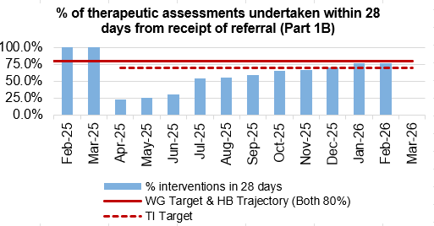
Level 3 – CAMHS
Criteria to Achieve | Current Performance
80% of LPMHSS mental health assessments undertaken within 28 days from the date of receipt of referral | December – 98% January – 93.5% February – 94%
70% of therapeutic interventions started within 28 days following an assessment by LPMHS | December – 70% January – 75.6% February – 76%
85% of HB residents in receipt of secondary mental health services who have a valid care and treatment plan | December -98% January – 97% February – 95%
CAMHS 1A & Part 2 ​
Performance remains strong in these areas and no issues anticipated to maintaining this in future. ​
​
CAMHS Part 1B:​
Recovery of the trajectory continues and is just off target at 76% for February 2026. The directorate remains on target to meet 80% in March 2026. ​
Weekly meetings continue over booking and utilisation of capacity and using our staffing resource as flexibly as possible. ​
Future bookings are also under close scrutiny with chronological booking firmly in place and scrutinization over those booked over target to see if they can be accommodated in earlier cancellation slots to increase compliance. ​
To make aid in meeting the trajectory and target ongoing, 1.0wte B6 funding has been created by repurposing non-clinical posts to provide more 1B capacity, however awaiting break-glass process to enable recruitment.

Slide 18
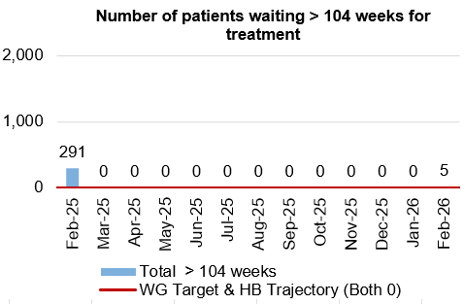
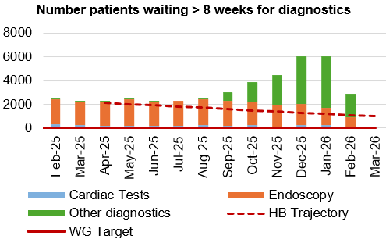
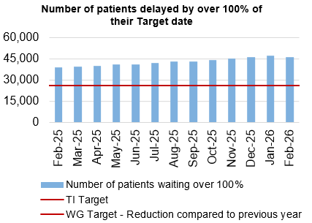
Level 3 – Planned Care
Criteria to Achieve | Current Performance (February 2026)
100% of open outpatient pathways to be waiting less than 52 weeks and maintained for 3 months. | 100%
Continuous improvement towards 75% of all open outpatient pathways waiting less than 26 weeks. | 83.41%
100% of open pathways to be waiting less than 104 weeks and maintained for 3 months. | 99.99%
Continuous improvement towards 80% of all open pathways waiting less than 36 weeks. | 76.24%
12% reduction in the number of patients delayed by 100% for their follow up appointment in three consecutive months and maintained for 3 months (Based on the November 2024 baseline). | 19.67% increase against baseline
68% R1 ophthalmology patient pathways to be waiting within or no longer than 25% of their target date for an outpatient appointment and maintained for 3 months. | 72.60% - meets de-escalation criteria
85% of patients waiting for a diagnostic test to be waiting less than 8 weeks and maintained for 3 months. | 82.17%
85% of patients waiting for a diagnostic endoscopy to be waiting less than 8 weeks and maintained for 3 months. | 63.87%
85% of patients waiting for a NOUS and non-cardiac MRI to be waiting less than 8 weeks and maintained for 3 months. | 82.06%
90% of patients waiting for therapies to be waiting less than 14 weeks and maintained for 3 months. | 100%

Slide 19
Section 2:
Summary of the performance against the Health Boards Strategic Objectives

Slide 20


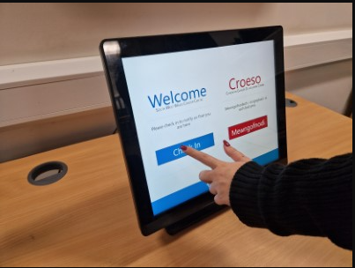


SBUHB Strategic Objectives and Quality Aspects
Our refreshed Strategic Objectives –aligned to ‘a Healthier Wales’ articulate the future state of Swansea Bay UHB as a high-quality organisation. We have set out what this looks like for our population, communities, staff , partners and services and are developing strategic indicators that will tell us if our efforts are delivering our objectives
People of Swansea Bay live healthier, equitable and more equal and prosperous lives
Every child has the best start in life
All children, young people and adults are enabled to maximise their capabilities and have control over their lives
Good work and fair employment is created for all
A healthy standard of living is ensured for all
Healthy and sustainable places are created through placemaking
The role and impact of ill-health prevention is strengthened
Racism, discrimination and their outcomes are tackled
Environmental sustainability and health equity are pursued together
Care is high quality, safe, efficient and delivers the best possible outcomes for people
Care is safe, it helps people and avoids harm
Care is evidence based, effective and improves outcomes
Care is timely and delivered by the right person in the right place
Care is efficient
Care delivers equitable outcomes regardless of demographic, socioeconomic or geographic factors
Care is person centred and delivered with compassion, dignity and mutual respect
Care is delivered in safe and appropriate settings supported by innovative digital solutions
Care is delivered around the patient in the most appropriate setting as close to home as possible supported by digital and data solutions
Care settings are fit for purpose, appropriately designed and equipped
Secure, trusted and insightful data and digital platforms empower staff to deliver more and higher quality care and improved patient outcomes and population health
We have a digitally inclusive culture, where patients, clinicians and non-clinical colleagues work collaboratively to create effective and efficient services and patients are empowered to make informed and meaningful choices about their health and care
Through where and how they are delivered, services contribute to the environmental, economic, social and cultural well-being of Swansea Bay
The health board is a great place to work where staff feel valued and work together towards a common goal
Our Workforce is engaged, motivated and healthy; they feel valued, fairly-rewarded and supported
The Health Board is recognised as an employer of choice
We have a well-planned workforce with the right number of skilled people working on the right things
People feel ready for our digital future
People are supported to develop the skills and capabilities they need
People role model collective and compassionate leadership and live our values
We are diverse and inclusive, ensuring all voices are heard
The health board is a resilient, financially sustainable and responsible organisation
The health board is financially balanced and able to invest in service transformation and change
Decisions are made balancing short-term improvements and long-term impacts
Resources are used efficiently and proportionately, reducing waste and variation
The environmental impact of health care delivery in Swansea Bay is minimised
The health board invests in and works with others locally and responsibly, using our assets to positively contribute to the community
Citizen stakeholders are meaningfully involved and engaged in decision making
The health board has the capacity to effectively plan for and respond to incident and emergencies

Slide 21
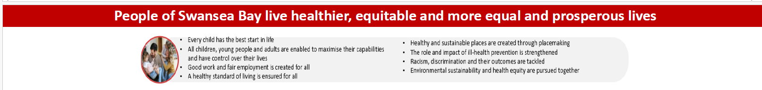
SBUHB organisational strategy indicators | Target/standard | Time period (reporting frequency) | Most recent data available
Percentage of children who are up to date with the scheduled vaccinations by age 5 (‘4 in 1’ preschool booster, the Hib/MenC booster and the second MMR dose) | 95% | Jul-Sep 2025 (quarterly*) | 88.4%
Percentage of children receiving the Human Papillomavirus (HPV) vaccination by the age of 15 | 90% | Jul-Sep 2025 (quarterly*) | 85.8%
Percentage of adult smokers who make a quit attempt via smoking cessation services | 5% | 2024/25 (annually) | 3.5%
Percentage of eligible adults who participate in bowel screening | 60% | 2023/24 (annually**) | 64.2%
Welsh Government Immunisation targets 2025/26 | Target/standard | Time period (reporting frequency) | Most recent data available
Percentage uptake of influenza vaccine in adults 65 years and over | 75% | March (monthly) | 68.1%
Percentage uptake of COVID-19 vaccine for all those eligible | 75% | March (monthly) | 54.6%
*Quarterly data release from PHW for Oct-Dec 2025 is delayed (was due 28/02/26)
**PHW data on screening uptake in SBUHB will be reported quarterly from 2026/27 on

Slide 22
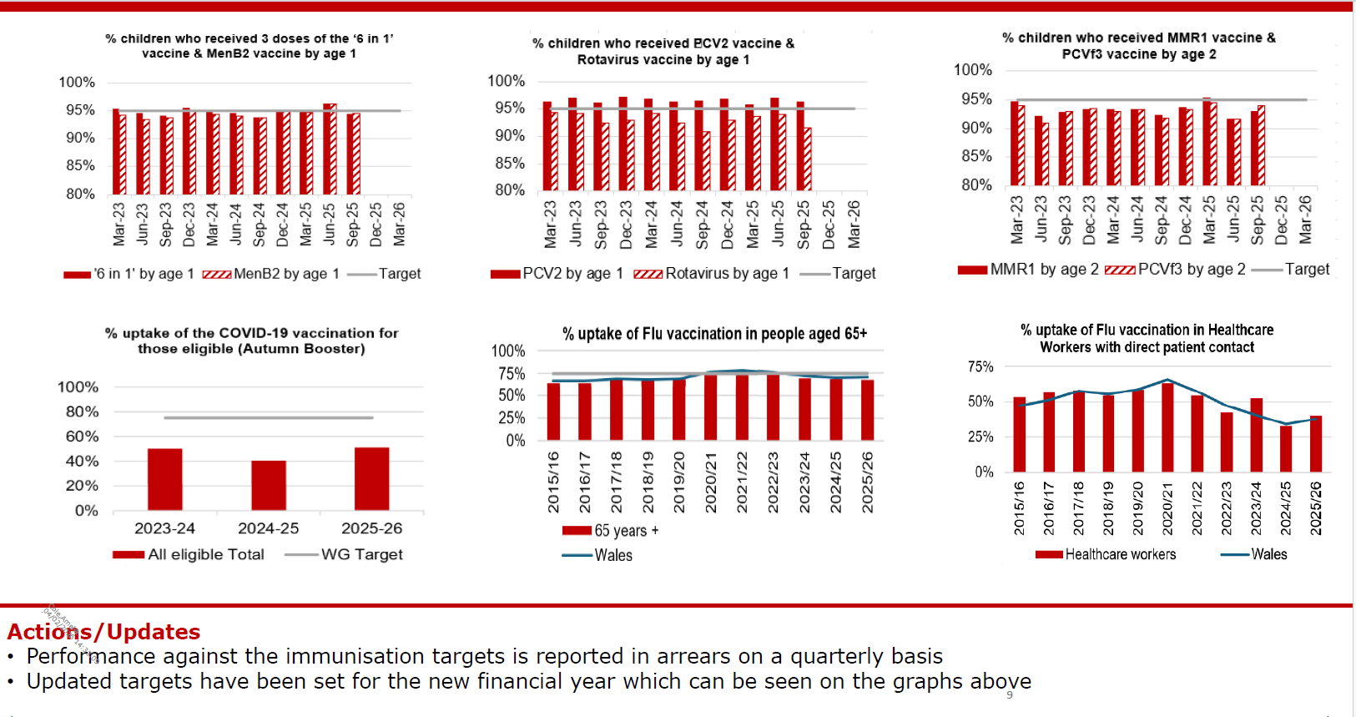

Slide 23
Care is high quality, safe, efficient and delivers the best possible outcomes for people
Accident & Emergency | Target | Feb-26
4 -hour performance | 95% | 67.68%
12-hour performance | 0 | 1,202
Number of Delayed Pathways of Care (HB wide) | Continuous Reduction | 200
Number of cancelled Electives | 0 | 9
Median time of arrival to assessment within 60 minutes | 97% | 82.93%
Ambulance
Median emergency ambulance response time to purple: arrest category calls | 6-8 minutes | 7.16 (Jan-26)
Median emergency ambulance response time to red: emergency category calls | 6-8 minutes | 9.46 (Jan-26)
Total Handovers lost over 15 minutes | 0 | 1,793
Total Handover Delays > 45 minutes | 0 | 591
DE
TI
DE
TI
TI

Slide 24
Care is high quality, safe, efficient and delivers the best possible outcomes for people
Stroke | Target | Jan -26
Percentage of admission within 4 hours | 95% | 25.1%
Percentage of stroke patients receiving a CT scan within 20 minutes | 40% | 6.7%
Percentage of patients assessed by a stroke consultant within 14 hours | 95% | 60%
Percentage of patients to receive a mechanical Thrombectomy | 10% | 6.7%
Planned Care | Target | Feb – 26
Percentage of patients waiting < 26 weeks for an outpatient appointment | 75% | 83.41%
Total number of patients waiting < 36 weeks | 80% | 76.24%
Number of patients waiting at Stage 1 > 52 Weeks | 0 | 0
Total number of patients waiting > 104 Weeks | 0 | 5
Diagnostics & Therapies | Target | Feb – 26
Number of patients waiting > 8 weeks for diagnostics | 0 | 2,917
Number of patients waiting > 8 weeks for an Endoscopy | 0 | 830
Number of patients waiting > 14 weeks for Therapies | 0 | 0
Number of children waiting > 6 weeks for Audiology | 0 | 107
TI
TI
TI
DE
TI
DE

Slide 25
Care is high quality, safe, efficient and delivers the best possible outcomes for people
FUNB | Target | Feb -26
Number of patients waiting for an outpatient follow-up (booked and not booked) who are delayed past their agreed target date (All Specialties) | N/A | 75,892
Total number of patients waiting 100% over their target date | 0 | 45,996
Total number of patients waiting for a follow-up appointment | N/A | 158,618
Mental Health & Learning Disabilities | Target | Feb – 26
Percentage of mental health assessments undertaken within (up to and including) 28 days from the date of receipt of referral | 80% | 98%
Percentage of therapeutic interventions started within (up to and including) 28 days following an assessment by LPMHSS | 80% | 84%
Percentage of patients waiting less than 26 weeks to start a psychological therapy in Specialist Adult Mental Health | 80% | 40.4%
Quality & Safety | Target | Feb – 26
Number of service user feedback experience responses on CIVICA | Monthly improvement | 6,668
Percentage of complaint responses sent within 30 working days | 80% | 59% (Dec-25)
Number of Nationally Reported Incidents | N/A | 3
Number of New Never Events | N/A | 0
TI
DE
DE
DE

Slide 26
Unscheduled Care

Slide 27
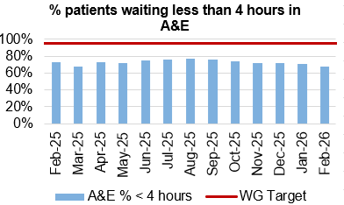
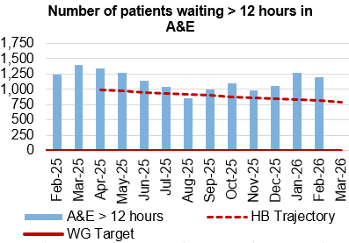
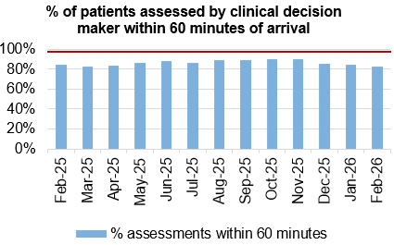
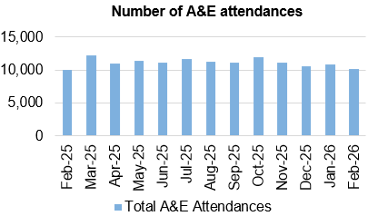
Unscheduled Care
Dashboard
Actions/Updates
Full implementation of D2RA model – recent communications between the Health Board Chair and CEO and council leaders have enabled a reprioritisation of the work programme to deliver discharge pathways whereby more of the patient assessment occurs within the community. There is an ongoing review of the integrated discharge hub as it is recognised that the resourcing of the service needs to increase in order to deliver an enhanced function. This will be achieved through redirection of Health Board resources in partnership with Local Authorities.
Pathway of Care Delays (PoCD) – The PoCD position continues to challenge patient flow at a time where both ED and ambulance attendance has increased. Despite significant effort being invested in managing the Clinically Optimised patients, the outputs remain limited resulting in patients spending extended periods of time in hospital when they are deemed clinically optimised. There has been a recent increase in the number of patients delayed and the bed days utilised by this patient group.

Slide 28
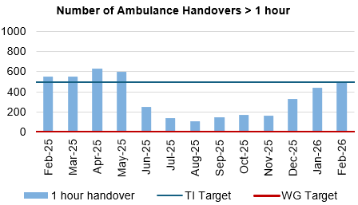
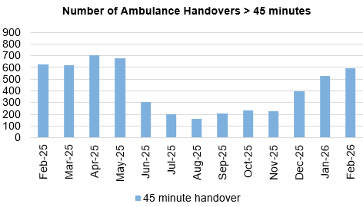
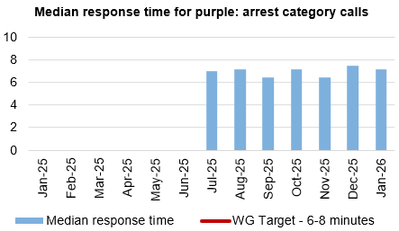
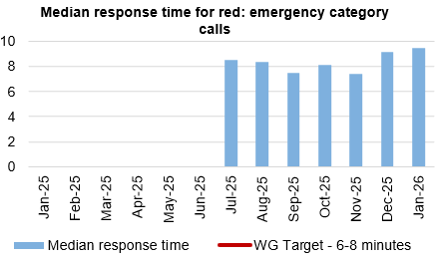
Ambulance
Dashboard
Actions/Updates
Revised flow operating model: The revised operating models implemented as part of the test of change in Morriston remain in place. However, increase in demand for emergency care, high levels of patient occupancy driven by medical bed day utilisation has challenged the Health Board’s ability to maintain flow and thus the level of ambulance handover performance achieved following the tests of change. The emergency pressures have tipped the Health Board into two formal Business Continuity incidents, consistent with the pattern currently seen across NHS Wales. These system pressures continue, however there is evidence to demonstrate that the improvements implemented in June 2025 continue to have impact. This position is further complicated with an increase in the Clinically Optimised patient cohort, which significantly impacts patient flow.
UEC capital redesign – The Health Board ambition to co-locate assessment functions in Morriston into one facility adjacent to the Emergency Department features as part of the capital plan. This remains a priority in terms of UEC service delivery however is dependent on Capital funding to progress.

Slide 29

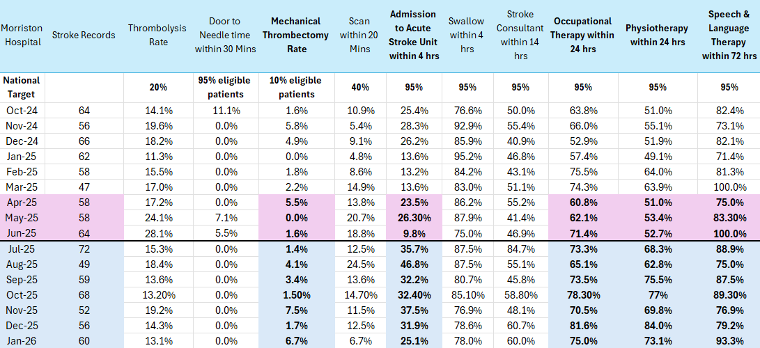
Stroke
Actions/Updates
Compliance against the 4-hour access target and the ring-fencing of beds for admission to the Acute Stroke Unit continues to remain challenging due to system wide pressures. However, work is taking place to improve flow between Morriston Hospital and Neath Port Talbot (NPTH).
Funding still not received to implement a 24/7 stroke consultant rota.
Performance against the new KPI metrics remain challenging.
Continued high compliance of thrombolysis rate, swallow assessments and therapeutic assessments.
Performance against the new KPI CT head within 20 minutes has positively increased
Reducing door to needle time for Thrombolysis is an area for improvement, more so since the introduction of the new KPI
Increase of Mechanical Thrombectomy remains a priority.
Embedding of CT Perfusion and MRI Perfusion.

Slide 30
Planned Care

Slide 31
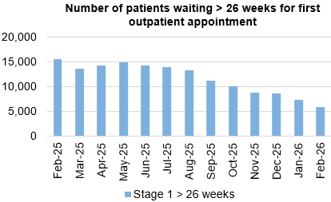
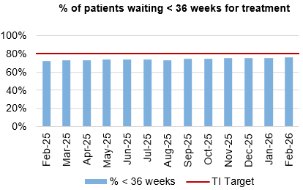
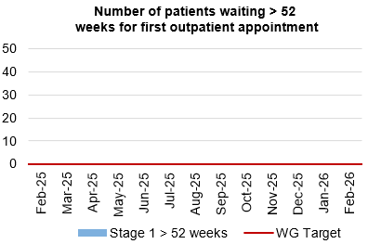
Planned Care
Dashboard
Actions/Updates
The Health Board have maintained the Stage 1 > 52 weeks target of 0 for February 2026.
The Health Board have reported 5 patients waiting > 104 weeks for treatment target of 0 for February 2026. The breached in February are result of the national bone cement shortage which affected the UK. All of these patients will be redated in March and so we will maintain 0 breach position for end of year.
Robust monitoring via live dashboards with revised Planned Care scrutiny structure due to go live in March providing clearer operational grip.
Outpatient Redesign Workplan for 26/27 agreed at OPRRG.
Targeted elimination of long waits through focused additional activity until end of March.
Q1 26/27 baseline reset within core capacity is planned via the Deloitte-supported productivity analysis.

Slide 32
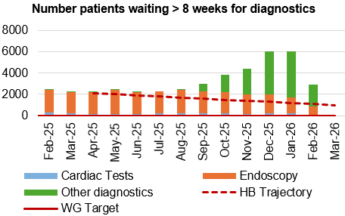
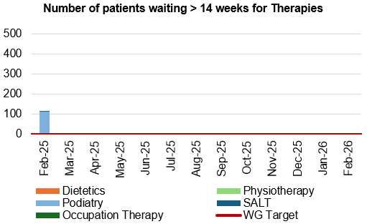
Diagnostics and Therapies
Actions/Updates
The total number of patients waiting > 8 weeks for diagnostics has decreased in February to 2,917 compared to 6,059 in January 2026.
As part of the recovery plan, the WG have funded a mobile Endoscopy unit which has been sited on Morriston Hospital to support additional capacity. The unit has however been running live activity again since the 30th December and is supporting the reduction of the number of patients waiting > 8 weeks for an Endoscopy and the waiting list continues to reduce as a result of the additional capacity.
The number of patients waiting > 14 weeks for therapies has been reported as 0 in February 2026

Slide 33
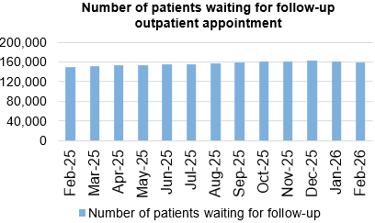
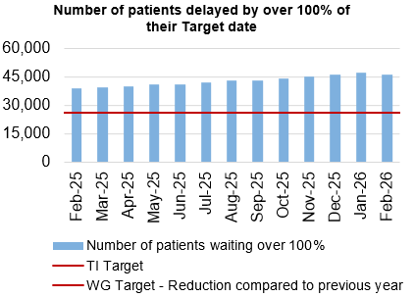
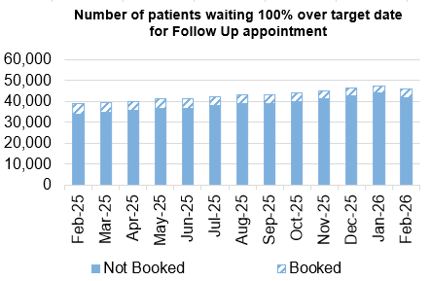
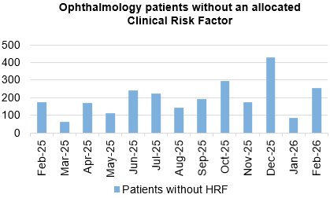
Follow-Ups & Activity

Slide 34
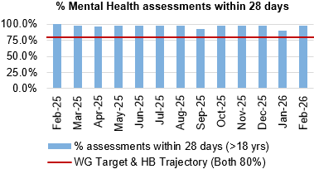
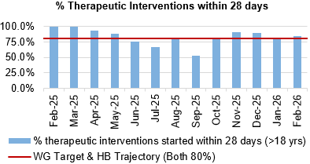
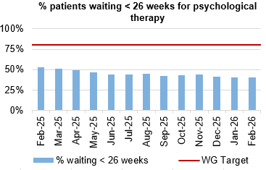
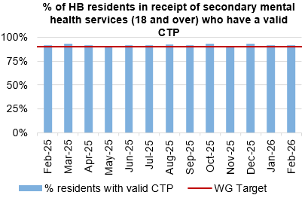
Mental Health & Learning Disabilities
Actions/Updates
The service continues to meet all of the Welsh Government targets, apart from for patients waiting < 26 weeks for Psychological therapies. Waits within this area continue to be a concern Nationally and the service are working closely with Welsh Government colleagues for a solution.
The Health Board continues to report on the work being undertaken as part of the Transformation programme, routine updated are provided to Board.

Slide 35
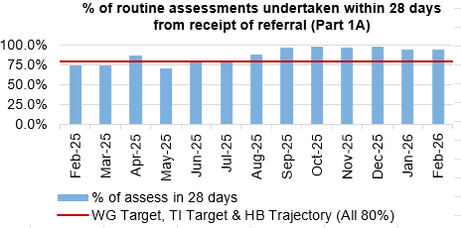
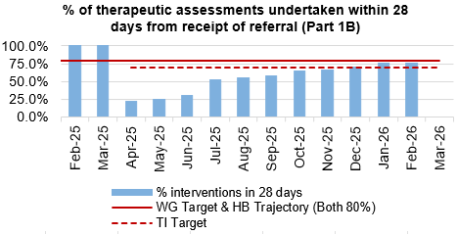
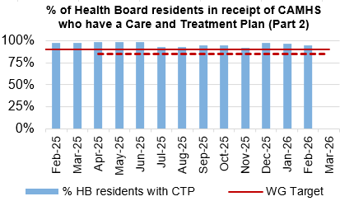
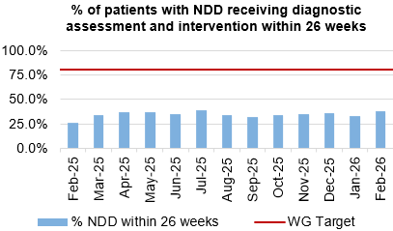
Child and Adolescent Mental Health Service (CAMHS)
Actions/Updates
CAMHS Part 1B:​
Recovery of the trajectory continues and is just off target at 76% for February 2026. The directorate remains on target to meet 80% in March 2026. ​
Weekly meetings continue over booking and utilisation of capacity and using our staffing resource as flexibly as possible. ​
Future bookings are also under close scrutiny with chronological booking firmly in place and scrutinization over those booked over target to see if they can be accommodated in earlier cancellation slots to increase compliance. ​
To make aid in meeting the trajectory and target ongoing, 1.0wte B6 funding has been created by repurposing non-clinical posts to provide more 1B capacity, however awaiting break-glass process to enable recruitment.

Slide 36
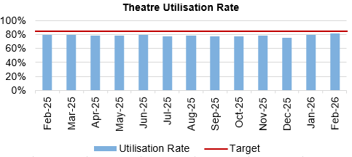
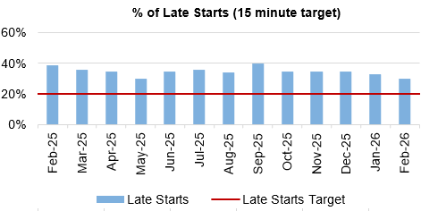
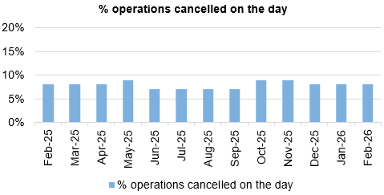
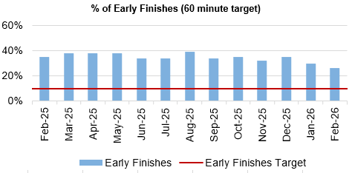
Theatre Efficiency
Actions/Updates
The Planning Framework sets out enabling actions that must underpin the delivery priorities to successfully achieve the core service and changes required. These include value projects, digital innovations, workforce developments, financial sustainability and ways of working. The enabling actions and planning framework have been incorporated into SBUHB’s Theatre performance framework and work is currently underway to report against these measures.
NPTSSG are currently undertaking focussed work to reduce late starts and maximise efficiency within theatre’s

Slide 37
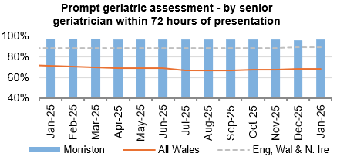
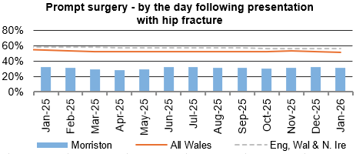
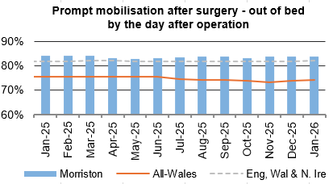



Fractured Neck of Femur (NOF)

Slide 38






Primary Care
Actions/Updates
GMS escalation levels are currently remaining steady as we head into the winter period.
The number of ACORNS completed is showing a steady increase towards the target as the year goes on.
Floride varnish remains over target for both children and adults.
The number of patients for eye health care Wales (emergency eye care) has increased from an average of 2,245 per month last year to an average of 2,641 per month this year to date. There is a slight increase in the number of patients receiving low vision services with an increase in domiciliary visits in particular.
Common ailments consultations continue to increase with an average of 900 more consultations per month in comparison to 24/25. If this trend continues this would be a further 17% increase on last year.

Slide 39
Quality & Safety

Slide 40




Infection, Prevention & Control
Dashboard
Actions/Updates
Gold C. difficile High Incidence Management Group.
Continuation of QI Project in Acute Medical Unit focusing on AMS and 72-hour review and improving switch to oral route for administration.
Trial of new Microfibre cleaning systems.
Procurement of additional high-level disinfection equipment (UV-C).
Primary care QI projects to reduce urinary tract infections in care home residents.
Review of prescribing guidelines for antibiotic prophylaxis during prolonged surgical interventions.
Repeat Hospital Acquired Pneumonia antimicrobial audit.

Slide 41




Serious Incidents and Risks
Actions/Updates
There were 3 Nationally Reported Incidents reported in February 2026 and there were no new never events reported. The detail surrounding the nature of the reported NRI’s can be found on the subsequent pages.
In February 2026, there were 106 open risks with a score >20 recorded for the Health Bord which is slightly lower than the figure reported in January. There were 251 open risks with a score >16, which again is a slight increase compared to 248 in January 2026.
There were 162 hospital falls recorded in February 2026

Slide 42



NRIs/NE’s/EWNs – February 2026
What is the data telling us?
Graph 1 – Number of NRIs / NE’s reported to P&I – 2 (includes retrospective reporting of: 1 avoidable pressure damage’)
Graph 2 – 39 NRIs open with NHSWP&I – 18 open past closure date of which 6 are awaiting outcome of external reviews; 2 infant deaths require receipt of external review before closure can occur; 6 remain under investigation. 6 outcome forms with service groups to complete
Graph 3 – Outcome forms submitted in month - 1 (100% performance)
What are we doing about it?
Weekly review with PSI investigator to:
  monitor progress of corporate investigations; identify barriers
  escalate outstanding actions required
Fortnightly service group meetings:
  service group investigations - progress towards closure date discussed
  updates on PSI investigation given
  escalate to service group barriers identified with corporate PSI investigations
Service Group Directors contacted separately for outstanding actions
Data presented and discussed at health board Patient Safety and Compliance Group; Quality and Safety Group; Patient Stakeholder and Experience Group - Service Group assurance sought against outstanding actions for completion of investigation / outcome form
What do we expect to see change and when?
Reduction in number of overdue investigation outcomes forms
Reduction in number of NRIs/NEs reported through recommendations/learning monthly
EWNs – February 2026
Risk or adverse publicity – Staff member arrested – Inappropriate online contact with child
Risk or adverse publicity – GP Fraud

Slide 43




Falls Prevention
  February 2026
Page 1
Project Team: Senior Responsible Officer: Helen Annandale, QP lead – Eleri D'Arcy
Underlying causes:
Ageing population with increasing frailty picture
Increased demand on WAST and front door services
Limited alternative WAST response to level 1 and level 2 falls regionally
Inconsistent approach to falls advice in community/primary care
Reduced access and provision of falls clinics across region
Limited prevention offers
Destabilisation at National Level re Governance
What is the Data telling us?:
In-patient falls rate remains below National average
January 2026 has seen the lowest falls rate (3.26/1000 bed days) since June 2023
Falls rate by ward has seen biggest reduction at Cefn Coed site across all older persons wards
Falls related attendance to MIU up 20% compared to last month but on par with previous year. ED attendance for falls 7% higher than prev year.
There have been 4 NRI falls related incidents in the last 12 months (Jan25--Dec25) compared to 10 in the previous 12 months = 60% decrease
Care Home falls project continuing roll out – now live across 15 homes and preparatory work across other sites complete – current ambulance call out rate at under 18% (compared to previous 94%) with a total of 555 falls incidents reported.
Health Board wide data
Falls rate /1000 bed days by ward Dec '25
What are we doing about it:
Review of Level 1 and 2 falls offer
Alignment with RPB Falls plan
Closer working with UEC
Re-establishing National Safer Mobilisation Group (previously National In patient falls Group)
Regional Falls Prevention taskforce enabling collaboration
Primary Care action plan agreed
Continued patient engagement events
Falls prevention (Dance to Health) programme developing due to commence prior to April 2027
Review of Care pathways National & Local
What do we expect to see change?
Reduction in WAST call out from care homes following falls incident (goal – 30% reduction per site by March '26) - ON TRACK
Falls rate not exceeding 5.0 (falls/1000beddays) over proceeding 12 months – ON TRACK
Reduction in conveyance to hospital via WAST for level 2 falls (WG target of 25% reduction) - OFF TRACK (current rate 16% reduction) - review underway to plan post March 2025
WAST - Conveyed calls (over 60yrs)

Slide 44




Patient Experience & Concerns
Actions/Updates
There were 5,959 friends and family surveys completed in February 2026 which is a reduction on the previous month where 6,549 surveys were completed.
Of those surveys completed, the 93% of patients would highly recommend the services they received.
There were 163 concerns received in December 2025, and 59% of those concerns had responses sent within 30 days in December.

Slide 45
Complaints – February 2026
What is the data telling us?
Graph 1 – is indicating that a number of complaints are not compliant with the 30 working day target for responding to formal complaints in line with the Putting Things Right Guidance.
Graph 2 – 210 new formal complaints in February which is an increase compared to 166 in December.
Graph 3 - The average number of days taken to close a formal complaint has decreased by 2 working days compared to the previous month. Average days for December being 28 days which is within the Welsh Government target of 30 working days.
Graph 4 - The number of overdue formal complaints is decreasing bi-weekly. As of the 27th February 2026, 257 formal complaints were overdue
What are we doing about it?
Bi-weekly report run on all overdue complaints which is sent to each Service Groups requesting updates.
Bi-weekly drop-in sessions where complaint handlers can join to discuss any issues.
Bi-weekly meetings with Service Groups to discuss open complaints and Ombudsman cases.
Test to Change in SNPT to trial new way of managing complaints and trying to resolve early on.
Corporate are supporting individual service groups with the aim of reducing the number of overdue complaints
What do we expect to see change and when?
There is evidence to indicate that there is a reduction in the overdue complaints as shown in graph 4
.
Early engagement with the complainant combined with listening meetings which will support an empathetic and compassionate handling of the complaint.
**Please note two graphs only go up as far as November, this is due to the 30 working days for complaints received in Dec/Jan not being up yet

Slide 46




Patient Experience – February 2026
What is the data telling us?
Graph 1 – Illustrates that Swansea Bay UHB’s overall score consistently exceeds the benchmark of 85%, maintaining a performance of 90% or higher.
Graph 2 – Displays the overall satisfaction scores across the different Service Groups.
Graph 3 – Highlights wards/clinics achieving scores above 100%, based on more than 30 responses..
Graph 4 – Identifies the wards/clinics with the lowest satisfaction percentages.
What are we doing about it?
The system generates weekly feedback summaries for Service Group Leads, enabling timely action on low scores and recognition of positive feedback and comments.
Ongoing drop-in feedback sessions are held to support teams in using Civica effectively and managing their feedback constructively.
For alerts flagged as very poor or poor, the Action Manager is triggered. This tool tracks the progress and resolution of issues within Civica, managed by the PALS and Quality & Safety departments.
What do we expect to see change and when?
We expect departments to take ownership of their low scores and implement improvements based on the feedback provided. Our role is to ensure timely alerts and supply weekly comment reports to support this process.
Graph 1
Graph 3
Graph 2
Graph 4

Slide 47




Quality & Safety
Actions/Updates
The percentage of completed discharge summaries was 65% in February 2026, which is the same figure which was reported in January.
There were 155 Pressure Ulcers reported in January 2026, of which 47 were recorded in the Community.
The percentage of episodes clinically coded within 1 month of discharge increased to 68% in January 2026.

Slide 48


Pressure Ulcers: Action & Intervention
Page 1
Pressure Ulcers – Action & Intervention
Goal – To reduce the amount of patients developing HB acquired avoidable pressure damage by 20% by end of March 2026
What is the Data telling us:
156 incidents were reported in January 2026, on par with December 2025, a 32% from previous months (Graph 1). This was reduced following the cleanse for December, not yet completed for January
Inpatient rate: 2.9 % per 1,000 bed days for 2026 (0.4% rate increase). There is no national average.
The highest inpatient rates are at NPSSG (R 3.0) and Morriston (R 2.9) for Q3.
PCS rates are challenging due to inaccuracies in caseload dashboards. 17% reduction in incidents.
Harm Profile
Severity: November to January data: (Graph 2)
87% of all health board-acquired incidents remain superficial in nature,
13 % deep in nature,
3% severe harm. Due to a backlog of cases requiring scrutiny review, this picture may not be accurate
The trajectory reflects an increase in incidents deep damage
75% are deemed unavoidable, 52% were closed with no status. (106 incidents)
Please note that this position may change pending validation through the scrutiny process
Quarter 3 Data (validated)
13 % increase in the total number of Health board acquired incidents reported, comparing reduction when comparing to the Q1/2 average. 23% increase in hospital sites.
3 % increase in deep tissue damage
Over 70% of all community damage incidents investigated were deemed unavoidable.
Underlying causes:
Patient vulnerability (esp. first 72h of admission).
Staff knowledge, skills and application of risk management principles
Delays in receiving specialist equipment
Limited prevention training, lack of tissue viability expertise Delayed/incomplete digital charting, and limited access to medical photography.
Whole system pressure affecting the timeliness of scrutiny review panels
What we are doing about it:
Improvement in number of incidents closed (65% in Quarter 3), increasing the accuracy of data
Pressure Ulcer Strategic Group, scrutiny panels, peer reviews.
Audit of documentation and care provided
Multi-layered education (face-to-face, Teams, videos
Development of PU pathways, policies, and improvement plans supported by All Wales Tissue Viability Forum.
Centralised Tissue Viability service, digital wound imaging (Improvement Cymru), bed contract finalisation. Shared education, champions and skills programme
Quality Improvement awareness campaign 2026
Graph 1
Graph 2
Graph 3
What we expect to see (Outcomes by 2026):
↓ 20% PU rates in acute sites; ≤1.6/1000 bed days.
↓ 20 % avoidable PU in HB.
↓ Reduce the total number of HBA incidents by 10%
↓ Reduce HB acquired Deep damage by 10%

Slide 49





Mortality: Action & Intervention
3.25%
The summary of deaths in the Emergency Department can be seen below:
Mortality Data Summary
The crude mortality rate has seen a reduction in February 2026, reporting 1.07% compared to 1.54% in January 2026.
Crude mortality over the last 4 years is within the control limits and the recent data reflects the predicted decline of mortality as expected during summer months
The summary of deaths in the Emergency Department has remained relatively stable in recent months
92.6%

Slide 50
Maternity & Neonates

Slide 51




Maternity & Neonates
Perinatal Mortality - Stillbirths | Perinatal Mortality - Neonatal Deaths
There have been 12 stillbirths during January – December 2025, all are included in the MBRRACE reporting data. One case did not receive any antenatal care within Swansea Bay; one was an unknown pregnancy that birthed pre-hospital with maternity services involved postnatally to provide care and support.
There have been 11 neonatal deaths between January 2025 and December 2025 and of these cases only five are reportable to MBRRACE as two were over 28 days of life. Of these five, only two will be represented in the MBRRACE report as deaths <24 weeks gestation are not included in the final report for analysis. The three deaths not included in MBRRACE analysis were extremely pre-term (less than 24 weeks) at the limit of viability .
No Stillbirths in February 2026
2025 - Based on 12 cases our crude stillbirth rate for 2025 is 3.68/1000 births, we won’t have the final figures both crude and stabilised, adjusted from MBRRACE until quarter 3 of 2027. Swansea Bay’s crude and stabilised, adjusted rate for stillbirths in 2023 based on 13 stillbirths was 4.79/1000 births.
No Neonatal Deaths in February 2026
Perinatal Morbidity – HIE Grade 2 and 3 | Maternal Morbidity – PPH <1.5litres
There have been 6 cases of HIE reported in January – December 2025. All babies survived to discharge with good outcomes. There is limited data published to allow National benchmarking. Latest published data from National Neonatal Research Database (NNRD) is 4 years out of date (Department of Health, 2021 data). This reports a UK average incidence for Moderate and Severe HIE cases of 1.59/1000 births (1.49-1.70).
Due to the low number of HIE and births in SBUHB a rolling 12-month HIE incidence reporting is more appropriate. This shows that in January 2026 our moderate to severe rolling 12-month HIE rate was 1.84/1000 births. This represents a 48% decrease since its peak in April 2024 of 3.32/1000 births. The 2025 HIE rate is 1.84/1000 births.
The NMPA published 2023 data for National benchmarking and reported postpartum haemorrhage incidence as 3.41/1000 births (2.98-3.79). SBUHB rate for postpartum haemorrhage in 2025 was reported as 2.49/1000 births, lower than the National benchmark. This showed a steady reduction from 2024 data, of 3.51/1000 births.
51

Slide 52



Maternity & Neonates
Maternity Triage - BSOTS
Birmingham Symptom Specific Obstetric Triage System (BSOTS) is the Maternity services emergency department to support women experiencing concerns or urgent complications with their pregnancy or postnatal period. The following metrics help the system understand how effective, efficient, timely and safe our triage system is in responding to these. In December 530 women were reviewed in triage and assessed for ongoing care requirements in comparison to 480 in November, an increase of 18% . Initial trigae within 15 minutes, standard is 90% - rate in January 93.2% which is a increase in the compliance in November of 87.5%. There were 14 incidents reported due to delays following initial assessment and risk stratification for yellow, amber and red pathways. There were no incidents of harm as a result of these delays. There were 24 breaches in timely medical review of 4.4% which is an improved position of 7.8% in December.
Workforce – Neonatal Staffing Establishment | Workforce – Maternity Staffing Establishment
52

Slide 53



Maternity & Neonates
Perinatal Training Compliance
 | There have been some challenges within the Neonatal medical workforce due to unavailability, this has been mitigated with flexible working arrangements which has meant there has been no gap in service. A Neonatal Consultant was successfully recruited on the 9th December, with 1 expected return following maternity leave in January. Obstetric workforce – 2 fixed term gaps for career break and other leave have been covered with no vacancies impacting on services. Training compliance is improving across the board and individual staff out of compliance have been emailed to complete their mandatory training. Respective line managers follow up is in place.
53

Slide 54
Care is delivered in safe and appropriate settings supported by innovative digital solutions
Communication with primary care ​ | Target​ | Oct 25​ | Nov 25 ​ | Dec 25 ​
% of discharge letters sent to GP ​ | 100% | ​69% | 73%​ | 71%​
Digital Inclusion ​ | Target​​ | ​ | ​ | ​
Total number of citizens that have downloaded the NHS Wales App | ​TBC | 72,651 | 75,406 | 77,829 (16% of population)
Total number of outpatients that have downloaded the Swansea Bay Patient Portal | 50%​ | 33,949 | 37,388 | 40,699 (​14% of outpatients)
% of Digital Health Assessment forms Completion Rate | 60%​ | 34.32%​ | 27.22%​ | 56.15% (2652 completed forms)
Diagnostic requesting ​ | ​ | ​ | ​ | ​
% of secondary care pathology tests raised electronically ​ | ​90% | ​83% | ​83.2% | ​85%
% of primary care pathology tests raised electronically ​ | ​95% | 95%​ | 95%​ | 95%​
Supporting safe discharge ​ | Target​ | ​ | ​ | ​
% of patients with a recorded estimated date of discharge | ​100% | 38% | 35% | 37%

Slide 55


Care is delivered in safe and appropriate settings supported by innovative digital solutions
National and Local Digital System availability​ | Target​ | Oct 25​ | Nov 25 ​ | Dec 25 ​
National | ​99.90% | 99.96% | 99.98% | 99.998%
Local | ​99.90% | 99.996% | 100% | 100%
Data Driven Organisation​ | Target​ | Oct 25​ | Nov 25 ​ | Dec 25 ​
No. Staff attended Digital Intelligence Data Literacy Course | 10 | 0 | 10 | 0
No. Unique Users Accessed Digital Intelligence Analytical Tools | 356 | 493 | 480 | 456
M365 Digital Champions engagement over the previous 12 months

Slide 56
Care is delivered in safe and appropriate settings supported by innovative digital solutions
A summary of the digital projects and their delivery status has been outlined below for Quarter 3:
Title | RAG Status | Rationale for RAG Status
D01 & D04 - Unscheduled and Emergency Care Solution encompassing delivery of the WECDS dataset | Amber | There is a requirement to provide a digital system to span UEC, rationalising the 7 different systems currently deployed across the UEC footprint. The solution must deliver against the WECDS dataset whilst also serving as replacement solution for the national WEDS solution in the MIU. The contract for WEDS in the MIU expires in May 2026. The digital team along with operational colleagues are developing a document to set out the proposed way forward for consideration by Execs at the end of Jan.
D02 - Pathology digital system replacement (LIMS 2.0) | Red | SBUHB Cellular Pathology’s go-live was delayed from November due to defect resolution and bulk data upload issues. A revised date of 12 January 2026 is confirmed. Blood Sciences aims for an ambitious Wales-wide go-live by end of Q1, but 217 critical defects pose significant risk. Microbiology is planned for a “big bang” implementation by April 2026, with confidence in meeting this deadline. Blood Bank faces risks as its current LIMS module becomes unsupported from August 2026, and the national migration plan is only now being worked up. To mitigate delays, a backup plan with estimated SBUHB costs of £0.4m per quarter is under review. These delays are recorded on the Health Board risk register (Datix ID 3114, score 16).
D03 - Radiology digital systems replacement (RISP) | Red | SBUHB is scheduled to go live with the Radiology system on 23 February 2026, with strong resource commitment across digital and operational teams. Quarter 3 saw good progress in system configuration and PACS data migration. Risks remain around testing (starting 5 January) and checks of scanner connectivity (21 January–11 February) potentially surfacing critical defects. The project team is closely monitoring the critical path and dependencies with DHCW, Soliton, and Philips. Concerns persist about Philips’ capacity to meet milestones; escalations continue, including a request to meet with their Managing Director in early January. Financial risk exists if Philips misses deadlines, with a potential impact of £150k. The Fuji PACS contract has been extended to March 2027 as mitigation to any further delays.

Slide 57
Care is delivered in safe and appropriate settings supported by innovative digital solutions
Title | RAG Status | Rationale for RAG Status
D05 - Patient Portal/NHS App | Green
D06 - Connecting Care (Rio Implementation across Integrated Teams) | Green
D07 - Hybrid Mail | Green
D08 - Signal | Green
D09 - Welsh Clinical Portal - Hospital Initiated Referrals | Green
D10 - Digital Health Assessments | Green
D11 - Welsh Nursing Care Record - Paediatrics | Green
D12 - Digital Maternity Cymru | Amber | RAG status remains as Amber due to ongoing concerns regarding the limited integrations scheduled for delivery in readiness for go live in March 2026. A clinical risk assessment has been undertaken, which is being escalated nationally. There is also slippage within the configuration workstream, however the team remain committed to working to meet the challenging timescales which were agreed nationally.
D13 - e-Prescribing & Meds Management (shared medicines record) | Amber | There is still a dependency on System C to provide us with development timescales and costs. We are working with System C to review what is required to develop the integration to the SMR, with a view this capability will be on their roadmap for 26/27.
D14 - WPAS and associated services disaggregation | Green
D15 - Implement Open Eyes (Open ERS/Open EPR) | Amber | Open Eyes continues to well received by the Ophthalmology Service. Welsh Government have written to all organisations to mandate the implementation of the Electronic Referral System solution to support WGOS pathways which is currently being configured nationally by DHCW. Timescales for completion are unavailable. In addition, DHCW are yet to engage with Health Boards to agree a rollout schedule.
D16 - Welsh Intensive Care Information System - Implementation | Green
D17 - Expand Electronic Test Requesting to cardiology | Amber | Timescales elongated for a number of integrations due to: - Awaiting supplier quote for Development (SpaceLabs) - Timelines extended for all cardiology integrations - New API DHCW Process to undertake
D18 - Systemic Anti-Cancer Therapy (SACT) | Green | Contract extended for 3 years. New procurement process for replacement system being planned
D19 - In-Touch - Go Live with 'In Touch' in Singleton Hospital | Green

Slide 58
Care is delivered in safe and appropriate settings supported by innovative digital solutions
Title | RAG Status | Rationale for RAG Status
D20 - Millcare System in Sexual Health | Green
D21 - WPAS Roll out across Mental Health, Learning Disabilities and Primary Care and Therapies | Green
D22- Cyber Secure Back Ups | Green
D23 - NPT wireless equipment replacement | Amber | Prioritisation of another Delivery Action with support ending soon (D29 - Call Manager Upgrade to Cloud Voice)
D24 - Laptop, PC, iPad and Printer Replacement | Green
D25 - Additional Server Equipment including Storage | Green
D26 - Imprivata Rollout | Green
D27 - Implement New Core Network at Morriston & Singleton | Amber
D28 - Windows 10 Removal | Green
D29 - Call Manager Upgrade to Cloud Voice | Amber | The implementation had stalled in Q3 due to the lack response from a third-party supplier (Call Recording Supplier). Work now continues with the migration partner and the migration is now due to commence in January 2026.
D31 - Creation of a measures to be visualised in Dashboard pulling data from various systems | Green
D32- Re-banding of Coding Staff and Development of Auto-coding Software | Green
D33 - Data Literacy and Value | Green
D34 - National Data Resource (NDR) | Green
D35- Health Records Centralisation | Green
D36 - Digital Cellular Pathology | Amber | Publication of national Invitation to Tender delayed as not all Health Boards have yet agreed a Business Case.
D37 - eTriage | Amber | This is on hold as the requirements to integrate with WEDS (Symphony) did not make the investment worthwhile, due to the Symphony contract expiring August 2026. SBUHB will continue to engage with DHCW to inform the integration requirements for the UEC App.

Slide 59


The health board is a great place to work where staff feel valued and work together towards a common goal
Dashboard
Actions/Updates:
Performance against the performance and development review compliance has improved February 2026 to 75.79% from 73.78% in January 2026. Performance is currently below the Welsh Government target of 85%
Compliance with the 85% Welsh Government target has been maintained over the last year with regards to staff completing mandatory training. Performance has deteriorated slightly to 88.39% in February from 88.97% in January 2026.

Slide 60

Workforce Sickness
February 2025
Reason | FTE Days Lost | %
Anxiety/Stress/Depression/Other psychiatric illnesses | 9,861.83 | 37.9%
Cold, Cough, Flu - Influenza | 2,702.77 | 10.4%
Other musculoskeletal problems | 2,155.19 | 8.3%
Gastrointestinal problems | 1,973.39 | 7.6%
Other known causes - not elsewhere classified | 1,460.31 | 5.6%
Actions/Updates:
The in-month workforce sickness rates have reduced slightly in February 2026 to 7.20% from 7.76% in January 2026
The 12-month rolling rate also increased slightly in February 2026, reporting 7.21% compared to 7.19% in January 2026.
Anxiety/Stress/Depression/Other psychiatric illnesses has remained the top reason for sickness absence over the last year
Detailed pieces of work are being undertaken within the service groups to address large areas of sickness with workforce colleagues

Slide 61

The health board is a resilient, financially sustainable and responsible organisation
Revenue Financial Position
The Plan submitted at the end of March, which has not been approved reported a £58.7m deficit with a requirement to deliver £55.4m of savings. The Control Total for the Health Board set by Welsh Government remains £17.1m.
In Month 11 there is an in-month underspend of (£0.1m) which is £5.0m below the planned deficit of £4.9m for the month.
The YTD overspend is £57.3m. This is £3.5m above the planned deficit of £53.8m.

Slide 62


The health board is a resilient, financially sustainable and responsible organisation
Workforce Spend
The pay budgets are underspent by £1.4m in Month
Variable pay is £0.969m lower in February 2026 (£4.353m vs £5.322m) when compared to the same period last year.
The biggest spends are attributable to ADH, Bank and Agency which make up 83% of the total variable pay spend.
Percentage of non-NHS invoices paid within 30 days of receipt of goods or valid invoice
PSPP was achieved in month at 96.85% vs a target of 95%. (Cumulatively we remain above the target at 96.42%).
There still remains issues with delays in receipting of invoices which is affecting the achievement of PSPP.

Slide 63


The health board is a resilient, financially sustainable and responsible organisation
Capital Financial Position
The forecast outturn capital position is balanced.
Any All Wales Capital schemes where a high/medium risk is reported are closely monitored and discussed at the Capital Review progress meetings with Welsh Government.
Agency spend as a % of the total pay bill
Agency spend as a total percentage of the total play bill has increased slightly in February 2026 to 1.34% from 1.3% in January 2026.

Slide 64
Section 3:
Service Specific Updates

Slide 65
Cancer Care

Slide 66

Cancer Performance & Breaches
The HB reports 55% for January 2026.
At time of submission of Januarys data, the volume of unreported pathology specimens for patients known to pathway was 78, predominantly skin records, this volume may result in more significant change position (uplift) at resubmission.

Slide 67

Cancer Backlog
Notes:
Almost half of patients in the diagnostic cohort are waiting pathology results (74).
51 of the patients under treatment are dated in March.

Slide 68
Top 5 Tumour sites It is recognised that the 5 tumour sites of highest priority across Wales (patient volumes, pathway variation and poor performance) are: Lower GI; Gynaecological; Urological; Breast and Skin
Tumour Site | Key notes
Lower GI | First OP waits maintained two weeks or less for both surgery and gastroenterology. Review of data within the colorectal dashboard in development is underway with MDT lead – expected to conclude end of March. Bowel Screening Wales waits continue to significantly impact the backlog position for Lower GI. Development of business case for CANSENSE
Gynaecological | To progress discussions regarding disaggregation of gynae services, particularly around the endometrial pathway. Consultant Gynae-oncologist appointed, awaiting start date.

Slide 69
Top 5 Tumour sites
Tumour Site | Key notes
Urological | Additional weekend robotic surgical capacity in to end of March 2026 Funding secured to fund the current SCP after current funding expires end of March 2025. Following a meeting with the Clinical Lead, plans to advance discussion regarding a 2nd SCP to support the robotic pathway. Scoping additional short term prostate biopsy capacity to reduce current waits.
Breast | One Stop (STT) – Median wait is now 12 days; the aim is to reduce that back to around 7 days. Working with theatres to increase capacity at Singleton and Morriston (to accommodate higher risk patients who are not suitable for NPTH where the majority of activity is undertaken). Meeting with BTW 8th Jan 2025 to discuss ‘late’ referrals that contribute to the breach position. Follow up meeting delayed by BTW to April 2026

Slide 70
Top 5 Tumour sites
Tumour Site | Key notes
Skin | Median wait to first OPA in Dermatology has reduced to 27 days in February Progress findings/recommendations of HCSE D&C report. 1 WLI planned in Plastics for February (12 patients). Overall, however, performance for this tumour group remains relatively high.

Slide 71
MAG Recommendations
 | Comment | RAG
Capsule sponge (minimum of 25 pr HB) | X2 ANP’s underwent training 8th October supported by Dr Haboubi and now qualified. 16 pts underwent procedure 8th October (2 session list) 8 pts planned for 19th November (1 session list) | Service is now live led by ANP, Clinical Endoscopist and overseen by Consultant Gastroenterologist. 3 sessions complete with 19 capsule sponge procedures undertaken.
Symptomatic Fit (80% of suspected LGI cancer referrals are accompanied by a FIT test) | From symptomatic FIT dashboard – SBU. 80.6% | Complete
UBHRT/PMB (HB undertakes a quarterly audit of the pathway) | Plans & SOP drawn up in conjunction with primary care, radiology and gynaecology services. To be approved November 2025 – FU meeting arranged 13/11/2025 Communicated wider in December Live from January 2026 | Plans to commence an audit in February 2026., Have chased progress with audit. AM on leave this week too.
BPOP (HB undertakes a quarterly audit of the pathway) | Plan developed and shared with COO. Following feedback and further discussions held 7th January 2026, revised plans have been submitted and further conversations taken place.. | meeting Tessa from P&I on 18th March to confirm the final bid and next steps
Teledermatololgy (95% of suspected skin cancer referrals are accompanied by a good quality image) | DHCW in development. SBU best performing organisation. | Complete. All referrals are accompanied by an image.

