Slide 1
SBUHB
MH&LD Service Redesign Workstream

Slide 2


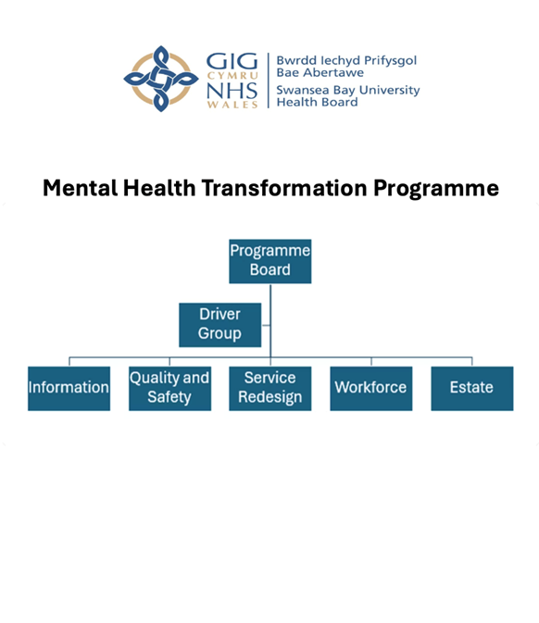
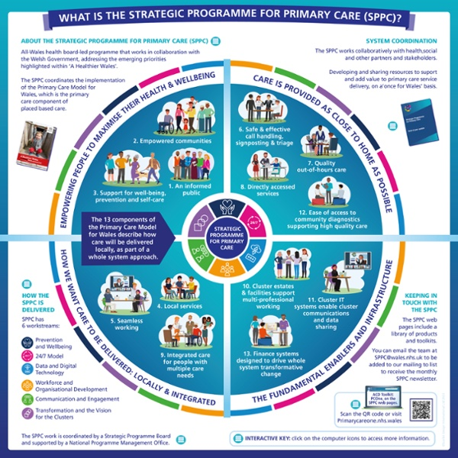
Alignment with other Programs
Strategic Programme for Primary Care

Slide 3
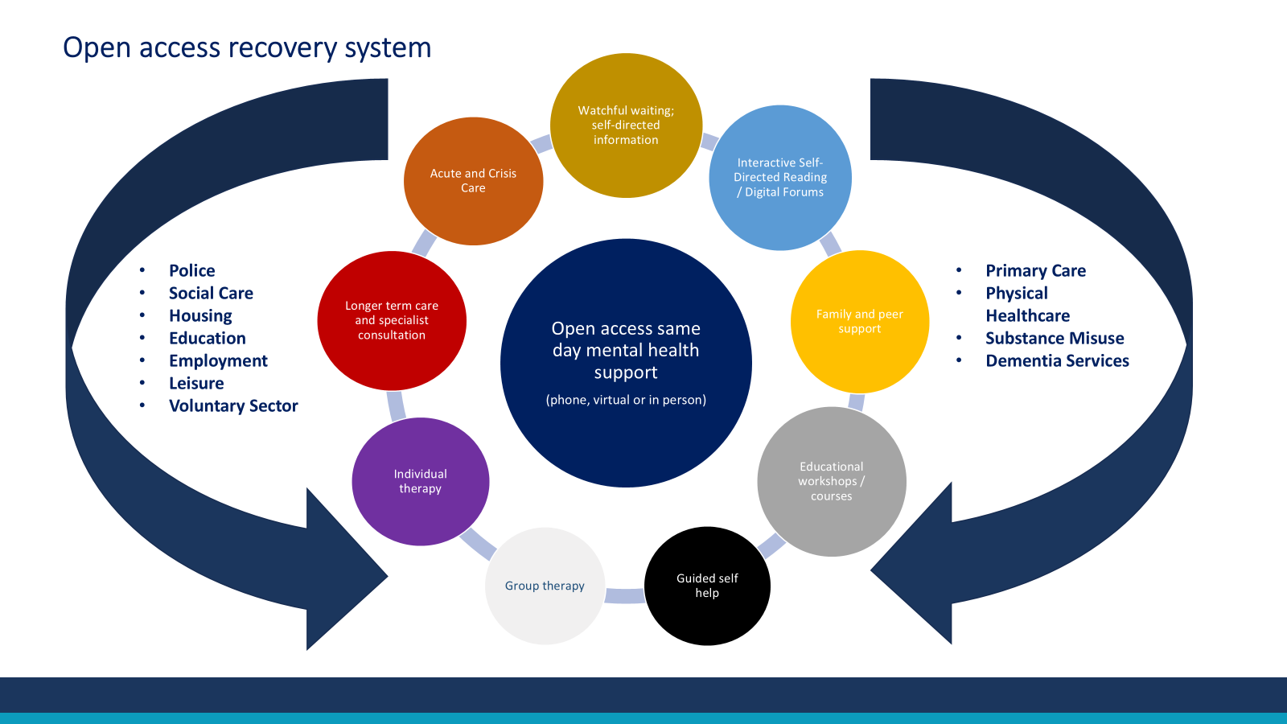
Example from MH National Wellbeing Strategy

Slide 4
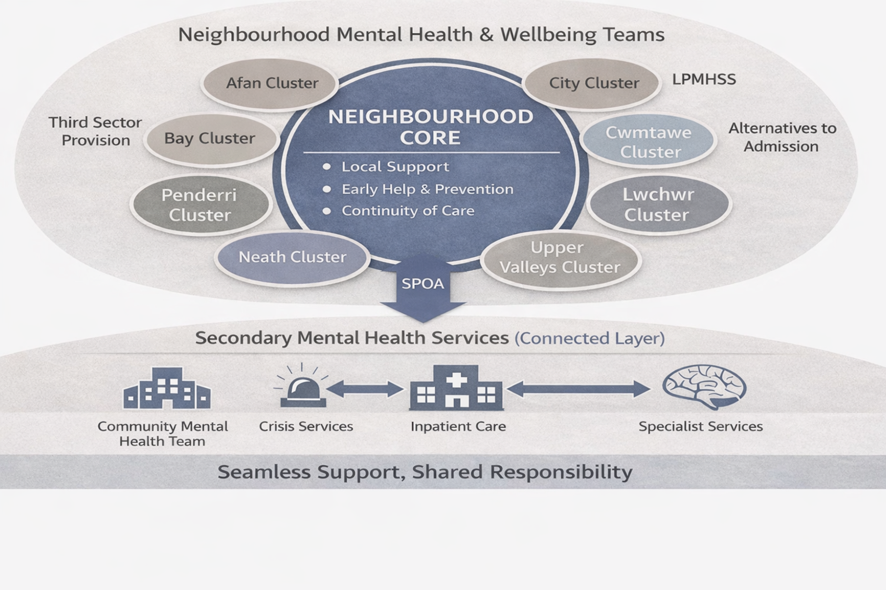
What this could look like in practice for Swansea Bay

Slide 5
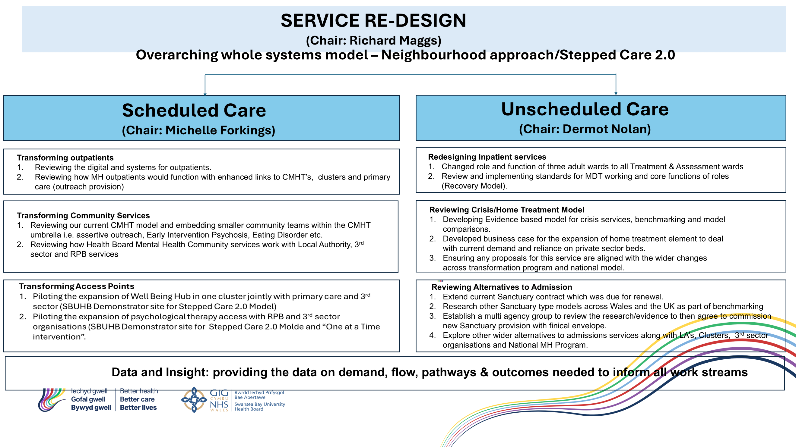

Slide 6
Mental Health Transformation Program Update - Regional Partnership Board Governance
Change to overall RPB governance structure for various Program Boards across the region.
Elements of Mental Health Transformation Program will be jointly managed under a new Regional Mental Health Transformation Board.
New Draft governance structure to be circulated.

