Slide 1
An Overview of the Future Direction of Mental Health Services in Wales
Dr Chris O’Connor, Clinical Lead, Strategic Programme for Mental Health
NHS Wales Performance and Improvement
Swansea Bay University Health Board Development Session
9th June 2026

Slide 2
Overview of Presentation
Strategic Context and Case for Change
Evidence Base regarding best practice within Mental Health Services
Strategic Vision for Wales; Open Access Mental Health Support
Implementation to Date
Next Steps; Development of a Mental Health Clinical Plan for Wales

Slide 3
The Strategic Context and Case for Change

Slide 4

The Ambition
The Mental Health and Wellbeing Strategy 2025-2035
Vision Statement 4: There are seamless mental health services – person centred, needs led and guided to the right support first time, without delay
Part of a connected system
High quality, delivering equitable access, experience and outcomes

Slide 5
The Challenge
The current state is one where every Health Board in Wales is experiencing demand and capacity challenges in their Mental Health Services. We face growing demand, service gaps, bed pressures, increasing use of out of area beds, workforce gaps and strain, financial pressures and significant staff time spent in low value processes and procedures.
This leads to avoidable harm and highly variable experiences and outcomes.
HELP SEEKING IS INCREASING
NEW PRESENTATIONS
DEMAND FOR SERVICES OUTSTRIPS SUPPLY
WORKFORCE IS A SIGNIFICANT CHALLENGE
LITTLE NEW FUNDING AVAILABLE
ACCESS IS A SIGNIFICANT CHALLENGE
LITTLE INVESTMENT IN ESTATE OR DIGITAL
QUALITY AND OUTCOMES ARE HIGHLY VARIABLE
Notes:
Crisis Resolution: most areas, limited hours, drift from evidence
Home Treatment: all areas, limited hours, drift from evidence
Psychiatric Liaison: limited hours, limited capacity for timely response
Remote support: 111#2, helplines, WAST, cluttered, loops
Crisis Houses and Sanctuaries: some areas, limited scope and scale
No acute day models
Under-reliance on other MH partners in the system i.e. third sector
Limited standards and guidance for any part of the system

Slide 6
Mental Health Need in Wales
High and persistent, affecting a large proportion of the population, 1 in 4 adults and 1 in 6 children in their lifetime.
Increasing mental health difficulties over time, especially among younger people
Socially unequal, with deprivation a major factor
Outstripping service capacity, leading to long waiting times
By 2035 people living with 4+ long term conditions will double, and the majority will have mental ill-health
35% 11-16 yr olds “high or very high” difficulties on the Strengths and Difficulties Questionnaire in 2023
Increase from 25% in 2019
Rises to 44% among least affluent families in Wales
More than 1 person every day dies by suicide in Wales
In 2024, 436 deaths were registered as suicides, the highest number since 1981 and higher than the rates in England
73% of adults in Wales reported feeling anxious in the two weeks before May 2023 (MIND Cymru)

Slide 7
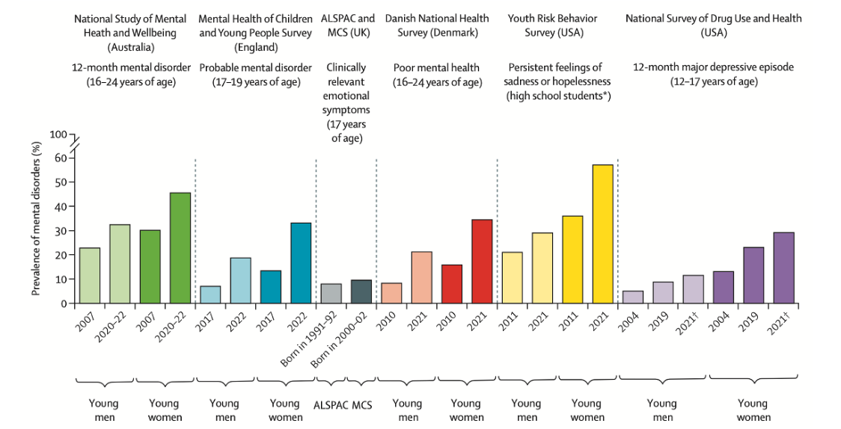
Increasing Mental Health Difficulties in Children and Young People is a Global Challenge
Increasing mental health difficulties being seen across developed countries.
Current challenge for CAMHS and future challenge for Adult MH services, given 75% of MH difficulties start before the age of 25.

Slide 8
Problem Statement
There are two inter-dependant problems:
  Our Community Mental Health Model of Care, from the late 1990s / early 2000s, has many services gaps and is no longer fit for purpose even if those gaps were filled. Patching it up won’t resolve the access and quality issues or the demand, capacity and workforce challenges. Even if we filled all our vacancies, problems would persist.
  Our inpatient mental health estate would not be tolerated in any other part of the UK. This needs to be resolved. Each Health Board re-providing like for like is unaffordable. But more importantly this risks missing the significant opportunity to apply the latest clinical evidence to reduce our reliance on inpatient care & improve outcomes and experience. Early data suggests a reduction in bed-based care is possible from modernising the community mental health model.
Notes:
Evidence from the past 25 years clearly shows what the new model of care should be and that when fully implemented it can significantly reduce the need for inpatient care.
This evidence is reflected in the Mental Health & Well-Being Strategy (April 2025) & The Mental Health Quality Statement (April 2026)
It has not yet been translated into a National Clinical Plan.
Some caution but appears Circa £500m or roughly 50% of budget spend on in-patient mental health care for 8,000 admissions c.f. £12.29m on community based crisis services

Slide 9
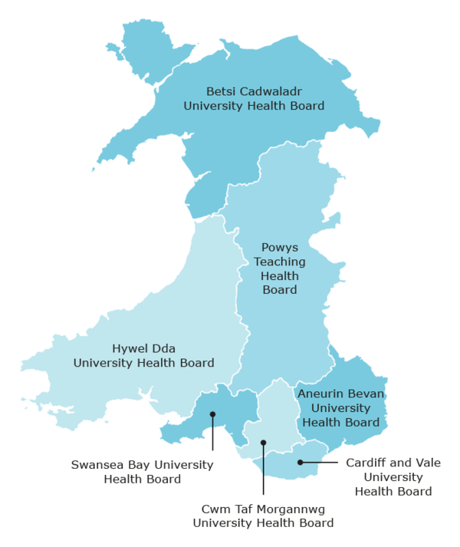
Existing Bed Provision
Wales
18+ pop: 3,186,581
Total sites: 37
Total MH Beds: 1131
Total Acute: 546
Adult Acute: 404
PICU: 54
OA Acute: 88
Older Adult mixed: 61
OA Dementia Ax: 249
Open Rehab: 115 Locked Rehab: 53
Alcohol/SM: 17
LSU: 41
Other: 16
S136 MH Places of Safety
NHS MH beds
Population estimates mid-year 2024, aged 18+ Population estimates by local authority, year, sex and age | StatsWales
HDUHB
18+ pop: 389,160
Total sites: 5
Total MH Beds: 101
Total Acute: 46*
Adult Acute: 39
PICU: 7
Older Adult: 41
(mixed functional/ organic)
LSU: 14
BCUHB
18+ pop: 697,115
Total sites: 8
Total MH Beds: 200
Total Acute: 128
Adult Acute: 90
Older Adult acute: 24
PICU: 14
Open Rehab: 24
Locked Rehab: 8
Dementia Ax: 40
PTHB
18+ pop: 135,059
Total sites: 3
Total MH Beds: 38
Total Acute: 28*
Adult Acute: 18
PICU: 0
Older Adult: 20
(mixed functional/ organic)
SBUHB
18+ pop: 394,553
Total sites: 4
Total MH Beds: 185
Total Acute: 75
Adult Acute: 55
Older Adult acute: 20
PICU: 0
Open Rehab: 8
Locked Rehab: 18
LSU: 28
Dementia Ax: 51
Alcohol/SM: 5
·
ABUHB
18+ pop: 601,686
Total sites: 7
Total MH Beds: 182
Total Acute: 107
Adult Acute: 78
Older Adult acute: 20
PICU: 9
Open Rehab: 12
Locked Rehab: 13
Dementia Ax: 44
Complex Emotional Needs: 6
CAVUHB
18+ pop: 519,662
Total sites: 4
Total MH Beds: 255
Total Acute beds: 90
Adult Acute: 66
Older Adult acute: 14
PICU: 10
Open Rehab: 45
YO Dementia: 15
Dementia Ax: 56
LSU: 13
Alcohol/SM: 12
CTMUHB
18+ pop: 449,346
Total sites: 6
Total MH Beds: 170
Total Acute: 82
Adult Acute: 58
Older Adult acute: 10
PICU: 14
Open Rehab: 16
Locked Rehab: 14
Dementia Ax: 58
*Where older adult wards are mixed functional/ organic, older adult acute beds are not included

Slide 10
Evidence Base regarding Best Practice within Mental Health Services

Slide 11
Lessons from Trieste & Lille (WHO recommended models) and Stepped Care 2.0 models in parts of Canada
Key Features of Successful Models
Community-first mental health care with small local multidisciplinary teams
Rapid 24/7 access to support through community centres, crisis teams, and home treatment
Support is flexible, scales up and down but doesn’t fall away completely
Recovery-oriented approach centred on personal goals and participation in community life
One At A Time Mindset and One At A Time Therapy
More availability of directly accessible low intensity options – self help, apps, guided self-help, peer support
Range of same day options based on preference and readiness
Strong focus on human rights, dignity, autonomy, and social inclusion
Integration with housing, employment, peer support, families, and social services
RCT on Open Dialogue to publish soon and expected to show improved outcomes and reduced admissions
Outcomes Demonstrated
Improved clinical and personal recovery outcomes
Improved staff recruitment, retention and satisfaction
Reduced or no waiting lists for therapy
Reduced hospital admissions and emergency presentations
Reduced bed numbers and shorter inpatient stays
Fewer incidents involving Police
Significantly reduced coercion or restraint
Higher employment and community participation
Lower suicide rates
Lower overall mental health system costs
Notes:
When look across the world at best practice within mental health care there are a number of key features.
Worth noting that some of the models have been in place for a number of decades (e.g. Trieste since the 1970’s) so learning over a significant period of time.
Complex needs don’t always require complex interventions. Evidence for OAAT approach.

Slide 12

Quality Statement and Human Rights
The Quality Statement for Mental Health, published in March 2026, outlines the outcomes and standards that define high-quality, person-focused services across health and social care, describing what good quality mental health services should look like.
It describes a shift away from traditional tiered models of care to flexible, trauma informed recovery-based system approaches.
There are clear ambitions for Wales to be the first nation to achieve same-day open-access mental health care to enable people receive help without unnecessary delay or multiple referrals, and at a level appropriate to their needs and readiness.
The Quality Statement is underpinned by a rights-based approach that recognises every person’s fundamental right to health and affirms the commitment to equity, inclusion, and social justice.

Slide 13
Strategic Vision for Wales: An Open Access Mental Health Support Model
(aligned to the Stepped Care 2.0 Model)

Slide 14


Core Components that Support
System Design
Vision for Wales: There are seamless mental health services – person-centred, needs led and guided to the right support first time, without delay (Welsh Government, 2025).
Delivered by Implementing an Open Access Mental Health Support Model (Stepped Care 2.0)
Core Components that Support People’s Experience
Access to same-day support, through multiple modes and at multiple intensities
Guided by a one-at-a-time approach, ensuring a helpful intervention at each interaction
Services are flexible, and data-informed
Care is person centred and collaborative (not a one-size fits all approach)
Co-designed with people holding diverse perspectives
A range of diverse services are included, both formal and informal
Promotion of safety is distributed across the system
Continuous learning and quality improvement cycles
Consistently recovery-oriented and trauma informed
Notes:
A Mental Health Quality Statement will be published by Welsh Government in early 2026 – the core components of the model will be mapped to the Welsh Health and Care Quality Standards and form the core of the Quality Statement

Slide 15
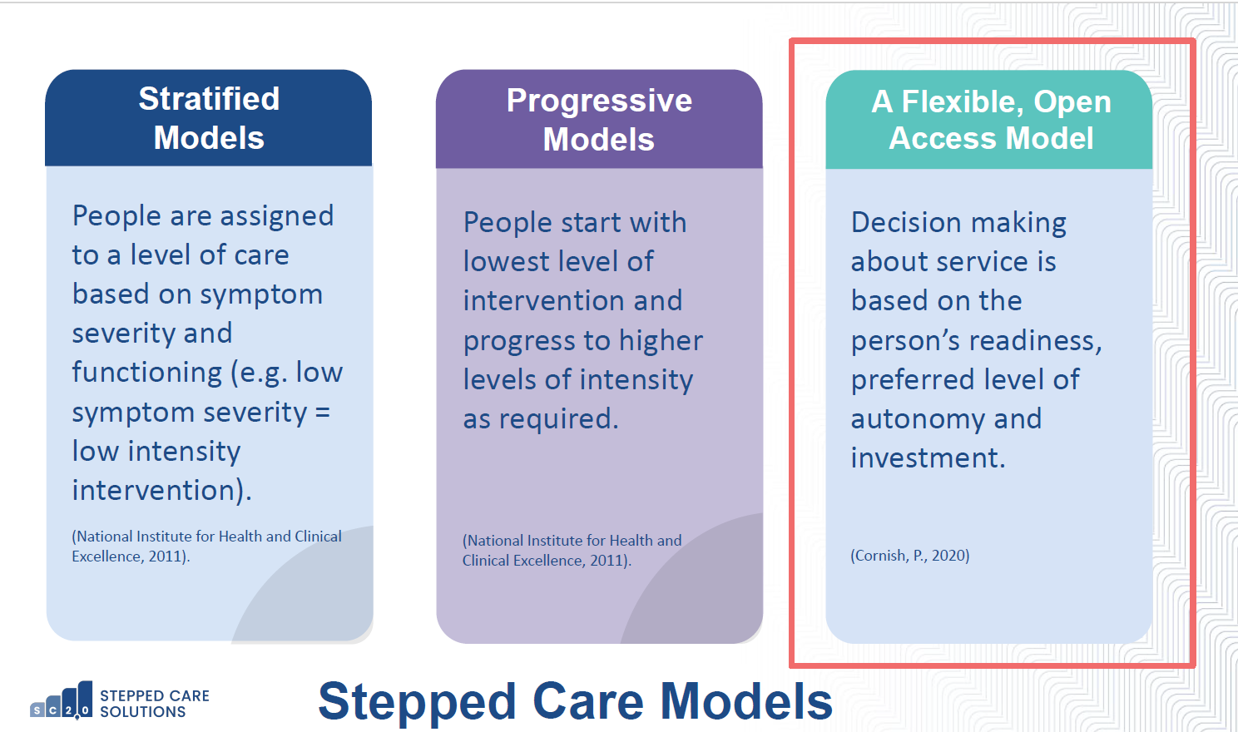

Slide 16

Core Component 2: Diverse Services on a Continuum of Care
Whole Population Mental Health Literacy
Range of providers: NHS, LA, third sector
Open access mental health support (phone/text, web, face to face)
Multi mode: digital and face to face
Peer Support: standalone service and embedded throughout
Specialist
Community Support and Consultation
Acute & Crisis care
Formal and Informal Services and Resources
Individual Intervention
Group Intervention
Flexible Person -Centred Access
Guided
Self-Help
Courses
Peer Support
Self-help Information
Service user
Readiness. Stakeholder investment
1
2
3
4
5
6
7
8
Service user
decision-making autonomy
Notes:
Multiple and diverse care options are required as one approach will not work for everyone
Individuals have choice in relation to both ‘what’ they engage with and ‘how’
Formal and informal services, support and resources
Range of providers e.g. NHS, LA, Third Sector, Communities

Slide 17
Service Changes
7. Specialist
Community Support and Consultation
Self-help Information
2. Peer Support
3. Courses
4. Guided
Self-help
5. Group Intervention
6. Individual
Intervention
8. Acute & Crisis Care
Digital offer for everyone in Wales giving direct access to quality assured information and apps
High-quality online peer support offer for Wales
Access to Recovery Colleges for everyone in Wales
Evidence-based courses in each Local Authority area
Digital guided self help offer embedded and fully utilised across Wales
Evidence-based group therapies delivered by each Health Board, using Open Access (OA) and One At A Time (OAAT) Principles
OAAT Approach to Psychological Therapy / Psychological Interventions in place in every Health Board
Includes Primary Care and Secondary Care Psychological Interventions
Open Dialogue model in place in every Health Board
24/7 Community Mental Health Centres / Offer with MDT following OA and OOAT approach
Flexible support scales up and down but doesn't fall away
Integrated approach with physical health, housing, employment, social care and voluntary sector
OA face-to-face crisis services, non-clinical community environments
- Sanctuaries
- Crisis Houses
- Acute Day Options
Single point for remote clinical assessment and duty to consult
Mental Health Rapid Response Vehicles
Crisis Resolution Home Treatment, fidelity and 24/7 response
When admission is needed it is in a high quality environment, with a clear therapeutic approach and full MDT
Entry point
NHS 111#2 and SPOAs moves from a triage and referral to a care first service using OAAT skills – i.e. single session clinic giving rapid access to mental health support for the entire population
Direct access from 111#2 / SPOA to the full continuum of care for those who need more – i.e. easily accessible not referral based

Slide 18
Practice Changes
Practice | Traditional Tiered Model | Open Access Mental Health Support Model
Assessment | Screening and in-depth up-front assessment | Initially minimal up-front assessment. Solution focused. Fail forward. Deep assessment only when there is a specific need for more information
Treatment Planning | Decision tree, pre-determined pathways, constructed on symptoms | Flexible, no pre-determined pathways, preference and readiness to engage
Target Population | Clinic focus, treatment is a priority for active help seekers with severe symptoms | Prevention and support for all, regardless of severity
Outcomes measured | Symptoms / deficits reduction; treatment fidelity | Holistic person defined outcomes, more focus on connection, meaning and quality of life
Sources of evidence | Independent randomised controlled trials Evidence based treatments | Continuous measurement of what’s working or not with the person Practice based evidence
Intervention settings | NHS based formal clinic and hospital settings | Multiple sectors – NHS, community, educational, informal
Peter Cornish and Gillian Berry (2021) Stepped Care 2.0: The Power of Conundrums

Slide 19
Initial Actions
to Support Implementation
of the Model

Slide 20

The Evidence – Practice Gap
Notes:
The evidence-practice gap (or "know-do gap") is the delay between discovering medical innovations through research and their actual adoption into routine clinical care. It currently takes roughly 15 years for clinical evidence to change standard practice, resulting in inconsistent care and wasted resources

Slide 21
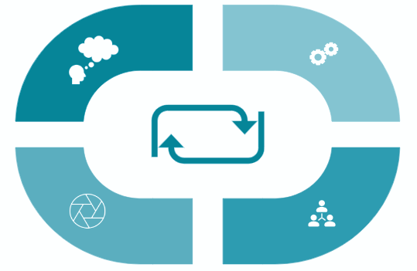
Using Implementation Science Evidence Base to Inform
Approach to Implementation
Non-linear phases that support practical starting points and ongoing improvement
Building Readiness
Preparing for Success
Defining and planning the system of care, and assembling the necessary resources and infrastructure
Establishing a solid foundation for ongoing changes
Ongoing Implementation and Improvement
Starting to Implement
Starting small, collecting data and improving
What felt new is now integrated into usual practice
21

Slide 22
Initial Actions to Support Implementation
Established national and local governance arrangements e.g. National Flexible, Open Access, Mental Health Model Steering Group (and sub-structures) and requested Health Boards to consider local governance structures.
Preparing to, and commencing, implementation of over 15 Demonstrator Projects across Wales aligned to the model.
Establishing CYP, Adult and Older Adult Advisory Panels to ensure people with lived experience and carers are true partners in next steps.
Secured resource from NIHR to undertake national evaluation of the implementation of the OAMHS model.
Defined core components to support transformation within the Welsh context and developing national visuals of the model.
Based on the implementation roadmap develop a detailed implementation plan that includes the processes, methodologies, tools to support change and continuous sharing of learning.
Further develop communication and engagement plan.

Slide 23
Next Steps – Development of a Mental Health Clinical Plan for Wales

Slide 24
Purpose
Building on the work already started under the Mental Health and Well-Being Strategy (2025-2035) on the Open Access Mental Health Support Model the NHS Wales Leadership Board have agreed to;
Defining and agreeing the Adult Mental Health Model of Care for Wales, i.e. a national clinical plan, based on the best evidence worldwide, being clear what is delivered locally, regionally and nationally
From that National Clinical Plan develop and agree an All-Wales estates plan for mental health inpatient care

Slide 25
Scope of Work - Proposed
Scope for Model of Care Development
Adult Mental Health (18 to 65) excluding Forensic
Full Continuum of Care, primary, secondary and tertiary, community and inpatients, all modalities, all professional groups
Rationale:
Adult Mental Health is where we see overuse of inpatient care and a high number of out of area beds
JCC have planned work on the Forensic Mental Health Model of Care (low secure and medium secure). Will not duplicate that work but it will be fully aligned
People with ‘secondary care’ level of need require the full continuum of care and access to low intensity options
Scope for Inpatient Estate Plan
All NHS Wales Mental Health inpatient estate – all age, all types.
All NHS Learning Disability inpatient estate.
Rationale:
The location of Children’s, Older People’s and Forensic inpatient estate will need to be considered in parallel to changes to the Adult Mental Health estate as they are often located on the same sites.
The Learning Disability estate is located with the Mental Health estate. In some cases, wards serve both populations. Any change to the NHS Mental Health inpatient estate will impact on the sustainability of NHS Learning Disability inpatient care.

Slide 26
Approach and Timeline
P&I will work with stakeholders across the system to develop the Plan
A Clinically Led task and finish group will be established
The task and finish group will be overseen by the existing Strategic Programme for Mental Health Programme Board, reporting to NHS Wales Leadership Group
A product will be available for Ministers in September 2026
The full final model of care and inpatient estate plan will be complete in December 2026
Strategic Programme for Mental Health Programme Board
Executive Leads
NHS Wales Leadership Group
CEOs
Mental Health Clinical Plan
Task & Finish Group

Slide 27
Diolch
Thank you

