Slide 1
MH Transformation Programme
Progress Overview

Slide 2
Independent Expert Review - Actions
Performance Monitoring:
Financial Stewardship:
Risk Management:
Stakeholder Engagement:
Diversity and Inclusion:
Agree suite of MHLD performance, quality and outcome metrics
CHC
The Board to review MHLD risk, to gain assurance that potential risks are identified, assessed, and managed appropriately.
Board to hold events & visits with patients, carers, staff and other partners
Strategic Leadership:
Scoping, development and delivery of organisation transformation programme
Additional Board Director Level capacity
Governance and Accountability:
Review effectiveness of Board structure
MHLD risk and assurance structures
Performance culture and focus
Population health use to guide access
Primary care support for physical health
Bed utilisation
Quality and Safety:
Board service visits
Development of embedded QI culture
Board level stakeholder mapping

Slide 3
MHTP – Workstream Objectives
Quality & Safety
Improved reporting, monitoring and escalation of key quality, safety & performance indicators, incidents and risks.
Service Redesign
Implement a modern, integrated service model, aligned with national strategy
Estates
Informatics
Workforce
Communication, Engagement & Co-production
Accelerate estates work required to address safety and dignity risks in existing inpatient environments
Progress interim solutions to improve ward conditions
Develop a business case for the long-term re-provision of the adult and older person inpatient estate
Implement digital systems, tools & processes that enable improved data capture, information sharing and monitoring of new KPIs and quality dashboards
Strengthen multi-disciplinary workforce models & develop innovative solutions to address workforce pressures.
Develop an effective engagement and consultation plan with stakeholders, public & staff.
Strengthen partnership working with regional teams, local authorities, third sector, service users & carers.
Improved access to psychological therapies & activity-based therapeutic programmes, embed evidence-based best practice across services, reduce reliance on crisis, inpatient & specialist services through strengthened prevention, early intervention & community-based MH support and ensuring equitable access to care.
Develop organisational statement of intent and strategy for coproduction and peer support in all aspects of MH planning, service design, delivery and evaluation.
Oversee establishment review,ensuring right level of staffing & skill-mix available to meet service need.
Focus on staff welfare and support.
Improved oversight of coroner’s process & recommendations and improvement plans from external reviews.
Develop quality improvement approach to MH services supported by methodology of continuous improvement & learning

Slide 4
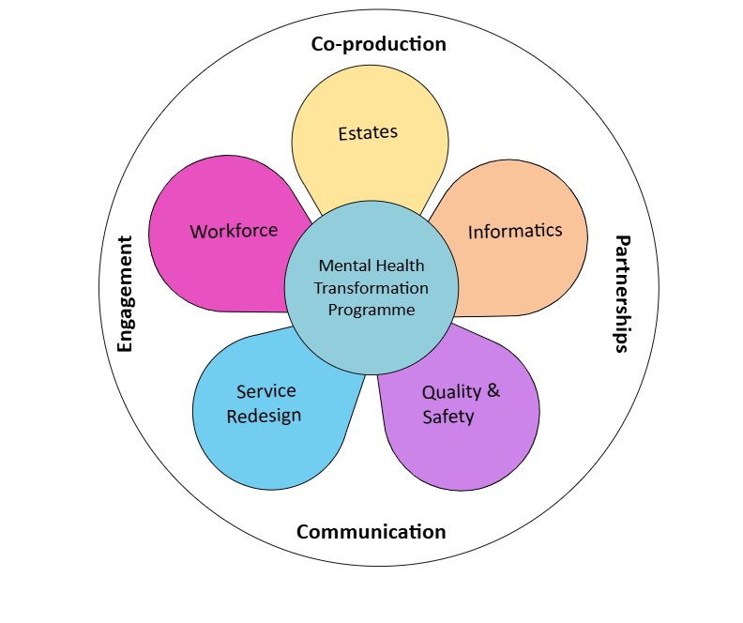
MHTP – Progress to date
Strengthened processes within Service Group for risk management, learning from adverse incidents and coroners’ reports, incident reporting and management.
Agreed revised service model for transforming mental health services, in line with national strategy.
Realigned wards to assessment and treatment.
Significant bed reduction in bed use by 10 outliers, 10 private bed, 4 surge beds plus 2 in temporary ward moves for adult and older persons mental health services.
£3.4 m Estates improvements at Tawe clinic, including anti-ligature work (TEF & HB discretionary capital) and Ward F
Short term estates stabilisation plan under development to consolidate acute adult wards and improve inpatient provision until long term solution in place.
Procurement and implementation of EPR (Rio) and digital literacy training.
Development of key Q&S metrics and reporting dashboards.
Improved oversight of recommendations and action plans from external inspections and reviews.
Business case development and approval for increasing nurse staffing establishment within acute adult mental health.
Introduced new roles (ANPs, approved non-medial clinicians)
Baseline assessment and benchmarking for Nursing, Medical staff, AHPs and Psychology across Mental Health & Learning Disabilities services and development of risk-based recruitment proposals.
Engagement and communication with key partner agencies, people with lived experience and service users and carers.

Slide 5
Phase 2
Next phase of transformation programme
Consolidation of phase 1
Revision and update of programme priorities
Strengthening connection and alignment with RPB, community by design, primary care cluster work, Emotional Health and wellbeing
Clinical leadership development
Response to All Wales clinical and estates plan
Wider MH and LD provision – eg older people, secure, perinatal, eating disorder services, CAMHS
Working JCC and other HB
,

