Slide 1
Mental Health Board Development
Accelerating Mental Health Transformation with Digital Solutions
Dermot Nolan – Service Group Director Mental Health
Deirdre Roberts – Assistant Director Digital Transformation

Slide 2
RIO Operational Coverage Across Mental Health and Learning Disabilities Services
Adult Mental Illness
Assertive Outreach Team NPT
Tonna CMHT
Forge Centre Adult CMHTs NPT
SPOA
Crisis Home Treatment Team NPT
Integrated Autism Service
Dechrau Newydd
AMH Psychology Team
AMH Occupational Therapy Team
Learning Disability
Facing the Challenge
LDIST Swansea
LDIST Cwm Taf
LDIST Cardiff
Neath CLDT
CTM North CLDT
CTM South CLDT
Bridgend CLDT
The Vale CLDT
Cardiff CLDT
Swansea CLDT
Specialist Behaviour Team
CLDT Psychology Team
CLDT SALT Team
CLDT Physiotherapy Team
CLDT Dietetics Team
CLDT Psychiatry Team
CLDT Occupational Therapy Team
CLDT Epilepsy Specialist Team
CLDT Arts Therapy Team

Slide 3
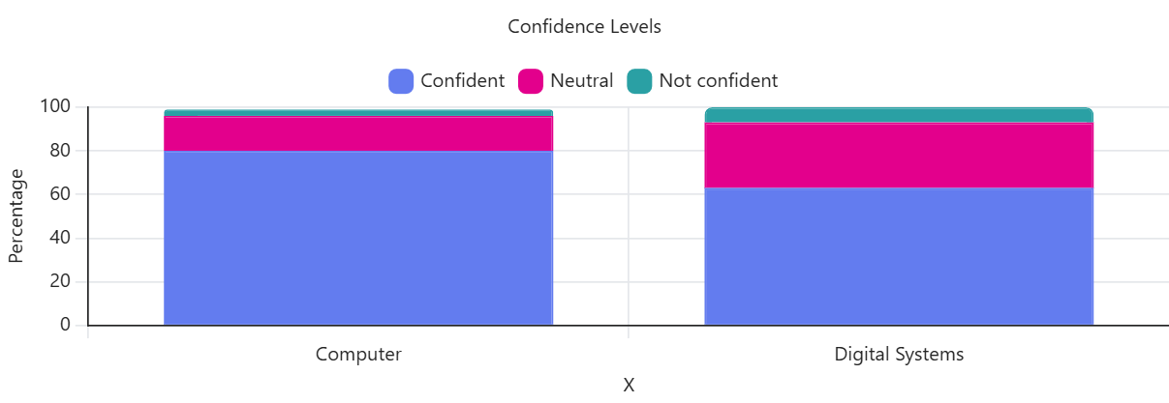
Digital Survey Summary – Pre Implementation
A total of 316 staff responses were received, providing a comprehensive baseline of digital capability.
Key Themes from Staff
Connectivity issues affecting care delivery
Device shortages delaying workflow
Need for role-based, practical training
Complexity from multiple systems
Demand for a single integrated system

Slide 4
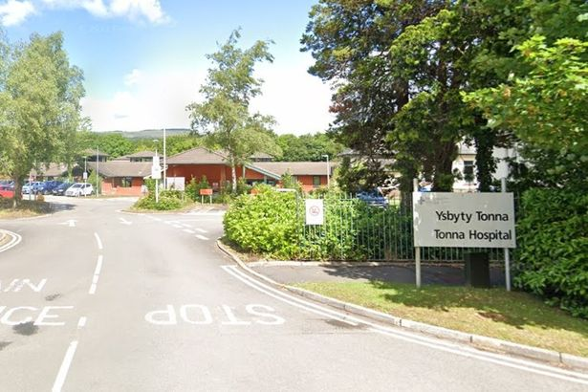
Tonna Community Mental Health Team
Delivers secondary mental health care for adults with complex needs
Provides assessment, treatment, and care coordination in line with the Mental Health (Wales) Measure 2010
Undertakes both routine and urgent assessments
Develops and manages Care and Treatment Plans (CTPs)
Delivers clinical interventions
Makes referrals to specialist services
Supports recovery and relapse prevention
Currently manages a caseload of 311 patients
Supported by a team of 22 health staff

Slide 5
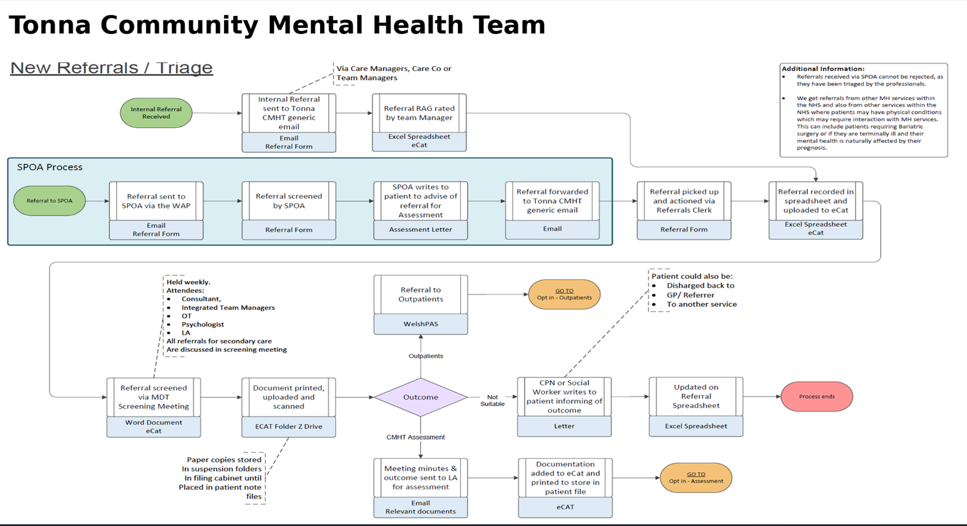

Slide 6
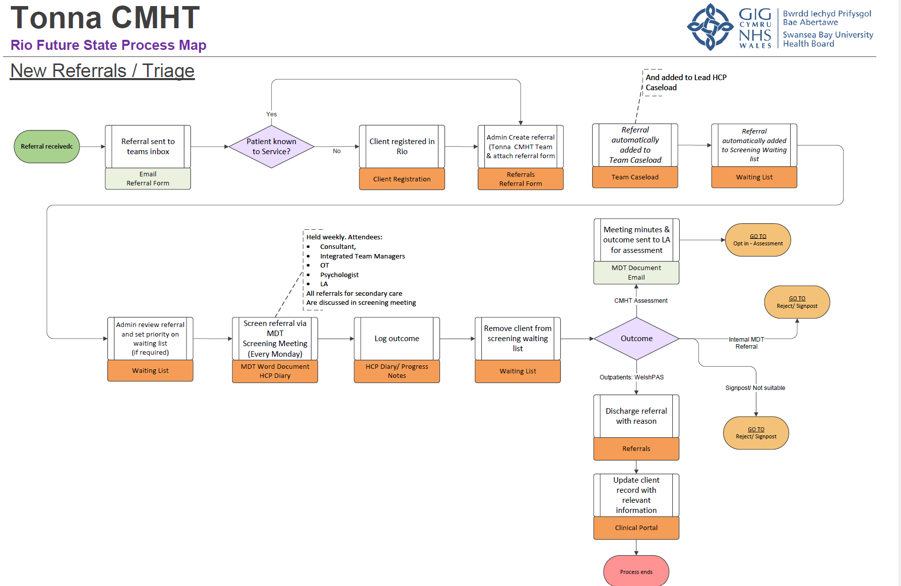
Notes:
The future-state RIO-enabled referrals and triage process for Tonna CMHT streamlines intake, screening and decision-making within a single digital workflow. Referrals are received into the team inbox and, where required, new clients are registered directly in RIO before a referral record is created and automatically added to team caseloads. Administrative staff prioritise referrals and maintain a dynamic waiting list, with all secondary care referrals reviewed at a weekly MDT screening meeting and outcomes recorded contemporaneously in the electronic record. Following screening, referrals are either progressed to CMHT assessment, outpatient services via WelshPAS, or discharged with rationale, supported by automated documentation, reduced reliance on paper, and real-time updates to patient records. The process removes duplicate data entry and manual tracking, strengthens governance through consistent digital recording, and improves efficiency and visibility of referral status across the pathway.

Slide 7
Key Benefits for Phase 1 Implementation
Process mapped “As is” and “To be” processes for all teams in scope
Time and motion studies to baseline current ways of working and the anticipated efficiencies
  Removal of fragmented record releasing time to care: 3.5 hours per week per nurse
  Improved data quality and data capture removes duplication releasing 25 hours administrative capacity per month for all teams included in phase 1
Real time access to data at the point of care
Real time activity and performance management enabling more informed operational planning
Data from Rio is being leveraged to support the operational and quality and safety dashboards.

Slide 8
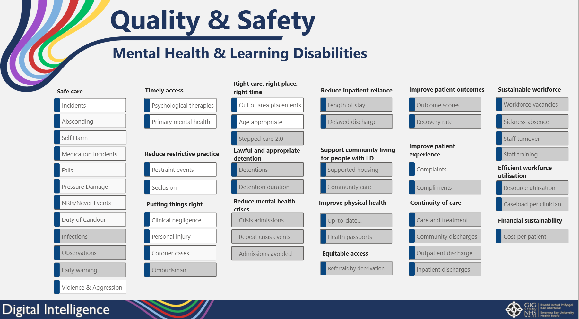

Slide 9
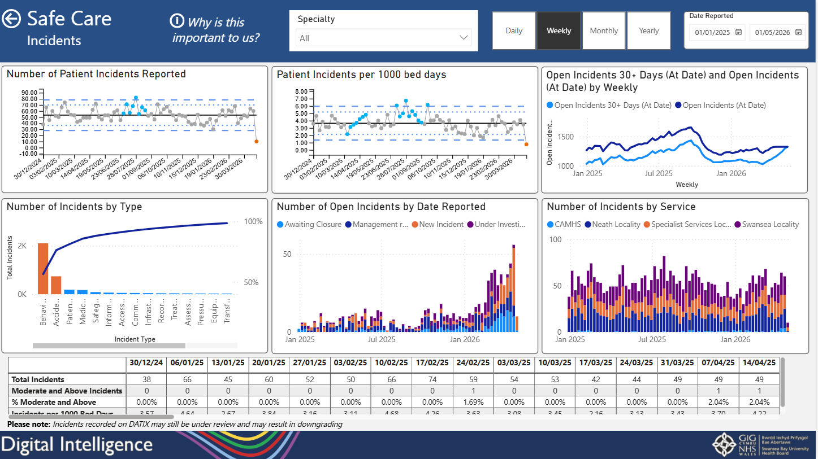

Slide 10
Staff Feedback on RiO System - Overall Experience
“Easy to use, much quicker and safer than ECAT.”
“A fantastic system – quick and easy to use.”
“A significant improvement compared to previous shared drive methods.”
Better collaborative working across teams
Improved access to multidisciplinary team (MDT) information
“Information is easily accessed, helping us make better use of time.”
“Strengthens MDT working.”
“Ease of communication and documentation sharing between teams.”
Real-time access to up-to-date patient records
Improved accuracy of referral information
“We can now view other professionals’ notes, improving decision-making.”
“Access to updated and accurate information has significantly reduced issues.”
Elimination of email-based document sharing
Reduced duplication of work
More efficient workflows across teams
More concise, standardised documentation across teams
“Universal documentation improves consistency.”
Single, chronological patient timeline for all records
Flexibility & Remote Working
Ability to write and access notes remotely
Supports flexible and responsive care delivery

Slide 11
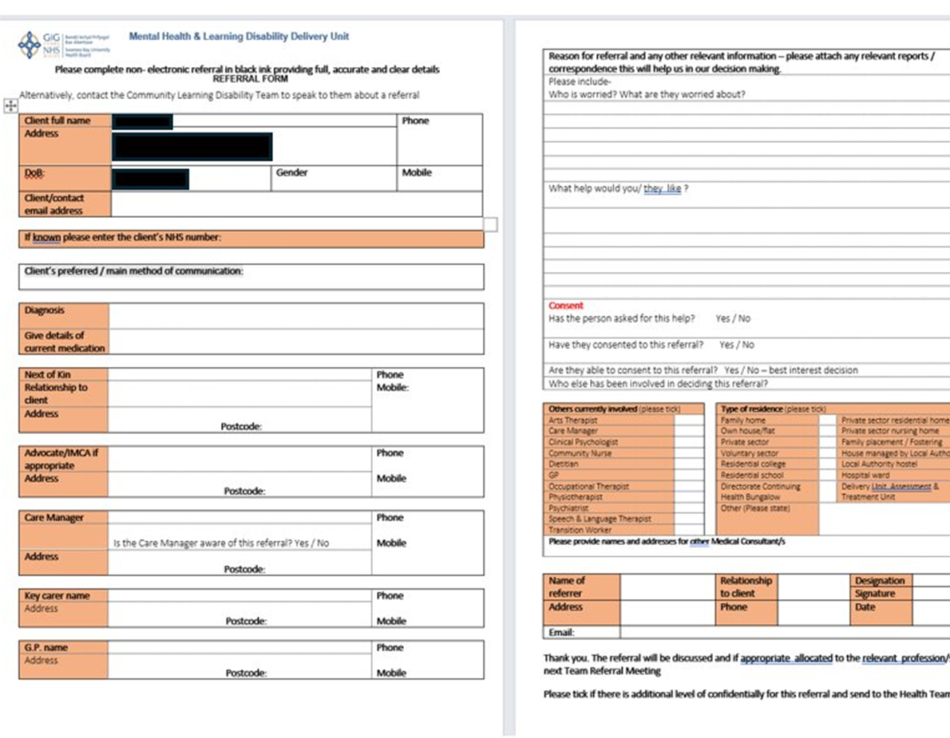


Slide 12
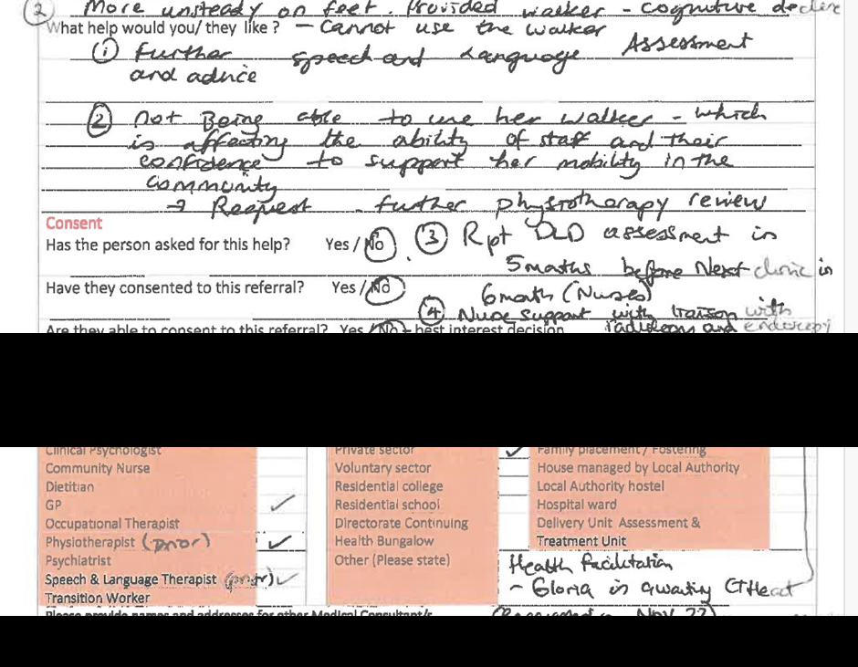
Key Issues with Current Document
Poor layout – cluttered and difficult to read
Limited space – insufficient room for full clinical details
Handwritten entries – risk of misinterpretation and poor data quality
Incomplete information – no mandatory fields or validation
Information governance risk – personal data hard to redact securely
No audit or reporting capability – no visibility of who completed or updated the form or collection of data from paper records.

Slide 13
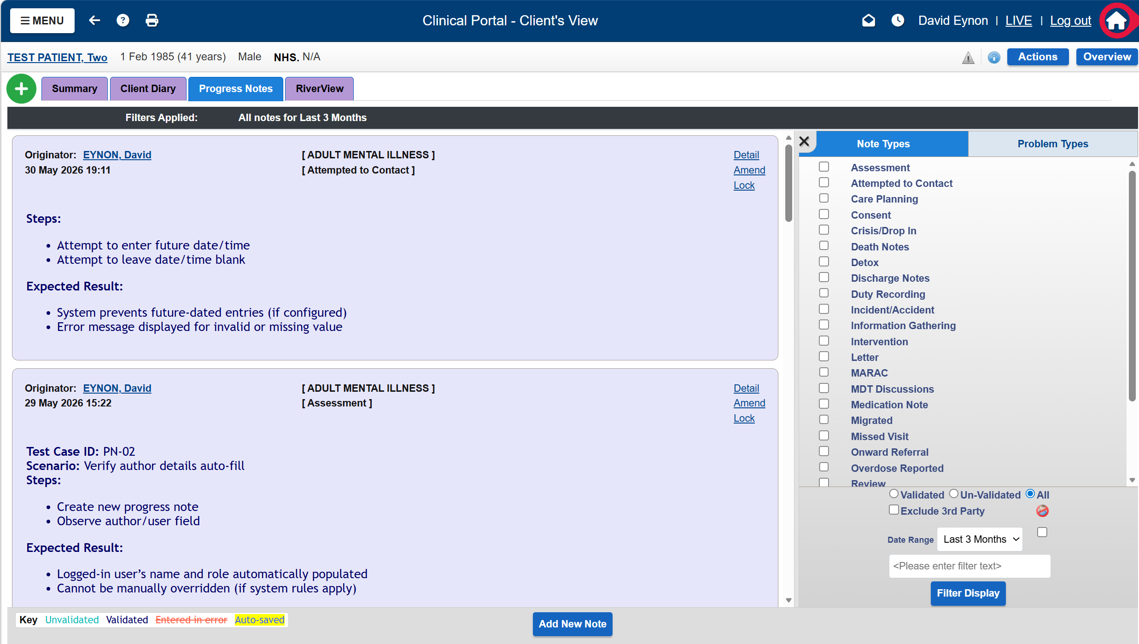
Progress Notes

Slide 14
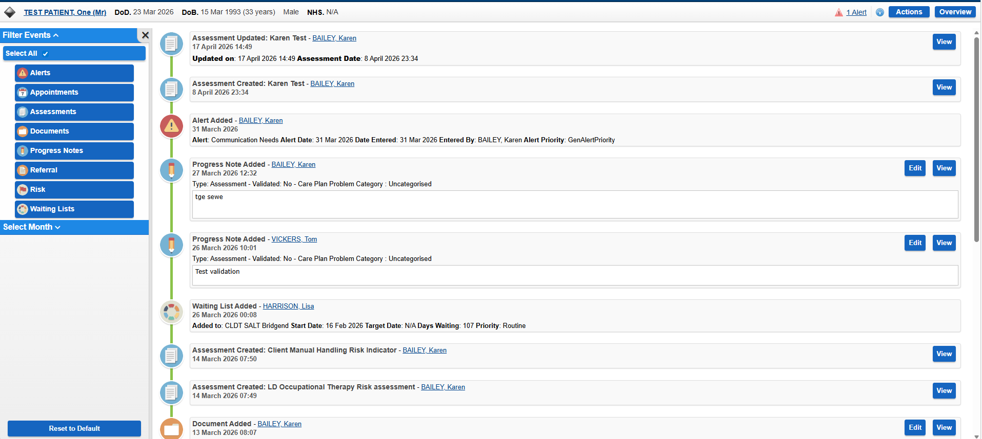
River View – Chronological Timeline
RiverView in RIO presents a chronological timeline of a patient’s record, displaying key clinical and administrative events with the most recent entries first. It enables clinicians to quickly gain an overview of patient activity in one place.
Key Features:
Chronological timeline of events (most recent at the top)
Displays progress notes, referrals, assessments, and waiting lists
Ability to filter events by type (e.g. notes, documents, referrals)
Ability to refine the view by month or year for targeted review
Direct access to open and review detailed records from the timeline

Slide 15
Delivery Plan 2026/2027
Successful rollout of RIO to Mental Health and Learning Disabilities services completed on 24 March 2026
Planned transition of remaining teams from WCCIS to RIO during Q4 2026/27 (Integrated Teams, Mental Health Users ~450)
Development of a business case to procure a wider Electronic Patient Record (EPR) solution for remaining Mental Health and Learning Disabilities services
AICP (Access Intelligent Care Platform) will be implemented alongside the migration of WCCIS teams to the RIO system, enabling a single, integrated view of care

Slide 16
Thank you for listening
Any questions?

Slide 17
Planned transition of remaining teams from WCCIS to RiO during Q4 2026/27
Mental Health
ADHD Clinic
Adult Community Forensic
Assertive Outreach
Assessment & Home Treatment
Criminal Justice Team
Early Intervention Psychosis
Eating Disorder Service
Lithium / Mood Clinic
Depot Clinic North / South
Therapies & Community Health
Flying Start Integrated Therapies
CRS Therapies (OT / Physio / Dietetics / SALT/CRS Nurse Assessors
CRS Specialist Practitioners
CRS Physio Exercise Class
Clozapine Clinic
Core Community and Access Services
  Includes multiple community mental health teams and assessment units managing referrals, assessments, and care coordination.
Specialist Clinic Services
  Supports clinics focused on specific conditions with structured clinical workflows for prescribing and monitoring treatments.
Specialist and Community-Based Services
  Offers targeted interventions for specific patient groups requiring data sharing and clinical recording capabilities.
Integrated and Residential Services
  Ensures interoperability across community, residential, and multidisciplinary care settings for continuous patient care.
Notes:
---
This slide references information from the following file: https://nhswales365-my.sharepoint.com/personal/david_eynon_wales_nhs_uk/_layouts/15/Doc.aspx?sourcedoc=%7B3432AC0A-994B-4A48-9A51-D18506A37C05%7D&file=Worksheet%20in%20https%20%20%20nhswales365.sharepoint.com%20sites%20SBU_ConnectingCare%20Shared%2520Documents%20General%20Local%2520Business%2520Case%20Business%2520Case%2520Options%2520Appraisal.docx&action=default&mobileredirect=true
This slide presents a comprehensive overview of the key Mental Health teams identified for alignment with the RiO system as part of the transition away from Care Director. The teams included span multiple functional areas, highlighting the complexity and breadth of mental health service delivery within the organisation. Core community and access services include Community Mental Health Team 1, Community Mental Health Team 2, Community Mental Health Team 3, the Single Point of Access for Mental Health, and the Assessment and Home Treatment Team. These teams are central to managing referrals, assessments, and ongoing care coordination within community settings. In addition, specialist clinic services such as Depot Clinic South, Depot Clinic North, Attention Deficit Hyperactivity Disorder Clinic, Clozapine Clinic, and the Lithium and Mood Clinic are included, indicating the need to support structured clinical workflows, including prescribing and monitoring activities.
The scope also incorporates specialist and community-based mental health services, including Adult Community Forensic Service, Assertive Outreach Service, Early Intervention Psychosis Service, Eating Disorder Service, Criminal Justice Mental Health Team, Psychiatrist Team, and the Rehabilitation and Recovery Community Team. These services provide targeted interventions for specific patient cohorts and require robust data sharing and clinical recording capabilities. Older People’s Mental Health services are represented through Older Adult Mental Health Outpatient Services, Older Adult Mental Health Liaison Services, and Memory Assessment Clinics, reflecting the need to support age-specific care pathways.
Finally, integrated and residential services such as Crest Mental Health Service and Llanfair House Mental Health Residential Service are included, demonstrating the need for interoperability across community, residential, and multidisciplinary care environments. Collectively, these teams highlight the importance of a unified system that can support diverse workflows, facilitate information sharing, and maintain continuity of care across different service boundaries. These requirements are critical considerations for RiO alignment within the broader digital transformation programme.

Slide 18
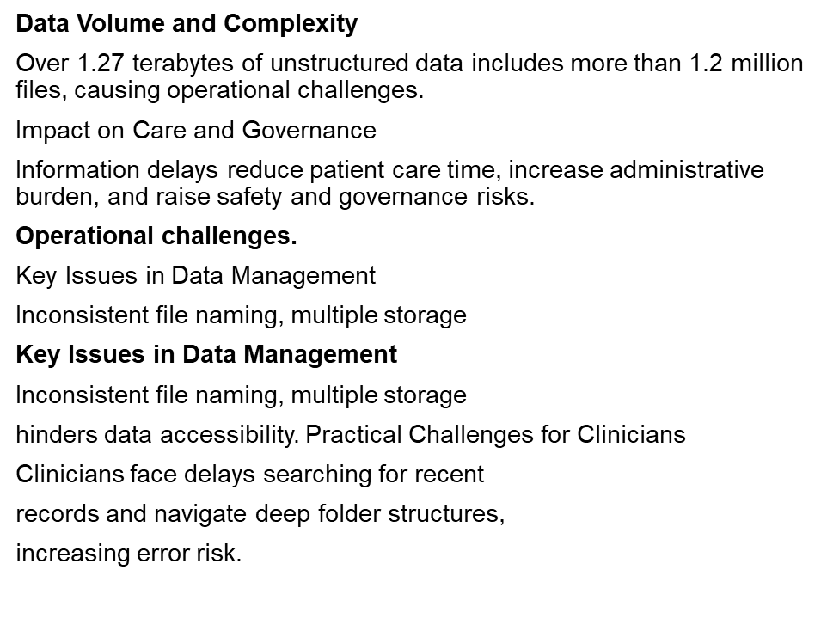

Key Issues – Impact Z-Drive (ECAT)

