Slide 1

Sustainable Planned Care Plan
Summary for SBUHB Board Meeting
30 July 2026

Slide 2
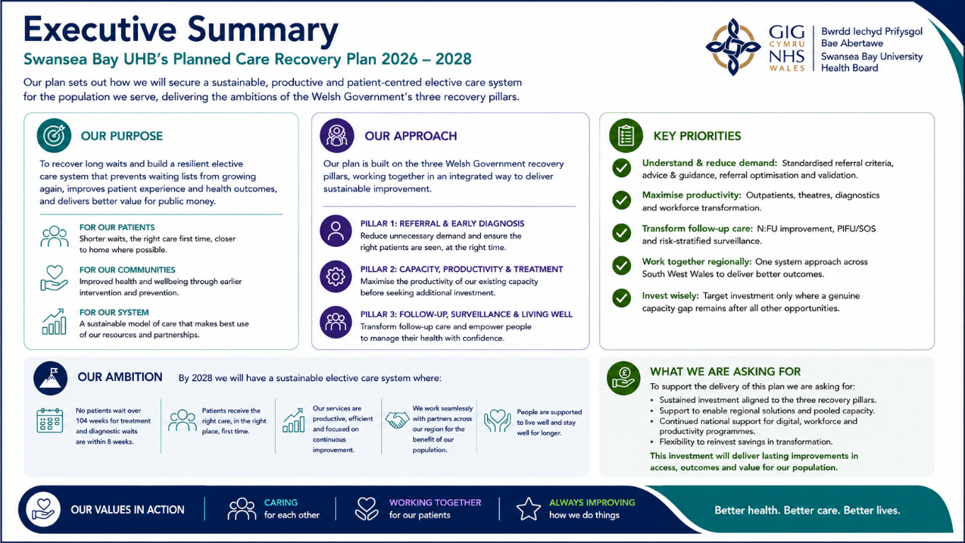

Slide 3
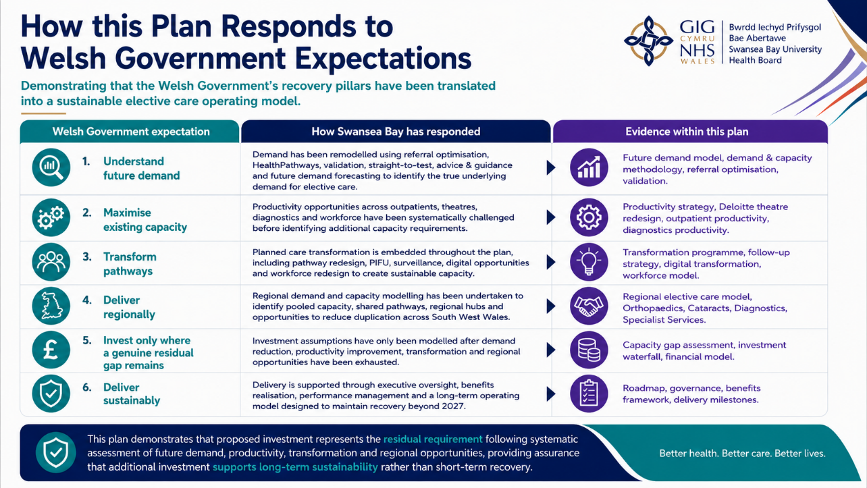

Slide 4
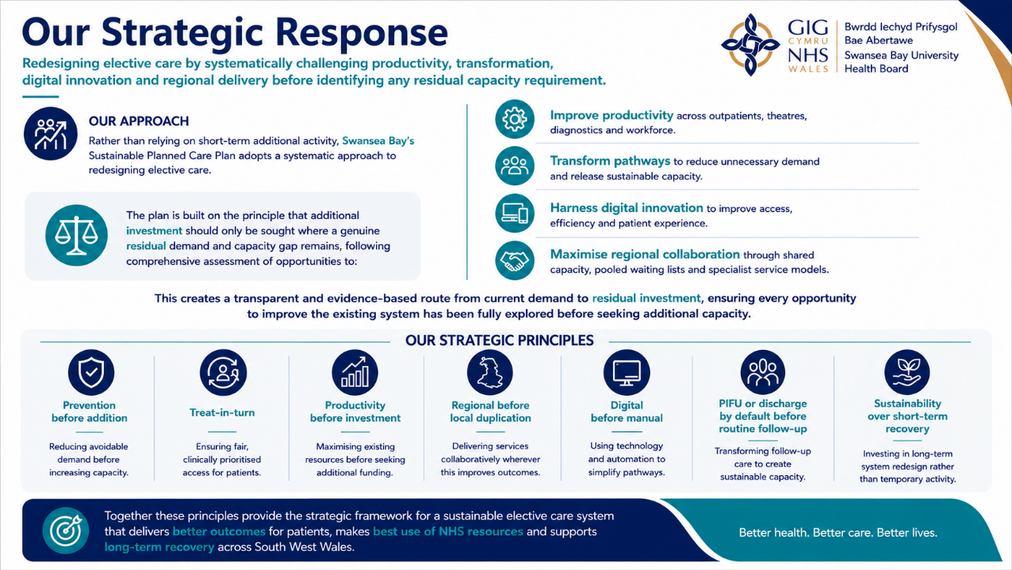

Slide 5
What this Plan Asks For
Delivering sustainable planned care through recovery, transformation, productivity and targeted investment
Priority
What this plan commits to delivering
Deliver Sustainable Recovery
Sustain elimination of 104-week waits, restore delivery of the 8-week diagnostic standard, maintain waiting list control and protect elective performance despite continuing growth in demand.
Optimise the Surgical Pathway
Implement a comprehensive Pre-Surgical Optimisation Programme including intelligent health screening (iHSQ), prehabilitation, POPS, anaesthetic optimisation, pain optimisation, frailty pathways and digital patient preparation to improve outcomes, reduce cancellations and maximise theatre productivity.
Transform Outpatients
Reduce unnecessary outpatient demand through professional triage, standardised referral criteria, straight-to-test pathways, patient initiated follow-up (PIFU), surveillance redesign, clinical/admin validation, consultant productivity improvements and expanded multidisciplinary models of care.
Deliver Digital Transformation
Deploy AI-supported validation, AI referral screening, Ambient Voice Technology, NHS Wales App, Patient Portal, Hybrid Mail, Theatre Management System, virtual consultations, digital pre-assessment (iHSQ) and PRO-MAPP.
Improve Productivity Before Investment
Deliver measurable improvements in theatre utilisation, consultant job planning, outpatient productivity, follow-up ratios, day surgery performance, scheduling and pathway redesign before seeking additional recurrent investment.
Develop Sustainable Clinical Services
Address underlying recurrent demand-capacity gaps across Radiology, Endoscopy, Diagnostics, Oncology, Neurophysiology, Cellular Pathology, Psychological Therapies, Special Care Dentistry and other priority services.
Strengthen Regional Working
Develop a sustainable South West Wales elective care system through shared capacity, regional clinical networks, mutual aid, workforce collaboration and coordinated delivery of specialist services.
Target Investment Only Where Required
Following delivery of productivity, transformation, digital and regional opportunities, seek targeted investment to address the remaining workforce, infrastructure and capacity gaps necessary to deliver sustainable planned care.

Slide 6
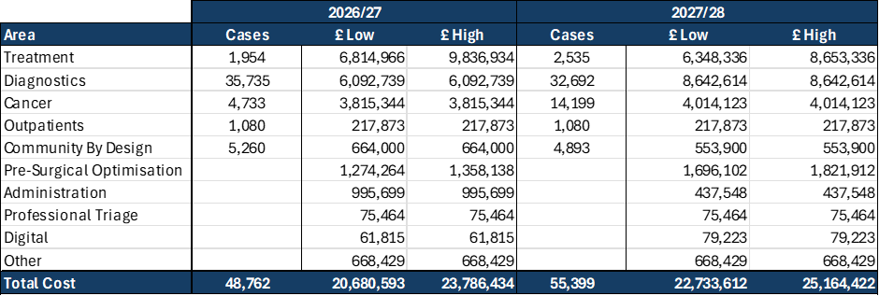
Funding Requirements Summary
Our funding requirement reflects both the recurrent capacity gap associated with the traditional delivery model and the targeted transformational investment required to deliver a sustainable planned care system.
• Funding methodology agreed with Executive Team and Performance & Finance Committee.
• Combines investment required to close the underlying recurrent capacity gap with one-off transformational investment.
• Investment supports sustainable recovery rather than short-term activity alone.
• Transformation initiatives reduce future reliance on recurrent funding and improve long-term productivity – further work planned to understand how we robustly evidence these.
The funding ask should be considered as a single integrated investment proposition to deliver recovery, sustainability and transformation.

Slide 7
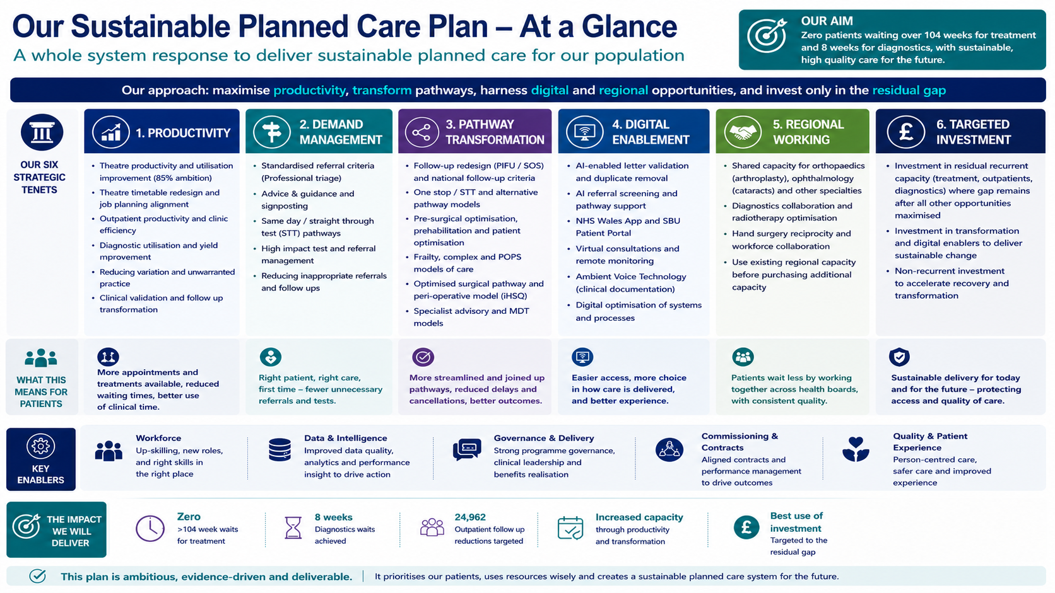

Slide 8
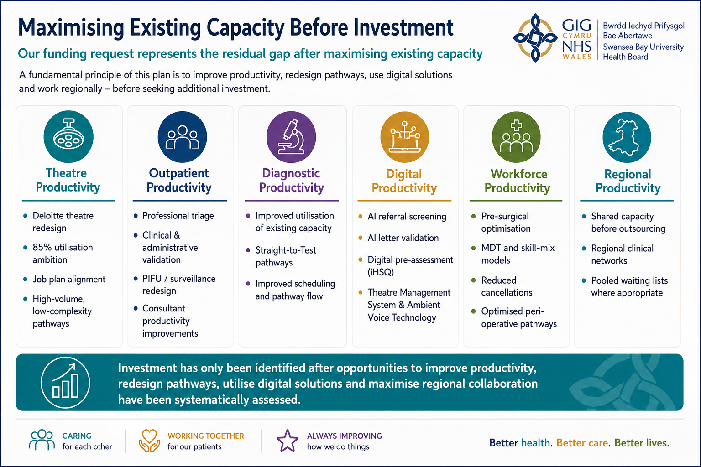

Slide 9
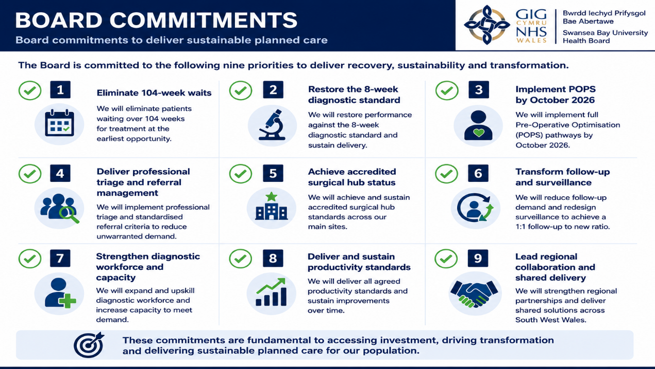

Slide 10
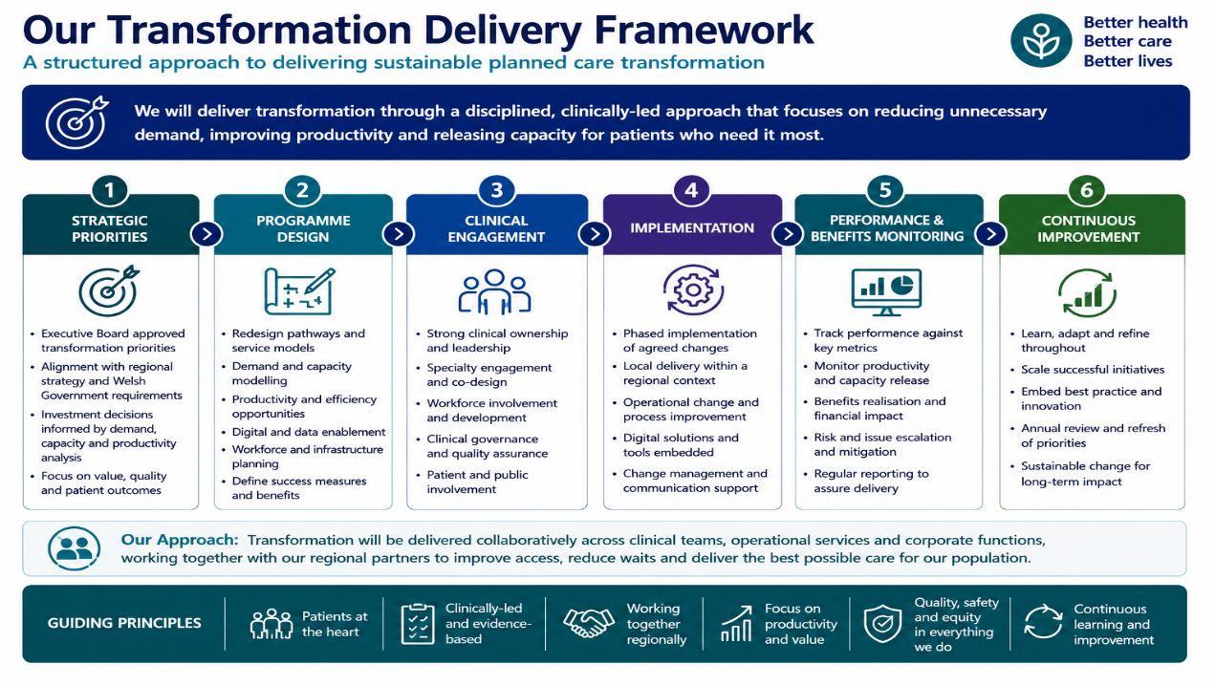

Slide 11
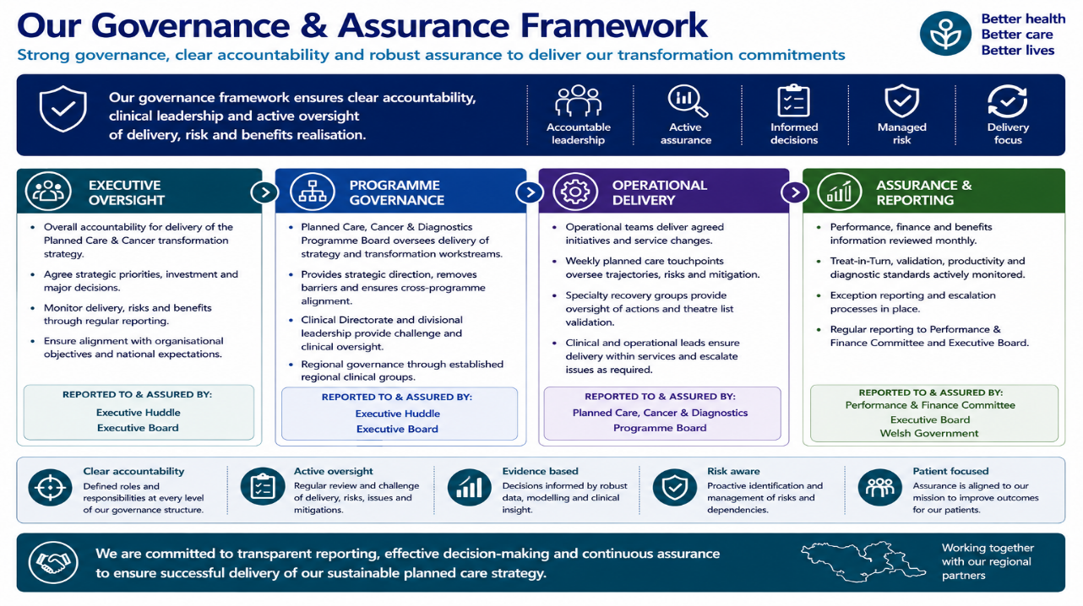
Working together with our Regional Partners

Slide 12
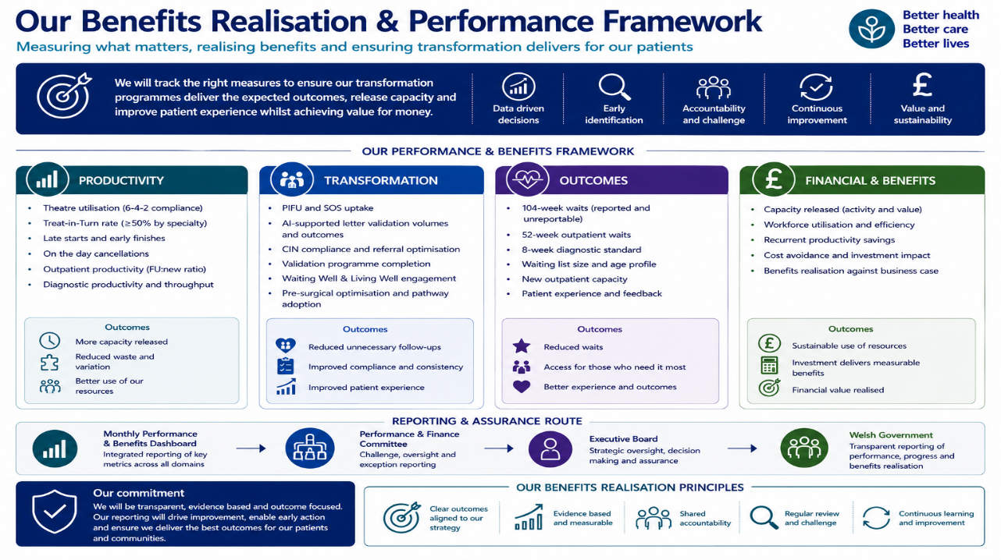

Slide 13
