Slide 1
Swansea Bay Perinatal Services
Outcome data and key critical safety metrics
July 2025 – July 2026, 12 month rolling data
Notes:
This slide can be used for presentations which are from a health board-wide perspective or for a whole HB audience as the graphic device to the right of the slide includes all four service group colours and red for the corporate team.

Slide 2
Some data fields still require data validation
Caesarean section rates
Midwifery led births in the alongside unit

Slide 3
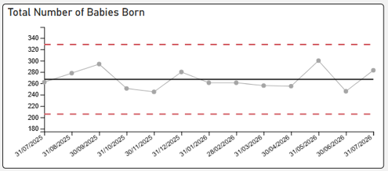
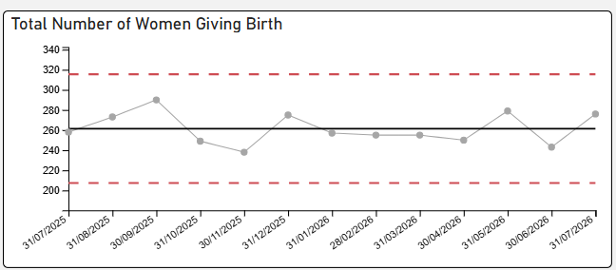
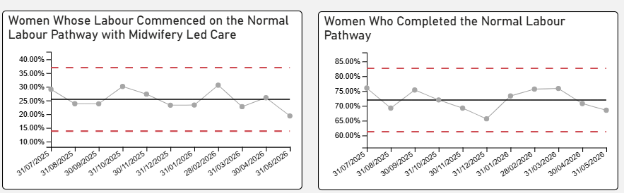
Total Number of Women whose labour commenced and completed on the Normal Labour Care Pathway.
Births

Slide 4
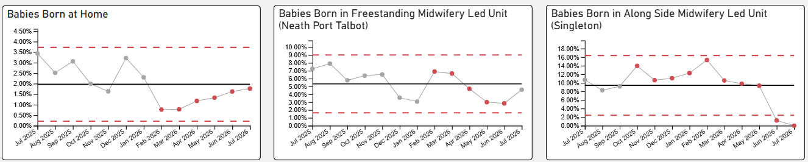
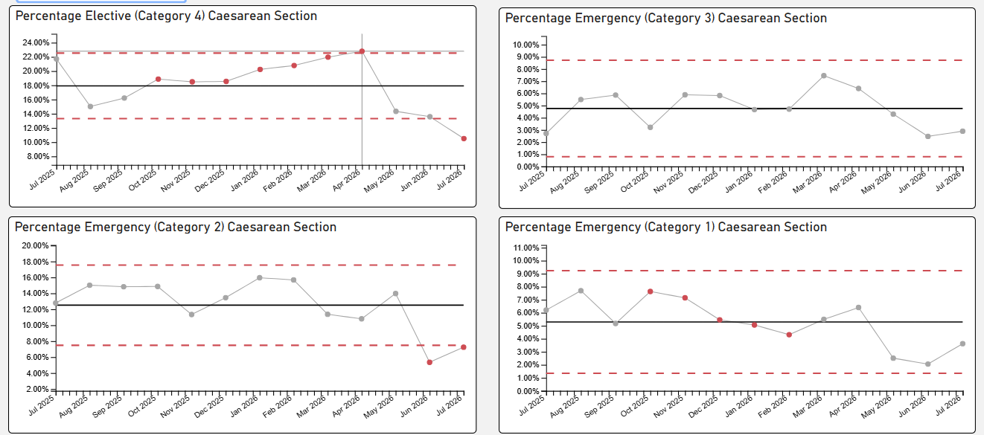
Total Number of Women who birthed by Caesarean Section
Total Number of Births in Midwife led Areas

Slide 5
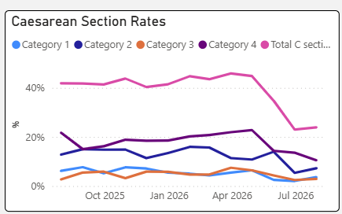
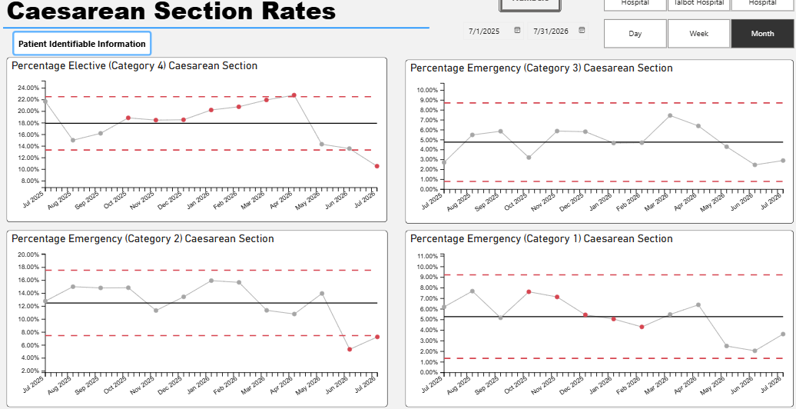
Births by Caesarean Section
Unable to provide accurate data due to Badgernet transition.
Meeting arranged with digital to implement mandatory field due Badgernet digital system to ensure accurate data capture for Dashboard.

Slide 6
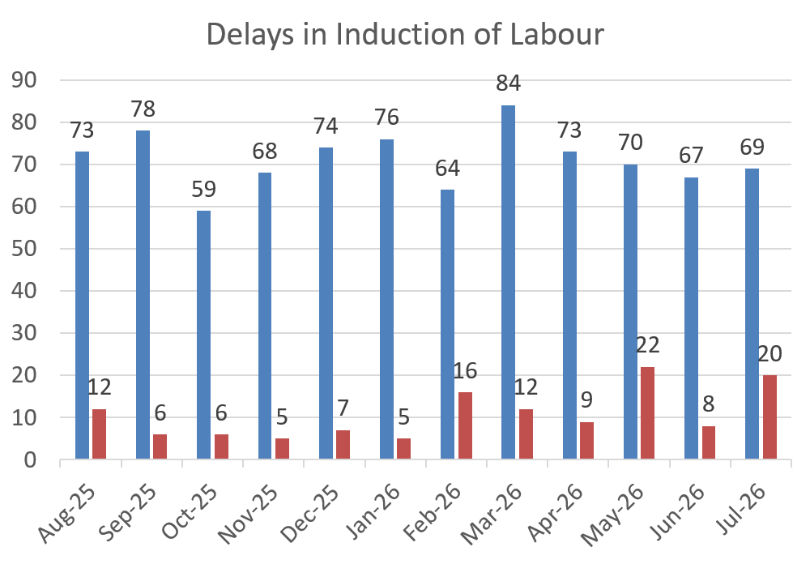
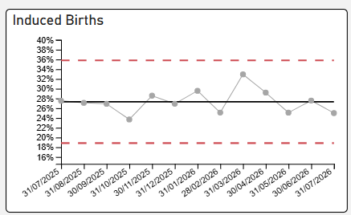
Induction of Labour
The ongoing dataset reflects periods of increased clinical acuity, which have contributed to the delays. During these periods, multidisciplinary safety huddles are convened to assess risk, support dynamic prioritisation of women requiring care, and ensure appropriate escalation where required. To date, there has been no increase in DATIX reporting associated with these delays, and no adverse maternal or neonatal outcomes have been identified.

Slide 7
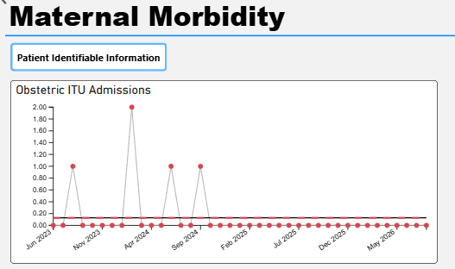
ITU Admissions and Split Site Working
One admission to ITU in April 2026 following postpartum Haemorrhage of 9636mls with hysterectomy. Recovered and transferred back to Maternity services for continued care within 48 hours.
Escalation to digital services has information not on Dashboard
Risk assessment for Split site working completed and added to HBRR

Slide 8
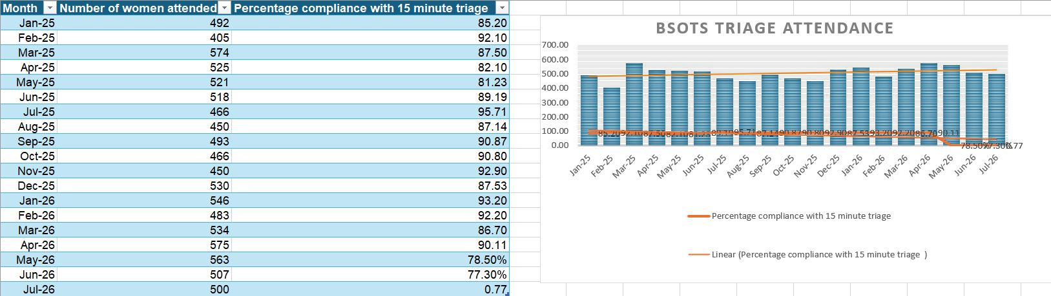
Maternity Triage
Full BadgerNet Go Live 19th May
BSOTS BadgerNet Data Reports from May 20th onwards
May 2026 was 2 systems merge
June first full month reported on BadgerNet
Bespoke Data reporting request in process
The ongoing dataset reflects increasing staff familiarity with the new BadgerNet triage documentation and improved capture of clinical information. Findings should therefore be interpreted in the context of evolving recording practices. To date, there has been no corresponding increase in DATIX reports relating to unmet triage criteria, and no adverse outcomes have been identified.

Slide 9
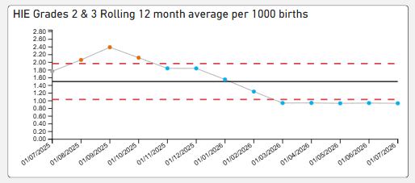
Hypoxic-ischemic encephalopathy (HIE) – Trends 12 months – July 2026
The 2025 HIE rate is 1.68/1000 births.
One mortality in December 2025 – HIE Grade 3. Reported as National Reportable Incident (NRI). No HIE IN 2026
As seen there are 8 plots below centre line of 2.1 therefore showing a SHIFT in data. This is a strong example of Non random variation.
Monitoring will continue
HIE 2 and 3 rolling 12 month average – 0.94/1000 births

Slide 10
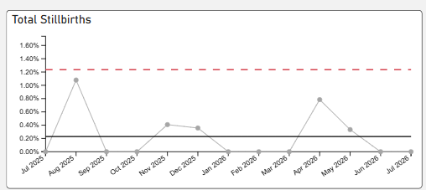
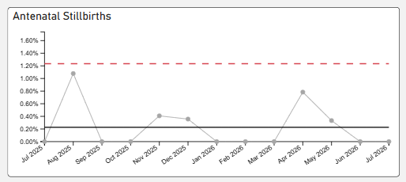
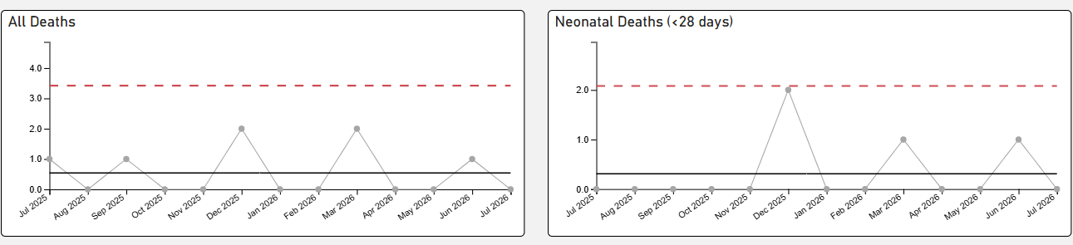
Stillbirth and Neonatal Deaths

Slide 11
Training and Compliance

Slide 12
Perinatal workforce Training and Compliance – July 2026
Statutory and Mandatory Training |  |  | June -25 | July - 25 | Aug - 25 | Sept -25 | Oct- 25 | Nov - 25 | Dec - 25 | Jan - 26 | Feb – 26 | Mar - 26 | Apr - 26 | May -26 | June - 26 | Jul – 26
* Welsh Government Target 85%
Medical Staff | Obstetric | 78% |  | 91% | 85.4% | 81% | 81.0% | 85.4% | 88.95% | 89.95% | 89.95% | 88.32% | 89.98% | 89.98% | 91.40% | 90.38%
 | Neonatal | 87.1% |  | 86% | 84.8% | 76.3% | 80.4% | 88.63% | 88.92% | 88.92% | 93.14% | 94.12% | 95.89% | 95.89% | 94.74% | 95.36%
Additional Clinical Services | Maternity | 92.9% |  | 94% | 93.5% | 91.5% | 91.5% | 93.0% | 93.0% | 91.73% | 91.73% | 91.51% | 91.11% | 91.11% | 93.84% | 92.87%
 | Neonatal | 100% |  | 100% | 100% | 97.3% | 97.3% | 97.3% | 97.3% | 97.37% | 97.37% | 93.42% | 94.74% | 94.74% | 96.05% | 98.68%
Nursing and Midwifery | Maternity | 95.5% |  | 96% | 96.1% | 94.8% | 94.8% | 95.4% | 95.4% | 94.92% | 94.92% | 92.95% | 95.01% | 95.01% | 95.16% | 94.89%
 | Neonatal | 95.2% |  | 95% | 95.6% | 92.4% | 92.4% | 95.2% | 95.2% | 95.81% | 94.49% | 93.33% | 95.89% | 93.33% | 96.41% | 96.83%

Slide 13
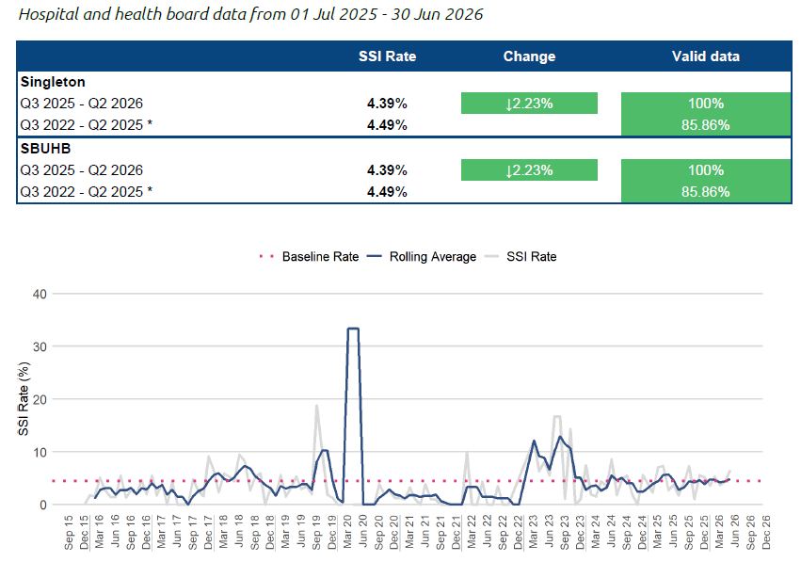
Surgical Site Infections (Supplied by PHW so data to end of June 2026)

Slide 14
Workforce – Training Compliance - July 2026
NLS Neonatal Training | Sep-25 | Oct-25 | Nov - 25 | Dec -25 | Jan 26 | Feb - 26 | Mar 26 | Apr - 26 | May -26 | Jun - 26 | Jul – 26
Nursing | 95% | 88% | 88% | 87% | 87% | 87% | 92% | 92% | 92% | 96% | 96%
Consultants | 100% | 100% | 100% | 100% | 100% | 100% | 100% | 100% | 100% | 100% | 100%
Juniors - Tier 1 | 90.9% | 90.0% | 100% | 100% | 100% | 100% | 100% | 100% | 100% | 100% | 100%
Juniors - Tier 2 | 100% | 100% | 100% | 100% | 100% | 100% | 100% | 100% | 100% | 100% | 100%
Nurses Qualified in Speciality | Sept - 25 | Oct - 25 | Nov – 25 | Dec 25 | Jan 26 | Feb 26 | Mar 26 | Apr - 26 | May 26 | Jun 26 | Jul - 26
Module 1 | 59.0% | 59.0% | 59.0% | 51% | 51% | 51% | 51% | 51% | 51% | 51% | 51%
Module 2 | 59.0% | 59.0% | 59.0% | 51% | 51% | 51% | 51% | 51% | 515 | 51% | 51%
NLS figures will improve in March 2026, with two scheduled training courses.
QIS figures unchanged.
5 neonatal nurses currently completing the QIS modules at 50% study leave due to staffing pressures. Planning to offer more places next year at risk.
MoNET training | Compliance end of June
Consultants | 0%
T1 + T2 | 0%
ANNP | 0%
Band 7 | 0%
Band 6 | 0%
Band 5 | 0%
Total | 0%
MoNET training 0% due to plan new programme originally scheduled for January 2026. Training day's have been cancelled in since January, with predicted cancellation until January 2027.

Slide 15
Infection, Prevention and Control
Infection slides, AMAT only started recording data from November 2025

Slide 16
Infection prevention and control – July 2026
Compliance with national cleaning standards in line with national standards
Compliance with hand hygiene audits in line with national standards
Ward | Nov 25 | Dec 25 | Jan 26 | Feb 26 | Mar 26 | Apr 26 | May 26 | June 26 | Jul - 26
NICU | 97.9% | 97.9% | 97.9% | 97.9% | 97.9% | 97.9% | 97.9% | 97.9% | 100%
Labour Ward | 87.5% | 97.9% | 100% | 95.8% | 100% | 95.8% | 100% | 100% | 91.9%
Antenatal | 93.8% | 100% | 95.8% | 93.8% | 93.8% | 93.8% | 100% | 89.6% | 91.5%
Ward 20/Post Natal | 95.8% | 95.8% | 100% | 100% | 100% | 97.9% | 93.8% | 100% | 100%
Ward 5 (SCBU) | 98.8% | 97.9% | 95.8% | 95.8% | 95.8% | 93.8% | 97.9% | 97.9% | 93.8%
NPT BC | 100% | Not done | 100% | 100% | 100% | 100% | 100% | 100%
Bay BC | 97.8% | 95.6% | 97.8% | 97.8% | 100% | 97.8% | 97.8% | 100% | 97.8%
Sing ANC | 97.9% | 97.9% | 97.9% | 100% | 100% | 97.9% | 100% | 97.9% | 100%
NPT ANC | Not done | 100% | 100% | 100% | 100% | 100% | 100% | 100% | 100%
Ward | Nov 25 | Dec 25 | Jan 26 | Feb 26 | Mar 26 | Apr 26 | May 26 | Jun 26 | Jul - 26
NICU | 96.8% | 80% | 100% | 97.4% | 77.8% Rpt 100% | 100% | 96.9% | 93.1% | 100%
Labour Ward | 100% | 97.5% | 100% | 100% | Not done | 100% | 96.4% | 100% | 97.6%
Antenatal | 100% | 97.5% | 100% | 100% | 100% | 100% | 100% | 100% | 100%
Ward 20/Post Natal | 100% | 100% | 100% | 97.2% | 96.9% | 100% | 100% | 100% | Not done
Ward 5 (SCBU) | 100% | 97.2% | 100% | 96.7% | 100% | 100% | 96.2% | 100% | 97.3%
NPT BC | 100% | 100% | 100% | 100% | 100% | 100% | 100% | 98.3% | 100%
Bay BC | 97.8% | 100% | 97.6% | 100% | 97.8% | 100% | 95.6% | 100% | 97.1%
Sing ANC | 100% | 100% | 96.7% | 100% | 100% | 100% | 100% | 100% | 100%
NPT ANC | Not done | 100% | 100% | 100% | 100% | 100% | !00% | 100% | 100%100%
16

Slide 17
Incident Review and Management

Slide 18
Maternity Incidents – As at 03.08.2026
Oldest incidents
2024
October 2024 – Response finalised and signed off
November 2024 –Response awaiting approval following completion of external review
November 2024 –Response awaiting approval following completion of external review
2025
4 Incidents logged for historic issues with Kleihauer results – Under investigation – for closure by ASW lead- closed
April 2025 – Indirect Maternal Death – closed.
April 2025 – External review – awaiting reports
May 2025 – External review – 1 report received.
August 2025 – Awaiting IR3 approval
September 2025 –Awaiting IR3 approval
December 2025 – Report sent for approval
December 2025 - Awaiting IR approval
Total incidents open – 77 (as at 03.08.2026)
The 77 incidents currently open include:-
31 - Incidents relating to unexpected admissions to NICU.
Notes:
This is a generic copy slide.

Slide 19
Maternity Incidents – Activity over 12 months
Total number of new incidents received in July - 161
Out of which, 121 incidents have been closed following investigation
Notes:
This is a generic copy slide.

Slide 20
Incident review – Maternity Newly Reported Incidents: 01/07/2026 – 31/07/2026
Maternity Adverse Occurrences:
Sub-categories Number of incidents
Baby unexpected admission to neonatal unit (gestation up to 36 weeks) | 1
Congenital anomaly | 1
Cord prolapse | 1
Delivery of baby born below 10th centile | 12
Delivery of baby with no professional in attendance (e.g. Born before admission (BBA)) | 1
Major post-partum haemorrhage (> 1500mls) | 7
Postponement / delay of induction of labour or elective procedure | 20
Shoulder dystocia | 6
Third or fourth degree tear | 5
Unexpected admission to neonatal unit (gestation 37 weeks+) | 22

Slide 21
Neonatal Incidents
2025
May 2025 –external review
May 2025 –Neonatal review completed- maternal external witness reports being reviewed
July 2025 – External review)
Dec 2025 – linked to a Maternity incident - Awaiting sign off to finalise investigation
Dec 2025 – Staff injury investigation ongoing
Total Numbers of incidents open – 18 (as at 03.08.2026)
Notes:
This is a generic copy slide.

Slide 22
Neonatal Incidents – Activity over 12 months
Total number of new incidents received in July – 16
Out of which, 9 incidents have been closed following investigation
Notes:
This is a generic copy slide.

Slide 23
Incident review – Neonatal Newly Reported Incidents: 01/07/2026 – 31/07/2026
Categories Number of Incidents
Assessment, Investigation, Diagnosis | 1
Equipment, Devices | 2
Infrastructure (including staffing, facilities, environment, security) | 3
Manual Handling | 1
Medication, IV Fluids | 1
Nutrition, Hydration | 1
Patient/service user death | 1
Records, Information | 2
Safeguarding | 1
Treatment, Procedure | 3

Slide 24
Perinatal Concerns Outstanding
Perinatal Services have 9 open concerns – 2 of which are currently overdue:-
1 response awaited from External Investigation Team response (chased)
1 response awaiting Paediatric approval
Notes:
This is a generic copy slide.

Slide 25
Perinatal DoC cases
Notes:
This is a generic copy slide.

Slide 26
REDRESS
Number of Redress cases currently open for Perinatal Services
There are currently 19 Redress cases open
12 Redress cases are as a result of incidents being investigated
7 Redress cases are as a result of concerns being investigation
Notes:
This is a generic copy slide.

Slide 27
Mortality

Slide 28
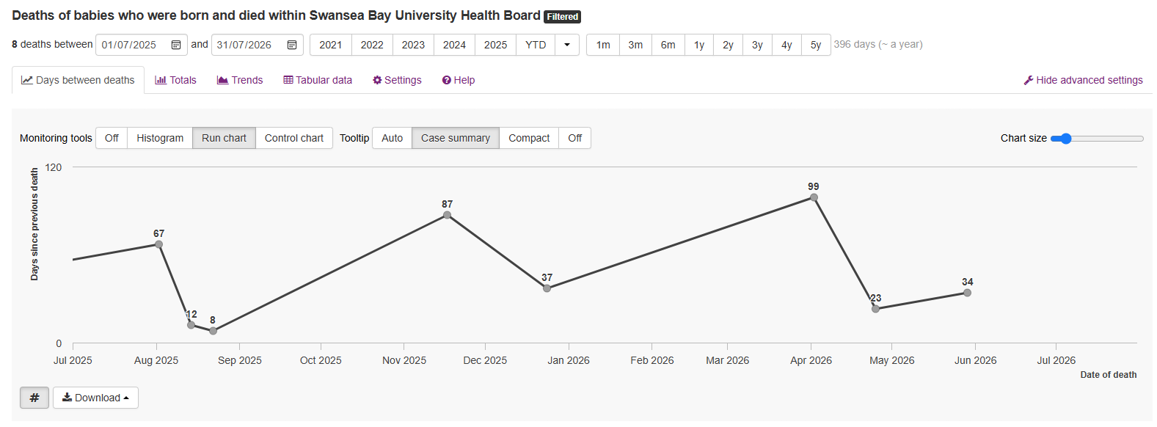
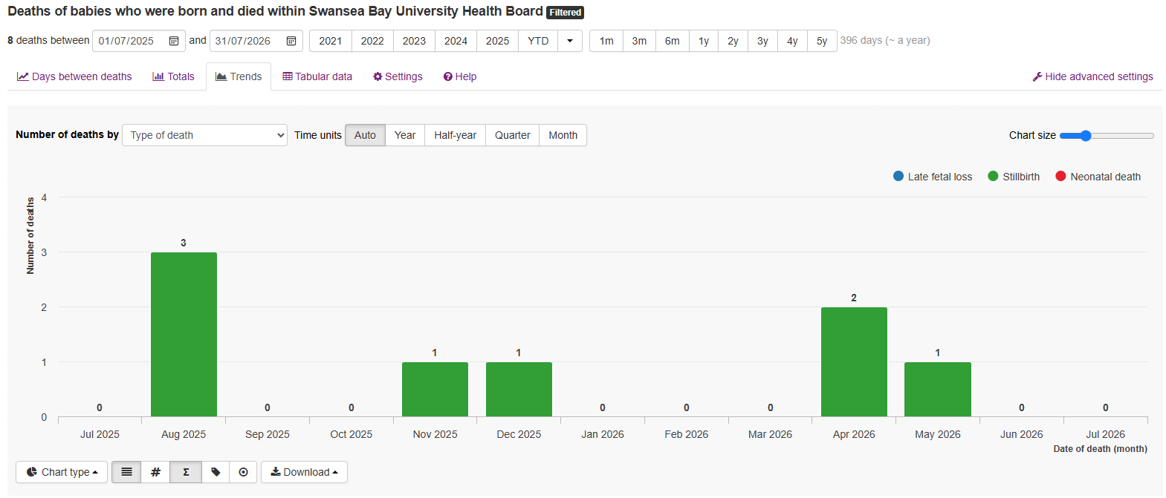
Mortality Data for July 2025 – July 2026 - Stillbirth
Notes:
Serial scans performed. Attended with first episode of DFM
Serial scans performed – noted growth under 10th centile. At 34 weeks AFI and EDF normal. When attended for rescan a week later IUD
Serial scans performed – all scans reported as normal. Attended with first episode of DFM.
Serial scans performed (diabetic). Booked for ELCS at 38+6. On attending for CS no FH identified. Noted non adherence to medication with diabetic team.
Neonatal death following birth – low birthweight baby and decision to reorientate care.
6. – Serial scans performed and normal. Attended with first episode of DFM

Slide 29
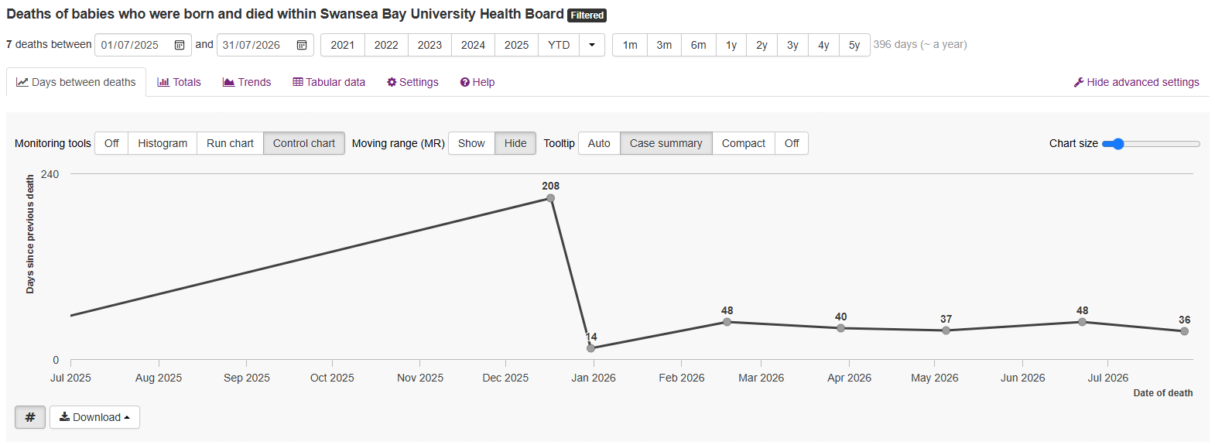
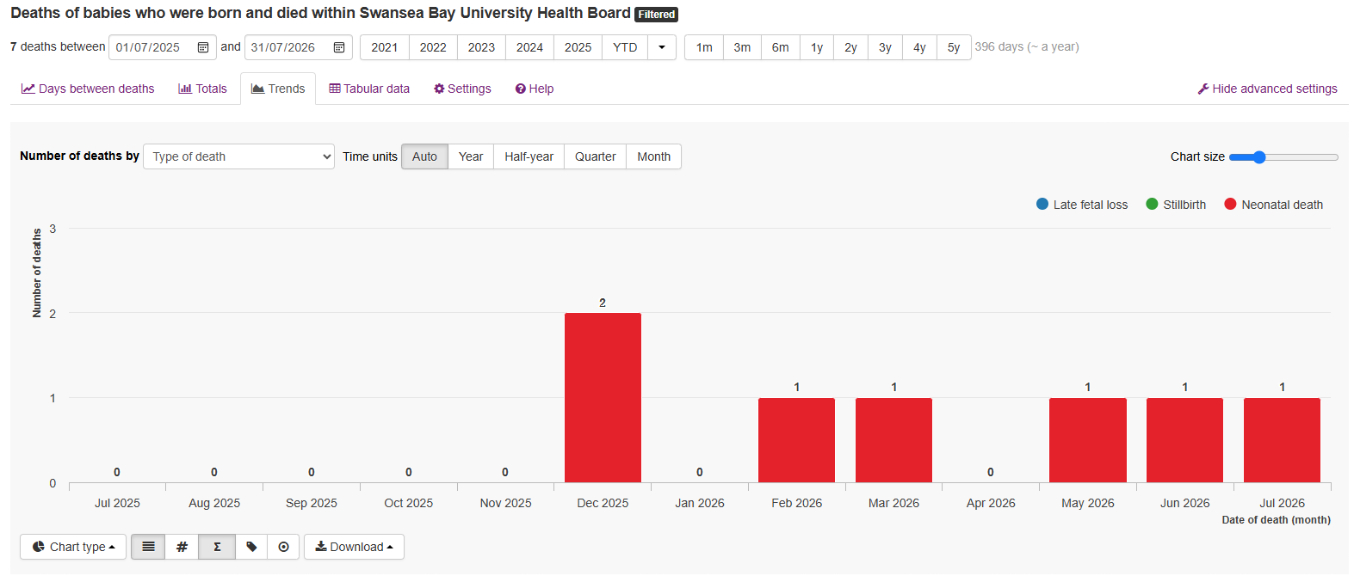
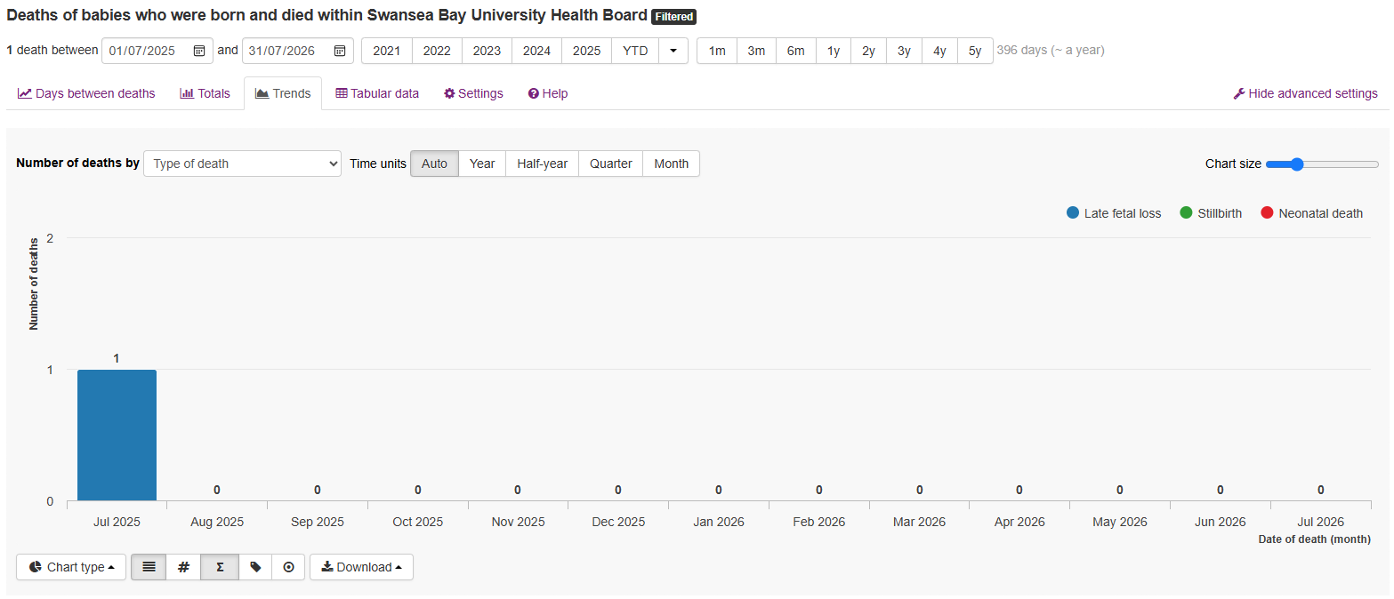
Maternity and Neonatal
Mortality January 2024 – August 2024
Neonatal Mortality data and Late Fetal Loss for July 2025 – July 2026
Notes:
Serial scans performed. Attended with first episode of DFM
Serial scans performed – noted growth under 10th centile. At 34 weeks AFI and EDF normal. When attended for rescan a week later IUD
Serial scans performed – all scans reported as normal. Attended with first episode of DFM.
Serial scans performed (diabetic). Booked for ELCS at 38+6. On attending for CS no FH identified. Noted non adherence to medication with diabetic team.
Neonatal death following birth – low birthweight baby and decision to reorientate care.
6. – Serial scans performed and normal. Attended with first episode of DFM

