Slide 1
Mental Health
Capital Programme Business Case
Implementation Options – Critical Path
Executive Board 12 August 2026 (Updated to include Ward F works)
Mental Health Transformation Board Meeting 22 July 2026

Slide 2
Index
Option 1 – Initial Anti-Ligature using Celyn as a Decant (Completes May 2030) Discounted
Option 2 - Onnen and Derwen/Celyn Anti-Ligature in live environment with no decant at CCH or NPT (Complete Sept 2030) Discounted
Option 3 - Derwen (part anti-ligature / full anti-ligature), Celyn Re-design including Anti-Ligature and Onnen Anti-Ligature (Complete April 2029) Preferred Option
Recommendations & Next Steps
Business Cases Process & Format Agreed with WG Capital & Estates
Step 1 Technical PBC. Contains current level of detail, proposed projects with a single technical delivery option for each proposed project.
Submission September 2026.
Step 2 Individual single option BJC. Fully designed and tendered cost forms for each investment as completed. Subject to technical scrutiny by SES.
Submission as per table above.

Slide 3
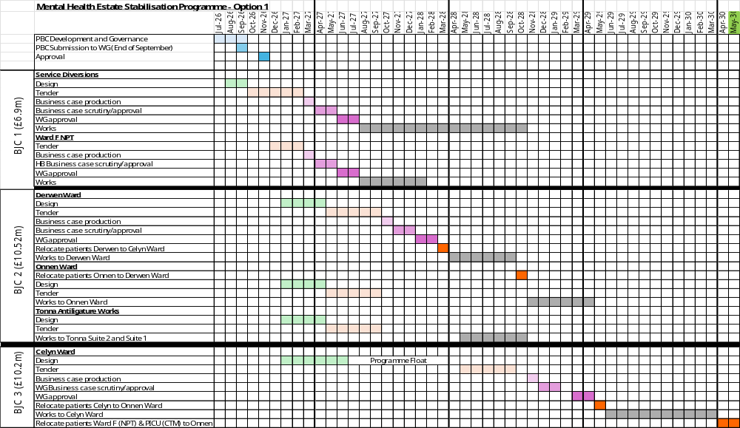
Option 1 - Initial Anti-Ligature using Onnen as a Decant
Summary
Service diversions have no interdependencies.
Derwen & Onnen anti-ligature works take place using Celyn as a decant ward.
Programme would not complete until NPT Ward F and PICU move to CCH in Apr/May
2030.
Discounted as Ward F to Celyn is top priority and overall programme is nearly 4 years.

Slide 4
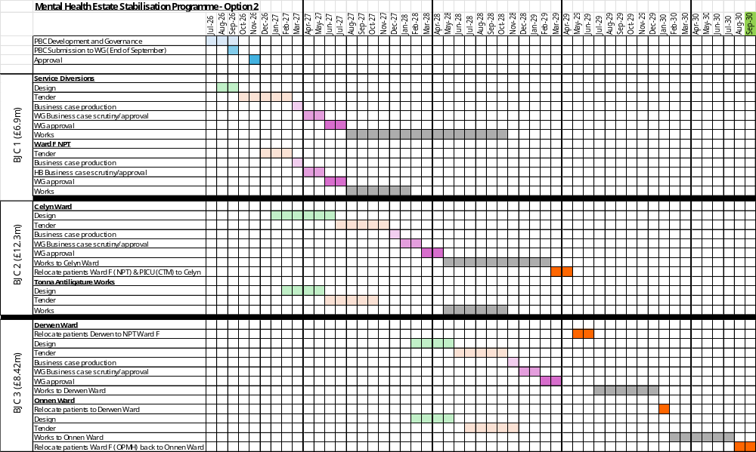
Option 2 Onnen, Derwen & Celyn Anti-Ligature in live environment with no decant at CCH or NPT
Summary
Service diversions have no interdependencies.
Celyn works for Ward F transfer complete April 2029.
OPMH Derwen & Onnen cannot relocate to Ward F (AMH) as a decant.
OPMH Derwen & Onnen works cannot both take place in a live environment.
Programme would not complete until Onnen anti-ligature works Sept 2030
Discounted as overall programme over 4 years and unable to decant Derwen & Onnen to Ward F NPT
or
Live working not appropriate within Onnen and Derwen due to scope and patient cohort to work in both Derwen & Onnen.

Slide 5
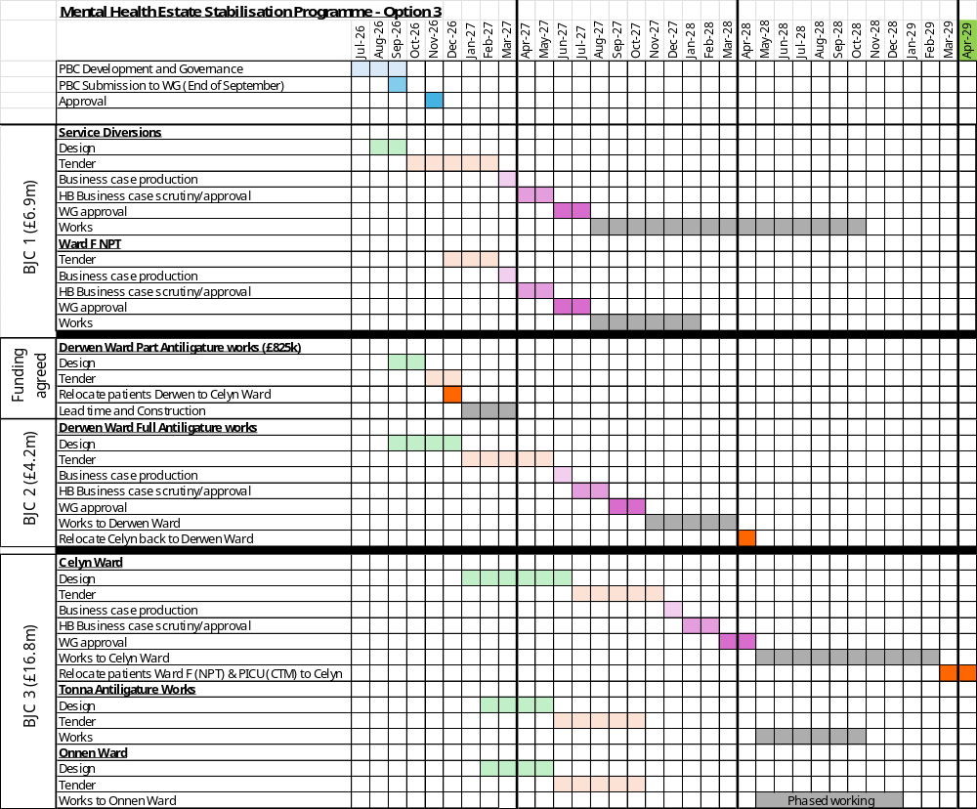
Option 3 Derwen (part anti-ligature / full anti-ligature), Onnen (anti-ligature) & Celyn
Summary
Service diversions have no interdependencies.
Initial anti-ligature works take place in Derwen 2026-27 using Celyn as a decant using approved MH Quality & Safety approved capital £825k.
On WG approval continue Derwen full anti-ligature works using Celyn as a decant.
Celyn works for Ward F transfer complete April 2029.
Onnen anti-ligature works would take place in a live environment.
Preferred Option as programme complete April 2029.
Decisions Required
Health Board will need to proceed at risk with design of Derwen Ward at approx. £200k from August 2026.
S136 suite to permanently locate to Tawe Clinic (subject to final test to fit design) in 2026-27 using approved £421k WG MH Quality & Safety capital funding rather than to Ward F.
Seclusion Suite being planned for Ward F using approved £210k WG TEF capital funding to be stopped (waiting on final tender from PFI) and will instead form part of Onnen redevelopment.
Ward F Anti-Ligature works in this programme to be reviewed, given ward F would move to Celyn by April 2029.

Slide 6
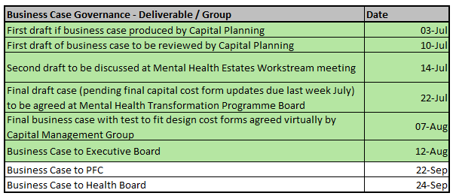
Recommendations & Next Steps
Full technical PBC to go through Health Board scrutiny beginning 7 August and finally onto Health Board meeting 24 September.
Technical Programme Business Case agreed at Executive Board, with proposed option 3 implementation plan.
Option 3 - Derwen (part anti-ligature / full anti-ligature), Celyn Re-design including Anti-Ligature and Onnen Anti-Ligature (Complete April 2029) Preferred Option
Summary
Service diversions have no interdependencies.
Initial anti-ligature works take place in Derwen 2026-27 using Celyn as a decant using approved MH Quality & Safety approved capital £825k.
On WG approval continue Derwen full anti-ligature works using Celyn as a decant.
Celyn works for Ward F transfer complete April 2029.
Onnen anti-ligature works would take place in a live environment.
Preferred Option as programme complete April 2029.
Decisions Required
Health Board will need to proceed at risk with design of Derwen Ward at approx. £200k from August 2026.
S136 suite to permanently locate to Tawe Clinic (subject to final test to fit design) in 2026-27 using approved £421k WG MH Quality & Safety capital funding rather than to Ward F.
Seclusion Suite being planned for Ward F using approved £210k WG TEF capital funding to be stopped (waiting on final tender from PFI) and will instead form part of Celyn redevelopment.
Ward F Anti-Ligature works in this programme to be reviewed, given ward F would move to Celyn by April 2029.

